Slide 1
Black Box Testing
Sources:
Code Complete, 2nd Ed., Steve McConnell
Software Engineering, 5th Ed., Roger Pressman
Testing Computer Software, 2nd Ed., Cem Kaner, et. Al.

Slide 2
Black Box Testing
Testing software against a specification of its external behavior without knowledge of internal implementation details
Can be applied to software “units” (e.g., classes) or to entire programs
External behavior is defined in API docs, Functional specs, Requirements specs, etc.
Because black box testing purposely disregards the program's control structure, attention is focused primarily on the information domain (i.e., data that goes in, data that comes out)
The Goal: Derive sets of input conditions (test cases) that fully exercise the external functionality

Slide 3
Black Box Testing
Black box testing tends to find different kinds of errors than white box testing
Missing functions
Usability problems
Performance problems
Concurrency and timing errors
Initialization and termination errors
Etc.
Unlike white box testing, black box testing tends to be applied later in the development process
Black Box Testing Example #1

Slide 4
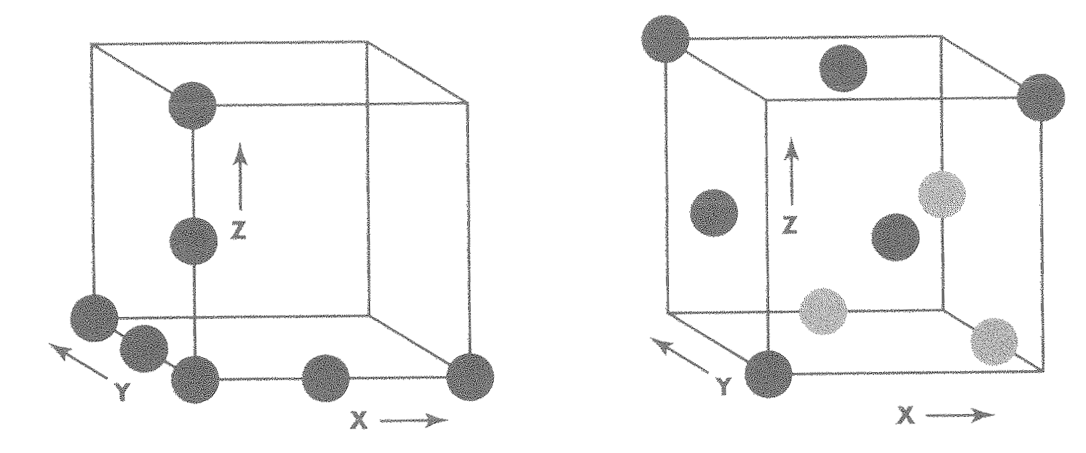
The Information Domain: inputs and outputs
Inputs
Individual input values
Try many different values for each individual input
Combinations of inputs
Individual inputs are not independent from each other
Programs process multiple input values together, not just one at a time
Try many different combinations of inputs in order to achieve good coverage of the input domain
Vary more than one input at a time to more completely cover the input domain

Slide 5
The Information Domain: inputs and outputs
Inputs (continued)
Ordering and Timing of inputs
In addition to the particular combination of input values chosen, the ordering and timing of the inputs can also make a difference
Outputs
In addition to covering the input domain, make sure your tests thoroughly cover the output domain
What are the legal output values?
Is it possible to select inputs that produce invalid outputs?

Slide 6
The Information Domain: inputs and outputs
Defining the input domain
Boolean value
T or F
Numeric value in a particular range
99 <= N <= 99
Integer, Floating point
One of a fixed set of enumerated values
{Jan, Feb, Mar, …}
{Visa, MasterCard, Discover, …}
Formatted strings
Phone numbers
File names
URLs
Credit card numbers
Regular expressions

Slide 7
Equivalence Partitioning
Consider all of the possible values for a single input (i.e., the input's domain)
Frequently the domain is so large that you can't test all possible values
You have to select a relatively small number of values to actually test
Which values should you choose?
Equivalence partitioning helps answer this question

Slide 8
Equivalence Partitioning
Partition the input's domain into "equivalence classes"
Each equivalence class contains a set of "equivalent" values
Two values are considered to be equivalent if we expect the program to process them both in the same way
If you expect the program to process two values in the same way, only test one of them, thus reducing the number of test cases you have to run

Slide 9
Equivalence Partitioning
First-level partitioning: Valid vs. Invalid values
Invalid
Valid

Slide 10
Equivalence Partitioning
Partition valid and invalid values into equivalence classes
Invalid
Valid

Slide 11
Equivalence Partitioning
Create a test case for at least one value from each equivalence class
Invalid
Valid

Slide 12
Equivalence Partitioning
Equivalence classes can overlap
If an oracle is available, the test values in each equivalence class can be randomly generated. This is more useful than always testing the same static values.
Oracle: something that can tell you whether a test passed or failed
Test multiple values in each equivalence class. Often you’re not sure if you have defined the equivalence classes correctly or completely, and testing multiple values in each class is more thorough than relying on a single value.

Slide 13
Equivalence Partitioning - examples
Input | Valid Equivalence Classes | Invalid Equivalence Classes
A integer N such that: -99 <= N <= 99 | ? | ?
Phone Number Area code: [200, 999] Prefix: (200, 999] Suffix: Any 4 digits | ? | ?

Slide 14
Equivalence Partitioning - examples
Input | Valid Equivalence Classes | Invalid Equivalence Classes
A integer N such that: -99 <= N <= 99 | [-99, -10] [-9, -1] 0 [1, 9] [10, 99] | ?
Phone Number Area code: [200, 999] Prefix: (200, 999] Suffix: Any 4 digits | ? | ?

Slide 15
Equivalence Partitioning - examples
Input | Valid Equivalence Classes | Invalid Equivalence Classes
A integer N such that: -99 <= N <= 99 | [-99, -10] [-9, -1] 0 [1, 9] [10, 99] | < -99 > 99 Malformed numbers {12-, 1-2-3, …} Non-numeric strings {junk, 1E2, $13} Empty value
Phone Number Area code: [200, 999] Prefix: (200, 999] Suffix: Any 4 digits | ? | ?

Slide 16
Equivalence Partitioning - examples
Input | Valid Equivalence Classes | Invalid Equivalence Classes
A integer N such that: -99 <= N <= 99 | [-99, -10] [-9, -1] 0 [1, 9] [10, 99] | < -99 > 99 Malformed numbers {12-, 1-2-3, …} Non-numeric strings {junk, 1E2, $13} Empty value
Phone Number Area code: [200, 999] Prefix: (200, 999] Suffix: Any 4 digits | 555-5555 (555)555-5555 555-555-5555 200 <= Area code <= 999 200 < Prefix <= 999 | ?

Slide 17
Equivalence Partitioning - examples
Input | Valid Equivalence Classes | Invalid Equivalence Classes
A integer N such that: -99 <= N <= 99 | [-99, -10] [-9, -1] 0 [1, 9] [10, 99] | < -99 > 99 Malformed numbers {12-, 1-2-3, …} Non-numeric strings {junk, 1E2, $13} Empty value
Phone Number Area code: [200, 999] Prefix: (200, 999] Suffix: Any 4 digits | 555-5555 (555)555-5555 555-555-5555 200 <= Area code <= 999 200 < Prefix <= 999 | Invalid format 5555555, (555)(555)5555, etc. Area code < 200 or > 999 Area code with non-numeric characters Similar for Prefix and Suffix

Slide 18
Boundary Value Analysis
When choosing values from an equivalence class to test, use the values that are most likely to cause the program to fail
Errors tend to occur at the boundaries of equivalence classes rather than at the "center"
If (200 < areaCode && areaCode < 999) { // valid area code }
Wrong!
If (200 <= areaCode && areaCode <= 999) { // valid area code }
Testing area codes 200 and 999 would catch this error, but a center value like 770 would not
In addition to testing center values, we should also test boundary values
Right on a boundary
Very close to a boundary on either side

Slide 19
Boundary Value Analysis
Create test cases to test boundaries of equivalence classes
Invalid
Valid

Slide 20
Boundary Value Analysis - examples
Input | Boundary Cases
A number N such that: -99 <= N <= 99 | ?
Phone Number Area code: [200, 999] Prefix: (200, 999] Suffix: Any 4 digits | ?

Slide 21
Boundary Value Analysis - examples
Input | Boundary Cases
A number N such that: -99 <= N <= 99 | -100, -99, -98 -10, -9 -1, 0, 1 9, 10 98, 99, 100
Phone Number Area code: [200, 999] Prefix: (200, 999] Suffix: Any 4 digits | ?

Slide 22
Boundary Value Analysis - examples
Input | Boundary Cases
A number N such that: -99 <= N <= 99 | -100, -99, -98 -10, -9 -1, 0, 1 9, 10 98, 99, 100
Phone Number Area code: [200, 999] Prefix: (200, 999] Suffix: Any 4 digits | Area code: 199, 200, 201 Area code: 998, 999, 1000 Prefix: 200, 199, 198 Prefix: 998, 999, 1000 Suffix: 3 digits, 5 digits

Slide 23
Boundary Value Analysis - examples
Numeric values are often entered as strings which are then converted to numbers internally [int x = atoi(str);]
This conversion requires the program to distinguish between digits and non-digits
A boundary case to consider: Will the program accept / and : as digits?
Char
/ | 0 | 1 | 2 | 3 | 4 | 5 | 6 | 7 | 8 | 9 | :
47 | 48 | 49 | 50 | 51 | 52 | 53 | 54 | 55 | 56 | 57 | 58
ASCII

Slide 24
Testing combinations of inputs
Equivalence Partitioning and Boundary Value Analysis are performed on each individual input, resulting in a set of test values for each input
TV₁ = set of test values for Input 1
TV₂ = set of test values for Input 2
Etc.
Beyond testing individual inputs, we must also consider input combinations

Slide 25
Testing combinations of inputs
Suppose there are 3 inputs
An input combination is a 3-tuple (tv₁, tv₂, tv₃)
where tv₁ ∈ TV₁, tv₂ ∈ TV₂, tv₃ ∈ TV₃
Test as many different combinations as possible
Avoid testing redundant combinations (ones that follow the same path thru the code)
Vary multiple inputs at once to better cover the input domain
TV₁
TV₂
TV₃
X
X

Slide 26
Testing combinations of inputs
Rather than analyzing each input individually, it often makes sense to do EP and BVA on multiple inputs together
If two or more inputs interact heavily with each other, effective testing often requires their values to be selected together
In this case, each “test value” is actually a tuple of values
Example: Substring Search (solution)
(a₁,b₁,c₁)
(a₂,b₂,c₂)

Slide 27
Mainstream usage testing
Don't get so wrapped up in testing boundary cases that you neglect to test "normal" input values
Values that users would typically enter during mainstream usage

Slide 28
More black box testing examples
Black Box Example #2
Black Box Example #3

Slide 29
Error Guessing
Based on intuition, guess what kinds of inputs might cause the program to fail
Create some test cases based on your guesses
Intuition will often lead you toward boundary cases, but not always
Some special cases aren't boundary values, but are mishandled by many programs
Try exiting the program while it's still starting up
Try loading a corrupted file
Try strange but legal URLs: hTtP://Www.bYu.EDU/

Slide 30
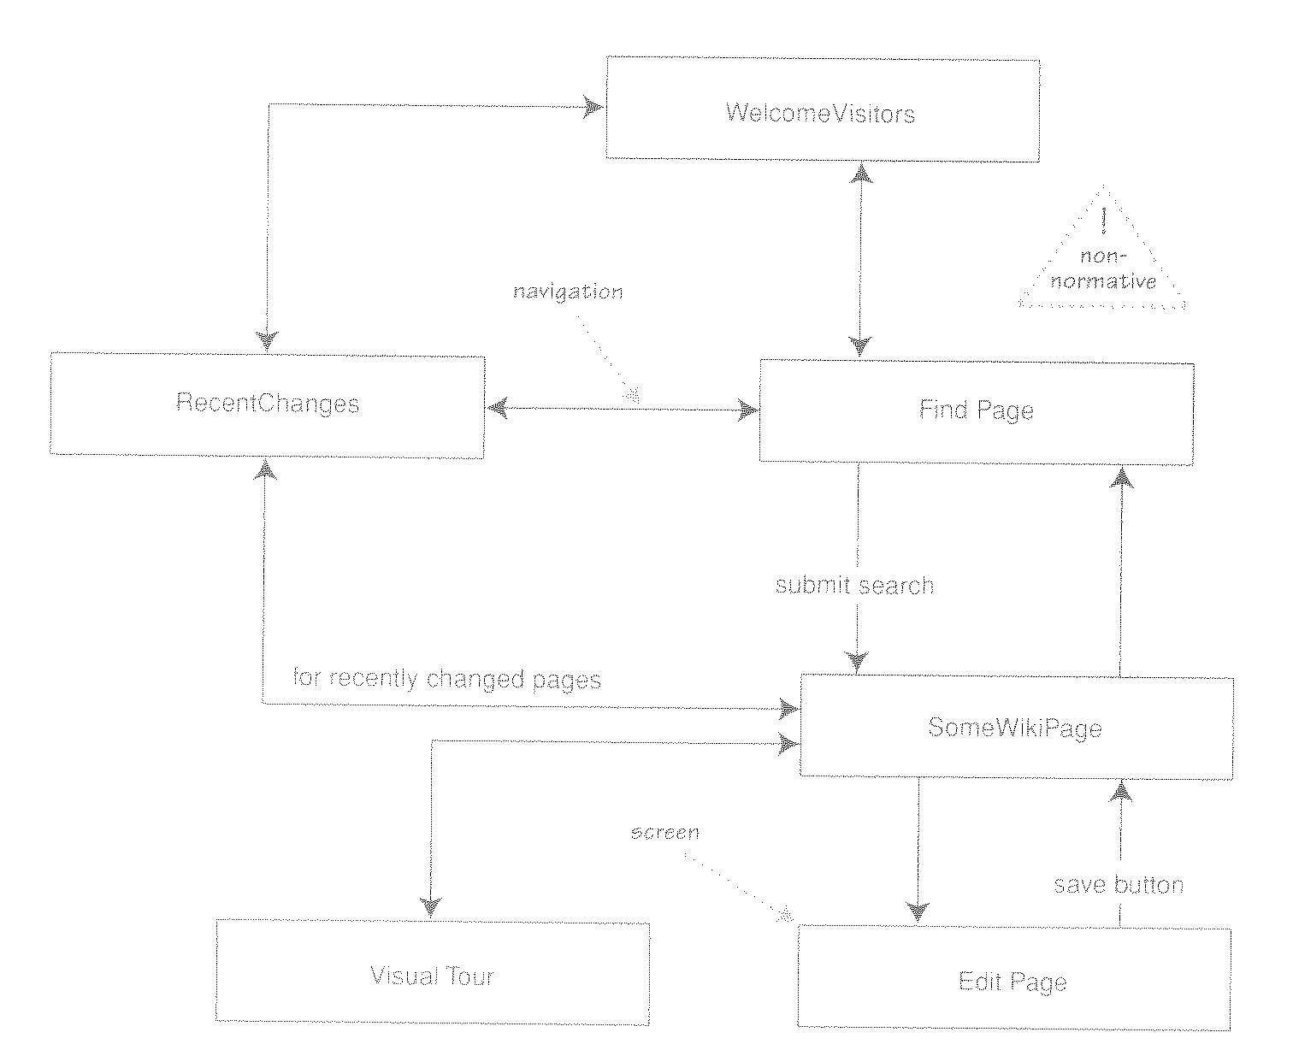
State Transition testing
Every interactive program has user observable states
What screen the user is on
What information is displayed to the user
What actions the user is allowed to perform
User observable states are often modeled using a screen flow diagram that shows how users can move from screen to screen

Slide 31
State Transition testing
Ideally, you will test all of the different paths that a user may follow to reach each screen, and ensure that the program is always in the correct state
Example: Test all of the different paths for reaching the “Order Confirmation" screen on an e-commerce web site. Can you trick the software into letting you submit an order without entering payment information?
It's not only where you are, but also how you got there

Slide 32
Comparison Testing
Also called Back-to-Back testing
If you have multiple implementations of the same functionality, you can run test inputs through both implementations, and compare the results for equality
Why would you have access to multiple implementations?
Safety-critical systems sometimes use multiple, independent implementations of critical modules to ensure the accuracy of results
You might use a competitor's product, or an earlier version of your own, as the second implementation
You might write a software simulation of a new chip that serves as the specification to the hardware designers. After building the chip, you could compare the results computed by the chip hardware with the results computed by the software simulator
Inputs may be randomly generated or designed manually
Notes:
EX: Nvidia graphics chips specified with software simulation. Real chip compared back-to-back with simulation to verify implementation.
EX: Database drivers
EX: Web Crawler in 240

Slide 33
Testing for race conditions and other timing dependencies
Many systems perform multiple concurrent activities
Operating systems manage concurrent programs, interrupts, etc.
Servers service many clients simultaneously
Applications let users perform multiple concurrent actions
Test a variety of different concurrency scenarios, focusing on activities that are likely to share resources (and therefore conflict)
"Race conditions" are bugs that occur only when concurrent activities interleave in particular ways, thus making them difficult to reproduce
Test on hardware of various speeds to ensure that your system works well on both slower and faster machines

Slide 34
Performance Testing
Measure the system's performance
Running times of various tasks
Memory usage, including memory leaks
Network usage (Does it consume too much bandwidth? Does it open too many connections?)
Disk usage (Is the disk footprint reasonable? Does it clean up temporary files properly?)
Process/thread priorities (Does it play well with other applications, or does it hog the whole machine?)

Slide 35
Limit Testing
Test the system at the limits of normal use
Test every limit on the program's behavior defined in the requirements
Maximum number of concurrent users or connections
Maximum number of open files
Maximum request size
Maximum file size
Etc.
What happens when you go slightly beyond the specified limits?
Does the system's performance degrade dramatically, or gracefully?

Slide 36
Stress Testing
Test the system under extreme conditions (i.e., beyond the limits of normal use)
Create test cases that demand resources in abnormal quantity, frequency, or volume
Low memory conditions
Disk faults (read/write failures, full disk, file corruption, etc.)
Network faults
Unusually high number of requests
Unusually large requests or files
Unusually high data rates (what happens if the network suddenly becomes ten times faster?)
Even if the system doesn't need to work in such extreme conditions, stress testing is an excellent way to find bugs

Slide 37
Random Testing
Randomly generate test inputs
Could be based on some statistical model
How do you tell if the test case succeeded?
Where do the expected results come from?
Some type of “oracle” is needed
Expected results could be calculated manually
Possible, but lots of work
Automated oracles can often be created to measure characteristics of the system
Performance (memory usage, bandwidth, running times, etc.)
Did the system crash?
Maximum and average user response time under simulated user load

Slide 38
Security Testing
Any system that manages sensitive information or performs sensitive functions may become a target for intrusion (i.e., hackers)
How feasible is it to break into the system?
Learn the techniques used by hackers
Try whatever attacks you can think of
Hire a security expert to break into the system
If somebody broke in, what damage could they do?
If an authorized user became disgruntled, what damage could they do?

Slide 39
Usability Testing
Is the user interface intuitive, easy to use, organized, logical?
Does it frustrate users?
Are common tasks simple to do?
Does it conform to platform-specific conventions?
Get real users to sit down and use the software to perform some tasks
Watch them performing the tasks, noting things that seem to give them trouble
Get their feedback on the user interface and any suggested improvements
Report bugs for any problems encountered

Slide 40
Recovery Testing
Try turning the power off or otherwise crashing the program at arbitrary points during its execution
Does the program come back up correctly when you restart it?
Was the program’s persistent data corrupted (files, databases, etc.)?
Was the extent of user data loss within acceptable limits?
Can the program recover if its configuration files have been corrupted or deleted?
What about hardware failures? Does the system need to keep working when its hardware fails? If so, verify that it does so.

Slide 41
Configuration Testing
Test on all required hardware configurations
CPU, memory, disk, graphics card, network card, etc.
Test on all required operating systems and versions thereof
Virtualization technologies such as VMWare and Virtual PC are very helpful for this
Test as many Hardware/OS combinations as you can
Test installation programs and procedures on all relevant configurations

Slide 42
Compatibility Testing
Test to make sure the program is compatible with other programs it is supposed to work with
Ex: Can Word 12.0 load files created with Word 11.0?
Ex: "Save As… Word, Word Perfect, PDF, HTML, Plain Text"
Ex: "This program is compatible with Internet Explorer and Firefox"
Test all compatibility requirements

Slide 43
Documentation Testing
Test all instructions given in the documentation to ensure their completeness and accuracy
For example, “How To ...” instructions are sometimes not updated to reflect changes in the user interface
Test user documentation on real users to ensure it is clear and complete

