Slide 1
Introduction to Software Quality Assurance & Testing
Sources:
Code Complete, 2nd Ed., Steve McConnell
Software Engineering, 5th Ed., Roger Pressman
Testing Computer Software, 2nd Ed., Cem Kaner, et. Al.

Slide 2
Software Quality Assurance
The purpose of SQA is to find and report defects AND succeed in getting them fixed
What is a software defect?
Definition #1: There is a mismatch between the program and its requirements spec or functional spec
This definition is fine if a requirements specification exists and is complete and correct (not always true)
Definition #2: The program does not do what its end user reasonably expects it to do
This definition always applies, even when there's no specification

Slide 3
Software Quality Assurance
Categories of Defects
Functional defects
The program’s features don’t work as they should
User Interface defects
Usability problems
Performance defects
Too slow, Uses too much memory/disk space/bandwidth/etc.
Error Handling defects
Failure to anticipate and handle possible errors, or deal with them in a reasonable way
Security defects
Attackers can compromise the system and access sensitive data or other resources

Slide 4
Software Quality Assurance
Categories of Defects
Load defects
Can't handle many concurrent users, can't handle large data sets
Configuration defects
Doesn't work on the required hardware/OS/browser configurations
Race conditions
Behavior depends on the interleaving of concurrent activities
Documentation defects
User manuals or online help isn't clear, complete, well-organized

Slide 5
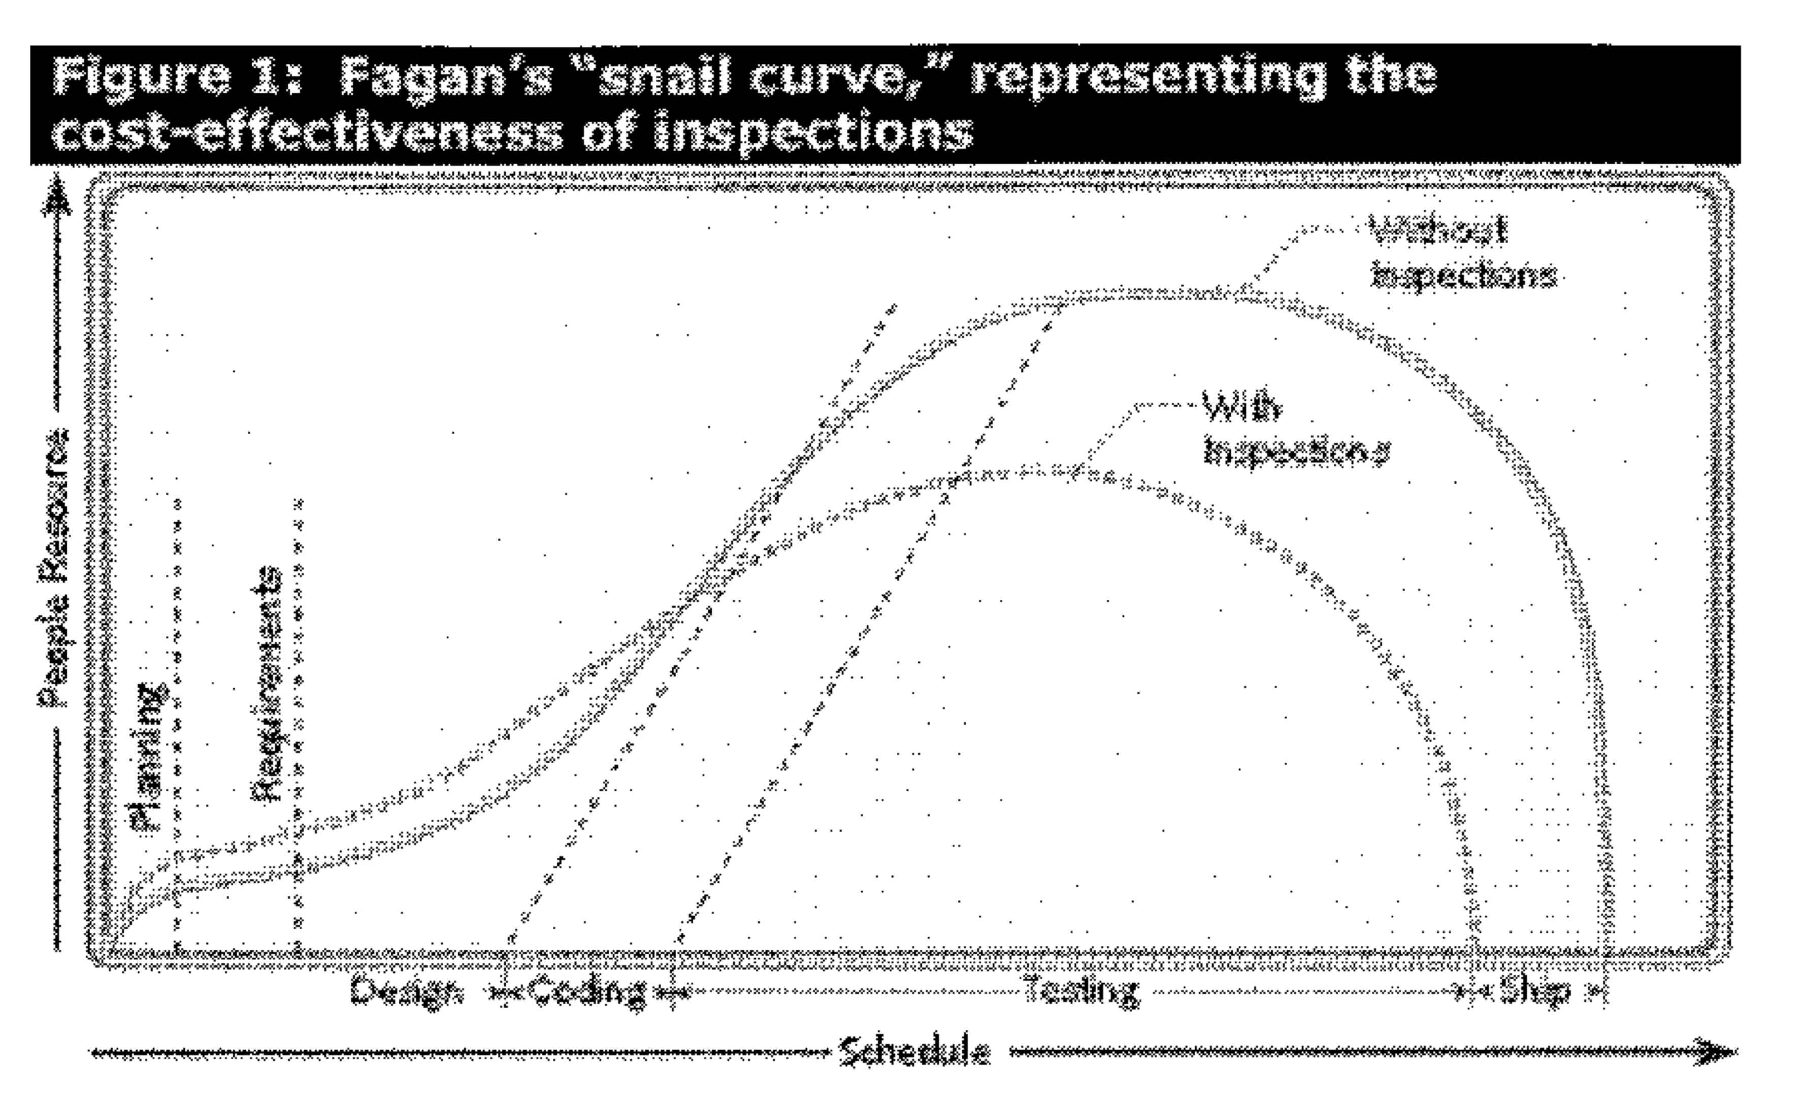
Software Quality Assurance
The longer defects remain in the system, the more expensive they become
The cost of a defect grows dramatically the longer it remains in the system
What is the cost of a defect in the requirements specification if it’s found found
during requirements phase?
during implementation?
after product ships?
SQA should be performed throughout the software development life cycle
It's not something you do only at the end after everything's pretty much done

Slide 6
Verification & Validation
Validation
Build the right product
Those activities that attempt to determine that customer needs can be met by a product
Verification
Build the product right
Transformational activities that are performed at each step of the product life cycle
Evaluating at each stage of the life cycle to ensure the software meets the requirements
Focus
Completeness, Consistency, Feasibility, Testability

Slide 7
Software Quality Assurance
The two primary SQA activities:
Technical Reviews
Software Testing

Slide 8
Technical Reviews
A “review” is a meeting where a work product is reviewed by a small group of people who are qualified to give feedback, find problems, suggest improvements, etc.
Anything can be reviewed: requirements spec, functional spec, design, code, test plan, user documentation
Reviews range in formality
In the morning, spend some time reviewing your work of the previous day
Informal requests for feedback from peers
Pair programming
Formal meetings, pre-scheduled, specific invitees, prior preparation
Problems found during reviews are fixed, resulting in improved quality
Reviews are the most effective QA technique, both in terms of cost and number of defects discovered

Slide 9
Review Meetings
Review the product – not the producer
Set an agenda and keep it
Limit debate and rebuttal
Enunciate problem areas but don’t try to fix anything
Take written notes
Limit the number of participants
Insist upon advance preparation
Develop a checklist
Allocate resources and time schedules
Conduct meaningful training

Slide 10
Software Testing
Testing is the process of detecting errors by running the actual software and verifying that it works as it should
Test cases, Expected results, Actual results
Testing is by far the most popular QA activity (but not the most effective)
Formal technical reviews are cheaper and more effective than testing, but are often ignored
Research has shown that all forms of testing combined usually find less than 60% of the errors present
A typical project might expend 50% of its resources on testing

Slide 11
Software Testing
Exhaustively testing software is not feasible
The number of possible input combinations is effectively infinite
The number of unique paths through the code is effectively infinite
You might not live long enough to exhaustively test a non-trivial software system
We must do partial testing because we only have enough resources (time and money) to run relatively few test cases
Partial testing can never prove the absence of defects
If the system passes all your test cases, there could still be defects, you just need more or better test cases to find them

Slide 12
Software Testing
Effective testing lies in intelligently choosing the relatively few test cases that will actually be executed
Test all requirements and features defined in the requirements spec. and functional spec.
Focus on scenarios that users are likely to encounter in practice
Test cases should not be redundant (i.e., each one should follow a different path through the code)
Analyze the program’s design and code to find potential weak areas
Analyze all points at which data enters the system and look for ways to attack it
Code coverage

Slide 13
Software Testing
Approaches for test case design are generally divided into two broad categories: Black Box Testing and White Box Testing
Black Box Testing
The tester has limited knowledge of the inner workings of the item being tested
Test cases are based on the specification of the item's external behavior
White Box Testing
The tester has knowledge of the inner workings of the item being tested
Test cases are based on the specification of the item's external behavior AND knowledge of its internal implementation

Slide 14
Software Testing
Testing is unlike other software development activities because the goal is to break the software rather than to create it
Effective testing requires the assumption that you will find defects
Effective testing requires that you want to find defects
If you think you won't find defects, or you don't want to, you will have set up a self-fulfilling prophecy
Testing by both developers and an independent testing group are essential
They have different perspectives and motivations
They do different kinds of tests (developer does white box, test team does black box), which tend to discover different types of defects

Slide 15
Software Testing
Defects are not evenly distributed (i.e., they tend to cluster)
Research has shown that:
80% of a system's defects are found in 20% of its code
50% of a system's defects are found in 5% of its code
There is a high correlation between bugs and complex code.
Use tools to measure code complexity, and focus testing on those modules with the most complex code
One goal of testing is to identify the most problematic modules
Redesign may be needed if there is an inherent design flaw
Or, replace buggy module with a third-party library/product

Slide 16
Software Testing
How many defects should you expect to find?
It depends on your development process
Most projects experience between 1 and 25 errors per 1000 LOC
The Applications Division at Microsoft reports 10 to 20 errors per 1000 LOC, with 0.5 errors per 1000 LOC in released products

Slide 17
Software Testing
Automation of test cases is essential to make frequent re-running of test cases feasible
A lot of the interesting testing work is found in inventing and creating ways to automate test cases (i.e., create programs whose purpose is to test other programs)
Automation requires a lot of software design and implementation (sometimes called “Test Engineering”)
Some tests are difficult to automate and must be run manually

Slide 18
Unit Testing
Exercise a specific module in a controlled environment
Typically involves
Scaffolding
Stubs and drivers
Stubs
Modules below a unit to mimic behavior of dependent modules
Drivers
Modules above a unit that drive the unit in the same fashion its calling modules do
Involves both white box and black box testing

Slide 19
Integration Testing
After unit testing – put them together to do testing
Top down or bottom up
Tester needs to understand the behavior of integrated modules
Module hierarchy can help

Slide 20
System Testing
Execution of the entire system
Does it conform to the overall system requirements
Depends on the document
May be simulated
Depends on accuracy of the simulator
Tests
Functionality
Performance
Reliability
Usability

Slide 21
Regression Testing
Check to see that an update does not re-introduce errors
Check
Functionality – typically black box tests
Architecture – gray box tests (some knowledge of inner workings)
Typically a large suite of tests
All functionality
All changes
Needs to be automated

Slide 22
Regression Testing
Build results for version x
Test data
Build tests for version x
Run tests for version x
Compare
Verdict

Slide 23
Automating Regression Testing
Challenging
What parts of program output should be checked?
Simple but annoying issues
Use of dates in output
Changes in whitespace
Format changes
Lead text changes
Answer
Don’t use complete output
Just extract the relevant information

Slide 24
Regression Testing
Keep it updated!
Bug fixes – tests to ensure they stay fixed
Functionality additions
Platform changes
Etc.
If you branch the code, you must branch the regression tests

Slide 25
Formal Verification
In addition to Technical Reviews and Software Testing, Formal Verification is another approach to QA
Create a formal “model” of the system
Some kind of automaton (i.e., state machine) or other mathematical abstraction that precisely captures the system’s behavior
“Check” the model by formally proving that it implements the desired behavior
Automated theorem proving systems are often applied
Or, prove that the model does not behave correctly, thus revealing a defect
Historically, formal verification has been expensive and limited to relatively small programs, but techniques are improving all the time. Challenges include:
Complex systems are hard to formalize
State space explosion: real systems have so many possible states that proving things about them is hard
Ensuring that the “model” accurately captures the system’s behavior
Making it accessible to people who aren’t formal verification experts

