Slide 1
Chapter 6
Properties of Regular Languages

Slide 2
Regular Sets and Languages
Claim(1). The family of languages accepted by FSAs consists of precisely the regular sets over a given alphabet.
Every regular set is accepted by some NFA-λ,
a) φ:
b) λ:
c) ∀a ∈ ∑:
Defn. 2.3.1 (on regular sets): Let ∑ be an alphabet. The regular sets over ∑ are defined recursively as follows:
i) Basis: φ, { λ }, and { a }, ∀a ∈ ∑, are regular sets over ∑
ii) Recursion: Let X and Y be regular sets over ∑. The sets X ∪ Y, XY, and X* are regular sets over ∑.
iii) Closure: Every regular set is obtained from (i) by a finite number of application of (ii)
q₀
q_{f}
q₀
λ
q_{f}
or
q₀
q₀
a
q_{f}

Slide 3
Regular Sets and Languages
Let M₁ and M₂ be two FSAs, and let S_{m1}, F_{m1}, S_{m2} , and F_{m1}, be the new start and accepting states of M₁ and M₂, respectively:
a) L(M₁) ∪ L(M₂): a string can be processed by M₁ and M₂ in parallel
b) L(M₁) • L(M₂): a string is processed by the composite machine sequentially
c) L(M₁)*
λ
M₁
λ
F_{m1}
λ
λ
S_{m1}
S
λ
λ
F
λ
S_{m2}
M₂
F_{m2}
λ
λ
λ
λ
λ
λ
S_{m1}
M₁
F_{m1}
S_{m2}
M₂
F_{m2}
λ
λ
λ
λ
λ
S
S_{m1}
M₁
F_{m1}
F
λ

Slide 4
3.3 Regular Grammars
A grammar is defined as a quadruple (V, ∑, P, S), where
V is a finite set of nonterminals, or variables
∑ is a finite set of terminals
S ∈ V, is a start symbol, and
P is a finite set of rewrite/production rules of the form α → β, where α ∈ (V ∪ ∑ )*, β ∈ (V ∪ ∑)*
Defn 3.3.1. A regular grammar is a grammar in which each rule has one of the following forms, where A, B ∈ V and a ∈ ∑
(i) A → a
(ii) A → aB
(iii) A → λ
A language is regular if it can be generated by a regular grammar
Regular grammars generate precisely the languages defined by regular expressions
Regular expressions are used to abbreviate the descriptions of regular sets

Slide 5
3.3 Regular Grammars
Example. Given G = (V, ∑, P, S), where
P = { S → xX
X → yY
Y → xX
Y → λ }
⇔ (xy)⁺
Example. Let G = (V, ∑, P, S), where
P = { S → aA
A → aA | bB
B → aB | bC
C → aC | λ }
⇔ a⁺ba*ba*
Other examples: Examples 3.29, 3.2.10, 3.2.11, 3.2.12

Slide 6
6.2 Expression Graphs
Claim(2). Every language accepted by a FSA is regular by constructing a RE
Defn. 6.2.1 An expression graph is a labeled digraph in which arcs are labeled by regular expressions.
Paths in expression graphs generate regular expressions
Algorithm 6.2.2 Construction of a regular expression from a FSA
Produce an arbitrary expression graph by repeatedly removing nodes from the state diagram.
Produce the language of the FSA by the union of the sets of strings whose processing successfully terminates in one of the accepting states
Case 1.2.1
(i)
(ii)
w_{j,i}
w_{i,k}
w_{j,i} w_{i,k}
j
i
k
j
k
w_{i,i}
w_{j,i}
w_{i,k}
w_{j,i}(w_{i,i})*w_{i,k}
j
i
k
j
k

Slide 7
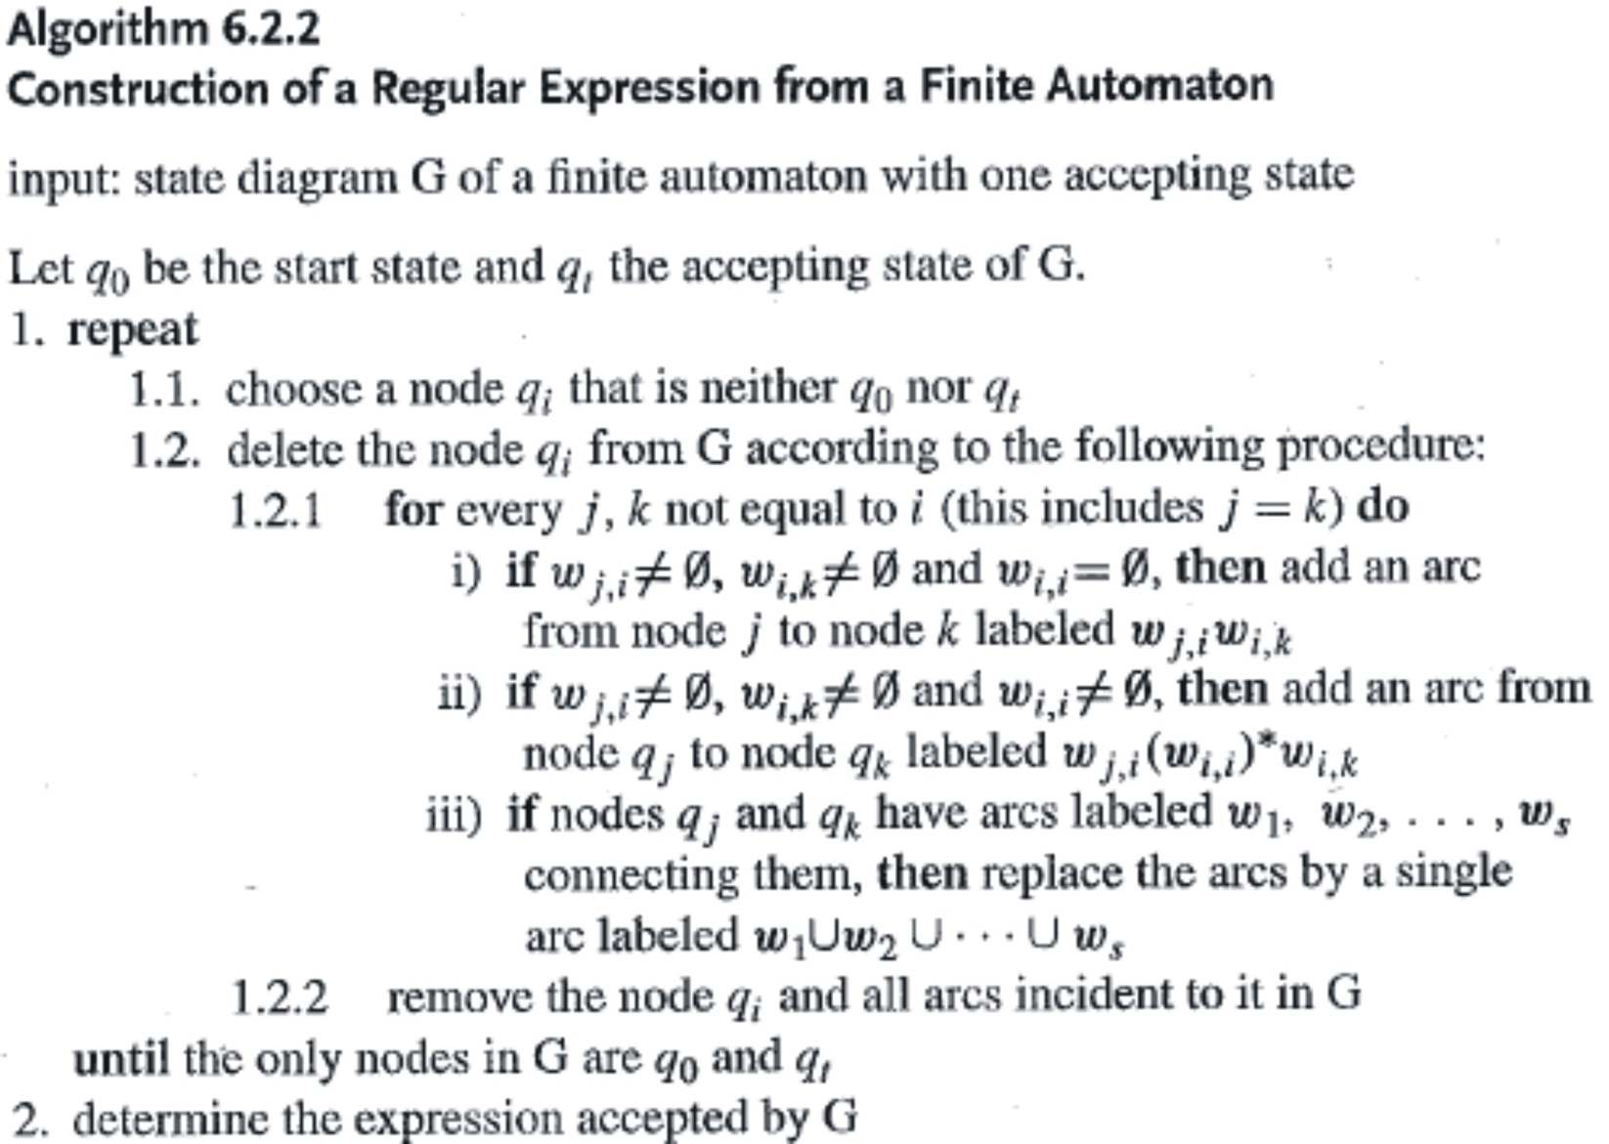
6.2 Expression Graphs
Note. If there are multiple final states in the given FSA M, then for each
accepting state F, we produce an expression for the strings accepted
by F. The language accepted by M is the union of the regular expressions.

Slide 8
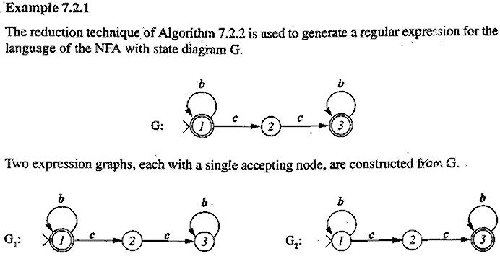
6.2 Expression Graphs
6.2.2
cc
cc
i
i
j k
j k

Slide 9
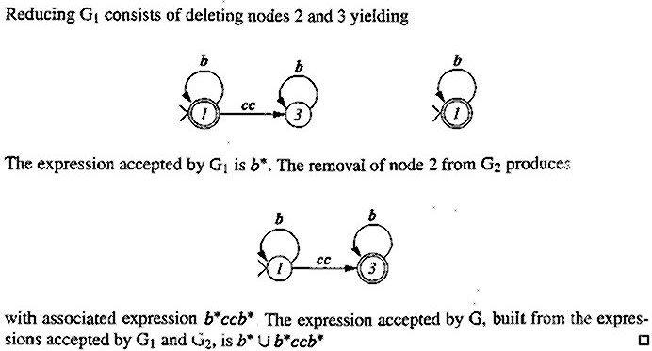
6.2 Expression Graphs
j = k
i
There is no such i that is
neither the start state nor
a final state

Slide 10
6.3 Regular Grammars and FA
Given a regular grammar G, there exists a NFA M such that L(G) = L(M)
Theorem. 6.3.1 Let G = (V, ∑ , P, S) be a regular grammar. Define the NFA M = (Q, ∑, δ , S, F) as follows:
a) V ∪ { Z }, where Z ∉V, if P contains a rule A → a
V O.W.
b) δ(A, a) = B whenever A → aB ∈ P
δ(A, a) = Z whenever A → a ∈ P
c) { A | A → λ ∈ P } ∪ { Z }, if Z ∈ Q
{ A | A → λ ∈ P } O.W.
Then L(M) = L(G)
Q =
F =

Slide 11
6.3 Regular Grammars and FA
Example 6.3.1 Given G = (V, ∑, P, S), where V = { S, B }, ∑ = { a, b }, and P = { S → aS | bB | a, B → bB | λ}, the corresponding NFA M = (Q, ∑, δ, S, F), where
Q = { S, B, Z },
∑ = { a, b },
δ(S, a) = S, δ(S, b) = B, δ(S, a) = Z, δ(B, b) = B,
F = { B, Z }
Theorem 6.3.2 Given an NFA M, there exists a regular grammar G .∋. L(M) = L(G).
(i) V = Q
(ii) The transition δ(A, a) = B yields the rule A → aB in G
(iii) For each accepting state C, create the rule C → λ in G
Example 6.3.4
P: S → bB, S → aA;
A → aS, A → bC;
B → bS, B → aC, B → λ;
C → bA, C → aB;

Slide 12
6.4 Regular Languages
A language over an alphabet ∑ is regular if it can be
i) specified as a regular set/expression over ∑
ii) accepted by DFA / NFA / NFA-λ
iii) generated by a regular grammar
Regular languages are closed under ∪, •, *, ¯, and ∩ since applying any of these operations to regular languages produces a regular language.
Theorems 6.4.1, 6.4.2, 6.4.3
Let L₁ and L₂ be two regular languages. Then
L₁ ∪ L₂, L₁L₂, L₁*, L, and L₁ ∩ L₂
are regular languages.
Example 6.4.1
(a ∪ b)*aa(a ∪ b)* ∩ (a ∪ b)*bb(a ∪ b)* is regular

Slide 13
6.5 A Nonregular Language
The language { a^{i}b^{i} | 0 ≤ i ≤ n } is regular, but the language { a^{i} b^{i} | i ≥ 0 } is not.
Proof.
Theorem 6.5.1 (P. 204). The language { a^{i}b^{i} | i ≥ 0 } is not regular (see a sketched proof in Example 6.6.3).
a₀
a
a₁
a
a
. . .
a
a_{n-1}
a
a_{n}
>
a₂
b
b
b
b
b
b
. . .
b
b_{n-2}
b
b_{n-1}
b₀
b₁
However, this technique cannot be extended to accept the language { a^{i}b^{i} | i ≥ 0 } since an infinite number of
states are needed.

Slide 14
6.5 A Nonregular Language
Corollary 6.5.2 (Proof of Theorem 6.5.1) Let L be a language over ∑. If
U_{i} ∈ ∑* and V_{i} ∈ ∑*, i ≥ 0, .∋. U_{i}V_{i} ∈ L and U_{i}V_{j} ∉ L, i ≠ j,
then L is not regular, i.e., a language that generates strings with equal length of two distinct substrings is not regular.
Example 6.5.1 The set of palindromes over { a, b } is not regular.
Example 6.5.2 Regular grammars are not a sufficiently powerful tool to define programming languages containing nesting of parentheses.
Example 6.5.3 The language L = { a^{i}b^{j} | i, j ≥ 0 and i ≠ j } is not regular; otherwise, L, i.e., { a^{i}b^{i} | i ≥ 0 }, is regular.

Slide 15
6.6 The Pumping Lemma for Regular Languages
The pumping lemma can be used to show a language is nonregular.
Pumping a string refers to constructing new strings by repeating/pumping substrings in the original string.
Processing a substring of a string in a DFA M correspond to generating a path in the state diagram of M.
The proofs of nonregular languages using pumping lemma adopts a simple counting argument known as the pigeonhole principle.
Lemma 6.6.1 Let G be the state diagram of a DFA with k states. Any path of length k in G contains a cycle.
Proof: A path P of length k contains k+1 nodes (states). Since there are only k nodes in G, one of the nodes, q, must occurs in P at least twice. The subpath from the first q to the second q yields a cycle.

Slide 16
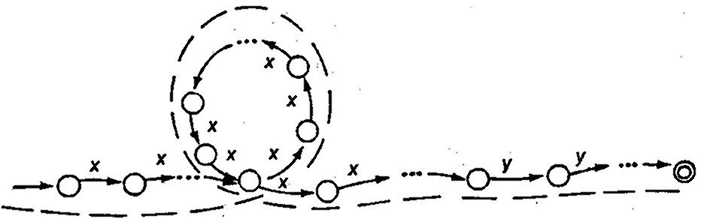
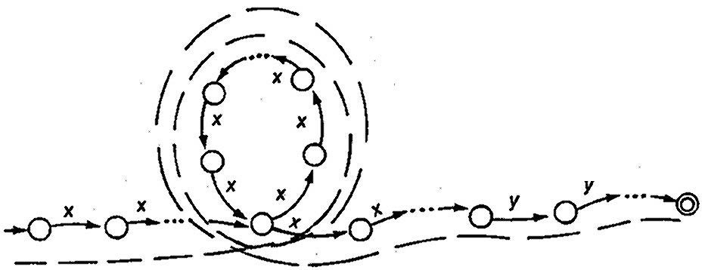
The portion of a transition that accepts both x^{k}y^{k} and x^{k+n}y^{k}
a. The path traversed when accepting x^{k}y^{k}
b. The path traversed when accepting x^{k+n}y^{k}, where n is the length of the cycle

Slide 17
6.6 The Pumping Lemma for Regular Languages
Corollary 6.6.2. Let G be the state diagram of a DFA with k states, and let p be a path of length k or more. The path p can be decomposed into sub paths (some of them can be empty) q, r, & s, where p = qrs, |qr| ≤ k & r is a cycle.
Theorem 6.6.3 (Pumping Lemma for Regular Languages)
Let L be a regular language that is accepted by a DFA M with k states. Let Z ∈ L with |Z| ≥ k, and let Z = uvw such that |uv| ≤ k, |v| > 0, and uv^{i}w ∈ L, ∀_{i ≥ 0}
Example 6.6.3. Show that L = {a^{i}b^{i} | i ≥ 0} is nonregular.
Assume that L is regular accepted by a DFA M with k states. Let Z ∈ L with |Z| ≥ k > 0 & Z = a^{k}b^{k} such that
u = a^{i}, v = a^{j}, and w = a^{k-i-j}b^{k}
Pumping v twice yields the string
uv²w = a^{i} a^{j} a^{j} a^{k-i-j} b^{k} = a^{k} a^{j} b^{k} ∉ L, since k + j > k.

