Slide 1
Chapter 5
Finite Automata

Slide 2
5.1 Finite State Automata
Capable of recognizing numerous symbol patterns, the class of regular languages
Suitable for pattern-recognition type applications, such as the lexical analyzer of a compiler
An abstract (computing) machine M, which is implementation independent, can be used to determine the acceptability (the outputs) of input strings (which make up the language of M)

Slide 3
Lexical Analyzer
Recognizes occurrences of (valid/acceptable) strings concisely
Use a (state) transition diagram for producing lexical analysis routines, e.g., Figure 1 (next page)
Use a transition table whose entries provide a summary of a corresponding transition diagram, which consists of rows (representing states), columns (representing symbols) and EOS (End_of_string)
Entries of a transition table contain the values “accept”, “error”, next states. e.g., Figure 3
Can be encoded in a program segment, e.g., Figure 2

Slide 4
Transition Diagram and Table
letter
letter
3
digit
1
digit
2
Figure 1. A transition diagram representing the syntax
of a variable name
Figure 2. A transition table constructed from the transition diagram of Figure 1

Slide 5
Instruction Sequence
letter
digit
EOS
1
3
2
error
2
error
error
error
3
3
3
accept
Figure 3. An instruction sequence suggested by the transition diagram of Figure 1

Slide 6
5.2 Deterministic Finite Automaton
DFA (Deterministic Finite Automaton) is a quintuple M = (Q, Σ, δ, q₀, F), where
Q is a finite set of states
Σ is a finite set of (machine) alphabet
δ is a transitive function from Q x Σ to Q, i.e., δ: Q x Σ → Q
q₀ ∈ Q, is the start state
F ⊆ Q, is the set of final (accepting) states
letter
letter
3
digit
1
digit
2

Slide 7
Transition Diagram
Figure 5. A transition diagram representing the syntax of a real number

Slide 8
Transition Table
accept
Table 1. A transition table constructed from the transition diagram of the previous figure

Slide 9
Deterministic Finite Automaton
Input tape
…
…
Figure 6. A representation of a deterministic finite automaton

Slide 10
Computation in DFA
M: Q = {q
0
, q
1
}
δ
( q
0
, a) = q
1
Σ
= {a, b}
δ
( q
0
, b) = q
0
F = { q
1
}
δ
( q
1
, a) = q
1
δ
( q
1
, b) = q
0
a
b
a
q
0
a
b
a
q
1
a
b
a
q
0
a
b
a
q
1
Figure 5.2 Computation in a DFA

Slide 11
State Diagrams
Defn 5.3.1. The state diagram of a DFA M = (Q, ∑, δ, q₀, F) is a labeled graph G defined by the following:
For each node N ∈ G, N ∈ Q
For each arc E ∈ G, label(E) ∈ ∑
q₀ is depicted
For each f ∈ F, f is depicted
For each δ(q_{i}, a) = q_{j}, ∃ E(q_{i}, q_{j}) and label(E) = a
a transition is represented by an arc
For each q_{i} ∈ Q & a ∈ ∑, ∃! E(q_{i}, q_{j}) & label(E) = a, where q_{j} ∈ Q
Example: Construct the state diagram of L(M) for DFA M:
L(M) = {w | w contains at least one 1 and an even number of 0 follow the first 1}
0
1
0
1
>
q₀
1
q₁
q₂
0

Slide 12
Definitions
Defn 5.2.2. Let m = (Q, Σ, δ, q₀, F) be a DFA. The language of m, denoted L(m), is the set of strings in Σ* accepted by m.
Defn 5.2.3 (Machine configuration). The function (“yields”) on Q x Σ⁺ is defined by
[q_{i}, aw] [δ(q_{i}, a), w]
where a ∈ Σ, w ∈ Σ*, and δ ∈ M. Also,
[q_{i}, u] [q_{j}, v]
denotes a sequence of 0 or more transitions.
Defn. 5.2.4. The function ( ): Q x Σ* → Q of a DFA is called the extended transition function such that
δ(q_{i}, ua) = δ(δ(q_{i}, u), a))
M
M
*
M
∧
*
δ
M
∧
∧

Slide 13
State Diagrams (Continued)
Example: Give the state diagram of a DFA M such that M accepts all strings that start and end with a, or that start and end with b, i.e., M accepts strings that start and end with the same symbol, over the alphabet ∑ = {a, b}
Note: Interchanging the accepting states and non-accepting states of a state diagram for the DFA M yields the DFA M’ that accepts all the strings over the same alphabet that are not accepted by M.
a
b
q₁
b
a
q₃
a
>
q₀
q₂
a
b
q₄
b
b
a

Slide 14
DFA and State Diagrams
Construct a DFA that accepts one of the following languages over the alphabet { 0, 1 }
“The set of all strings ending in 00”.
“The set of all strings when interpreted as a binary integer, is a multiple of 5, e.g., strings 101, 1010, and 1111 are in the language, whereas 10, 100, and 111 are not”.

Slide 15
State Diagrams
Theorem 5.3.3. Let M = (Q, ∑, δ, q₀, F) be a DFA. Then M’ = (Q, ∑, δ, q₀, Q - F) is a DFA w/ L(M’) = ∑* - L(M)
Proof: Let w ∈ ∑* and be the extended transition function constructed form δ.
Examples 5.3.7 and 5.3.8 (page 157)
An incompletely specified DFA M is a machine defined by a partial function from Q × ∑ to Q such that M halts as soon as it is possible to determine that an input string is (not) acceptable.
M can be transformed into an equivalent DFA by adding a non-accepting “error” state and transitions out of all the states in M with other input symbols to the “error” state.
For each w ∈ L(M), (q₀, w) ∈ F. Thus,
w ∉ L(M’). Conversely, if w ∉ L(M),
then (q₀, w) ∈ Q - F and
thus w ∈ L(M’).

Slide 16
5.4. Non-deterministic Finite Automata(NFA)
Relaxes the restriction that all the outgoing arcs of a state must be labeled with distinct symbols as in DFAs
The transition to be executed at a given state can be uncertain, i.e., > 1 possible transitions, or no applicable transition.
Applicable for applications that require backtracking technique.
Defn 5.4.1 A non-deterministic finite automaton is a quintuple M = (Q, ∑, δ, q₀, F), where
Q is a finite set of states
∑ is a finite set of symbols, called the alphabet
q₀ ∈ Q the start state
F ⊆ Q, the set of final (accepting) states
δ is a total function from (Q × ∑) to ℘(Q), known as the transition function

Slide 17
NFA
Every DFA is an NFA, and vice versa
Hence, in an NFA, it is possible to have (p, a, q₁) ∈ δ and (p, a, q₂) ∈ δ, where q₁ ≠ q₂
Example. Consider the following state diagram of NFA M:
M stays in the start state until it “guesses” that it is three places from the end of the computation.
Deterministic Computation
Non-deterministic Computation
start
accept or reject
reject
accept
0,1
q₀
1
q₁
0,1
q₂
0,1
q₃
>

Slide 18
Advantages of NFAs over DFAs
Sometimes DFAs have many more states, conceptually more complicated
Understanding the functioning of the NFAs is much easier.
Example 5.4.2 M₁(DFA) and M₂(NFA) accept (a ∪ b)* bb (a ∪ b)*
Example 5.4.3 An NFA accepts strings over { a, b } with substring aa or bb.
a
a, b
a, b
a, b
M₁:
M₂:
>
q₀
b
q₁
b
q₂
b
b
>
q₀
q₁
q₂
a
a, b
a
a
q₁
q₂
a, b
>
q₀
b
b
q₃
q₄
a, b

Slide 19
5.5 Lambda Transitions
A transition of any finite automata which shifts from one state to another without reading a symbol from the input tape is known as λ-transition
λ-transition is labeled by λ on an arc in the state transition diagram
λ-transition represent another form of non-DFA computations
Provide a useful tool for designing finite automata to accept complex languages
Defn. 5.5.1. An NFA with λ-transition, denoted NFA-λ, is a quintuple M = (Q, ∑, δ, q₀, F), where
i) Q, ∑, q₀, and F are the same as in an NFA
ii) δ: Q × (∑ ∪ { λ }) → ℘(Q)
Example 5.5.1 (∪) and compared with the equivalent DFA in Ex. 5.3.3
Example 5.5.2 (•) and Example 5.5.3 (*)

Slide 20
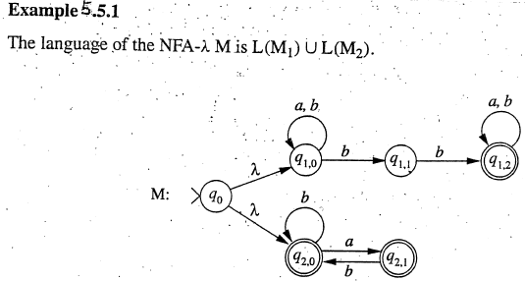
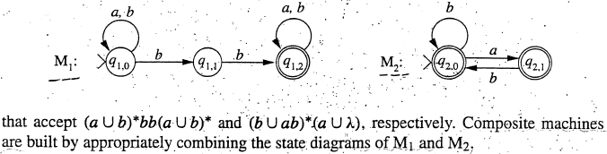
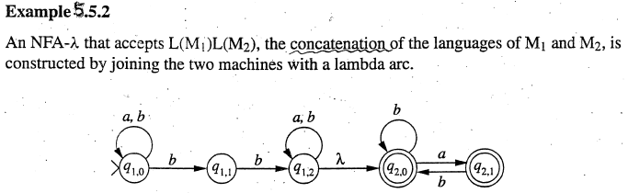
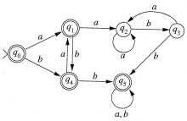
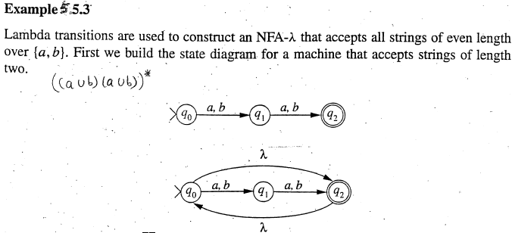
5.5 Lambda Transitions
M₁
M₂
M₁
M₂
M

Slide 21
5.6. Removing Non-determinism
Given any NFA(-λ), there is an equivalent DFA.
Defn 5.6.1. The λ-closure of a state q_{i}, denoted λ-closure(q_{i}), is defined recursively by
(i) Basis: q_{i} ∈ λ-closure(q_{i})
(ii) Recursion: let q_{j} ∈ λ-closure(q_{i}) and q_{k} ∈ δ(q_{j}, λ) ⇒ q_{k} ∈ λ-closure(q_{i})
(iii) Closure: each q_{j} ∈ λ-closure(q_{i}) is obtained by a number of applications of (ii)
Defn 5.6.2. The input transition function t of an NFA-λ M = (Q, ∑, δ, q₀, F) is a function from Q × ∑ →℘(Q) such that
t is used to construct an equivalent DFA
(3)
(2)
t
(
q
,
a
)
=
∪
λ
−
closure
(δ
(
q
,
a
))
i
j
q
∈
λ
j
−
closure
(
q
i
)
(1)

Slide 22
Removing Non-determinism
Example: Consider the transition diagram in Fig. 5.3 on p. 171 to compute t(q₁ , a):
λ-closure(q₁) =
t(q₁, a) = λ-closure(δ(q₁, a)) ∪
λ-closure(δ(q₄, a))
= λ-closure({ q₂ }) ∪
= { q₂, q₃ } ∪
= { q₂, q₃, q₅, q₆ }
Given M = (Q, ∑, δ, q₀, F), t = δ iff there is no λ-transition in δ
Example 5.6.1.
To remove the non-determinism in an NFA(-λ), an equivalent DFA simulates the exploration of all possible computations in the NFA (-λ)
the nodes of the DFA are sets of nodes from the NFA(-λ)
node Y ⊆ Q in NFA(-λ) can be reached from node X ⊆ Q in NFA(-λ) on ‘a’
if ∃q ∈Y and ∃p ∈ X such that δ(p, a) ∋ q in the DFA
{ q₁, q₄ }
a
q₂
λ
q₃
q₁
λ
q₄
q₅
q₆
a
λ
λ-closure({ q₅ })
{ q₅, q₆ }

Slide 23
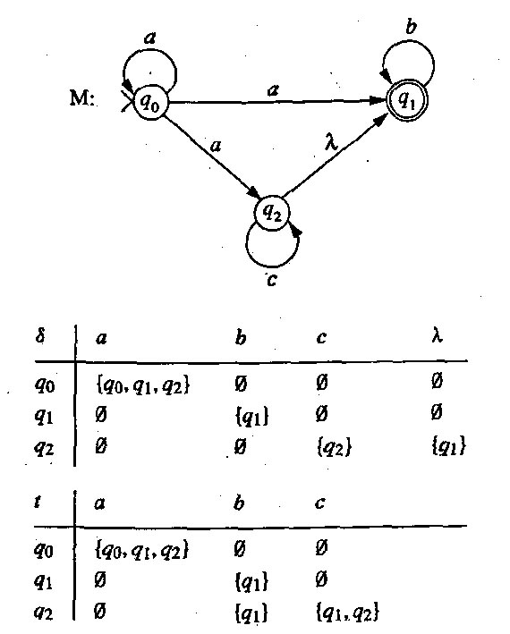
Removing Non-determinism
Example 5.6.1. Transition tables are given (below) for the transition function δ. Compute the input transition function t of the NFA-λ with state diagram M. The language of M is a⁺c*b*
t | a | b | c
q₀ | { q₀,q₁,q₂ } | { } | { }
q₁ | { } | { q₁ } | { }
q₂ | { } | { q₁ } | { q₁,q₂ }

Slide 24
DFA Equivalent to NFA-λ
Algorithm 5.6.3. Construction of DM, a DFA Equivalent to NFA-λ
Input: an NFA-λ M = (Q, ∑, δ, q₀, F), input transition function t of M
1. Initialize Q’ to { λ-closure(q₀) }
2. Repeat
2.1. IF there is a node X ∈ Q’ and a symbol a ∈ ∑ with no arc
leaving X labeled a, THEN
2.1.1. Let Y = ∪_{qi ∈ X} t(q_{i}, a)
2.1.2. IF Y ∉ Q’, THEN set Q’ = Q’ ∪ { Y }
2.1.3. Add an arc from X to Y labeled a
ELSE done := true
UNTIL done
3. the set of accepting states of DM is
F’ = { X ∈ Q’ | X contains q_{i} ∈ F }

Slide 25
Removing Non-determinism
Example. Consider the t-transition table for Example 5.6.1
δ’ a b c
{q₀} {q₀, q₁, q₂} φ φ
{q₀, q₁, q₂}* {q₀, q₁, q₂} {q₁} {q₁, q₂}
{q₁}* φ {q₁} φ
{q₁, q₂}* φ {q₁} {q₁, q₂}
φ φ φ φ
Theorem 5.6.4. Let w ∈ ∑* and Q_{w} = { q_{w1}, …, q_{wj} } be the set of states entered upon the completion of the processing of the string w in M. Processing w in DM terminates in state Q_{w}. (Prove by induction on |w|.)
t | a | b | c
q₀ | { q₀,q₁,q₂ } | { } | { }
q₁ | { } | { q₁ } | { }
q₂ | { } | { q₁ } | { q₁,q₂ }

Slide 26
Determinism and Non-determinism
Corollary 5.6.5. The finite automata M and DM (as shown in Algorithm 5.6.3) are ≡.
Example 5.6.2 and Example 5.6.3 show NFA ⇒ DFA
(Transformation) Relationships between the classes of finite automata:
DFA ⇐ NFA-λ
⊆ ⊆
NFA

