Slide 1
CS240: Advanced Programming Concepts
Week 8
Tuesday

Slide 2
Announcements
Please see Learning Suite for schedule and reading…

Slide 3
Topics
Packages revisited: The role of CLASSPATH and its ramifications on package organization…
Defensive Programming
Assertions and parameter checking
Unit Testing
Unit testing
JUnit testing
Note: Content for these slides is derived from the “DefensiveProgramming” and “UnitTesting”
presentations on our website.

Slide 4
Packages Revisited
“A package is basically a folder”
Perhaps more accurately we should think of a package as a location where we will find a class or set of classes. The compiler will enforce package and protected scoping relative to these locations.
Thanks to the CLASSPATH this may include more than one folder…
The CLASSPATH provides locations for the compiler to begin looking for java files or class files.
When you import a specific class the compiler looks for it beginning at those locations, and using the package name to navigate to the class file itself
When you specify a package, you may use an identical “subpath” for two different files in folders that sit below two different locations in the CLASSPATH. They will be treated as the same package…

Slide 5
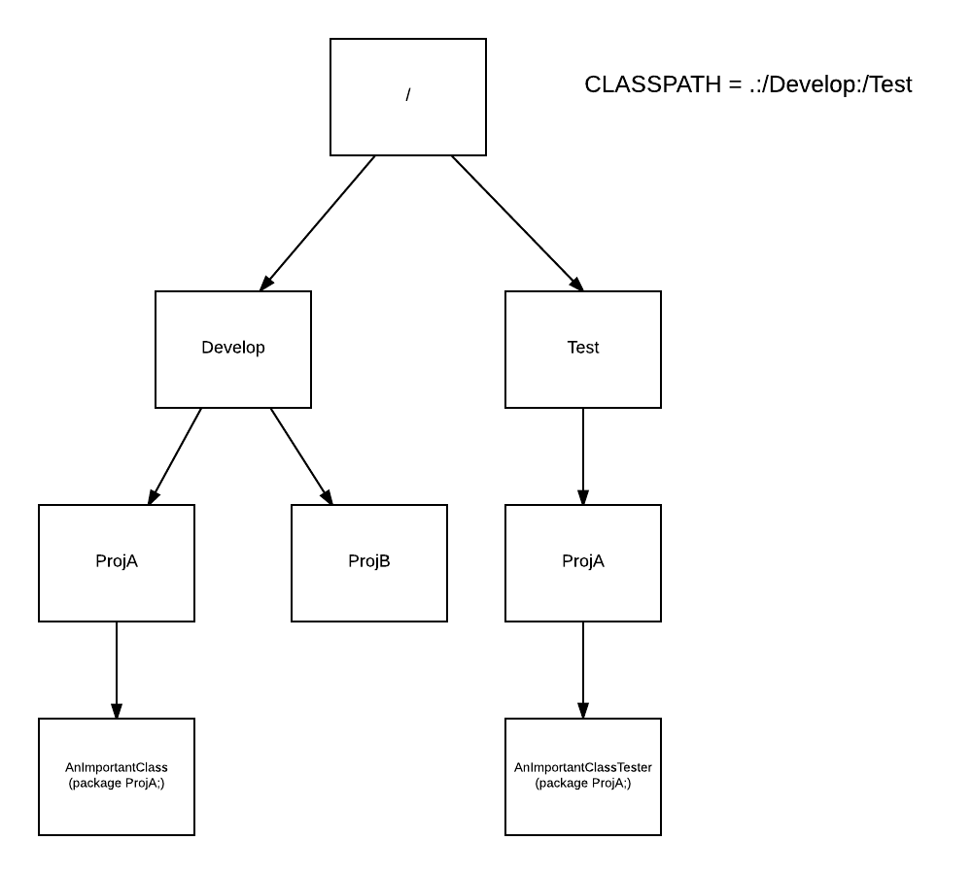

Slide 6
Defensive Programming
Assertions and Parameter Checking

Slide 7
Defensive Programming
Good programming practices that protect you from your own programming mistakes, as well as those of others
Assertions
Parameter Checking

Slide 8
The Reality of Assumptions…
As we program, we make many assumptions about the state of the program at each point in the code
A variable's value is in a particular range
A file exists, is writable, is open, etc.
Some data is sorted
A network connection to another machine was successfully opened
…
The correctness of our program depends on the validity of our assumptions
Faulty assumptions result in buggy, unreliable code

Slide 9
Assumptions
int binarySearch(int[] data, int searchValue) {
// What assumptions are we making about the parameter values?
…
}
data != null
data is sorted
What happens if these assumptions are wrong?

Slide 10
Assert your Assumptions…
Assertions are little test cases sprinkled throughout your code that alert you when one of your assumptions is wrong. They give us a way to make our assumptions explicit in the code
assert temperature > 32 && temperature < 212;
The parameter to assert is a boolean condition that should be true
assert condition;
If the condition is false, Java throws an AssertionError, which crashes the program
Stack trace tells you where the failed assertion is in the code

Slide 11
Assertions
int binarySearch(int[] data, int searchValue) {
assert data != null;
assert isSorted(data);
…
}
String[] someMethod(int y, int z) {
assert z != 0;
int x = y / z;
assert x > 0 && x < 1024;
return new String[x];
}

Slide 12
Assertions
Alternate form of assert
assert condition : expression;
If condition is false, expression is passed to the constructor of the thrown AssertionError
String[] someMethod(int y, int z)
{
assert z != 0 : ”invalid z value”;
int x = y / z;
assert x > 0 && x < 1024 : x;
return new String[x];
}

Slide 13
Things to Know…
Assertions are usually disabled in released software
(why do you think this would be?)
In Java, assertions are DISABLED by default
Enable them with the –enableassertions (or -ea) option
java –enableassertions MyApp
java –ea MyApp

Slide 14
But….
If one of my assumptions is wrong, shouldn't I throw an exception?
No. You should fix the bug, not throw an exception.

Slide 15
Parameter Checking
A method or function should always check its input parameters to ensure that they are valid
If they are invalid, it should indicate that an error has occurred rather than proceeding
This prevents errors from propagating through the code before they are detected
By detecting the error close to the place in the code where it originally occurred, debugging is greatly simplified

Slide 16
Parameter Checking
Two ways to check parameter values
assertions
if statement that throws exception if parameter is invalid
int binarySearch(int[] data, int searchValue)
{
assert data != null;
assert isSorted(data);
…
}
int binarySearch(int[] data, int searchValue)
{
if (data == null || !isSorted(data))
{
throw new InvalidArgumentException();
}
…
}

Slide 17
Parameter Checking
Should I use assertions or if/throw to check parameters?
If you have control over the calling code, use assertions: If parameter is invalid, you can fix the calling code
If you don't have control over the calling code, throw exceptions: e.g., your product might be a class library that is called by code you don’t control

Slide 18
Unit Testing
Packages revisited; Unit testing and JUnit testing

Slide 19
F-22 Raptor Fighter

Slide 20
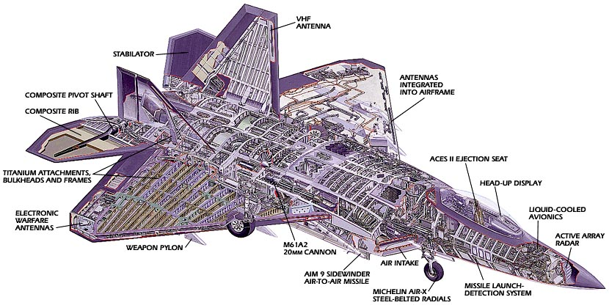
F-22 Raptor Fighter
Manufactured by Lockheed Martin & Boeing
How many parts does the F-22 have?

Slide 21
F-22 Raptor Fighter
What would happen if Lockheed assembled an F-22 with "untested" parts (i.e., parts that were built but never verified)?
It wouldn't work, and in all likelihood you would never be able to make it work
Cheaper and easier to just start over

Slide 22
Managing implementation complexity
Individual parts can/should be verified before being integrated with other parts
Integrated subsystems should also be verified
If adding a new part breaks the system, the problem is probably related to the recently added part
Track down the problem and fix it.
Iterate until the system is complete (hopefully).
Note: This approach will not overcome a fundamentally flawed design.
Notes:
We have already discussed design complexity, it is worth noting that we are now introducing tools for working with implementation complexity….
22

Slide 23
2 approaches to programming
Approach #1
"I wrote ALL of the code, but when I tried to compile and run it, nothing seemed to work!“
Approach #2
Write a little code (e.g., a method or small class)
Test it
Write a little more code
Test it
Integrate the two verified pieces of code
Test it
…
Notes:
23

Slide 24
Unit testing
Large programs consist of many smaller pieces
Classes, methods, packages, etc.
"Unit" is a generic term for these smaller pieces
Three important types of software testing are:
Unit Testing (test units in isolation)
Integration Testing (test integrated subsystems)
System Testing (test entire system that is fully integrated)
Unit Testing is done to test the smaller pieces in isolation before they are combined with other pieces
Usually done by the developers who write the code
Notes:
24

Slide 25
What unit tests do
Unit tests create objects, call methods, and verify that the returned results are correct
Actual results vs. Expected results
Unit tests should be automated so that they can be run frequently (many times a day) to ensure that changes, additions, bug fixes, etc. have not broken the code
Regression testing
Can notify you when changes have introduced bugs, and helps to avoid destabilizing the system
Notes:
25

Slide 26
Test driver program
The tests are run by a "test driver", which is a program that just runs all of the unit test cases
It must be easy to add new tests to the test driver
After running the test cases, the test driver either tells you that everything worked, or gives you a list of tests that failed
Little or no manual labor required to run tests and check the results
Tools like Ant or Make are often used to automate the building and running of the test driver (e.g., $ ant test)
Notes:
26

Slide 27
Android testing framework
Android provides a framework for writing automated unit tests
Based on the popular JUnit unit testing framework
There are two types of Android unit tests
Local Unit Tests
These tests depend only on standard Java classes, and so can be run on the development computer instead of on an Android device
Instrumented Unit Tests
These tests depend on Android-specific classes, and so must be run on an Android device
Notes:
27

Slide 28
Android local unit tests
Can run on the development computer without a device or emulator
App’s primary source code is located in the folder
app/src/main/java/<app-package>
Local unit test code is located in the folder
app/src/test/java/<app-package>

Slide 29
Android local unit tests
Example
SuperAsteroids (local test)
app/src/test/java/edu/byu/cs/superasteroids/core/LocalTests.java

Slide 30
Android local unit tests
Local test classes are written using the JUnit 4 unit test framework
Include the following in app/build.gradle
dependencies { … testCompile 'junit:junit:4.12' }
Import JUnit 4 classes
import org.junit.*;
import static org.junit.Assert.*;

Slide 31
Android local unit tests
Test classes are just regular classes (no special superclass)
Test methods may have any name (need not be test*), but must have the @Test annotation on them
Common initialization code can be placed in a method (any name) with the @Before annotation
Common cleanup code can be placed in a method (any name) with the @After annotation
Use JUnit assert* methods to implement test cases
JUnit 4 Assert Method Documentation

Slide 32
Running local unit tests
No device or emulator is needed
In Android Studio, open the “Build Variants” tool window in the bottom-left corner, and set the “Test Artifact” setting to “Unit Tests” (deprecated?)
To run a single test class, in the “Project” tool window right-click on a test class name, and select “Run *Tests”
To run all of your local unit tests, right-click on the “test/java” folder, and select “Run All Tests”

Slide 33
JUnit 4 unit testing framework
JUnit 4 Documentation
Use JUnit 4 annotations to mark test methods
Annotation | Description
@Test public void method() | The annotation @Test identifies that a method is a test method.
@Before public void method() | Will execute the method before each test. This method can prepare the test environment (e.g. read input data, initialize the class).
@After public void method() | Will execute the method after each test. This method can cleanup the test environment (e.g. delete temporary data, restore defaults).
Notes:
33

Slide 34
JUnit 4 unit testing framework
Use JUnit 4 annotations to mark test methods
Annotation | Description
@BeforeClass public void method() | Will execute the method once, before the start of all tests. This can be used to perform time intensive activities, for example to connect to a database.
@AfterClass public void method() | Will execute the method once, after all tests have finished. This can be used to perform clean-up activities, for example to disconnect from a database.
@Test (expected = Exception.class) | Fails, if the method does not throw the named exception.
@Test(timeout=100) | Fails, if the method takes longer than 100 milliseconds.
Notes:
34

Slide 35
Android instrumented unit tests
Require a device or emulator to run
App’s primary source code is located in the folder
app/src/main/java/<app-package>
Instrumented unit test code is located in the folder
app/src/androidTest/java/<app-package>

Slide 36
Android instrumented unit tests
For each primary class, you can create a corresponding test class
Put the test class in the same package as the primary class
app/src/main/java/<app-package>/SomeClass.java
app/src/androidTest/java/<app-package>/SomeClassTest.java
Putting both classes in the same package (although different folders) gives the test class greater access to the primary class’s members

Slide 37
Android instrumented unit tests
Examples
SuperAsteroids (basic test)
app/src/main/java/edu/byu/cs/superasteroids/core/GraphicsUtils.java
app/src/androidTest/java/edu/byu/cs/superasteroids/core/GraphicsUtilsTests.java
BookClub (database test, code under database lecture)
app/src/main/java/edu/byu/cs240/bookclub/database/BookDAO.java
app/src/androidTest/java/edu/byu/cs240/bookclub/database/BookDAOTest.java

Slide 38
Android instrumented unit tests
Test class is subclass of
android.test.AndroidTestCase
Put test cases in test* methods
Test methods follow this outline:
Initialize test objects/data
Invoke methods on test objects
Use assert* methods to compare expected and actual results
Cleanup test objects/data

Slide 39
Android instrumented unit tests
Test methods often have redundant (i.e., duplicated) initialization and cleanup code
You can override AndroidTestCase’s setUp() and tearDown() methods to centralize redundant initialization/cleanup code
setUp() is run before each test* method
tearDown() is run after each test* method
Test methods should not influence each other (i.e., they should not depend on each other or have “cross talk”)
It should be possible to run the test methods in a random order without affecting the results

Slide 40
Running instrumented unit tests
Make sure a device or emulator is available
In Android Studio, open the “Build Variants” tool window in the bottom-left corner, and set the “Test Artifact” setting to “Android Instrumentation Tests” (deprecated?)
To run a single test class, in the “Project” tool window right-click on a test class name, and select “Run *Tests”
To run all of your instrumented unit tests, right-click on the “androidTest/java” folder, and select “Run All Tests”

