Slide 1
CS240: Advanced Programming Concepts
Week 9
Thursday

Slide 2
Submission Schedule
Task 1 (Thur. Oct. 20th): Design documentation
Task 2 (Wed. Oct. 26th): Data importer working
Task 3 (Tue. Nov. 1st): Ship builder working
Task 4 (Thur. Nov. 10th): Game completed

Slide 3
Topics
Android UI Basics
Logging & Debugging
Object Serialization

Slide 4
Android UI Basics
Activities and Views

Slide 5
Views
Views are the basic element of an Android application’s visual interface
A View is an object that draws something on the screen, and can detect user interactions (i.e. clicks etc.)
A ViewGroup (subclass of View) holds other Views and enables us to automate the process of defining an interface’s layout
Linear
Frame
Relative
Absolute
A nice tutorial here: https://www.tutorialspoint.com/android/android_user_interface_layouts.htm
All user interfaces are built using View and ViewGroup objects.
Views can be nested in a tree to create complex layouts

Slide 6
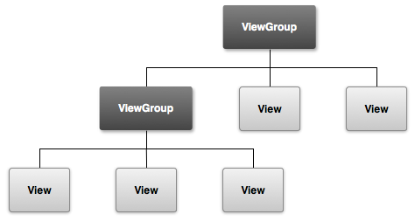
Example Layout Structure

Slide 7
Views
Can be instantiated in code
More easily managed via Android’s XML layout approach…
Button myButton = new Button(this);
myButton.setLayoutParams(new LinearLayout.LayoutParams(
LinearLayout.LayoutParams.MATCH_PARENT,
LinearLayout.LayoutParams.MATCH_PARENT));
myLayout.addView(myButton);

Slide 8
Android XML Layouts
Represent a “tree” of views as XML objects
Can be parsed in a manner similar to JSON objects
Views are “inflated” at runtime
Accessible/locatable via IDs
mQuestionTextView = (TextView) findViewById( R.id.question_text_view);
R class IDs (app/build/generated/source/r/debug/R.java)
Example…

Slide 9
<?xml version="1.0" encoding="utf-8"?> <FrameLayout xmlns:android="http://schemas.android.com/apk/res/android" android:layout_width="match_parent" android:layout_height="match_parent"> <TextView android:id="@+id/question_text_view" android:layout_width="wrap_content" android:layout_height="wrap_content" android:layout_gravity="center_horizontal" android:padding="24dp"/> .
.
. <LinearLayout android:layout_width="wrap_content" android:layout_height="wrap_content" android:layout_gravity="bottom|center_horizontal" android:orientation="horizontal"> <ImageButton android:id="@+id/previous_button" android:layout_width="wrap_content" android:layout_height="wrap_content" android:contentDescription="@string/previous_button" android:src="@drawable/arrow_left"/> <Button android:id="@+id/cheat_button" android:layout_width="wrap_content" android:layout_height="wrap_content" android:layout_gravity="bottom|center_horizontal" android:text="@string/cheat_button"/> .
.
. </LinearLayout> </FrameLayout>

Slide 10
Strings and Other Interface Values
Android provides a convenient method for centralizing commonly used strings and values
Treated as a resource: found in the res folder
Stored in XML files
Accessible/retrievable via their name
This approach lends itself to automated translation, themes etc.

Slide 11
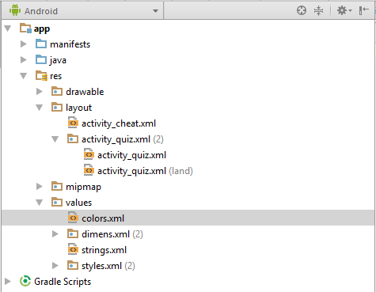
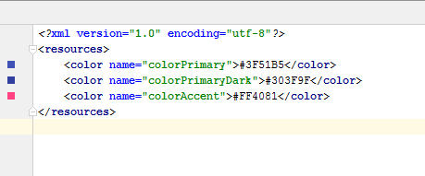
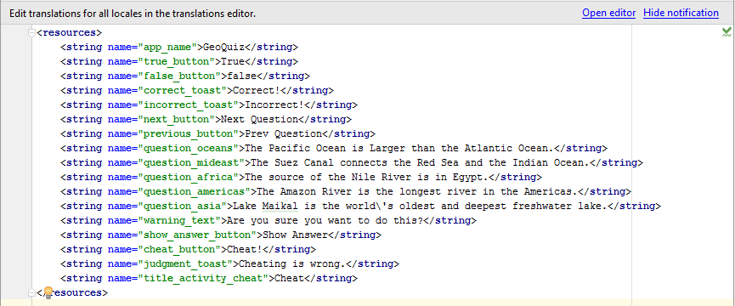

Slide 12
Activities
An Android Activity is a class that controls a screen of Views
Inherits from the Activity class
Contains “listener” objects that respond to user input at runtime
Can be created and destroyed at runtime
Serviced/Managed by Android’s ActivityManager (i.e. the OS does work for you)
Follow the activity life cycle

Slide 13
Creating an Activity Class…
AppCompatActivity inherits from Activity…

Slide 14
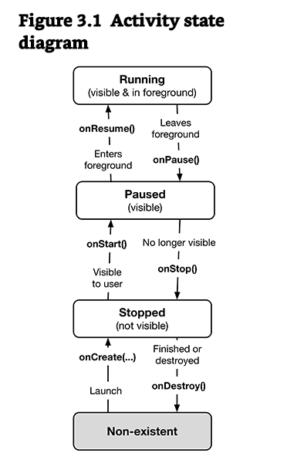
The Activity Life Cycle
Overriding inherited “life cycle” methods allows a developer to customize the behavior of an activity class.

Slide 15
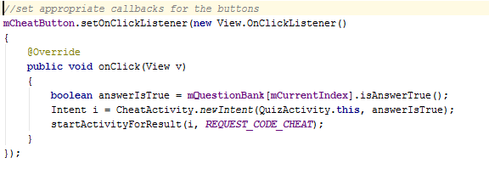
Creating a new activity and making it active…
Activities are started with an Intent: “An intent is an abstract description of an operation to be performed.” [https://developer.android.com/reference/android/content/Intent.html]

Slide 16
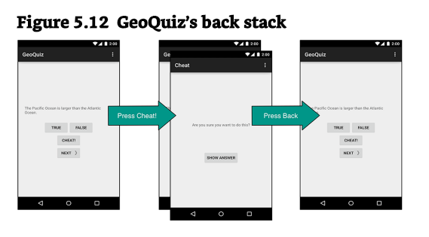
The Activity or “Back” Stack

Slide 17
Debugging and Logging

Slide 18
Using the Stack Trace
Sometimes bad stuff happens…
What if the following association is never created?...
mQuestionTextView = (TextView) findViewById( R.id.question_text_view);
Phillips, Bill; Stewart, Chris. Android Programming: The Big Nerd Ranch Guide (2nd Edition) (p. 75). Pearson Education. Kindle Edition.
Demo…

Slide 19
BreakPoints…
Demo

Slide 20
Using the logger
Log.d( TAG, "Updating question text for question #" + mCurrentIndex, new Exception());
“The exception that you pass to Log.d(…) does not have to be a thrown exception that you caught. You can create a brand new Exception and pass it to the method without ever throwing it, and you will get a report of where the exception was created.”
Phillips, Bill; Stewart, Chris. Android Programming: The Big Nerd Ranch Guide (2nd Edition) (p. 78 & 79). Pearson Education. Kindle Edition.

Slide 21
Object Serialization
“Java provides a mechanism, called object serialization where an object can be represented as a sequence of bytes that includes the object's data as well as information about the object's type and the types of data stored in the object.”
After a serialized object has been written into a file, it can be read from the file and deserialized that is, the type information and bytes that represent the object and its data can be used to recreate the object in memory.”
Most impressive is that the entire process is JVM independent, meaning an object can be serialized on one platform and deserialized on an entirely different platform.”
Classes ObjectInputStream and ObjectOutputStream are high-level streams that contain the methods for serializing and deserializing an object.”
Demo…
[ https://www.tutorialspoint.com/java/java_serialization.htm ]

