Slide 1
CS240: Advanced Programming Concepts
Week 7
Tuesday

Slide 2
Today’s Topics
Object Models vs Data Models
JSON & XML
Examples

Slide 3
Object Modeling
Object oriented design of the system
Classes
Methods
Properties
Relationships between classes

Slide 4
Data Modeling
Data storage/representation
May very well include storing objects (i.e. in a database)
Schema
Table design
Table relationships

Slide 5
In Other Words…
Object model: An object model is a collection of descriptions of classes or interfaces, together with their member data, member functions, and class-static operations.
Data model: A data model is a collection of descriptions of data structures and their contained fields, together with the operations or functions that manipulate them.
Source: http://www.w3.org/TR/DOM-Level-3-Core/glossary.html#dt-object-model

Slide 6
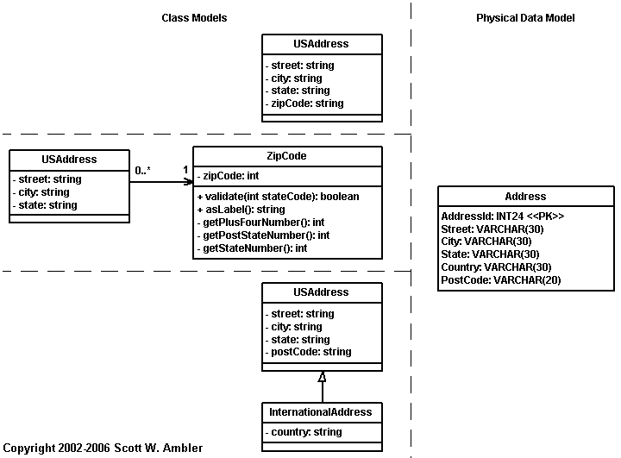
Example / Comparison (1 of 2)
Source: http://www.agiledata.org/essays/drivingForces.html

Slide 7
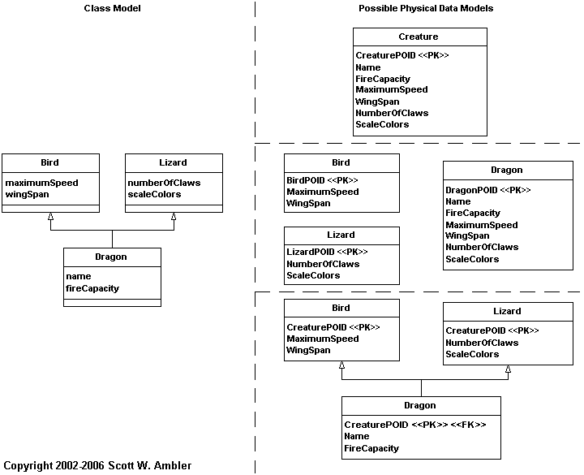
Example / Comparison (2 of 2)
Source: http://www.agiledata.org/essays/drivingForces.html

Slide 8
Document Object Model (DOM): What is it?
A W3Standard: the specification can be found at http://www.w3.org/DOM/DOMTR
“The DOM is a programming API for documents. It is based on an object structure that closely resembles the structure of the documents it models.”
“The name "Document Object Model" was chosen because it is an "object model" in the traditional object oriented design sense: documents are modeled using objects, and the model encompasses not only the structure of a document, but also the behavior of a document and the objects of which it is composed.”

Slide 9
Example
<table>
<tbody>
<tr>
<td>Shady Grove</td>
<td>Aeolian</td>
</tr>
<tr>
<td>Over the River, Charlie</td>
<td>Dorian</td>
</tr>
</tbody>
</table>
Source: http://www.w3.org/TR/DOM-Level-3-Core/introduction.html

Slide 10
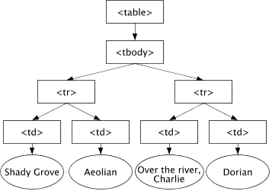
Example
Source: http://www.w3.org/TR/DOM-Level-3-Core/introduction.html

Slide 11
JavaScript Object Notation (JSON)
A useful “alternative” to XML and the DOM: JSON is made for describing JavaScript objects (i.e. it “fits” the kinds of objects we are working with a bit better)
“JSON (JavaScript Object Notation) is a lightweight data-interchange format. It is easy for humans to read and write. It is easy for machines to parse and generate. It is based on a subset of the JavaScript Programming Language, Standard ECMA-262 3rd Edition - December 1999. JSON is a text format that is completely language independent but uses conventions that are familiar to programmers of the C-family of languages, including C, C++, C#, Java, JavaScript, Perl, Python, and many others. These properties make JSON an ideal data-interchange language.” [ http://json.org/ ]
http://json.org/

Slide 12
JSON Example
File: https://students.cs.byu.edu/~cs240ta/fall2016/rodham_files/09-xml-json/cd_catalog.json.txt

Slide 13
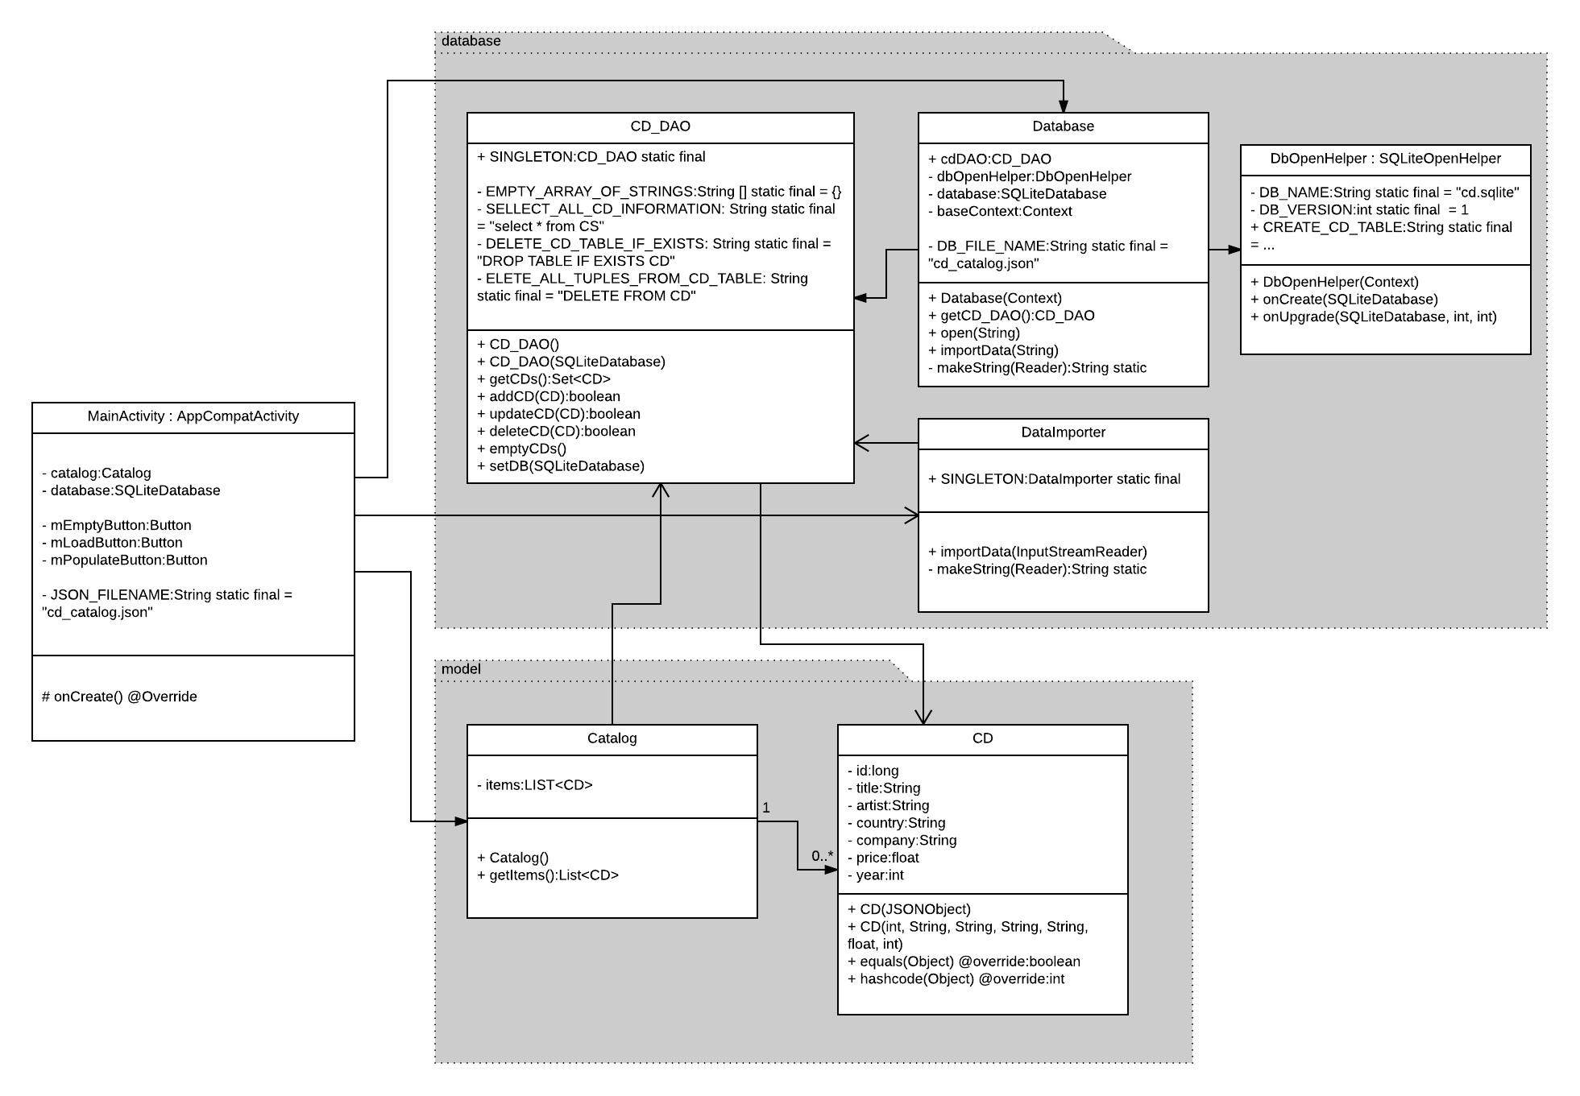
CatalogDemo

Slide 14
DataImporter.java …
public void importData(InputStreamReader reader) throws org.json.JSONException, IOException { JSONObject rootObject = new JSONObject(makeString(reader)); JSONArray cdArr = null; try { cdArr = rootObject.getJSONArray("CATALOG"); for (int i = 0; i < cdArr.length(); ++i) { JSONObject elemObj = cdArr.getJSONObject(i); JSONObject cdObj = elemObj.getJSONObject("CD"); CD cd = new CD(cdObj); CD_DAO.SINGLETON.addCD(cd); } } catch (JSONException e) { e.printStackTrace(); } }

Slide 15
… aaaaah that’s better…
public void importData(InputStreamReader reader) throws org.json.JSONException, IOException { JSONObject rootObject = new JSONObject(makeString(reader)); JSONArray cdArr = null; try { cdArr = rootObject.getJSONArray("CATALOG"); for (int i = 0; i < cdArr.length(); ++i) { JSONObject elemObj = cdArr.getJSONObject(i); JSONObject cdObj = elemObj.getJSONObject("CD"); CD cd = new CD(cdObj); CD_DAO.SINGLETON.addCD(cd); } } catch (JSONException e) { e.printStackTrace(); } }

