Slide 1
CS240: Advanced Programming Concepts
Week 7
Thursday

Slide 2
Android App Walk-Through
Our Case Study: CatalogDemo
Contains examples of JSON and SQLite library class usage
Demonstrates usage of anonymous classes and objects
Is fairly simple
Demonstrates the concept of a “Database Abstraction Layer”
“Data Access Objects” or DAO design pattern
Demonstrates the “singleton” pattern
And pitfalls to watch for in its implementation

Slide 3
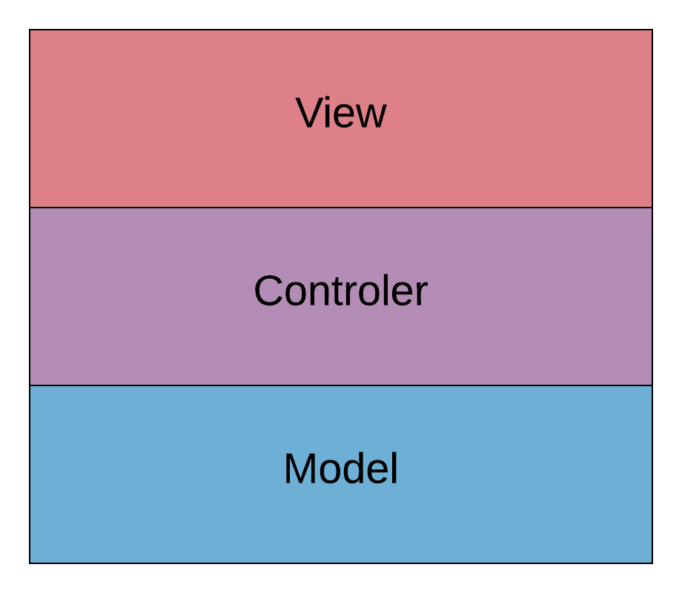
The MVC (Model View Controller) Design Pattern:

Slide 4
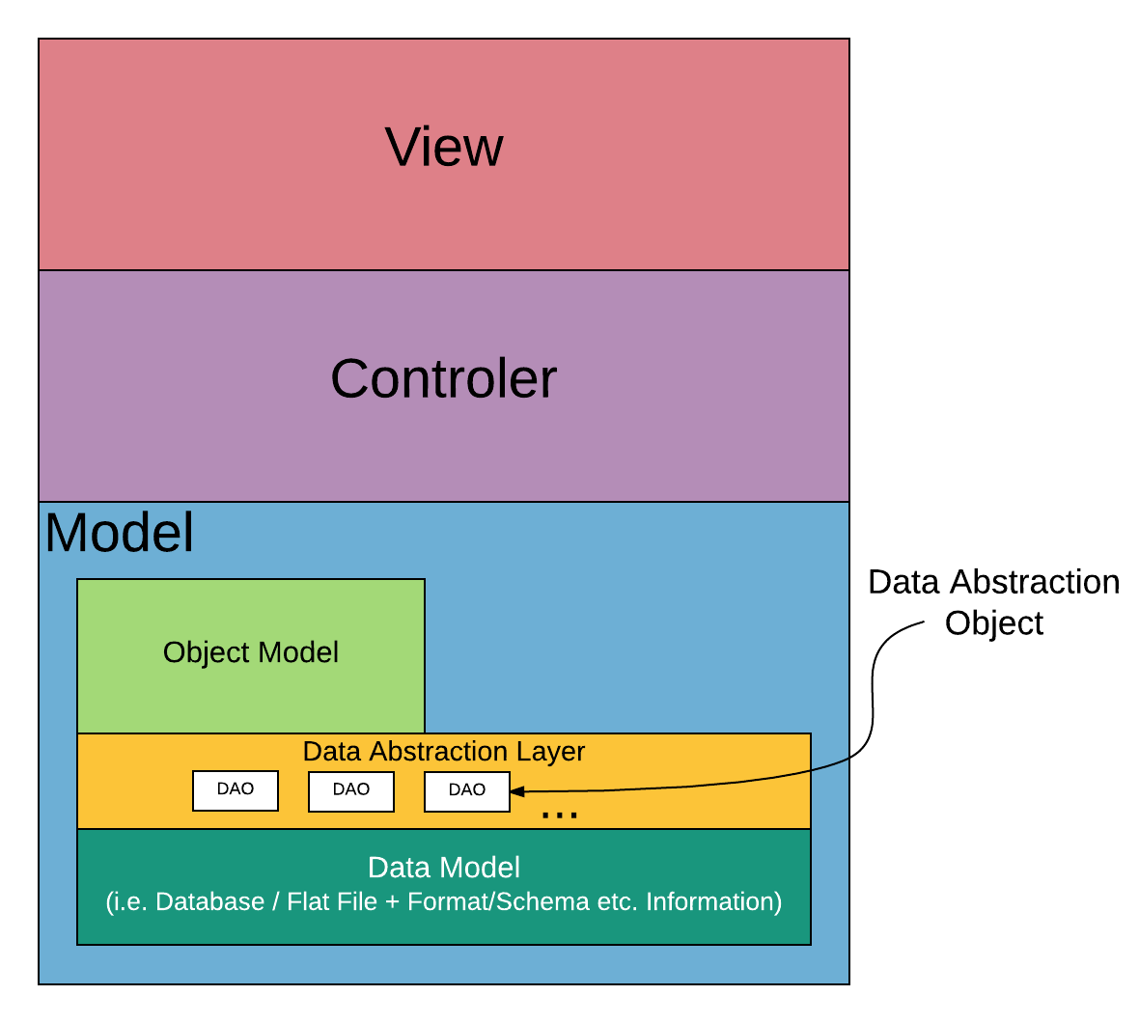
Embedding a Data Access Layer in MVC

Slide 5
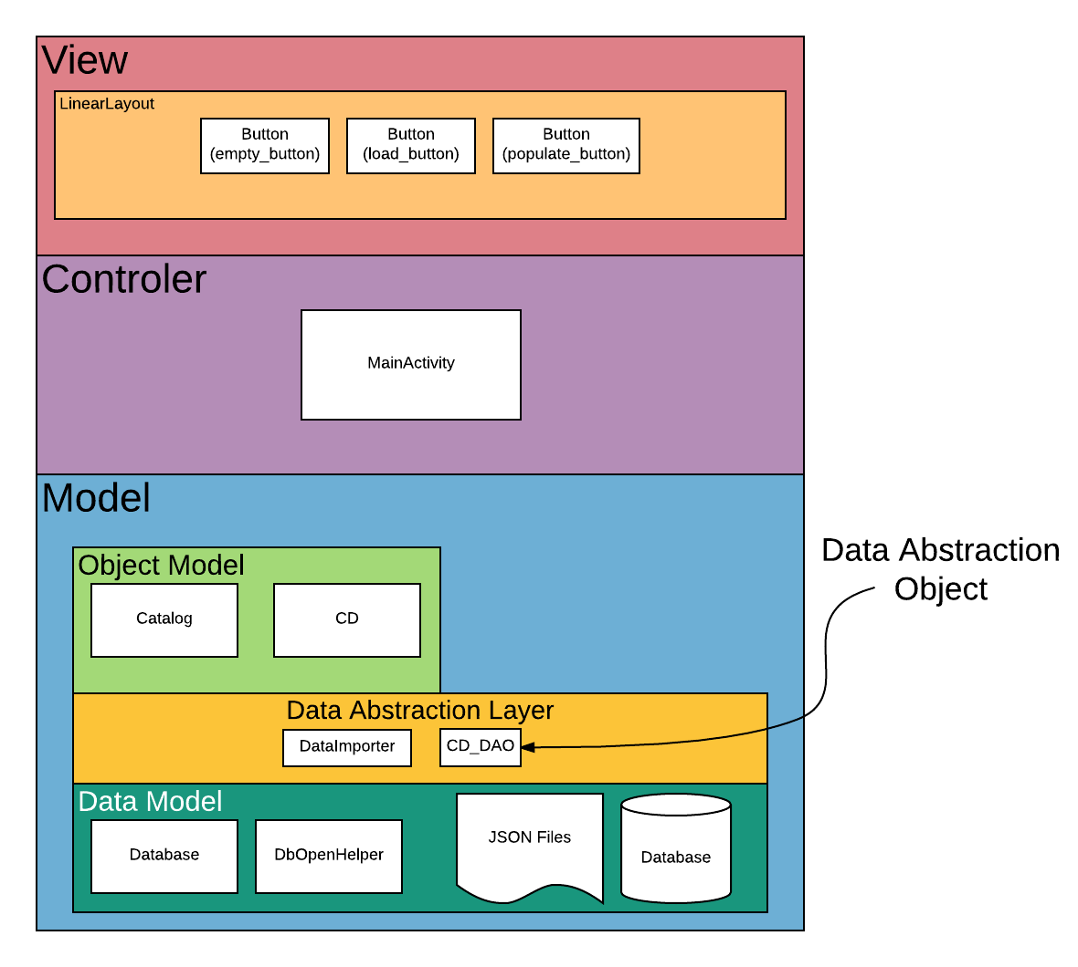
Catalog Demo Implementation of MVC + DAO

Slide 6
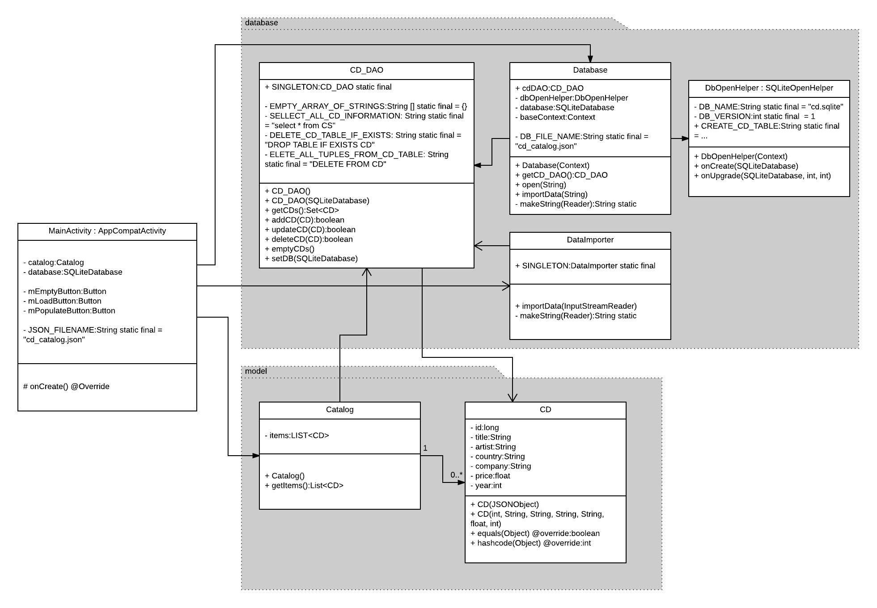
CatalogDemo

Slide 7
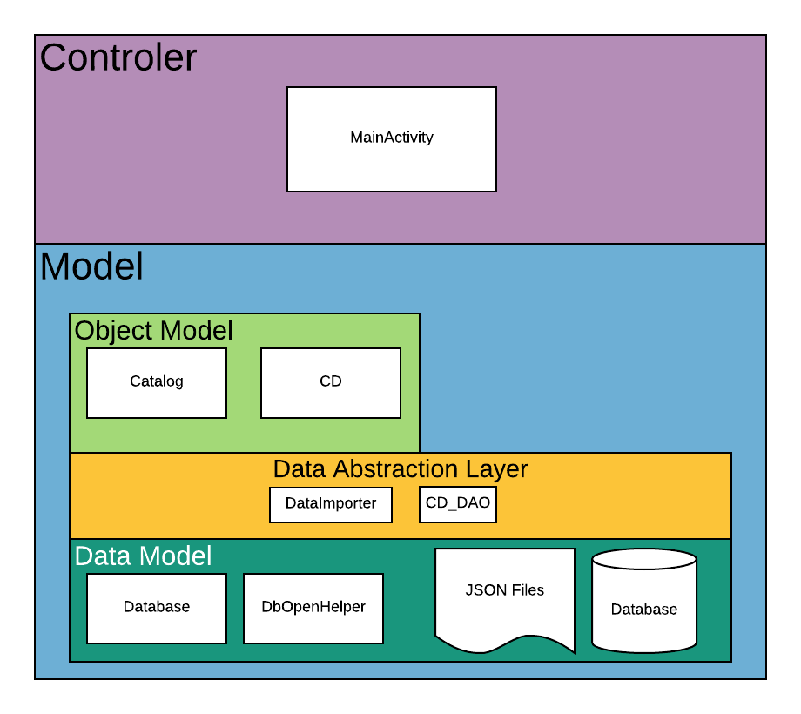
Analysis and Comment…

