Slide 1
CS240: Advanced Programming Concepts
Week 6
Thursday

Slide 2
Things to study
Things To Study
JSON
http://www.json.org/
SQLite
https://www.sqlite.org/about.html
JavaDoc/javadoc
https://students.cs.byu.edu/~cs240ta/fall2016/tutorials/Java_Doc_Tutorial.pdf
Junit Testing
http://www.vogella.com/tutorials/JUnit/article.html
Android Book: Chapters 3 - 5

Slide 3
Decomposition
Levels of decomposition
System
Subsystem
Packages
Classes
Routines
Hypo- and Hyper-Decomposition
When have we decomposed far enough?
Size metrics
Complexity metrics
Single responsibility

Slide 4
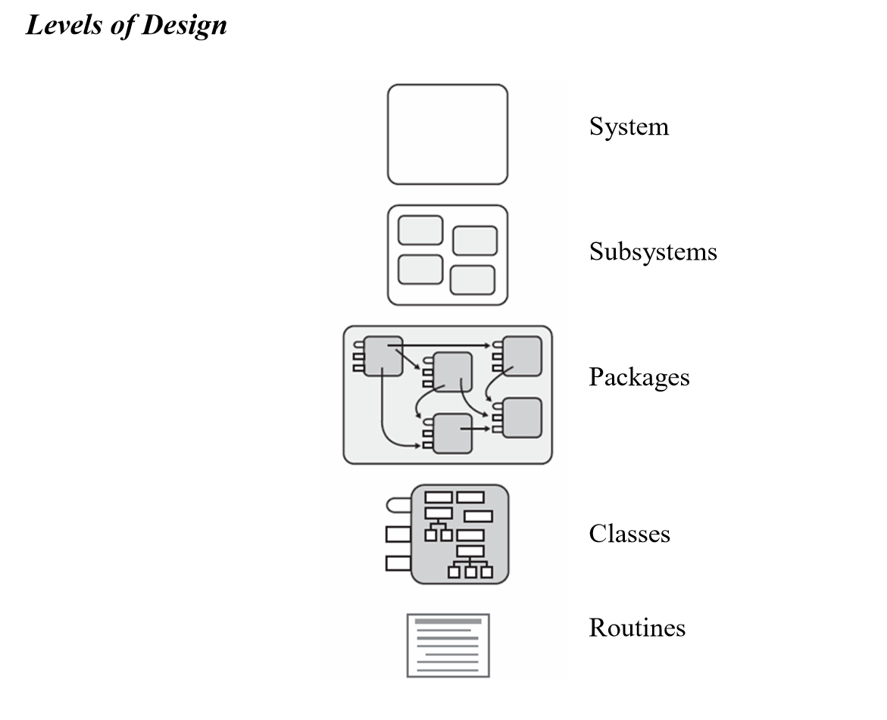

Slide 5
Algorithm & Data Structure Selection
No amount of decomposition or abstraction will hide a fundamentally flawed selection of algorithm or data structure.

Slide 6
Minimize Dependencies
Dependencies
Class A CALLS Class B
Class A HAS MEMBER OF Class B
Class A INHERITS FROM Class B

Slide 7
Minimize Dependencies
Minimizing the number of interactions between different classes has several benefits:
A class with few dependencies is easier to understand
A class with few dependencies is less prone to ripple effects
A class with few dependencies is easier to reuse

Slide 8
Minimize Dependencies
When classes must interact, if possible they should do so through simple method calls
This kind of dependency is clear in the code and relatively easy to understand

Slide 9
Separation of Interface and Implementation
Maintain a strict separation between a class’ interface and its implementation
This allows internal details to change without affecting clients
interface Stack + class StackImpl
Program to interfaces instead of concrete classes

Slide 10
Information Hiding
Many languages provide “public”, “private”, and “protected” access levels
All internal implementation is “private” unless there’s a good reason to make it “protected” or “public”
A class’ public interface should be as simple as possible

Slide 11
Information Hiding
Don’t let internal details “leak out” of a class
ClassRoll instead of StudentLinkedList
Some classes or methods are inherently tied to a particular implementation. For these it is OK to use an implementation-specific name
HashTable
TreeSet

Slide 12
Code Duplication
Code duplication should be strenuously avoided
Identical or similar sections of code
Disadvantages of duplication:
N copies to maintain
Bugs are duplicated N times
Makes program longer, decreasing maintainability
Solutions
Factor common code into a separate method or class
Shared code might be placed in a common superclass

