Slide 1
CS240: Advanced Programming Concepts
Week 4
Thursday

Slide 2
Inheritance

Slide 3
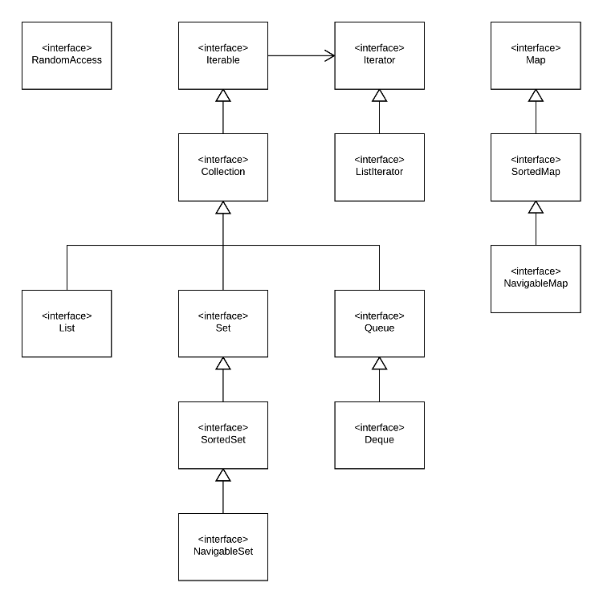
Java Collections Framework

Slide 4
List
ArrayList
LinkedList
”Random Access”

Slide 5
Iterator
Collection < String > coll = ...;
Iterator < String > iter = coll.iterator();
while (iter.hasNext())
{
String element = iter.next();
Process element
}
Horstmann, Cay S.. Core Java for the Impatient (p. 232). Pearson Education. Kindle Edition.

Slide 6
Enhanced For Loops (arrays/collections)…
for (String element : coll)
{
Process element
}
What actually “happens”?…
Horstmann, Cay S.. Core Java for the Impatient (p. 232). Pearson Education. Kindle Edition.

Slide 7
Set
HashSet
Fast
“Constant” time access
TreeSet (SortedSet/NavigableSet)
Ordered
Comparable interface or…
Supply a Comparator in the constuctor

Slide 8
Map
Key value pairs
One value per key
Map < String, Integer > counts = new HashMap < >();
counts.put(" Alice", 1); // Adds the key/ value pair to the map
counts.put(" Alice", 2); // Updates the value for the key
(Horstmann, Cay S.. Core Java for the Impatient (p. 237). Pearson Education. Kindle Edition. )
What is a key?
“What is a value”?

Slide 9
Views
Set < K > keySet()
Set < Map.Entry < K, V > > entrySet()
Collection < K > values()
“The collections that are returned are not copies of the map data, but they are connected to the map. If you remove a key or entry from the view, then the entry is also removed from the underlying map.”
Horstmann, Cay S.. Core Java for the Impatient (p. 237). Pearson Education. Kindle Edition.

Slide 10
Stacks, Queues, Deques, Priority Queues
Stack:
Push/Pop
Queue
Add/remove
Priority Queues
“Comparable”
https://docs.oracle.com/javase/7/docs/api/java/lang/Comparable.html
Weak Hash Maps
Weak References

Slide 11
From Stroustrup’s Presentation…
https://www.youtube.com/watch?v=YQs6IC-vgmo

