Slide 1
CS240: Advanced Programming Concepts
Week 3
Tuesday

Slide 2
Announcements
Due date for Evil Hangman lab…
Tuesday September 20th… Yep.

Slide 3
Lab 2 Read/Walk Through
Trie data structure (see next slide)
Characters as indexes
Use a char
Use a hashmap
Methods to override…
toString()
Can we use/reuse anything here when checking for equivalence?
hashCode()
equals()
Equals method() – review hashCode…
Similarity of words
Cumulative edit distance <= 2
Four edit distances
Deletion
Transposition (adjacent)
Alteration
Insertion

Slide 4
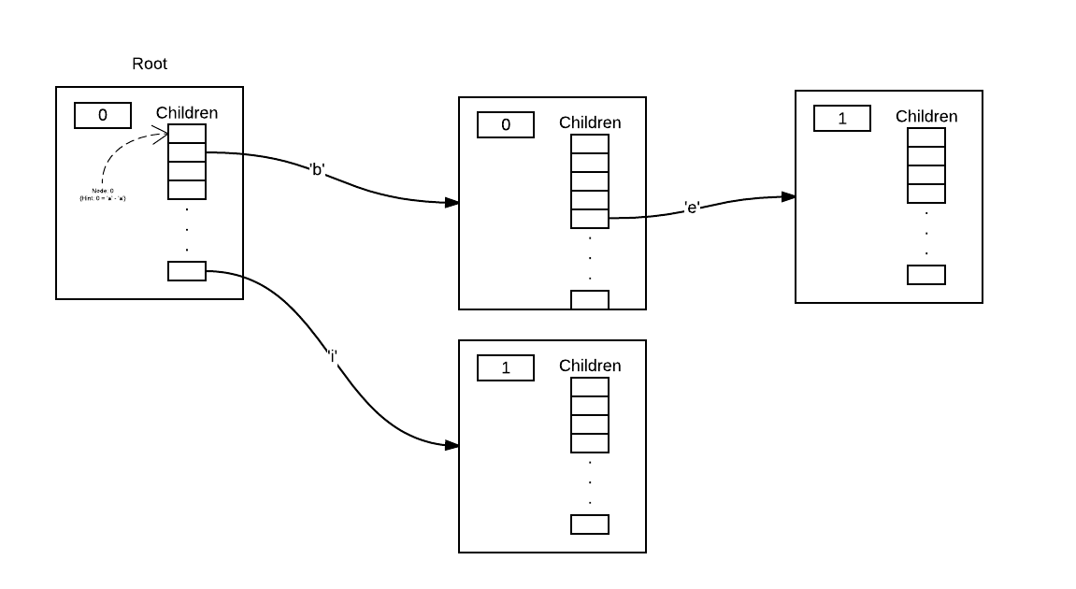
Data Structure: Trie

Slide 5
Exceptions
Exceptions provide a standardized way of gracefully handling… “situations”
try { <some statements> }
This is the block of code that might fail for some reason
throw <Throwable object>
throw new <exception type>;
catch(<ExceptiontType> <name>)
This block of code is your exception handler for the specified exception type. This is where you have a chance to respond gracefully to an otherwise potentially ugly situation, or perhaps to simply handle a specific (“exceptional”) circumstance.
finally { <some statements> }
“The finally block always executes when the try block exits. This ensures that the finally block is executed even if an unexpected exception occurs. But finally is useful for more than just exception handling — it allows the programmer to avoid having cleanup code accidentally bypassed by a return, continue, or break. Putting cleanup code in a finally block is always a good practice, even when no exceptions are anticipated.”
https://docs.oracle.com/javase/tutorial/essential/exceptions/finally.html

Slide 6
Lab 2 Tips and Tricks
Take advantage of help sessions!
Make it work, THEN make it fast
Strings are immutable…
http://www.javapractices.com/topic/TopicAction.do?Id=29
http://www.javapractices.com/topic/TopicAction.do?Id=15
Build your Trie class first
How might you build/test this data structure?

Slide 7
Lab 2 Tips and Tricks Continued
Spell checking:
Step one: Be able to identify a word in the dictionary
Throw an exception if you don’t find it
Step two: generate all possible variations of a word that are and edit distance of 1 from the desired word – search for these in the dictionary
Select from those found using the priority rules provided
If none found – proceed to step three
Step three: using the list of words with an edit distance of 1 from the entered word, generate all possible words with an edit distance of 1 from these words (these are the words with an edit distance of 2 from the entered word…)
Select from those found using the priority rules provided
If none found – throw the exception…

Slide 8
Packages
Demo
Simple: Woodfield example
A bit more complex: Rodham example

Slide 9
Creating Copies of Objects
.clone()
https://docs.oracle.com/javase/7/docs/api/java/lang/Object.html#clone()
Copy constructors
Demo: CopyConstructorDemo

