Slide 1
CS240: Advanced Programming Concepts
Week 15
Screencast 1

Slide 2
Topics
Recyclerview (finish up)
Expandable Recyclerview
Toolbars
ViewPager *
Dialogs*
*not discussed please see chapters 11 and 12 of our Android Text

Slide 3
RecyclerView
3 Principle Concerns
RecyclerView.ViewHolder - EXTEND
RecyclerView.Adapter – EXTEND
The “stuff” to be displayed
Methods of Concern
RecyclerView.ViewHolder
Interface methods – i.e. onClick(View)
Necessary custom methods
RecyclerView.Adapter<MyType>
Constructor?
MyType onCreateViewHolder(ViewGroup, int)
void onBindViewHolder(MyType, int)
int getItemCount()
Necessary custom methods
Notes:
*ViewHolder Possibly implements 1 or more interfaces. i.e. View.OnClickListener
*MyType is a subclass of RecylerView.ViewHolder

Slide 4
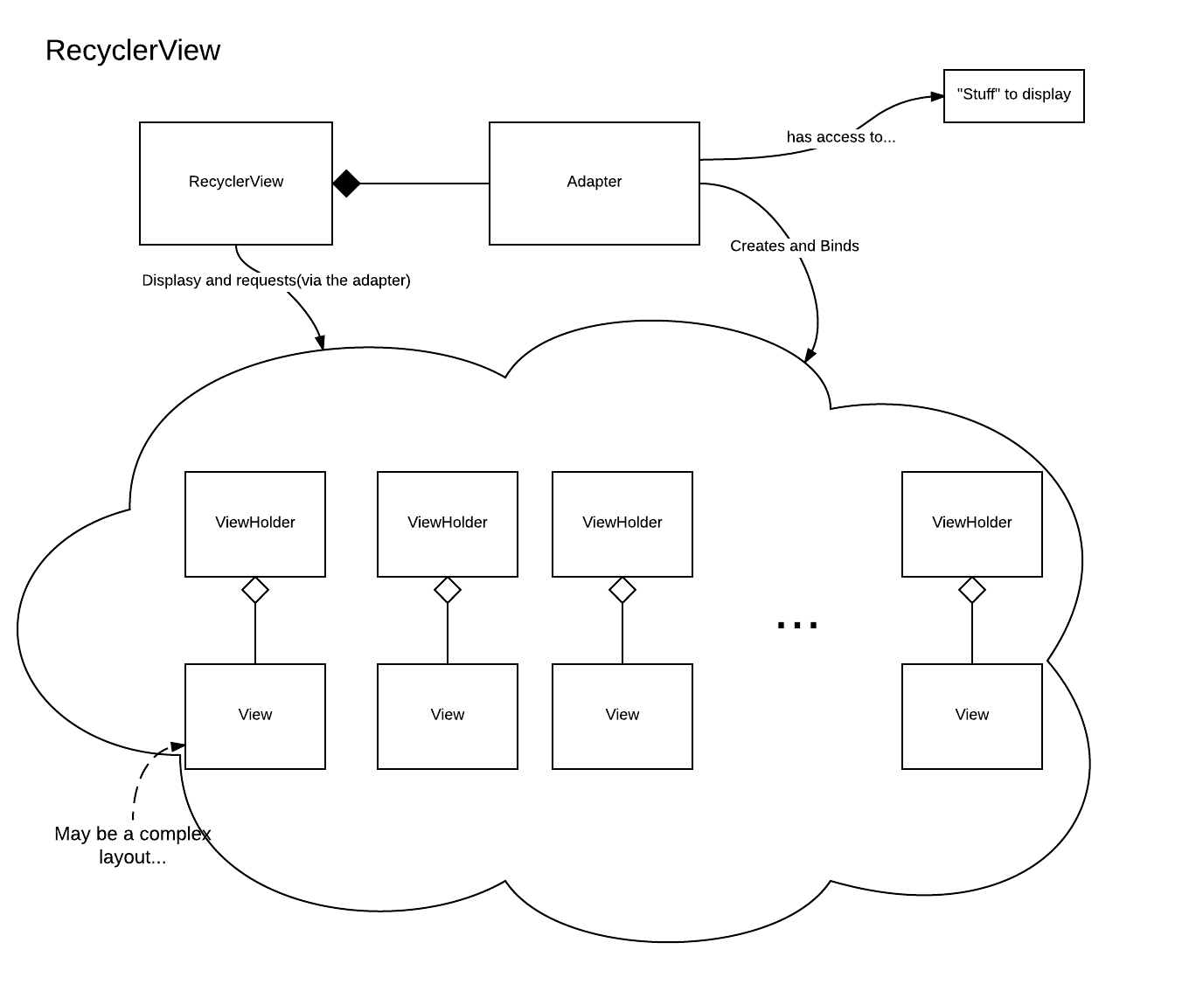

Slide 5
Adding a RecyclerView

Slide 6
<?xml version="1.0" encoding="utf-8"?> <android.support.v7.widget.RecyclerView xmlns:android="http://schemas.android.com/apk/res/android" android:id="@+id/crime_recycler_view" android:layout_width="match_parent" android:layout_height="match_parent"> </android.support.v7.widget.RecyclerView>
Notes:
First we will define our recyclerview in an xml layout file (this is fragment_crime_list.xml file from the crime fragment example project)

Slide 7
@Override public View onCreateView(LayoutInflater inflater, ViewGroup container, Bundle savedInstanceState) { View view = inflater.inflate(R.layout.fragment_crime_list, container, false); mCrimeRecyclerView = (RecyclerView) view.findViewById(R.id.crime_recycler_view); mCrimeRecyclerView.setLayoutManager(new LinearLayoutManager(getActivity())); .
.
. return view; }
Notes:
Next we inflate that layout within the onCreateView method of the fragment that will host it. Here we have also set the layout manager to be an instance of the LinearLayoutManager which will give us a nice linear list of views on the screen…

Slide 8
Implementing the Adapter and ViewHolder

Slide 9
private class CrimeAdapter extends RecyclerView.Adapter<CrimeHolder> { private List<Crime> mCrimes; public CrimeAdapter(List<Crime> crimes) { mCrimes = crimes; } @Override public CrimeHolder onCreateViewHolder(ViewGroup parent, int viewType) { LayoutInflater layoutInflater = LayoutInflater.from(getActivity()); View view = layoutInflater.inflate(R.layout.list_item_crime, parent, false); return new CrimeHolder(view); } @Override public void onBindViewHolder(CrimeHolder holder, int position) { Crime crime = mCrimes.get(position); holder.bindCrime(crime); } @Override public int getItemCount() { return mCrimes.size(); } }
Notes:
Finally the recyclerView requires us to extend the RecyclerView.Adapter class. Extending this generic class requires that we specify the type of ViewHolder that we are working with…
*mention the list of crimes – this adapters method of accessing the data that must be bound to the ViewHolders at runtime
*discuss the three methods overridden here…

Slide 10
<?xml version="1.0" encoding="utf-8"?> <RelativeLayout xmlns:android="http://schemas.android.com/apk/res/android" android:layout_width="match_parent" android:layout_height="wrap_content" xmlns:tools="http://schemas.android.com/tools"> <CheckBox android:id="@+id/list_item_crime_solved_check_box" android:layout_width="wrap_content" android:layout_height="wrap_content" android:layout_alignParentRight="true" android:padding="4dp" android:textSize="40dp"> </CheckBox> <TextView android:id="@+id/list_item_crime_title_text_view" android:layout_width="match_parent" android:layout_height="wrap_content" android:layout_toLeftOf="@id/list_item_crime_solved_check_box" android:textStyle="bold" android:padding="4dp" tools:text="Crime Title" android:textSize="40dp"> </TextView> <TextView android:id="@+id/list_item_crime_date_text_view" android:layout_width="match_parent" android:layout_height="wrap_content" android:layout_toLeftOf="@id/list_item_crime_solved_check_box" android:layout_below="@id/list_item_crime_title_text_view" android:textStyle="bold" android:padding="4dp" tools:text="Crime Date" android:textSize="40dp"> </TextView> </RelativeLayout>
Notes:
This is the list_item_crime view layout… (i.e. the layout our viewHolders will work with)

Slide 11
private class CrimeHolder extends RecyclerView.ViewHolder implements View.OnClickListener { private Crime mCrime; private TextView mTitleTextView; private TextView mDateTextView; private CheckBox mSolvedCheckBox; public CrimeHolder(View itemView) { super(itemView); mTitleTextView = (TextView)itemView.findViewById(R.id.list_item_crime_title_text_view); mDateTextView = (TextView)itemView.findViewById(R.id.list_item_crime_date_text_view); mSolvedCheckBox = (CheckBox)itemView.findViewById(R.id.list_item_crime_solved_check_box); itemView.setOnClickListener(this); } public void bindCrime(Crime crime) { mCrime = crime; mTitleTextView.setText(mCrime.getTitle()); mDateTextView.setText(mCrime.getDate().toString()); mSolvedCheckBox.setChecked(mCrime.isSolved()); } @Override public void onClick(View v) { Intent intent = CrimePagerActivity.newIntent(getActivity(),mCrime.getId()); startActivityForResult(intent, REQUEST_CRIME); } }
Notes:
As noted earlier, our recyclerview needs ViewHolders to display, and it is our responsibility to define these viewholders…
In this example, our ViewHolder class (named CrimeHolder) also implements View.OnClickListener – so it must override the onClick() method, allowing our ViewHolder subclass to respond to click events…

Slide 12
Expandable Recyclerview
https://www.bignerdranch.com/blog/expand-a-recyclerview-in-four-steps/
Notes:
This is a fantastic demo – it would be tough to do a better job. Please walk yourself through this demo, it is an extension of the CriminalIntent application. Enjoy!

Slide 13
Toolbars
Implemented in Android 5.0 and above, but the AppCompat library enables us to support toolbars back as far as Android 2.1
AppCompatActivity extends FragmentActivity…
Notes:
*Made pretty easy for us*
… so we can use this class pretty broadly, including in places where we need to manage fragments.

Slide 14
Enabling the Toolbar
1) Add the AppCompat library as a dependency to your app… (check)
2) Utilize an application theme that displays the action bar
Theme.AppCompat.Light.DarkActionBar
3) Make all activities a subclass of AppCompatActivity

Slide 15
<application android:allowBackup="true" android:icon="@mipmap/ic_launcher" android:label="@string/app_name" android:supportsRtl="true" android:theme="@style/AppTheme"> <activity android:name=".CrimeListActivity"> <intent-filter> <action android:name="android.intent.action.MAIN"/> <category android:name="android.intent.category.LAUNCHER"/> </intent-filter> </activity> <activity android:name=".CrimePagerActivity" android:label="@string/app_name" android:theme="@style/AppTheme.NoActionBar" android:parentActivityName=".CrimeListActivity"> </activity>
<?xml version="1.0" encoding="utf-8"?> <resources> <style name="AppTheme" parent="Theme.AppCompat.Light.DarkActionBar"></style> <style name="AppTheme.NoActionBar" parent="Theme.AppCompat.Light.DarkActionBar"></style> </resources>
Notes:
From AndroidManifest.xml and styles.xml (within the values folder)

Slide 16
Define the menu…
Right-click on res, select New->Android resource file. Change type to ‘Menu’, give it a name…
Edit the xml file to populate the menu…
Notes:
… this will generate an xml file containing an empty menu

Slide 17
fragment_crime_list.xml
<?xml version="1.0" encoding="utf-8"?> <menu xmlns:android="http://schemas.android.com/apk/res/android" xmlns:app="http://schemas.android.com/apk/res-auto"> <item android:id="@+id/menu_item_new_crime" android:icon="@drawable/ic_menu_add" android:title="@string/new_crime" app:showAsAction="ifRoom|withText"/> <item android:id="@+id/menu_item_show_subtitle" android:title="@string/show_subtitle" app:showAsAction="ifRoom"/> </menu>
Notes:
See chapter 13 for more detail concerning drawable assets…

Slide 18
Create the menu in the app
@Override public void onCreate(Bundle savedInstanceState) { super.onCreate(savedInstanceState); setHasOptionsMenu(true); }
@Override public void onCreateOptionsMenu(Menu menu, MenuInflater inflater) { super.onCreateOptionsMenu(menu, inflater); inflater.inflate(R.menu.fragment_crime_list, menu); .
.
.
}
Notes:
First we need to let the fragment manager know that our fragment has an options menu and needs to respond to the onCreatOptionsMenu() method (when called on the activity) – i.e. we are propagating this method call…
Within onCreateOptionsMenu we inflate the menu and perform any other setup logic that is required

Slide 19
@Override public boolean onOptionsItemSelected(MenuItem item) { switch(item.getItemId()) { case R.id.menu_item_new_crime: Crime crime = new Crime(); CrimeLab.get(getActivity()).addCrime(crime); Intent intent = CrimePagerActivity.newIntent(getActivity(), crime.getId()); startActivity(intent); return true; case R.id.menu_item_show_subtitle: mSubtitleVisible = !mSubtitleVisible; getActivity().invalidateOptionsMenu();//trigger a redraw of the menu... updateSubtitle(); return true; default: return super.onOptionsItemSelected(item); } }
Notes:
Responding to touch events in the menu is made easy by simply overriding the onOptionsItemSelected() method. Within this method we can determine which item was selected and respond accordingly. In this case we are retrieving the item’s resource ID number and using this value to drive a switch statement. In the case of the ‘new item’ option being selected we are creating a new crime object and then starting the CrimePagerActivity (An advancement of the simple CrimeActivity) to populate the details of the crime entry.

Slide 20
A note on “hierarchical navigation”
Easy to enable, simply add a parentActivityName attribute in the AndroidManifest.xml file
Allows us to “jump” to a particular activity within the application – overriding the behavior of the activity stack
Adjusts the stack as appropriate: if the desired activity exists on the stack then all activities up to and including that activity will be popped of the stack and A NEW INSTANCE of the activity will be created…
<activity android:name=".CrimePagerActivity" android:label="@string/app_name" android:theme="@style/AppTheme.NoActionBar" android:parentActivityName=".CrimeListActivity"> </activity>

Slide 21
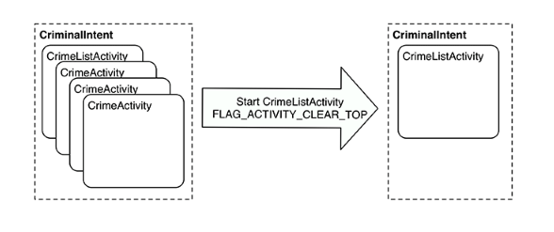
Hierarchical Navigation
Figure 13.13 from:
Phillips, Bill; Stewart, Chris. Android Programming:
The Big Nerd Ranch Guide (2nd Edition) (p. 249). Pearson Education. Kindle Edition.

