Slide 1
CS240: Advanced Programming Concepts
Week 14
Thursday

Slide 2
Advanced Widgets
Using Map Services
Dialogs
Recycler Views
RecyclerView.Adapter
Expandable Recycler Views (Screencast)
[ https://students.cs.byu.edu/~cs240ta/fall2016/rodham_files/21-advanced-widgets/AndroidAdvancedWidgets.pdf ]
Toolbars (Screencast)

Slide 3
Amazon Maps (ugh…)
See help sheet
Tip: When registering your app… do NOT do what seems intuitive (just find the maps tab)

Slide 4
Google Maps (:-)
Google itself has a great tutorial here.
We recommend that you create a new project to follow the tutorial then apply it to your own code.
To create the Google maps activity we recommend you use New-> Activity-> Gallery-> Google Maps Activity. This will update the Android manifest and generate an XML for you.
Follow the instructions in the generated XML and android manifest as to how to add the app to the registry.
If you are on campus we find it works best if you are connected to the CS dept. WiFi.

Slide 5
CriminalIntent Demo
RecyclerViews
Dialogs

Slide 6
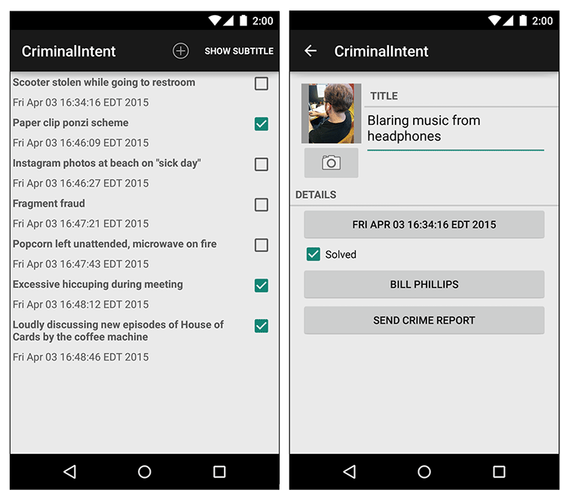
CriminalIntent

Slide 7
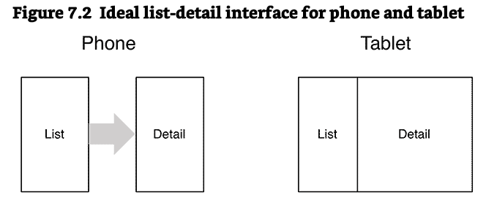
Fragments…(more of them)

Slide 8
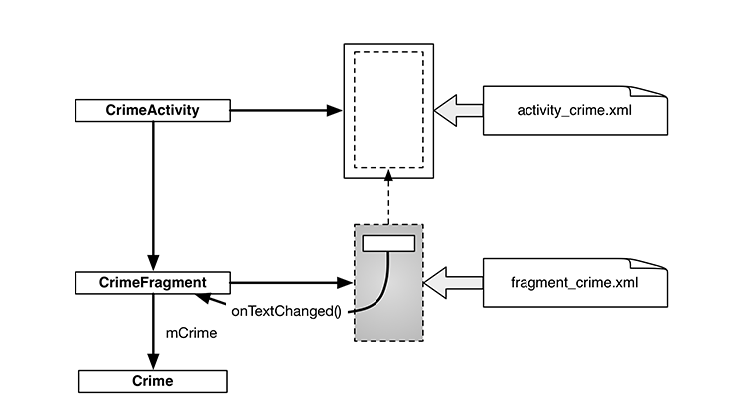

Slide 9
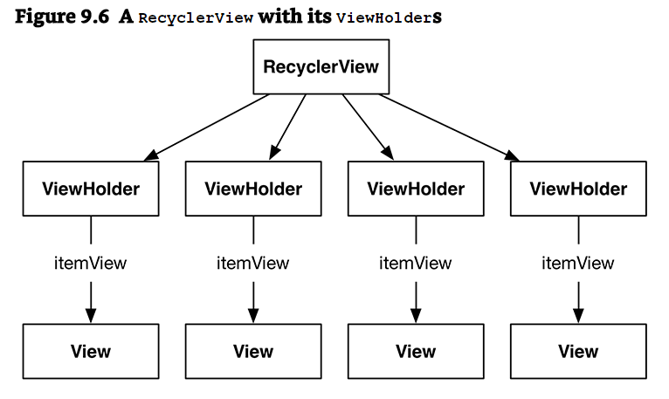
RecyclerView

Slide 10
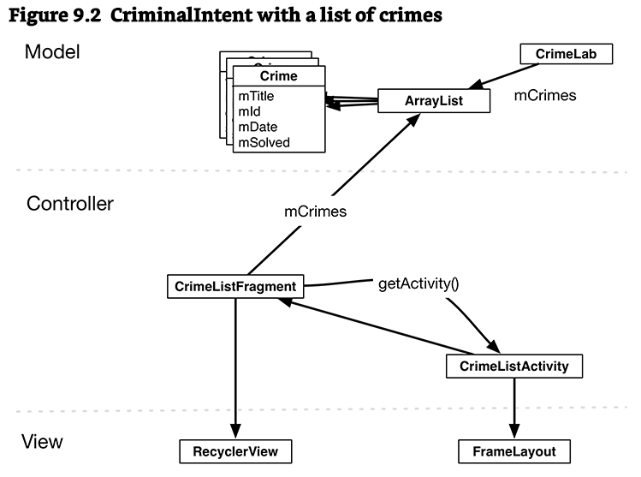
RecyclerView

