Slide 1
CS240: Advanced Programming Concepts
Screencast #1

Slide 2
Internet Basics 101 001
Notes:
This lecture is NOT intended to cover all things related to the internet, or even mention them for that matter. This lecture is meant to provide additional context for some of the tasks that you will be required to perform while completing the family map project…

Slide 3
Useful Term: Protocol
“A procedure for how an activity should be performed”
“Rules determining the format and transmission of data”
[WordWeb]
Notes:
You are going to see the letter ‘P’ a lot in this lecture. In general it means Protocol, and we are going to mention/discuss several… thus you should know what a protocol is…

Slide 4
The Internet
Billions of devices…
Constructed from thousands of technologies….
Spread across thousands of miles…
And located within diverse continents, countries, languages, etc….
COMMUNICATING WITH ONE ANOTHER
Notes:
The internet is AMAZING… how does this work? How is this even possible….

Slide 5
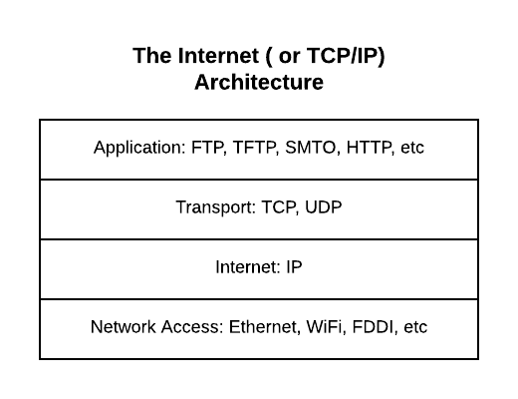
The Secret: Standards
Notes:
Here we see decomposition in action… By standardizing the protocols at the various layers of the Internet Architecture and endless array of new technologies and software products can interoperate with the millions of already existing devices and applications
For example, a new faster Network Access technology could be seamlessly incorporated and utilized transparently. Of course, new applications/programs can be and are added all the time…
– the possibilities are effectively infinite
FTP – File transfer protocol
TCP – Transmission control protocol
FDDI - Fiber Distributed Data Interface

Slide 6
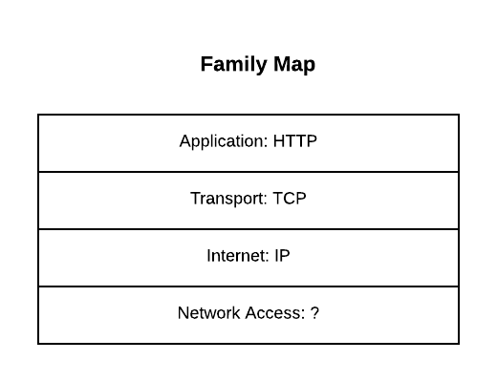
For our purposes…
Notes:
We will focus on only one possible use case of the Internet architecture (take a networking class for more info…)
For our purposes we need not concern ourselves with the underlying Network Access technology or technologies that we will leverage – since we don’t need to, we won’t

Slide 7
Hyper Text Transport Protocol (HTTP)
Network protocol that drives the Web
Built on top of Transmission Control Protocol (TCP)
HTTP has a Request/Response structure
Client (e.g., web browser) sends a “request” message to the server
Server sends back a “response” message to the client
Notes:
In class last week we started at the bottom and worked our way up through the TCP/IP stack, today we will go the other direction – starting first at the point at which our application wishes to initiate the transfer of information with a process running on another machine…
The basic unit of HTTP communication that we will work with is a message, of which there are two types (request/respond)

Slide 8
HTTP Request message format
<method> <request-URL> <version>\r\n
<headers>\r\n
\r\n
<entity-body>
<method> is the operation to perform on URL
<request-URL> can be full URL or just the path part
<version> is of the form HTTP/<major>.<minor>
<entity-body> is a stream of bytes (could be empty)
GET /test/hi-there.txt HTTP/1.1
Accept: text/*
Host: www.joes-hardware.com

Slide 9
HTTP Response message format
<version> <status> <reason-phrase>\r\n
<headers>\r\n
\r\n
<entity-body>
<version> is of the form HTTP/<major>.<minor>
<status> is a 3-digit number indicating status of request
<reason-phrase> human-readable description of status code
<entity-body> is a stream of bytes (could be empty)
HTTP/1.0 200 OK
Content-type: text/plain
Content-length: 18
Hi! I’m a message!

Slide 10
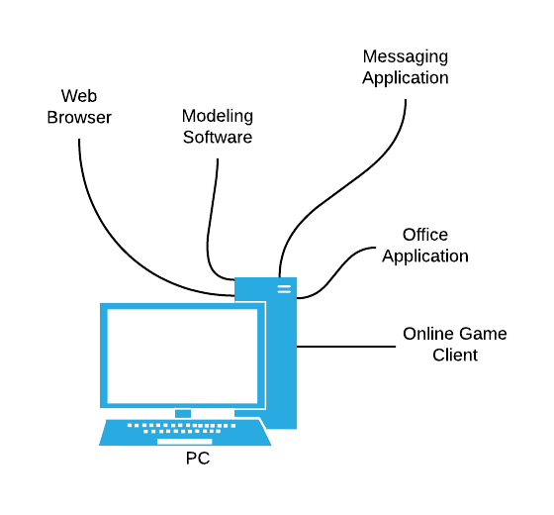
Transmission Control Protocol (TCP)
TCP allows programs running on different computers to connect and reliably communicate directly with each other over a shared network
Communication is accomplished via information segments
TCP Utilizes port numbers to disambiguate between the possibly (probably) numerous applications running on the source and destination machines
i.e. By default, Web servers run on TCP Port 80
Notes:
Our application will only be one of dozens that are running on a user’s computer at runtime. Thus we see that it is not enough to simply get messages from one COMPUTER to another, the operating system of each machine must somehow manage to forward messages to the proper APPLICATION.
As mentioned previously, HTTP is built atop the TCP protocol. Before making their way across the internet, HTTP messages must be processed and managed in accordance with this protocol.
TCP does some cool things… beyond simply disambiguating which application a message is from or intended for…

Slide 11
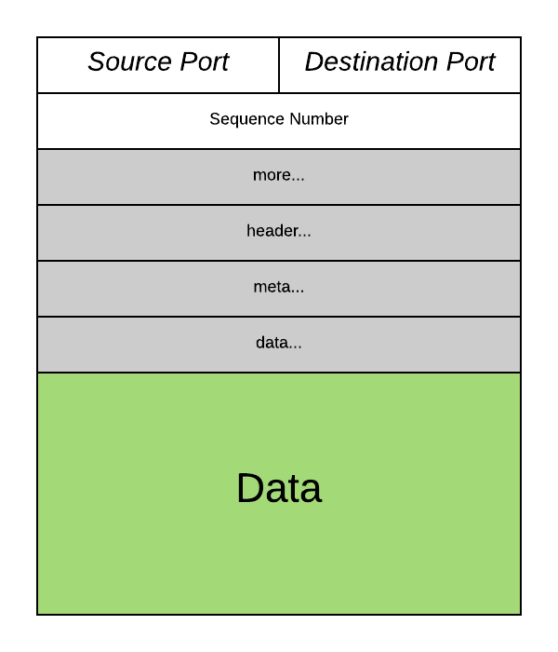
Simplified anatomy of a TCP segment
Notes:
Each row in this diagram is meant to represent 32 bits of information. Notice then that TCP ports are limited to 16 bits, which gives us 65K of available port numbers

Slide 12
TCP Port Number Conventions
TCP Port Numbers are in the range 0 – 65535
Ports 0 – 1023 are reserved for system services (email, web, etc.)
Ports 1024 – 49151 are registered to particular applications
Ports 49152 – 65535 can be used for custom or temporary purposes
Email servers typically run on Port 25
Web servers typically run on Port 80

Slide 13
Internet Protocol (IP)
IP Routers deliver/route packets of data between computers using 32 bit identifiers known as IP addresses
128.187.80.20
72.30.38.140
TCP requires that each computer have a unique address*
Notes:
Ok, so thus far we’ve discussed a simple protocol for encoding messages between client/server applications (HTTP), and a protocol that will enable an OS to reliably deliver those messages (as segments) to the appropriate applications on both ends of the conversation. Still missing is a method of actually getting these segments across the potentially vast expanse of the Internet.
Enter the Internet Protocol, or IP. IP does for computers what TCP ports do for applications
More on that unique IP address issue later…

Slide 14
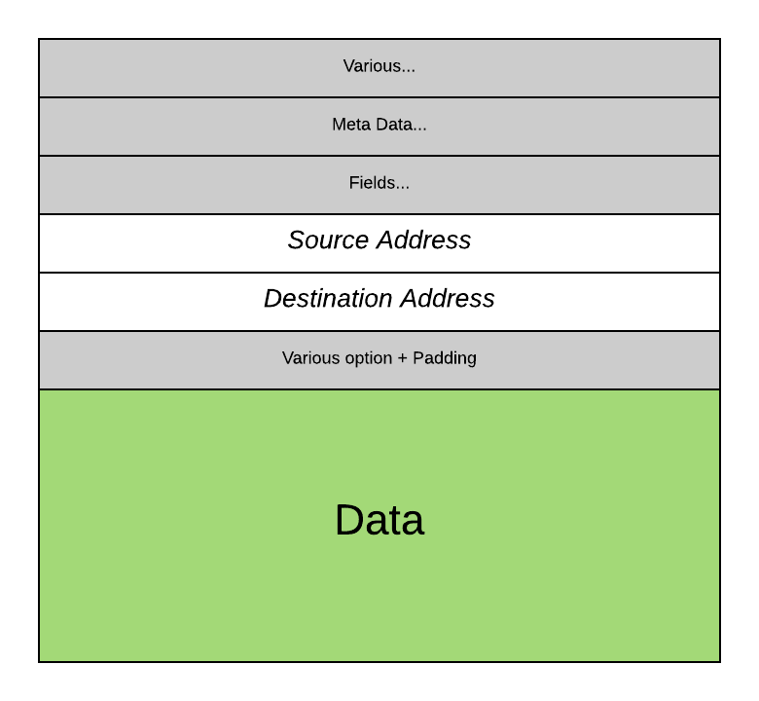
Simplified anatomy of an IP packet

Slide 15
Ultimately…
The combination of (IP Address, TCP Port Number) uniquely identifies a particular program on a particular computer
(128.187.80.20, 25) => Email server on machine 128.187.80.20
(72.30.38.140, 80) => Web server on machine 72.30.38.140
Through TCP, a program on one computer can connect to a program running on another computer by specifying its (IP Address, TCP Port Number)
Such a TCP connection is called a “Socket”
Once a connection has been established, the two programs can pass data back and forth to each other (i.e., communicate)

Slide 16
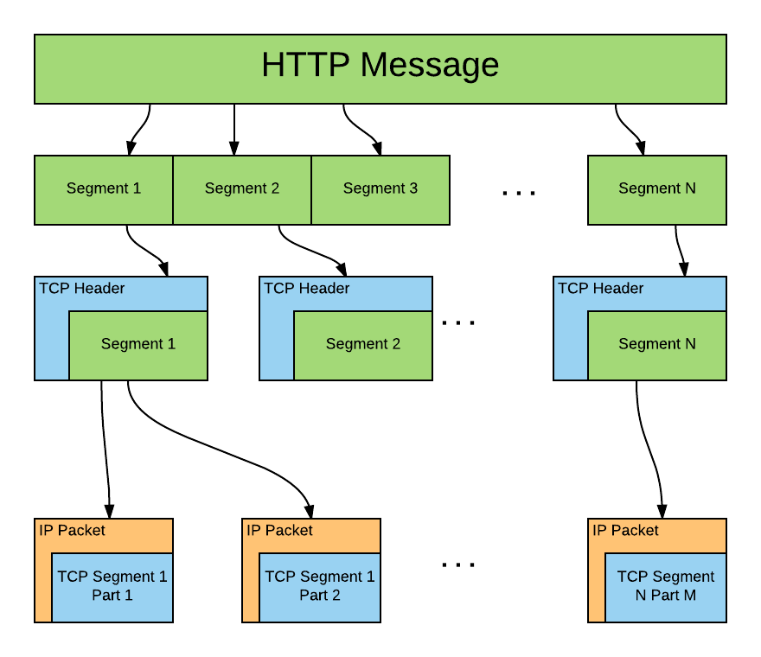
From here to there…
Notes:
So here is a visual approximation of how all of this goes down. Initially, our HTTP message must be broken into 1 or more pieces for transmission. These pieces are “wrapped” if you will, in TCP segments for transmission. This involves, among other things, attaching a TCP header to each segment, as well as the generation and processing of numerous handshaking and acknowledgment segments (not shown here) that ensure our message is transmitted and acknowledged properly. Depending on how reliable our network is, some segments may need to be retransmitted one or more times before the transmission is complete…
As mentioned earlier, TCP segments do not travel independently across then internet, they must first be broken into 1 or more IP packet sized chunks, wrapped up inside of an IP packet with its associated header, and then sent down the line. The IP address inserted into the IP Packet header, in tandem with the port number embedded in the TCP header are enough to ensure that our decomposed message reaches its destination computer and process… On the other end of all of this the receiving computer must reassemble the TCP segments from the associated IP packets, and from there the resulting TCP segments can be reassembled into the original message.

Slide 17
A couple of issues…
Domain Names
Network Address Translation (NAT)

Slide 18
Domain Names
IP Addresses are hard to remember and work with directly
Users prefer to reference machines by Name rather than by IP Address
pinky.cs.byu.edu instead of 128.187.80.20
www.yahoo.com instead of 72.30.38.140
DNS (Domain Name System) is a protocol for looking up a machine’s IP Address based on its (Domain) Name
Connect to (www.yahoo.com, 80)
DNS, what is the IP Address for “www.yahoo.com”?
72.30.38.140
OK, Connect to (72.30.38.140, 80)
Notes:
IP addresses are not human readable or memorable.
DNS servers make this possible, they maintain tables that map domain names to IP addresses
Our browsers kindly communicate with a DNS server to get the proper IP address and then proceed with our request…
Browsers can cache IP addresses in order to save time and reduce the load on the DNS server
Periodically the browser can/will check with the DNS server to get a refreshed and possibly updated IP for a given domain name

Slide 19
Network Address Translation (NAT)
IP Addresses are currently 32 bit values
~= 4 Billion addresses
~= 3.5 Billion internet users (10/22/16)
[http://www.internetlivestats.com/internet-users/ ]
Multiple devices per user….

Slide 20
NAT
Allows multiple devices to share a single unique public IP address by assigning locally unique private IP addresses
Requires the private machines to be located behind a gateway of some kind (i.e. a router) that performs NAT on incoming and outgoing traffic

Slide 21
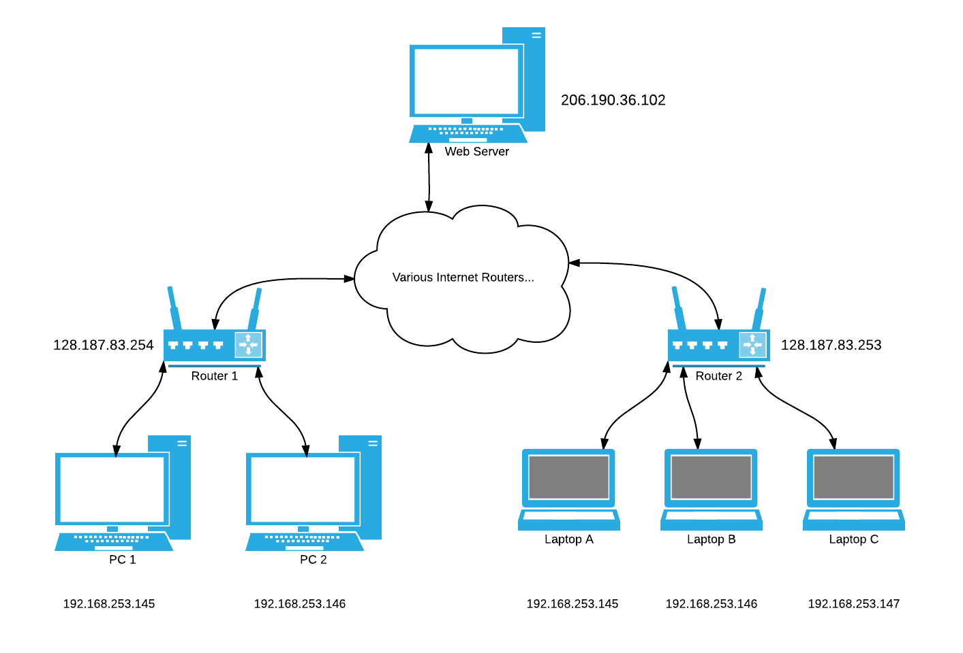
Example NAT scenario
Notes:
Each of the routers in this scenario has been assigned a unique PUBLIC IP address by an internet service provider. These routers in turn have assigned PRIVATE IP addresses to the computers “behind” them in a private network. Note that each machine has an IP that is unique within the private network, but not necessarily private in the world at large. For instance Laptop A has the same private IP address as PC 1 – and PC2 and Laptop B also have identical private IP addresses.
PC 1 and PC2 can safely communicate with each other via their private IP addresses – and Router 1 is able to detect and facilitate their attempts to do so: HOWEVER if for instance PC1 wished to communicate with the web server at the top of the image then PC1’s private IP address would cause problems – how is the web server, or the rest of the internet for that matter, to know if the traffic is coming from PC1, Laptop A – or perhaps thousands of other computers that are using that same private IP address?
NAT is the solution. Instead of simply routing PC1’s TCP/IP packets out onto the Internet in search of the desired Web Server, Router 1 will first modify the IP address and Port number recorded in the IP and TCP headers of those packets, inserting it’s own IP address, and a new port number that it can use to recognize responses from the web server that are intended for PC1. When those packets arrive, the router will modify the incoming packets – inserting PC1’s private IP address, as well as the appropriate port number. (Of course this means the router must maintain tables of this information)
Obviously there is a lot more to all of this than I have covered here… but hopefully what I have presented helps to answer some of your more pressing questions.

Slide 22
Final thoughts
All of this internet stuff takes time…
Android isn’t very patient…
Apps that are waiting for internet tasks can become “unresponsive”
You are not allowed to create internet connections in your “main thread”
Next time: Creating Asynchronous tasks to handle background tasks…

