Slide 1
CS240: Advanced Programming Concepts
Screencast #2

Slide 2
Multi-Threaded Execution and AsyncTask
An Introduction

Slide 3
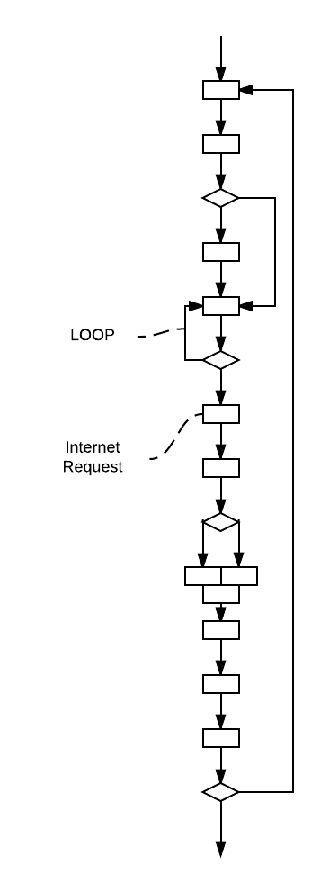
What is a computer program?
A collection of instructions and data
A set of related tasks that we desire the computer to perform for us

Slide 4
Concurrent vs. Parallel Processing
Concurrent or “Overlapped” execution
Multiple processes are accomplishing work over a period of time, though not necessarily executing at the same moment (i.e. interleaved execution)
Parallel execution
Multiple processes are in execution at the same moment

Slide 5
CPUs can take advantage of instruction level parallelism at runtime…
1: A = 6 + B;
2: C = A / 2;
3: D = C * 5;
4: E = A * B;
5: F = B / 2;
Pipelining
Superscalar (i.e. multi-issue pipeline)
Out of order execution
Etc.

Slide 6
CPU’s have more difficulty taking advantage of “task” level parallelism – Enter Multiprocessing …
Multiprocessing (OS enabled)
Multiple processes take turns utilizing the CPU (A program will be comprised of one or more processes)
Processes that ask to do something that takes a while (such as retrieve data from a large-but-slow storage device) are blocked until the requested data etc. is ready – they surrender some or all of their turn while their request is being processed, allowing a process that is ready to make use of the time…
Multi-core + multiprocessing: Same idea spread across multiple cores…
Notes:
A process that is capable of doing more than one of its tasks at a time does not benefit from multi-processing alone

Slide 7
Multiprocessing cont.
Limitations:
Human partitioning is needed…
Processes are “heavy”
Swapping them in and out requires a complete context switch
Inter-process communication is expensive compared to intra-process communication
Diminishing returns…
Missed opportunities - Programs/processes may be capable of doing other portions of their work while waiting on a request that causes them to be blocked/stalled

Slide 8
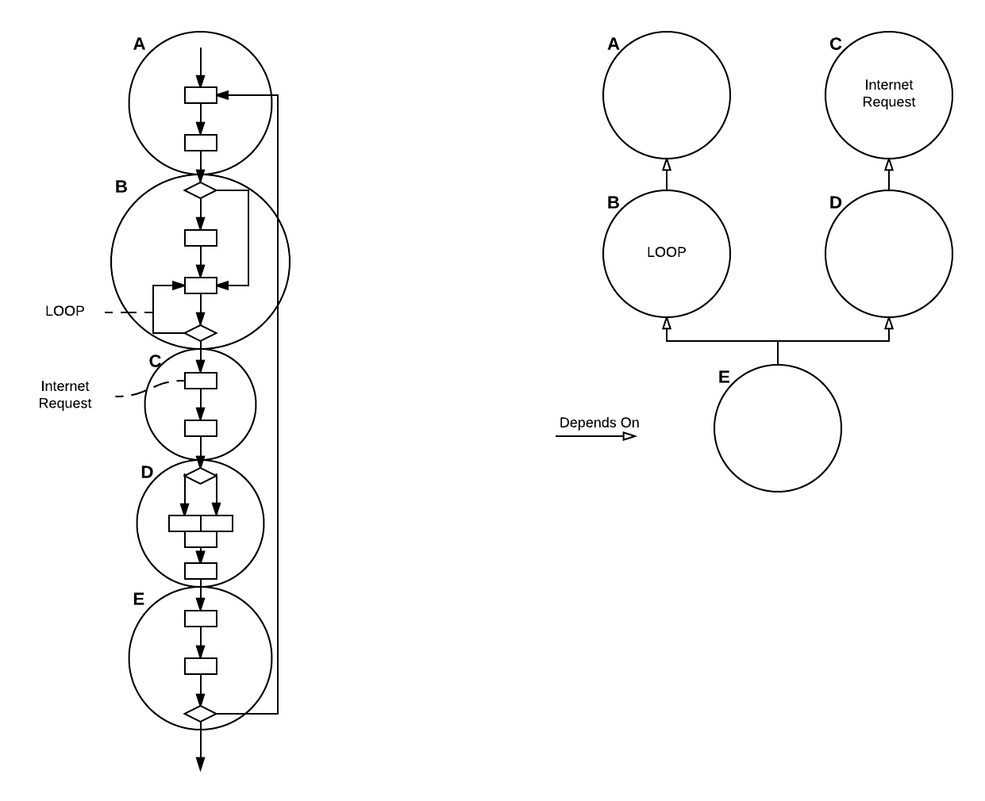
For example…
Notes:
CPU’s cannot identify tasks, nor effectively determine when, where, or how synchronization can or should be performed at the task level

Slide 9
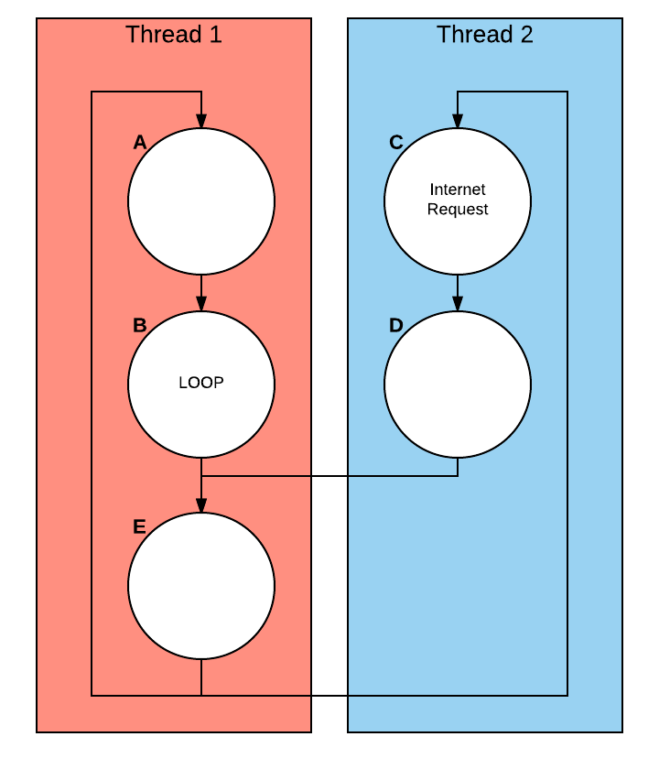
Threads: A way of splitting a process into “mini-processes”
On single core CPU
If one thread “blocks” other threads may utilize its CPU time
Shared memory (communication is efficient)
No need for a full context switch
On multiple cores
Multiple threads may be executing in parallel on multiple cores
Notes:
*We are ignoring a lot of details here, such as the mechanism for passing information between threads 1 and 2, and how this information is synchronized etc. but our purpose at the moment is simply to understand the main idea…

Slide 10
Android Apps
Always have at least one thread (duh) – the UI thread
Responds to asynchronous events:
Touch…
System events…
Etc.
Android doesn’t like to be ignored by this thread…:
“App isn’t responding. Do you want to close it?”
Accessing the internet is slow….
Android doesn’t allow us to access the internet from the UI thread….

Slide 11
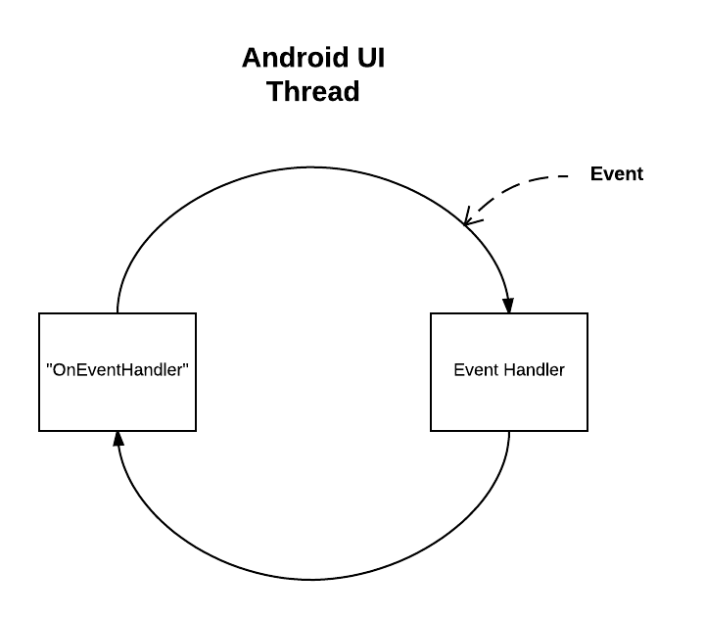

Slide 12
Using the AsyncTask Class to run background tasks in Android
Intended for short, single execution tasks. Use other approaches if you need long running threads in the background.
Perfect for our purposes in Family Map
Login to the server…
Retrieve appropriate data…
Extend this class to execute a task on a separate thread in the background
onPreExecute()
doInBackground()
onProgressUpdate()
onPostExecute()
https://developer.android.com/reference/android/os/AsyncTask.html

Slide 13
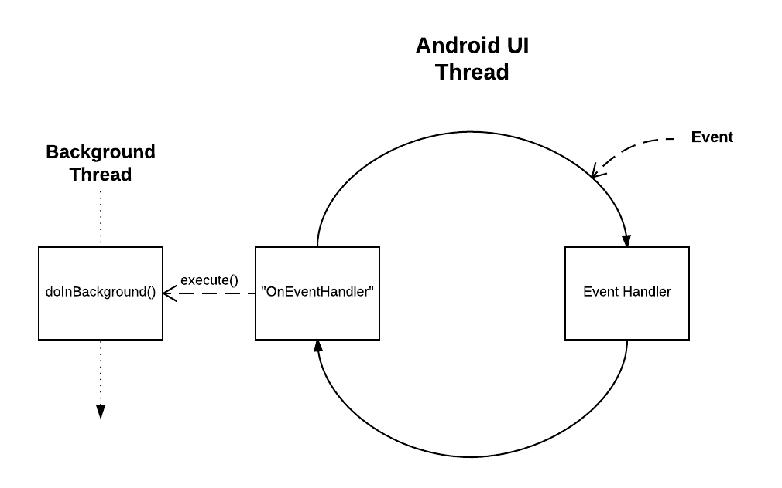

Slide 14
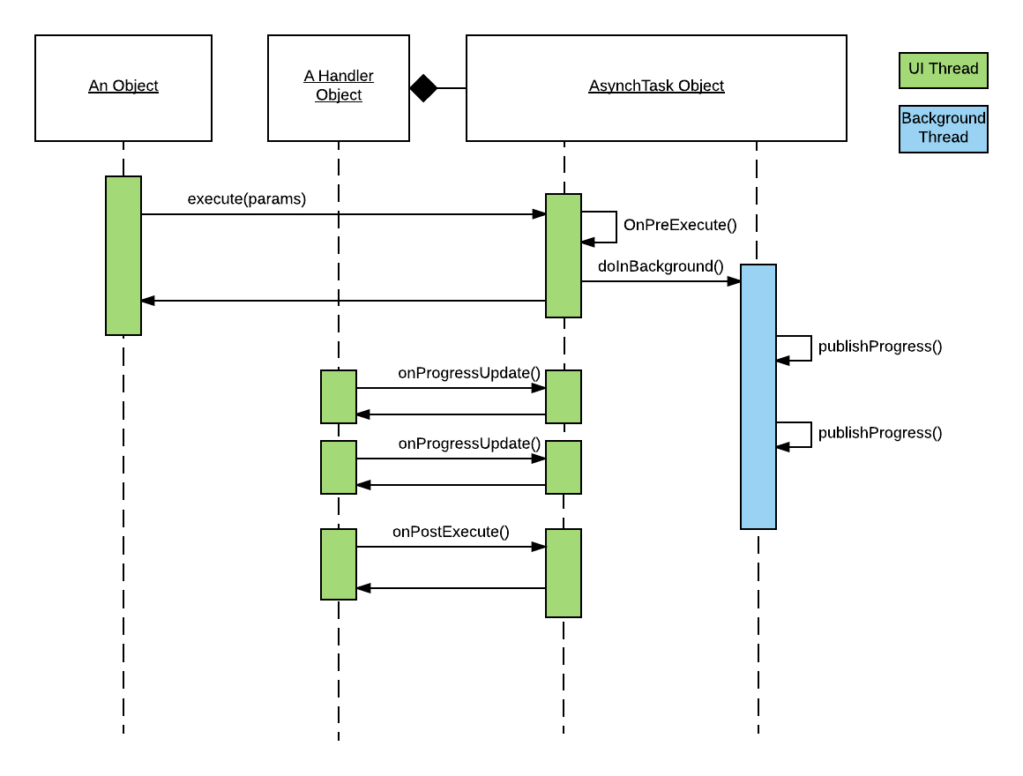
A closer look…

Slide 15
Rules To Observe…
“Threading rules
There are a few threading rules that must be followed for this class to work properly:
The AsyncTask class must be loaded on the UI thread. This is done automatically as of JELLY_BEAN.
The task instance must be created on the UI thread.
execute(Params...) must be invoked on the UI thread.
Do not call onPreExecute(), onPostExecute(Result), doInBackground(Params...), onProgressUpdate(Progress...) manually.
The task can be executed only once (an exception will be thrown if a second execution is attempted.)”
[ https://developer.android.com/reference/android/os/AsyncTask.html ]

