Slide 1
CS240: Advanced Programming Concepts
Java Language Basics

Slide 2
Java: A VERY Brief Introduction

Slide 3
Why Java?
C++
Cross Platform: Write “once” compile many, run anywhere…
Supports Object Oriented Programing: Supports classes etc.
Familiar Syntax: Based upon C
Fast (very)
Java
Cross Platform: Write “once” compile “once”, run anywhere…
Truly Object Oriented Language: Everything is a class
Familiar Syntax: Closely resembles C++
Fast (enough very)

Slide 4
Yet Another Java Resource…
http://docs.oracle.com/javase/tutorial/java/TOC.html

Slide 5
C++ (Compiled Language) Model

Slide 6
Interpreted Language Model
What does this mean for performance?....

Slide 7
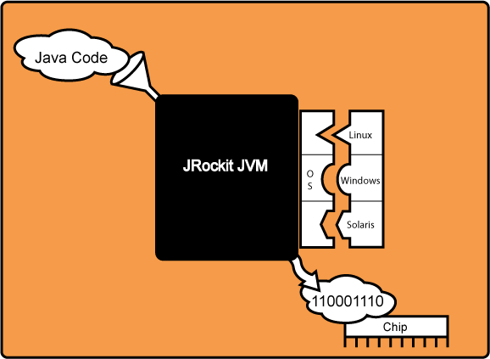
Bring on the JIT (Just In Time) Compiler (Note: This example is based on Oracle’s Jrockit JVM)
http://docs.oracle.com/cd/E13150_01/jrockit_jvm/jrockit/geninfo/diagnos/underst_jit.html

Slide 8
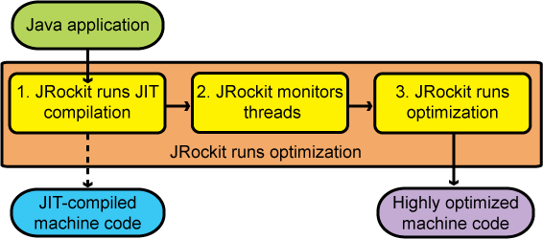
But Wait, There’s More…
Runtime Optimization
Function Inlining
Selective Compilation
Data Optimizations
Etc…
http://docs.oracle.com/cd/E13150_01/jrockit_jvm/jrockit/geninfo/diagnos/underst_jit.html

Slide 9
Results…

Slide 10
Result 2 (a bit easier)…

Slide 11
Take Away:
Java programs are not necessarily “slower” than precompiled programs
JIT compilation
Potential for dynamic runtime optimization
Interpreted / JIT’d languages offer certain advantages during development and maintenance such as reduced/eliminated compilation times for testing etc.
Interpreted languages are highly portable
Use of an interpreter/JIT compiler like the JVM means additional resource requirements at runtime vs a precompiled model

Slide 12
C++ File Organization
X.h
Y.h
Z.h
g++
X.cpp
Y.cpp
Z.cpp
Exactly one
main function
linker
X.o
Y.o
Z.o
EXE

Slide 13
Java File Organization
javac
X.java
Y.java
Z.java
At least one
main method
bin
X.class
Y.class
Z.class
java –cp bin/ X arg1 arg2 …
“java” = the Java
virtual machine
(runs your program)
“cp” = class path
(directory containing
the .class files)
“X” = name of
the class with
main method
“argN” = command
line arguments passed
to main method

Slide 14
Java Basics Continued
The main method(s)
Command line arguments
Arrays as objects
Primitive types
!!References!!
Garbage collection
Classes and objects, classes as objects
Variables
Methods
Packages, import vs. #include

Slide 15
Tips and Tricks
Use the provided BufferReader, don’t use a stream…
You might consider looking up/using the “split” method… (String class)
Don’t use String concatenation… use a StringBuilder object… (better performance)
Your ppm string needs to be terminated with a newline… (or it won’t work)

