Slide 1
Family Map

Slide 2
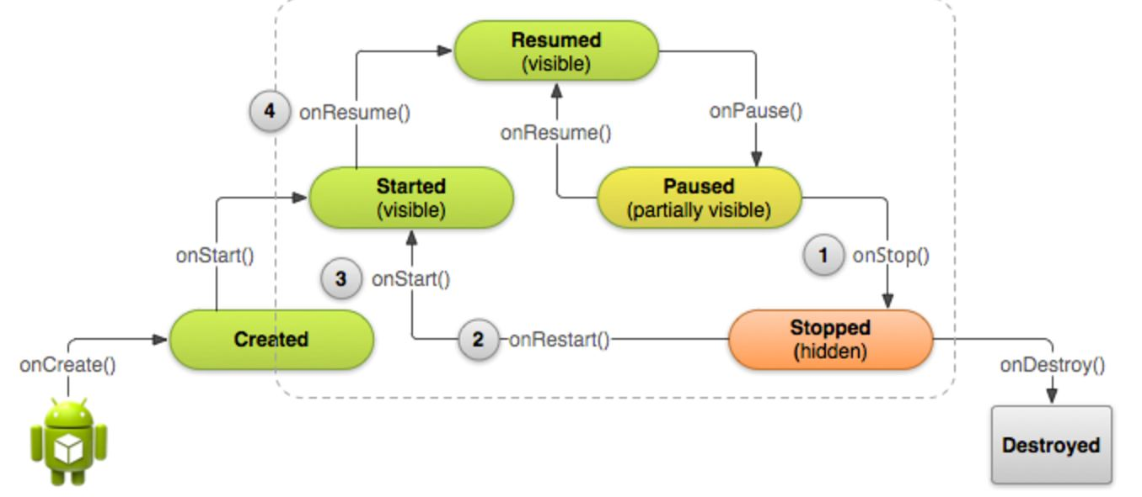
Activity Life Cycle

Slide 3
Starting A New Activity
Intent intent = new Intent(this, DisplayMessageActivity.class); EditText editText = (EditText) findViewById(R.id.edit_message); String message = editText.getText().toString(); intent.putExtra(EXTRA_MESSAGE, message); startActivity(intent);

Slide 4
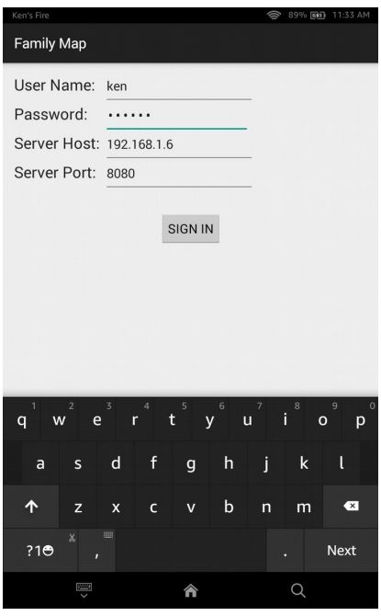
Login Activity
Login Fragment
Map Fragment

Slide 5
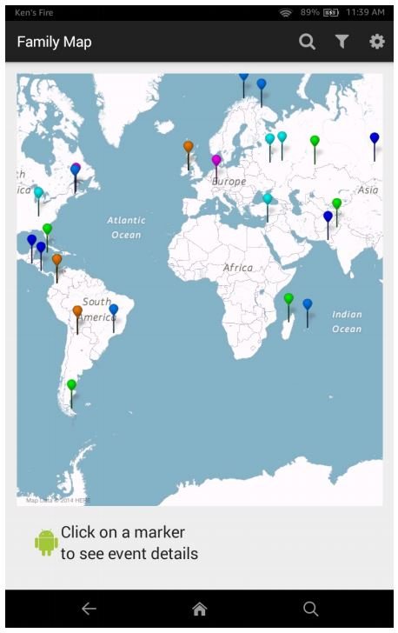
Map Activity
Map Fragment

Slide 6
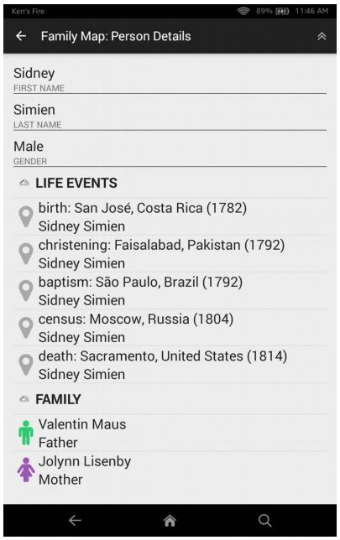
Person Activity

Slide 7
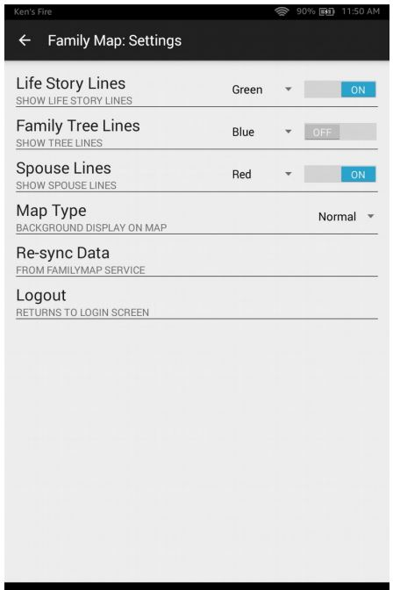
Settings Activity

Slide 8
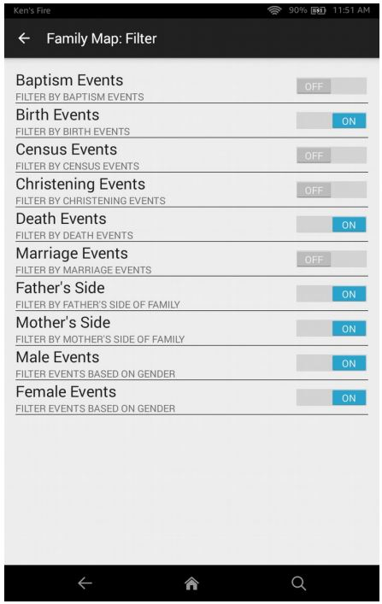
Filter Activity

Slide 9
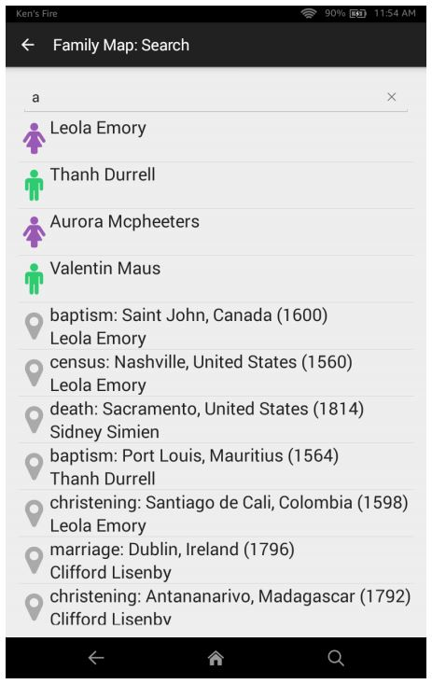
Search Activity

Slide 10
Login Events
“Sign In” button pressed
Success
Load’s User Information
Show map fragment
Show content based on current settings and filters
Person-Events
PolyLines
Search button pressed – go to Search Activity
Filters button pressed – go to Filter Activity
Settings button pressed – go to Setting Activity
Select Event
Show details below
Event Information Display is clicked – go to Person Activity
Failure
Show Toast
Clear entered data

Slide 11
Map Events
Show content based on current settings and filters
Person-Events
PolyLines
Previous button pressed go to parent activity
Press Go to Top button – Go to main activity (map)
Select Event
Show details below
Event Information Display is clicked – go to Person Activity
Event being viewed is centered

Slide 12
Person Activity
Go To Top Button pressed
Click on Person – go to Person Activity
Click on Event – go to Map Activity
Click on Up button – go to parent activity

Slide 13
Settings Activity
Toggle Life Story Lines – record state
Toggle Family Tree Lines – record state
Toggle Spouse Lines – record state
Select Life Story Color – record
Select Family Tree Color – record
Select Spouse Lines Color -- record
Select Map type – record state
Up Button – return to Login Activity , Map Fragment
Re-synch Data
Reload data from family map service
If successful go to Login Activity, Map Fragment
Show Toast if it fails
Logout – go to Login Activity, Login Fragment

Slide 14
Filter Activity Event
Toggle Baptism Events
Toggle Birth Events
Toggle Census Events
Toggle Christening Events
Toggle Death Events
Toggle Marriage Events
Toggle Father’s Side
Toggle Mother’s Side
Toggle Male Events
Toggle Female Events
Up Button – return to Login Activity , Map Fragment

Slide 15
Search Activity Events
Search Event – List all selected people and events
Person Selected – go to new Person Activity
Event Selected – go to new map activity
Up Button Pressed – return to Login Activity , Map Fragment

Slide 16
PolyLines
GoogleMap map;
// ... get a map.
// Add a thin red line from London to New York. Polyline line = map.addPolyline(
new PolylineOptions().
add(new LatLng(51.5, -0.1),
new LatLng(40.7, -74.0)
).
strokeWidth(5). //width(5)
visible(true).
strokeColor(Color.RED)); //color(Color.RED));

Slide 17
PolyLine Cont.
setVisible(boolean)
boolean isVisible()

