Slide 1
Welcome to
CS 235 Data Structures
2-3 Self-balancing Trees (41)
Chapter 11.4 2-3, pgs. 656-663.

Slide 2
Tip #41: Improve Success Ratio
Do the tough stuff first.
Think more, code less.
For big stuff, get someone’s brain wrapped around it.
Under promise, over deliver.
When something breaks, look at your assumptions.
Before you begin coding, decide how you are going to test it.
Trust your team, but ask to see.
Learn how to listen.
Don’t whine! (ie. Clear the Bozo bit.)
No Coding after midnight!

Slide 3
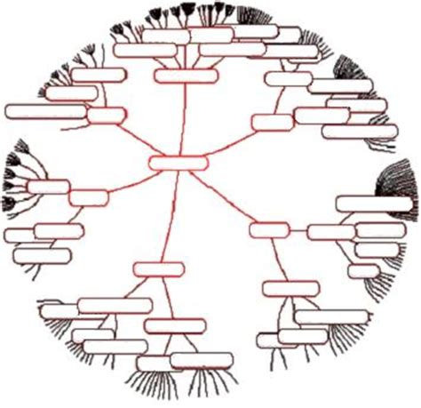
11.4 2-3 Trees
Searching a 2-3 Tree
Inserting an Item into a 2-3 Tree
Analysis of 2-3 Trees and Comparison with Balanced Binary Trees
Removal from a 2-3 Tree
11.4, pgs. 656-6663

Slide 4
B-Tree
A B-tree is a "fat" self-balancing tree data structure that maintains sorted data and allows searches, sequential access, insertions, and deletions in logarithmic time.
Self-balancing search trees (like AVL and Red-Black Trees), assume that everything is in main memory.
B-Trees work with huge amounts of data that cannot fit in main memory.
Since disk access time is very high compared to main memory access time, B-Trees make accesses more productive.
Using B-Trees reduces the number of disk accesses by putting maximum possible keys in a B-Tree node.
Height of B-Trees is kept low such that the total disk accesses for most operations is significantly reduced.
Generally, a B-Tree node size is kept equal to the disk block size.

Slide 5
Properties of B-Tree
All leaves are at same level.
A B-Tree is defined by the term minimum degree ‘t’.
The value of t depends upon disk block size.
Every node except root must contain at least (t - 1) keys.
Root must contain a minimum of 1 key.
All nodes (including root) may contain at most (2t – 1) keys.
Number of children of a node is equal to the number of keys in it plus 1.
All keys of a node are sorted in increasing order.
The child between two keys k1 and k2 contains all keys in range from k1 and k2.
B-Tree grows and shrinks from root which is unlike Binary Search Tree.
Binary Search Trees grow and shrink downward.
Like other balanced Binary Search Trees, time complexity to search, insert and delete is O(Log n).

Slide 6
2-3 Trees
A 2–3 tree is a B-tree of order 3.
Internal nodes have either two children (2-node) and one data element or three children (3-node) and two data elements.
Leaf nodes have no children and one or two data elements.
All leaf nodes of a 2-3 tree are at the lowest level.
All data is kept in sorted order.
A 2-node contains a data field and references to two child nodes
one child node contains data less than the node's data value
the other child contains data greater than the node's data value
A 3-node contains two data fields, ordered so that first is less than the second, and references to three children
One child contains data values less than the first data field
One child contains data values between the two data fields
One child contains data values greater than the second data field
7
3
11, 15
1
5
9
13
17, 19

Slide 7
2-3 Trees

Slide 8
Searching a 2-3 Tree
if the local root is NULL
Return NULL // the item is not in the tree.
elseif this is a 2-node
if the item is equal to the data1 field
Return the data1 field.
elseif the item is less than the data1 field
Recursively search the left subtree.
else
Recursively search the right subtree.
else // This is a 3-node
if the item is equal to the data1 field
Return the data1 field.
elseif the item is equal to the data2 field
Return the data2 field.
elseif the item is less than the data1 field
Recursively search the left subtree.
elseif the item is less than the data2 field
Recursively search the middle subtree.
else
Recursively search the right subtree.
Searching a 2-3 tree is very similar to searching a binary search tree.

Slide 9
Searching a 2-3 Tree
To search for 13
Compare 13 and 7
13 is greater than 7
7
3
11, 15
13 is in between 11 and 15
11 < 13 < 15
Compare 13 with 11 and 15
1
5
9
13
17, 19

Slide 10
Searching a 2-3 Tree
To search for 13
7
3
11, 15
1
5
9
13
17, 19
13 is in the middle child

Slide 11
Algorithm for Insertion into a 2-3 Tree
The insertion algorithm into a 2-3 tree is quite different from the insertion algorithm into a binary search tree.
A 2-3 tree maintains balance by being built from the bottom up.
Insert the new node into a leaf, instead of adding a new leaf.
Insert a new node as follows:
If the tree is empty, create a node and put value into the node.
Otherwise find the leaf node where the value belongs.
If the leaf node has only one value, put the new value into the node.
If the leaf node has more than two values, split the node and promote the median of the three values to parent.
If the parent then has three values, continue to split and promote, forming a new root node if necessary.

Slide 12
Insertion into a 2-3 Tree
Insert 15
7
3
11

Slide 13
Insertion into a 2-3 Tree
Insert 15
7
3
11
Because this node is a 2-node, we insert directly into the node creating a 3-node

Slide 14
Insertion into a 2-3 Tree
Insert 15
7
3
11, 15

Slide 15
Insertion into a 2-3 Tree
Insert 17
7
3
11, 15

Slide 16
Insertion into a 2-3 Tree
Insert 17
7
3
11, 15
Because we insert into leaves, 17 is virtually inserted into this node

Slide 17
Insertion into a 2-3 Tree
Insert 17
7
3
11, 15, 17
Because a node can't store three values, the middle value propagates up to the 2-node parent and this leaf node splits into two new 2-nodes

Slide 18
Insertion into a 2-3 Tree
Insert 17
7, 15
3
11
17

Slide 19
Insertion into a 2-3 Tree
Insert 5, 10, 20
7, 15
3
11
17

Slide 20
Insertion into a 2-3 Tree
Insert 5, 10, 20
7, 15
3, 5
11
17

Slide 21
Insertion into a 2-3 Tree
Insert 5, 10, 20
7, 15
3, 5
10, 11
17

Slide 22
Insertion into a 2-3 Tree
Insert 5, 10, 20
7, 15
3, 5
10, 11
17, 20

Slide 23
Insertion into a 2-3 Tree
Insert 13
7, 15
3, 5
10, 11
17, 20

Slide 24
Insertion into a 2-3 Tree
Insert 13
7, 15
3, 5
10, 11, 13
17, 20

Slide 25
Insertion into a 2-3 Tree
Insert 13
7, 15
3, 5
10, 11, 13
17, 20
Since a node with three values is a virtual node, move the middle value up and split the remaining values into two nodes

Slide 26
Insertion into a 2-3 Tree
Insert 13
7, 11, 15
3, 5
10
13
17, 20
Repeat

Slide 27
Insertion into a 2-3 Tree
11
Insert 13
7, 15
3, 5
10
13
17, 20
Move the middle value up

Slide 28
Insertion into a 2-3 Tree
11
Insert 13
7, 15
3, 5
10
13
17, 20
Split the remaining values into two nodes

Slide 29
Insertion into a 2-3 Tree
11
Insert 13
7
15
3, 5
10
13
17, 20
Split the remaining values into two nodes

Slide 30
Removal from a 2-3 Tree
Removing an item from a 2-3 tree is generally the reverse of the insertion process.
If the item to be removed is in a leaf with two items, simply delete the item.
If it’s not in a leaf, remove it by swapping it with its in-order predecessor in a leaf node and deleting it from the leaf node.
If removing an item from a leaf causes the leaf to become empty,
items from the sibling and parent can be redistributed into that leaf,
or the leaf can be merged with its parent and sibling nodes.

Slide 31
Removal from a 2-3 Tree
7
3
11, 15
1
5
9
13
17, 19

Slide 32
Removal from a 2-3 Tree
Remove 13
7
3
11, 15
1
5
9
13
17, 19

Slide 33
Removal from a 2-3 Tree
The node becomes empty
7
3
11, 15
1
5
9
17, 19

Slide 34
Removal from a 2-3 Tree
Merge 15 with a remaining child
7
3
11, 15
1
5
9
17, 19

Slide 35
Removal from a 2-3 Tree
Merge 15 with a remaining child
7
3
11
1
5
9
15, 17, 19

Slide 36
Removal from a 2-3 Tree
Split the node and move the middle value (17) up
7
3
11
1
5
9
15, 17, 19

Slide 37
Removal from a 2-3 Tree
Split the node and move the middle value (17) up
7
3
11, 17
1
5
9
15
19

Slide 38
Removal from a 2-3 Tree
Remove 11
7
3
11, 17
1
5
9
15
19

Slide 39
Removal from a 2-3 Tree
Because 11 is not in a leaf, replace it with its leaf predecessor (9)
7
3
17
1
5
9
15
19

Slide 40
Removal from a 2-3 Tree
Because 11 is not in a leaf, replace it with its leaf predecessor (9)
7
3
9, 17
1
5
15
19

Slide 41
Removal from a 2-3 Tree
The left leaf is now empty. Merge the parent (9) into its right child (15)
7
3
9, 17
1
5
15
19

Slide 42
Removal from a 2-3 Tree
The left leaf is now empty. Merge the parent (9) into its right child (15)
7
3
17
1
5
9, 15
19

Slide 43
Removal from a 2-3 Tree
Remove 1
7
3
17
1
5
9, 15
19

Slide 44
Removal from a 2-3 Tree
Remove 1
7
3
17
5
9, 15
19

Slide 45
Removal from a 2-3 Tree
Merge the parent (3) with its right child (5)
7
3
17
5
9, 15
19

Slide 46
Removal from a 2-3 Tree
Merge the parent (3) with its right child (5)
7
17
3, 5
9, 15
19

Slide 47
Removal from a 2-3 Tree
Repeat on the next level.
Merge the parent (7) with its right child (17)
7
17
3, 5
9, 15
19

Slide 48
Removal from a 2-3 Tree
Repeat on the next level.
Merge the parent (7) with its right child (17)
7, 17
9, 15
19
3, 5

Slide 49
Removal from a 2-3 Tree
Repeat on the next level.
Merge the parent (7) with its right child (17)
7, 17
3, 5
9, 15
19

Slide 50
2-3 Trees vs. Balanced Binary Trees
2-3 trees do not require the rotations needed for AVL and Red-Black trees.
The number of items that a 2-3 tree of height h can hold is between 2^{h} -1 (all 2 nodes) and 3^{h} – 1 (all 3-nodes).
Therefore, the height of a 2-3 tree is between log₃ n and log₂ n.
The search time is O(log n) -- logarithms are all related by a constant factor, and constant factors are ignored in big-O notation.

Slide 51
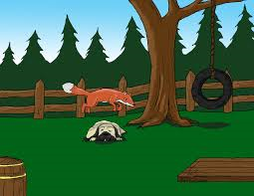
2-3 Tree Example
Build an 2-3 tree from the words:
"The quick brown fox jumps over the lazy dog."

Slide 52
Insertion Example
“The quick brown fox jumps over the lazy dog”
The

Slide 53
Insertion Example
“The quick brown fox jumps over the lazy dog”
The, quick

Slide 54
Insertion Example
“The quick brown fox jumps over the lazy dog”
The, brown, quick

Slide 55
Insertion Example
“The quick brown fox jumps over the lazy dog”
brown
The
quick

Slide 56
Insertion Example
“The quick brown fox jumps over the lazy dog”
brown
The
fox, quick

Slide 57
Insertion Example
“The quick brown fox jumps over the lazy dog”
brown
The
fox, jumps, quick

Slide 58
Insertion Example
“The quick brown fox jumps over the lazy dog”
brown, jumps
The
fox
quick

Slide 59
Insertion Example
“The quick brown fox jumps over the lazy dog”
brown, jumps
The
fox
over, quick

Slide 60
Insertion Example
“The quick brown fox jumps over the lazy dog”
brown, jumps
The
fox
over, quick, the

Slide 61
Insertion Example
“The quick brown fox jumps over the lazy dog”
brown, jumps, quick
The
fox
over
the

Slide 62
Insertion Example
“The quick brown fox jumps over the lazy dog”
jumps
brown
quick
The
fox
over
the

Slide 63
Insertion Example
“The quick brown fox jumps over the lazy dog”
jumps
brown
quick
The
fox
lazy, over
the

Slide 64
Insertion Example
“The quick brown fox jumps over the lazy dog”
jumps
brown
quick
The
dog, fox
lazy, over
the

Slide 65
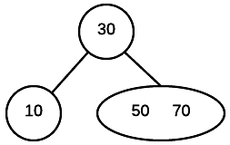
Insert 50, 30, 10, 70, 60 in a 2-3 tree.
If the tree is empty, create a node and put value into the node.
Otherwise find the leaf node where the value belongs.
If the leaf node has only one value, put the new value into the node.
If the leaf node has more than two values, split the node and promote the median of the three values to parent.
If the parent then has three values, continue to split and promote, forming a new root node if necessary.

Slide 66
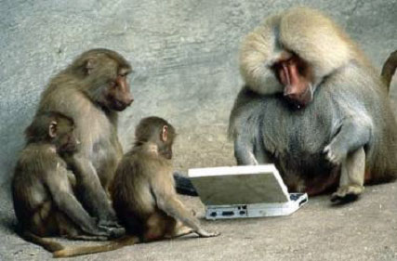
Be Safe

