Slide 1
Welcome to
CS 235 Data Structures
Sorting (36)
Chapter 10.7-8, pgs. 592-604

Slide 2
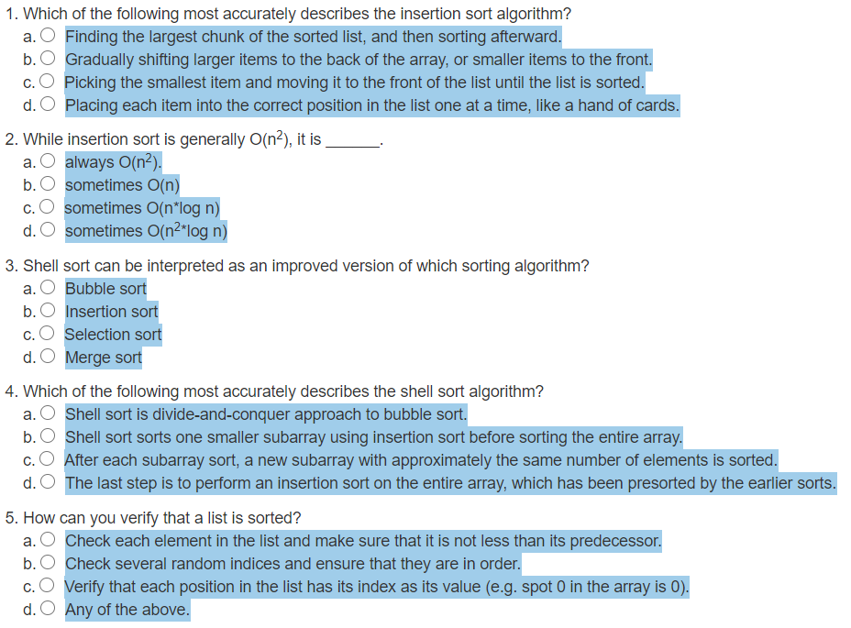
Attendance Quiz #35

Slide 3
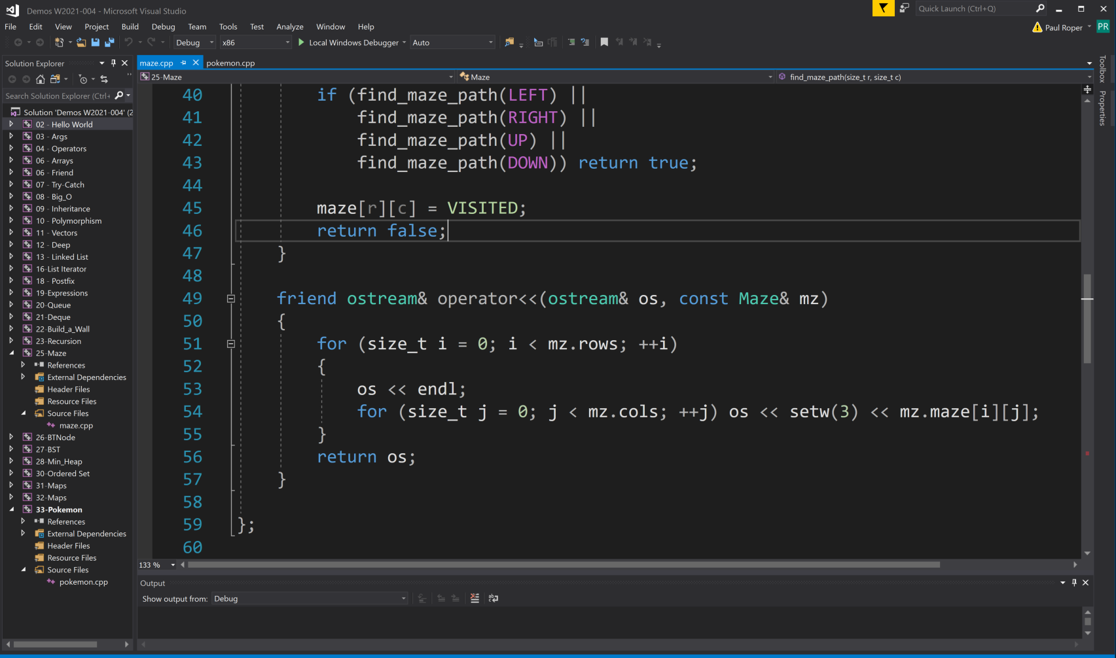
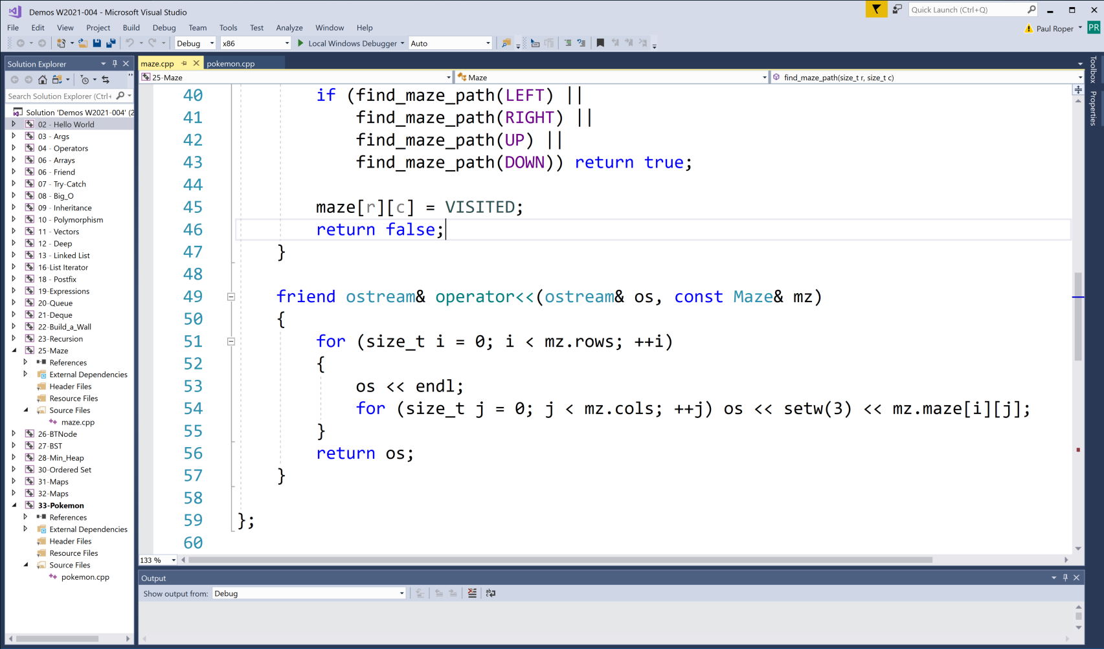
Tip #36: Black/White Screen Backgrounds
OR

Slide 4
Tip #36: Black/White Screen Backgrounds
With a smart phone, laptop, tablet or other electronic device, you must make the decision between the dark and light mode screen setting...
Readability
Black text on a white background is best suited for the human eye because white reflects every wavelength in the color spectrum.
The high-contrast black gives the sharpest impression on white, which is easier on your iris.
White text on a black background is less effective because the iris is required to open-up and receive more light, causing the white letters to bleed into the black background (halation – especially for those with astigmatism).
Eye Strain
While dark mode can reduce eye strain in low-light conditions...
White on a black background (100% contrast) can cause more eye strain making text harder to read.
Collaboration in most forms remains black on white across the spectrum - web pages are typically white, most programs use white backgrounds and of course, printed media is white (the standard for thousands of years).
Long chunks of text can be harder to read with a light-on-dark theme.
Thus, use a dark theme only in low light or if you don’t plan to read for long periods of time.

Slide 5
C++ pow Function
/** String Specialization using pow: s0 x 31^(n-1) + s2 x 31^(n-1) + ... + sn-1 */
template<>
struct myHash<std::string>
{
size_t operator()(const std::string& s)
{
size_t result = 0;
for (size_t i = 0; i < s.length(); ++i)
result = result + (s[i] * pow(HASH_CONSTANT, s.length() - i - 1));
}
};
/** String specialization: (((s0 x 31 + s2) x 31 + s3) x 31 + ... + sn-1) */
template<>
struct myHash<std::string>
{
size_t operator()(const std::string& s)
{
size_t result = 0;
for (size_t i = 0; i < s.length(); i++)
result = result * HASH_CONSTANT + s[i];
return result;
}
};
OR

Slide 6
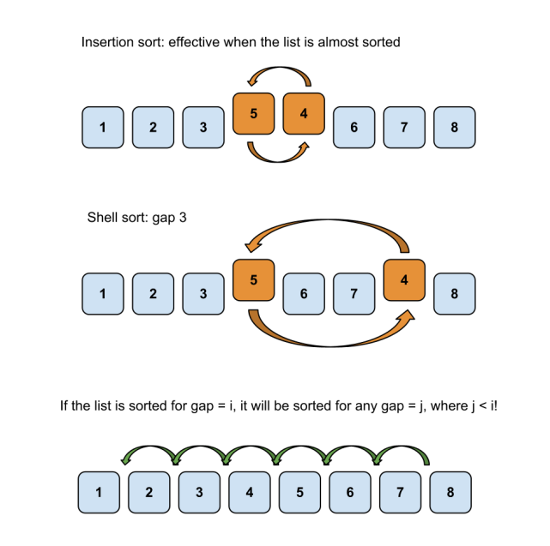
10.6 Shell Sort: A Better Insertion Sort
Analysis of Shell Sort
Code for Shell Sort
10.6, pgs. 588-590

Slide 7
Shell Sort: A Better Insertion Sort
A Shell sort is a type of insertion sort, but with O(n^{3/2}) or better performance than the O(n²) sorts.
It is named after its discoverer, Donald Shell.
A Shell sort can be thought of as a divide-and-conquer approach to insertion sort.
Instead of sorting the entire array, Shell sort sorts many smaller subarrays using insertion sort before sorting the entire array.
The initial subarrays will contain two or three elements, so the insertion sorts will go very quickly.
After each collection of subarrays is sorted, a new collection of subarrays with approximately twice as many elements as before will be sorted.
The last step is to perform an insertion sort on the entire array, which has been presorted by the earlier sorts.

Slide 8
Shell Sort Algorithm
1. Set the initial value of gap to n / 2.2
2. while gap > 0
3. for each array element from position gap to the last element
4. Insert this element where it belongs in its subarray.
4.1 next_pos is an iterator to the element to insert
4.2 Save the value of the element to insert in next_val
4.3 while next_pos > first + gap and the element at next_pos – gap > next_val
4.4 Shift the element at next_pos – gap to position next_pos
4.5 Decrement next_pos by gap
4.6 Insert next_val at next_pos
5. if gap is 2, set it to 1
6. else gap = gap / 2.2 // chosen by experimentation

Slide 9
Shell Sort
gap value | 7
Let’s sort the following array using initial subarrays with only two and three elements.
0 | 1 | 2 | 3 | 4 | 5 | 6 | 7 | 8 | 9 | 10 | 11 | 12 | 13 | 14 | 15
40 | 35 | 80 | 75 | 60 | 90 | 70 | 75 | 55 | 90 | 85 | 34 | 45 | 62 | 57 | 65
0 | 1 | 2 | 3 | 4 | 5 | 6 | 7 | 8 | 9 | 10 | 11 | 12 | 13 | 14 | 15
40 | 35 | 80 | 75 | 60 | 90 | 70 | 75 | 55 | 90 | 85 | 34 | 45 | 62 | 57 | 65
How many subarrays with gap of 7?

Slide 10
Shell Sort
gap value | 7
0 | 1 | 2 | 3 | 4 | 5 | 6 | 7 | 8 | 9 | 10 | 11 | 12 | 13 | 14 | 15
40 | 35 | 80 | 75 | 60 | 90 | 70 | 75 | 55 | 90 | 85 | 34 | 45 | 62 | 57 | 65
subarray 1
We determine the elements in each subarray by setting a gap value between the subscripts in each subarray.
We will use an initial gap of 7.

Slide 11
Shell Sort
gap value | 7
0 | 1 | 2 | 3 | 4 | 5 | 6 | 7 | 8 | 9 | 10 | 11 | 12 | 13 | 14 | 15
40 | 35 | 80 | 75 | 60 | 90 | 70 | 75 | 55 | 90 | 85 | 34 | 45 | 62 | 57 | 65
subarray 2

Slide 12
Shell Sort
gap value | 7
0 | 1 | 2 | 3 | 4 | 5 | 6 | 7 | 8 | 9 | 10 | 11 | 12 | 13 | 14 | 15
40 | 35 | 80 | 75 | 60 | 90 | 70 | 75 | 55 | 90 | 85 | 34 | 45 | 62 | 57 | 65
subarray 3

Slide 13
Shell Sort
gap value | 7
0 | 1 | 2 | 3 | 4 | 5 | 6 | 7 | 8 | 9 | 10 | 11 | 12 | 13 | 14 | 15
40 | 35 | 80 | 75 | 60 | 90 | 70 | 75 | 55 | 90 | 85 | 34 | 45 | 62 | 57 | 65
subarray 4

Slide 14
Shell Sort
gap value | 7
0 | 1 | 2 | 3 | 4 | 5 | 6 | 7 | 8 | 9 | 10 | 11 | 12 | 13 | 14 | 15
40 | 35 | 80 | 75 | 60 | 90 | 70 | 75 | 55 | 90 | 85 | 34 | 45 | 62 | 57 | 65
subarray 5

Slide 15
Shell Sort
gap value | 7
0 | 1 | 2 | 3 | 4 | 5 | 6 | 7 | 8 | 9 | 10 | 11 | 12 | 13 | 14 | 15
40 | 35 | 80 | 75 | 60 | 90 | 70 | 75 | 55 | 90 | 85 | 34 | 45 | 62 | 57 | 65
subarray 6

Slide 16
Shell Sort
gap value | 7
0 | 1 | 2 | 3 | 4 | 5 | 6 | 7 | 8 | 9 | 10 | 11 | 12 | 13 | 14 | 15
40 | 35 | 80 | 75 | 60 | 90 | 70 | 75 | 55 | 90 | 85 | 34 | 45 | 62 | 57 | 65
subarray 7

Slide 17
Shell Sort
gap value | 7
Sort subarray 1
0 | 1 | 2 | 3 | 4 | 5 | 6 | 7 | 8 | 9 | 10 | 11 | 12 | 13 | 14 | 15
40 | 35 | 80 | 75 | 60 | 90 | 70 | 75 | 55 | 90 | 85 | 34 | 45 | 62 | 57 | 65
subarray 1

Slide 18
Shell Sort
gap value | 7
Sort subarray 2
0 | 1 | 2 | 3 | 4 | 5 | 6 | 7 | 8 | 9 | 10 | 11 | 12 | 13 | 14 | 15
40 | 35 | 80 | 75 | 60 | 90 | 70 | 75 | 55 | 90 | 85 | 34 | 45 | 62 | 57 | 65
subarray 2

Slide 19
Shell Sort
gap value | 7
Sort subarray 3
0 | 1 | 2 | 3 | 4 | 5 | 6 | 7 | 8 | 9 | 10 | 11 | 12 | 13 | 14 | 15
40 | 35 | 80 | 75 | 60 | 90 | 70 | 75 | 55 | 90 | 85 | 34 | 45 | 62 | 57 | 65
subarray 3

Slide 20
Shell Sort
gap value | 7
Sort subarray 4
0 | 1 | 2 | 3 | 4 | 5 | 6 | 7 | 8 | 9 | 10 | 11 | 12 | 13 | 14 | 15
40 | 35 | 80 | 75 | 60 | 90 | 70 | 75 | 55 | 90 | 85 | 34 | 45 | 62 | 57 | 65
subarray 4

Slide 21
Shell Sort
gap value | 7
Sort subarray 5
0 | 1 | 2 | 3 | 4 | 5 | 6 | 7 | 8 | 9 | 10 | 11 | 12 | 13 | 14 | 15
40 | 35 | 80 | 75 | 60 | 90 | 70 | 75 | 55 | 90 | 85 | 34 | 45 | 62 | 57 | 65
subarray 5

Slide 22
Shell Sort
gap value | 7
Sort subarray 5
0 | 1 | 2 | 3 | 4 | 5 | 6 | 7 | 8 | 9 | 10 | 11 | 12 | 13 | 14 | 15
40 | 35 | 80 | 75 | 34 | 90 | 70 | 75 | 55 | 90 | 85 | 60 | 45 | 62 | 57 | 65
subarray 5

Slide 23
Shell Sort
gap value | 7
Sort subarray 6
0 | 1 | 2 | 3 | 4 | 5 | 6 | 7 | 8 | 9 | 10 | 11 | 12 | 13 | 14 | 15
40 | 35 | 80 | 75 | 34 | 90 | 70 | 75 | 55 | 90 | 85 | 60 | 45 | 62 | 57 | 65
subarray 6

Slide 24
Shell Sort
gap value | 7
Sort subarray 6
0 | 1 | 2 | 3 | 4 | 5 | 6 | 7 | 8 | 9 | 10 | 11 | 12 | 13 | 14 | 15
40 | 35 | 80 | 75 | 34 | 45 | 70 | 75 | 55 | 90 | 85 | 60 | 90 | 62 | 57 | 65
subarray 6

Slide 25
Shell Sort
gap value | 7
Sort subarray 7
0 | 1 | 2 | 3 | 4 | 5 | 6 | 7 | 8 | 9 | 10 | 11 | 12 | 13 | 14 | 15
40 | 35 | 80 | 75 | 34 | 45 | 70 | 75 | 55 | 90 | 85 | 60 | 90 | 62 | 57 | 65
subarray 7

Slide 26
Shell Sort
gap value | 7
Sort subarray 7
0 | 1 | 2 | 3 | 4 | 5 | 6 | 7 | 8 | 9 | 10 | 11 | 12 | 13 | 14 | 15
40 | 35 | 80 | 75 | 34 | 45 | 62 | 75 | 55 | 90 | 85 | 60 | 90 | 70 | 57 | 65
subarray 7

Slide 27
Shell Sort
gap value | 7
Sort subarray 1
0 | 1 | 2 | 3 | 4 | 5 | 6 | 7 | 8 | 9 | 10 | 11 | 12 | 13 | 14 | 15
40 | 35 | 80 | 75 | 34 | 45 | 62 | 75 | 55 | 90 | 85 | 60 | 90 | 70 | 57 | 65
subarray 1

Slide 28
Shell Sort
gap value | 7
Sort subarray 1
0 | 1 | 2 | 3 | 4 | 5 | 6 | 7 | 8 | 9 | 10 | 11 | 12 | 13 | 14 | 15
40 | 35 | 80 | 75 | 34 | 45 | 62 | 57 | 55 | 90 | 85 | 60 | 90 | 70 | 75 | 65
subarray 1

Slide 29
Shell Sort
gap value | 7
Sort subarray 2
0 | 1 | 2 | 3 | 4 | 5 | 6 | 7 | 8 | 9 | 10 | 11 | 12 | 13 | 14 | 15
40 | 35 | 80 | 75 | 34 | 45 | 62 | 57 | 55 | 90 | 85 | 60 | 90 | 70 | 75 | 65
subarray 2

Slide 30
Shell Sort
gap value | 3
Sort on smaller gap value
0 | 1 | 2 | 3 | 4 | 5 | 6 | 7 | 8 | 9 | 10 | 11 | 12 | 13 | 14 | 15
40 | 35 | 80 | 75 | 34 | 45 | 62 | 57 | 55 | 90 | 85 | 60 | 90 | 70 | 75 | 65

Slide 31
Shell Sort
gap value | 3
Sort subarray 1
0 | 1 | 2 | 3 | 4 | 5 | 6 | 7 | 8 | 9 | 10 | 11 | 12 | 13 | 14 | 15
40 | 35 | 80 | 75 | 34 | 45 | 62 | 57 | 55 | 90 | 85 | 60 | 90 | 70 | 75 | 65
subarray 1

Slide 32
Shell Sort
gap value | 3
Sort subarray 2
0 | 1 | 2 | 3 | 4 | 5 | 6 | 7 | 8 | 9 | 10 | 11 | 12 | 13 | 14 | 15
40 | 35 | 80 | 75 | 34 | 45 | 62 | 57 | 55 | 90 | 85 | 60 | 90 | 70 | 75 | 65
subarray 2

Slide 33
Shell Sort
gap value | 3
Sort subarray 2
0 | 1 | 2 | 3 | 4 | 5 | 6 | 7 | 8 | 9 | 10 | 11 | 12 | 13 | 14 | 15
40 | 34 | 80 | 75 | 35 | 45 | 62 | 57 | 55 | 90 | 85 | 60 | 90 | 70 | 75 | 65
subarray 2

Slide 34
Shell Sort
gap value | 3
Sort subarray 3
0 | 1 | 2 | 3 | 4 | 5 | 6 | 7 | 8 | 9 | 10 | 11 | 12 | 13 | 14 | 15
40 | 34 | 80 | 75 | 35 | 45 | 62 | 57 | 55 | 90 | 85 | 60 | 90 | 70 | 75 | 65
subarray 3

Slide 35
Shell Sort
gap value | 3
Sort subarray 3
0 | 1 | 2 | 3 | 4 | 5 | 6 | 7 | 8 | 9 | 10 | 11 | 12 | 13 | 14 | 15
40 | 34 | 45 | 75 | 35 | 80 | 62 | 57 | 55 | 90 | 85 | 60 | 90 | 70 | 75 | 65
subarray 3

Slide 36
Shell Sort
gap value | 3
Sort subarray 1
0 | 1 | 2 | 3 | 4 | 5 | 6 | 7 | 8 | 9 | 10 | 11 | 12 | 13 | 14 | 15
40 | 34 | 45 | 75 | 35 | 80 | 62 | 57 | 55 | 90 | 85 | 60 | 90 | 70 | 75 | 65
subarray 1

Slide 37
Shell Sort
gap value | 3
Sort subarray 1
0 | 1 | 2 | 3 | 4 | 5 | 6 | 7 | 8 | 9 | 10 | 11 | 12 | 13 | 14 | 15
40 | 34 | 45 | 62 | 35 | 80 | 75 | 57 | 55 | 90 | 85 | 60 | 90 | 70 | 75 | 65
subarray 1

Slide 38
Shell Sort
gap value | 3
Sort subarray 2
0 | 1 | 2 | 3 | 4 | 5 | 6 | 7 | 8 | 9 | 10 | 11 | 12 | 13 | 14 | 15
40 | 34 | 45 | 62 | 35 | 80 | 75 | 57 | 55 | 90 | 85 | 60 | 90 | 70 | 75 | 65
subarray 2

Slide 39
Shell Sort
gap value | 3
Sort subarray 3
0 | 1 | 2 | 3 | 4 | 5 | 6 | 7 | 8 | 9 | 10 | 11 | 12 | 13 | 14 | 15
40 | 34 | 45 | 62 | 35 | 80 | 75 | 57 | 55 | 90 | 85 | 60 | 90 | 70 | 75 | 65
subarray 3

Slide 40
Shell Sort
gap value | 3
Sort subarray 3
0 | 1 | 2 | 3 | 4 | 5 | 6 | 7 | 8 | 9 | 10 | 11 | 12 | 13 | 14 | 15
40 | 34 | 45 | 62 | 35 | 55 | 75 | 57 | 80 | 90 | 85 | 60 | 90 | 70 | 75 | 65
subarray 3

Slide 41
Shell Sort
gap value | 3
Sort subarray 1
0 | 1 | 2 | 3 | 4 | 5 | 6 | 7 | 8 | 9 | 10 | 11 | 12 | 13 | 14 | 15
40 | 34 | 45 | 62 | 35 | 55 | 75 | 57 | 80 | 90 | 85 | 60 | 90 | 70 | 75 | 65
subarray 1

Slide 42
Shell Sort
gap value | 3
Sort subarray 2
0 | 1 | 2 | 3 | 4 | 5 | 6 | 7 | 8 | 9 | 10 | 11 | 12 | 13 | 14 | 15
40 | 34 | 45 | 62 | 35 | 55 | 75 | 57 | 80 | 90 | 85 | 60 | 90 | 70 | 75 | 65
subarray 2

Slide 43
Shell Sort
gap value | 3
Sort subarray 3
0 | 1 | 2 | 3 | 4 | 5 | 6 | 7 | 8 | 9 | 10 | 11 | 12 | 13 | 14 | 15
40 | 34 | 45 | 62 | 35 | 55 | 75 | 57 | 80 | 90 | 85 | 60 | 90 | 70 | 75 | 65
subarray 3

Slide 44
Shell Sort
gap value | 3
Sort subarray 3
0 | 1 | 2 | 3 | 4 | 5 | 6 | 7 | 8 | 9 | 10 | 11 | 12 | 13 | 14 | 15
40 | 34 | 45 | 62 | 35 | 55 | 75 | 57 | 60 | 90 | 85 | 80 | 90 | 70 | 75 | 65
subarray 3

Slide 45
Shell Sort
gap value | 3
Sort subarray 1
0 | 1 | 2 | 3 | 4 | 5 | 6 | 7 | 8 | 9 | 10 | 11 | 12 | 13 | 14 | 15
40 | 34 | 45 | 62 | 35 | 55 | 75 | 57 | 60 | 90 | 85 | 80 | 90 | 70 | 75 | 65
subarray 1

Slide 46
Shell Sort
gap value | 3
Sort subarray 2
0 | 1 | 2 | 3 | 4 | 5 | 6 | 7 | 8 | 9 | 10 | 11 | 12 | 13 | 14 | 15
40 | 34 | 45 | 62 | 35 | 55 | 75 | 57 | 60 | 90 | 85 | 80 | 90 | 70 | 75 | 65
subarray 2

Slide 47
Shell Sort
gap value | 3
Sort subarray 2
0 | 1 | 2 | 3 | 4 | 5 | 6 | 7 | 8 | 9 | 10 | 11 | 12 | 13 | 14 | 15
40 | 34 | 45 | 62 | 35 | 55 | 75 | 57 | 60 | 90 | 70 | 80 | 90 | 85 | 75 | 65
subarray 2

Slide 48
Shell Sort
gap value | 3
Sort subarray 3
0 | 1 | 2 | 3 | 4 | 5 | 6 | 7 | 8 | 9 | 10 | 11 | 12 | 13 | 14 | 15
40 | 34 | 45 | 62 | 35 | 55 | 75 | 57 | 60 | 90 | 70 | 80 | 90 | 85 | 75 | 65
subarray 3

Slide 49
Shell Sort
gap value | 3
Sort subarray 3
0 | 1 | 2 | 3 | 4 | 5 | 6 | 7 | 8 | 9 | 10 | 11 | 12 | 13 | 14 | 15
40 | 34 | 45 | 62 | 35 | 55 | 75 | 57 | 60 | 90 | 70 | 75 | 90 | 85 | 80 | 65
subarray 3

Slide 50
Shell Sort
gap value | 3
Sort subarray 1
0 | 1 | 2 | 3 | 4 | 5 | 6 | 7 | 8 | 9 | 10 | 11 | 12 | 13 | 14 | 15
40 | 34 | 45 | 62 | 35 | 55 | 75 | 57 | 60 | 90 | 70 | 75 | 90 | 85 | 80 | 65
subarray 1

Slide 51
Shell Sort
gap value | 3
Sort subarray 1
0 | 1 | 2 | 3 | 4 | 5 | 6 | 7 | 8 | 9 | 10 | 11 | 12 | 13 | 14 | 15
40 | 34 | 45 | 62 | 35 | 55 | 75 | 57 | 60 | 90 | 70 | 75 | 65 | 85 | 80 | 90
subarray 1

Slide 52
Shell Sort
gap value | 3
Sort subarray 1
0 | 1 | 2 | 3 | 4 | 5 | 6 | 7 | 8 | 9 | 10 | 11 | 12 | 13 | 14 | 15
40 | 34 | 45 | 62 | 35 | 55 | 75 | 57 | 60 | 65 | 70 | 75 | 90 | 85 | 80 | 90
subarray 1

Slide 53
Shell Sort
gap value | 3
Sort subarray 1
0 | 1 | 2 | 3 | 4 | 5 | 6 | 7 | 8 | 9 | 10 | 11 | 12 | 13 | 14 | 15
40 | 34 | 45 | 62 | 35 | 55 | 65 | 57 | 60 | 75 | 70 | 75 | 90 | 85 | 80 | 90
subarray 1

Slide 54
Shell Sort
gap value | 1
Sort on gap value of 1 (a regular insertion sort)
0 | 1 | 2 | 3 | 4 | 5 | 6 | 7 | 8 | 9 | 10 | 11 | 12 | 13 | 14 | 15
40 | 34 | 45 | 62 | 35 | 55 | 65 | 57 | 60 | 75 | 70 | 75 | 90 | 85 | 80 | 90

Slide 55
Shell Sort
gap value | 1
Sort on gap value of 1 (a regular insertion sort)
0 | 1 | 2 | 3 | 4 | 5 | 6 | 7 | 8 | 9 | 10 | 11 | 12 | 13 | 14 | 15
40 | 34 | 45 | 62 | 35 | 55 | 65 | 57 | 60 | 75 | 70 | 75 | 90 | 85 | 80 | 90

Slide 56
Shell Sort
gap value | 1
Sort on gap value of 1 (a regular insertion sort)
0 | 1 | 2 | 3 | 4 | 5 | 6 | 7 | 8 | 9 | 10 | 11 | 12 | 13 | 14 | 15
34 | 40 | 45 | 62 | 35 | 55 | 65 | 57 | 60 | 75 | 70 | 75 | 90 | 85 | 80 | 90

Slide 57
Shell Sort
gap value | 1
Sort on gap value of 1 (a regular insertion sort)
0 | 1 | 2 | 3 | 4 | 5 | 6 | 7 | 8 | 9 | 10 | 11 | 12 | 13 | 14 | 15
34 | 40 | 45 | 62 | 35 | 55 | 65 | 57 | 60 | 75 | 70 | 75 | 90 | 85 | 80 | 90

Slide 58
Shell Sort
gap value | 1
Sort on gap value of 1 (a regular insertion sort)
0 | 1 | 2 | 3 | 4 | 5 | 6 | 7 | 8 | 9 | 10 | 11 | 12 | 13 | 14 | 15
34 | 40 | 45 | 62 | 35 | 55 | 65 | 57 | 60 | 75 | 70 | 75 | 90 | 85 | 80 | 90

Slide 59
Shell Sort
gap value | 1
Sort on gap value of 1 (a regular insertion sort)
0 | 1 | 2 | 3 | 4 | 5 | 6 | 7 | 8 | 9 | 10 | 11 | 12 | 13 | 14 | 15
34 | 40 | 45 | 62 | 35 | 55 | 65 | 57 | 60 | 75 | 70 | 75 | 90 | 85 | 80 | 90

Slide 60
Shell Sort
gap value | 1
Sort on gap value of 1 (a regular insertion sort)
0 | 1 | 2 | 3 | 4 | 5 | 6 | 7 | 8 | 9 | 10 | 11 | 12 | 13 | 14 | 15
34 | 40 | 45 | 62 | 35 | 55 | 65 | 57 | 60 | 75 | 70 | 75 | 90 | 85 | 80 | 90

Slide 61
Shell Sort
gap value | 1
Sort on gap value of 1 (a regular insertion sort)
0 | 1 | 2 | 3 | 4 | 5 | 6 | 7 | 8 | 9 | 10 | 11 | 12 | 13 | 14 | 15
34 | 40 | 45 | 62 | 35 | 55 | 65 | 57 | 60 | 75 | 70 | 75 | 90 | 85 | 80 | 90

Slide 62
Shell Sort
gap value | 1
Sort on gap value of 1 (a regular insertion sort)
0 | 1 | 2 | 3 | 4 | 5 | 6 | 7 | 8 | 9 | 10 | 11 | 12 | 13 | 14 | 15
34 | 40 | 45 | 35 | 62 | 55 | 65 | 57 | 60 | 75 | 70 | 75 | 90 | 85 | 80 | 90

Slide 63
Shell Sort
gap value | 1
Sort on gap value of 1 (a regular insertion sort)
0 | 1 | 2 | 3 | 4 | 5 | 6 | 7 | 8 | 9 | 10 | 11 | 12 | 13 | 14 | 15
34 | 40 | 35 | 45 | 62 | 55 | 65 | 57 | 60 | 75 | 70 | 75 | 90 | 85 | 80 | 90

Slide 64
Shell Sort
gap value | 1
Sort on gap value of 1 (a regular insertion sort)
0 | 1 | 2 | 3 | 4 | 5 | 6 | 7 | 8 | 9 | 10 | 11 | 12 | 13 | 14 | 15
34 | 35 | 40 | 45 | 62 | 55 | 65 | 57 | 60 | 75 | 70 | 75 | 90 | 85 | 80 | 90

Slide 65
Shell Sort
gap value | 1
Sort on gap value of 1 (a regular insertion sort)
0 | 1 | 2 | 3 | 4 | 5 | 6 | 7 | 8 | 9 | 10 | 11 | 12 | 13 | 14 | 15
34 | 35 | 40 | 45 | 62 | 55 | 65 | 57 | 60 | 75 | 70 | 75 | 90 | 85 | 80 | 90

Slide 66
Shell Sort
gap value | 1
Sort on gap value of 1 (a regular insertion sort)
0 | 1 | 2 | 3 | 4 | 5 | 6 | 7 | 8 | 9 | 10 | 11 | 12 | 13 | 14 | 15
34 | 35 | 40 | 45 | 55 | 62 | 65 | 57 | 60 | 75 | 70 | 75 | 90 | 85 | 80 | 90

Slide 67
Shell Sort
gap value | 1
Sort on gap value of 1 (a regular insertion sort)
0 | 1 | 2 | 3 | 4 | 5 | 6 | 7 | 8 | 9 | 10 | 11 | 12 | 13 | 14 | 15
34 | 35 | 40 | 45 | 55 | 62 | 65 | 57 | 60 | 75 | 70 | 75 | 90 | 85 | 80 | 90

Slide 68
Shell Sort
gap value | 1
Sort on gap value of 1 (a regular insertion sort)
0 | 1 | 2 | 3 | 4 | 5 | 6 | 7 | 8 | 9 | 10 | 11 | 12 | 13 | 14 | 15
34 | 35 | 40 | 45 | 55 | 62 | 65 | 57 | 60 | 75 | 70 | 75 | 90 | 85 | 80 | 90

Slide 69
Shell Sort
gap value | 1
Sort on gap value of 1 (a regular insertion sort)
0 | 1 | 2 | 3 | 4 | 5 | 6 | 7 | 8 | 9 | 10 | 11 | 12 | 13 | 14 | 15
34 | 35 | 40 | 45 | 55 | 62 | 57 | 65 | 60 | 75 | 70 | 75 | 90 | 85 | 80 | 90

Slide 70
Shell Sort
gap value | 1
Sort on gap value of 1 (a regular insertion sort)
0 | 1 | 2 | 3 | 4 | 5 | 6 | 7 | 8 | 9 | 10 | 11 | 12 | 13 | 14 | 15
34 | 35 | 40 | 45 | 55 | 57 | 62 | 65 | 60 | 75 | 70 | 75 | 90 | 85 | 80 | 90

Slide 71
Shell Sort
gap value | 1
Sort on gap value of 1 (a regular insertion sort)
0 | 1 | 2 | 3 | 4 | 5 | 6 | 7 | 8 | 9 | 10 | 11 | 12 | 13 | 14 | 15
34 | 35 | 40 | 45 | 55 | 57 | 62 | 65 | 60 | 75 | 70 | 75 | 90 | 85 | 80 | 90

Slide 72
Shell Sort
gap value | 1
Sort on gap value of 1 (a regular insertion sort)
0 | 1 | 2 | 3 | 4 | 5 | 6 | 7 | 8 | 9 | 10 | 11 | 12 | 13 | 14 | 15
34 | 35 | 40 | 45 | 55 | 57 | 62 | 60 | 65 | 75 | 70 | 75 | 90 | 85 | 80 | 90

Slide 73
Shell Sort
gap value | 1
Sort on gap value of 1 (a regular insertion sort)
0 | 1 | 2 | 3 | 4 | 5 | 6 | 7 | 8 | 9 | 10 | 11 | 12 | 13 | 14 | 15
34 | 35 | 40 | 45 | 55 | 57 | 60 | 62 | 65 | 75 | 70 | 75 | 90 | 85 | 80 | 90

Slide 74
Shell Sort
gap value | 1
Sort on gap value of 1 (a regular insertion sort)
0 | 1 | 2 | 3 | 4 | 5 | 6 | 7 | 8 | 9 | 10 | 11 | 12 | 13 | 14 | 15
34 | 35 | 40 | 45 | 55 | 57 | 60 | 62 | 65 | 75 | 70 | 75 | 90 | 85 | 80 | 90

Slide 75
Shell Sort
gap value | 1
Sort on gap value of 1 (a regular insertion sort)
0 | 1 | 2 | 3 | 4 | 5 | 6 | 7 | 8 | 9 | 10 | 11 | 12 | 13 | 14 | 15
34 | 35 | 40 | 45 | 55 | 57 | 60 | 62 | 65 | 75 | 70 | 75 | 90 | 85 | 80 | 90

Slide 76
Shell Sort
gap value | 1
Sort on gap value of 1 (a regular insertion sort)
0 | 1 | 2 | 3 | 4 | 5 | 6 | 7 | 8 | 9 | 10 | 11 | 12 | 13 | 14 | 15
34 | 35 | 40 | 45 | 55 | 57 | 60 | 62 | 65 | 75 | 70 | 75 | 90 | 85 | 80 | 90

Slide 77
Shell Sort
gap value | 1
Sort on gap value of 1 (a regular insertion sort)
0 | 1 | 2 | 3 | 4 | 5 | 6 | 7 | 8 | 9 | 10 | 11 | 12 | 13 | 14 | 15
34 | 35 | 40 | 45 | 55 | 57 | 60 | 62 | 65 | 70 | 75 | 75 | 90 | 85 | 80 | 90

Slide 78
Shell Sort
gap value | 1
Sort on gap value of 1 (a regular insertion sort)
0 | 1 | 2 | 3 | 4 | 5 | 6 | 7 | 8 | 9 | 10 | 11 | 12 | 13 | 14 | 15
34 | 35 | 40 | 45 | 55 | 57 | 60 | 62 | 65 | 70 | 75 | 75 | 90 | 85 | 80 | 90

Slide 79
Shell Sort
gap value | 1
Sort on gap value of 1 (a regular insertion sort)
0 | 1 | 2 | 3 | 4 | 5 | 6 | 7 | 8 | 9 | 10 | 11 | 12 | 13 | 14 | 15
34 | 35 | 40 | 45 | 55 | 57 | 60 | 62 | 65 | 70 | 75 | 75 | 90 | 85 | 80 | 90

Slide 80
Shell Sort
gap value | 1
Sort on gap value of 1 (a regular insertion sort)
0 | 1 | 2 | 3 | 4 | 5 | 6 | 7 | 8 | 9 | 10 | 11 | 12 | 13 | 14 | 15
34 | 35 | 40 | 45 | 55 | 57 | 60 | 62 | 65 | 70 | 75 | 75 | 90 | 85 | 80 | 90

Slide 81
Shell Sort
gap value | 1
Sort on gap value of 1 (a regular insertion sort)
0 | 1 | 2 | 3 | 4 | 5 | 6 | 7 | 8 | 9 | 10 | 11 | 12 | 13 | 14 | 15
34 | 35 | 40 | 45 | 55 | 57 | 60 | 62 | 65 | 70 | 75 | 75 | 90 | 85 | 80 | 90

Slide 82
Shell Sort
gap value | 1
Sort on gap value of 1 (a regular insertion sort)
0 | 1 | 2 | 3 | 4 | 5 | 6 | 7 | 8 | 9 | 10 | 11 | 12 | 13 | 14 | 15
34 | 35 | 40 | 45 | 55 | 57 | 60 | 62 | 65 | 70 | 75 | 75 | 90 | 85 | 80 | 90

Slide 83
Shell Sort
gap value | 1
Sort on gap value of 1 (a regular insertion sort)
0 | 1 | 2 | 3 | 4 | 5 | 6 | 7 | 8 | 9 | 10 | 11 | 12 | 13 | 14 | 15
34 | 35 | 40 | 45 | 55 | 57 | 60 | 62 | 65 | 70 | 75 | 75 | 85 | 90 | 80 | 90

Slide 84
Shell Sort
gap value | 1
Sort on gap value of 1 (a regular insertion sort)
0 | 1 | 2 | 3 | 4 | 5 | 6 | 7 | 8 | 9 | 10 | 11 | 12 | 13 | 14 | 15
34 | 35 | 40 | 45 | 55 | 57 | 60 | 62 | 65 | 70 | 75 | 75 | 85 | 90 | 80 | 90

Slide 85
Shell Sort
gap value | 1
Sort on gap value of 1 (a regular insertion sort)
0 | 1 | 2 | 3 | 4 | 5 | 6 | 7 | 8 | 9 | 10 | 11 | 12 | 13 | 14 | 15
34 | 35 | 40 | 45 | 55 | 57 | 60 | 62 | 65 | 70 | 75 | 75 | 85 | 80 | 90 | 90

Slide 86
Shell Sort
gap value | 1
Sort on gap value of 1 (a regular insertion sort)
0 | 1 | 2 | 3 | 4 | 5 | 6 | 7 | 8 | 9 | 10 | 11 | 12 | 13 | 14 | 15
34 | 35 | 40 | 45 | 55 | 57 | 60 | 62 | 65 | 70 | 75 | 75 | 80 | 85 | 90 | 90

Slide 87
Shell Sort
gap value | 1
Sort on gap value of 1 (a regular insertion sort)
0 | 1 | 2 | 3 | 4 | 5 | 6 | 7 | 8 | 9 | 10 | 11 | 12 | 13 | 14 | 15
34 | 35 | 40 | 45 | 55 | 57 | 60 | 62 | 65 | 70 | 75 | 75 | 80 | 85 | 90 | 90

Slide 88
Shell Sort
gap value | 1
Sort on gap value of 1 (a regular insertion sort)
0 | 1 | 2 | 3 | 4 | 5 | 6 | 7 | 8 | 9 | 10 | 11 | 12 | 13 | 14 | 15
34 | 35 | 40 | 45 | 55 | 57 | 60 | 62 | 65 | 70 | 75 | 75 | 80 | 85 | 90 | 90

Slide 89
Code for Shell Sort
#ifndef SHELLSORT_H_
#define SHELLSORT_H_
/** Insert the element at position next_pos in the sorted subarray. */
template<typename RI>
void insert2(RI first, RI next_pos, int gap)
{
typename std::iterator_traits<RI>::value_type next_val = *next_pos;
while ((next_pos > first + gap - 1) && (next_val < *(next_pos - gap)))
{
*next_pos = *(next_pos - gap); // Shift down.
next_pos -= gap; // Check next position in subarray.
}
*next_pos = next_val;
return;
}
/** Sort data in the specified range using Shell sort. */
template<typename RI>
void shell_sort(RI first, RI last)
{
int gap = (last - first - 1) / 2; // Set initial gap between adjacent elements.
while (gap > 0)
{
for (RI next_pos = first + gap; next_pos != last; ++next_pos)
{
insert2(first, next_pos, gap); // Insert element at next_pos in its subarray.
}
gap = (gap == 2) ? 1 : int(gap / 2.2); // Reset gap for next pass.
}
}
#endif // SHELLSORT_H_

Slide 90
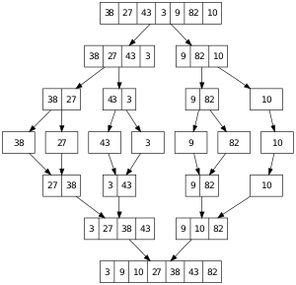
10.7 Merge Sort
Analysis of Merge
Code for Merge
Algorithm for Merge Sort
Trace of Merge Sort Algorithm
Analysis of Merge Sort
Code for Merge Sort
10.7, pgs. 592-597

Slide 91
Merge Sort
A merge is a common data processing operation performed on two sequences of data with the following characteristics:
Both sequences are ordered by the same comparison operator (that is, both sequences are sorted).
The result of the merge operation is a third sequence containing all the data from the first two sequences.
Analysis of Merge Sort:
For two input sequences each containing n elements, each element needs to move from its input sequence to the output sequence.
Merge time is O(n).
Space requirements:
The array cannot be merged in place.
Additional space usage is O(n).

Slide 92
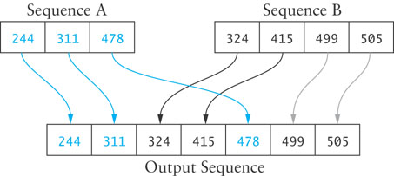
Merge Algorithm
Merge Algorithm
1. Access the first item from both sequences.
2. while not finished with either sequence
3. Compare the current items from the two sequences, copy the smaller current item to the output sequence, and access the next item from the input sequence whose item was copied.
4. Copy any remaining items from the first sequence to the output sequence.
5. Copy any remaining items from the second sequence to the output sequence.

Slide 93
Code for Merge
/** Merge data in two sorted input sequences into a sorted output sequence.
pre: Both input sequences are sorted.
post: The output sequence is sorted and contains all elements in both sequences.
@param left/end_left: left sequence
@param right/end_right: right sequence
@param out: first element in the output sequence
*/
template<typename RI>
void merge(RI left, RI end_left, RI right, RI end_right, RI out)
{
// While there is data in both input sequences
while ((left != end_left) && (right != end_right))
{
// Find the smaller and insert it into the output sequence.
if (*left < *right) *out++ = *left++;
else *out++ = *right++;
}
// Assert: one of the sequences has more items to copy.
// Copy remaining input from left/right sequence into the output.
while (left != end_left) *out++ = *left++;
while (right != end_right) *out++ = *right++;
}

Slide 94
Recursive Merge Sort
We can modify merging to sort a single, unsorted array
Split the array into two halves
Sort the left half
Sort the right half
Merge the two
This algorithm can be written with a recursive step
If the table has more than one element
Store the first half of the table in left_table
Store the second half of the table in right_table
Recursively apply the merge sort algorithm to left_table
Recursively apply the merge sort algorithm to right_table
Call the merge function with left_table and right_table as the input sequences and the original table as the output sequence.

Slide 95
Merge Sort
50
60
45
30
90
20
80
15
50
60
45
30
90
20
80
15
50
60
45
30
90
20
80
15

Slide 96
Merge Sort
50
60
45
30
90
20
80
15
50
60
45
30
90
20
80
15
50
60
45
30
50
60
45
30

Slide 97
Merge Sort
50
60
45
30
90
20
80
15
50
60
45
30
90
20
80
15
50
60
45
30
50
60
50
60

Slide 98
Merge Sort
50
60
45
30
90
20
80
15
50
60
45
30
90
20
80
15
50
60
45
30
50
60
60

Slide 99
Merge Sort
50
60
45
30
90
20
80
15
50
60
45
30
90
20
80
15
50
60
45
30
45
30
45
30

Slide 100
Merge Sort
50
60
45
30
90
20
80
15
50
60
45
30
90
20
80
15
50
60
30
45
30
45
45
30
45

Slide 101
Merge Sort
50
60
45
30
90
20
80
15
30
50
45
60
50
45
60
30
90
20
80
15
50
60
30
45
30
45
45
30

Slide 102
Merge Sort
50
60
45
30
90
20
80
15
30
50
45
60
50
45
60
30
90
20
80
15
90
20
80
15

Slide 103
Merge Sort
50
60
45
30
90
20
80
15
30
50
45
60
50
45
60
30
90
20
80
15
90
20
80
15
90
20

Slide 104
Merge Sort
50
60
45
30
90
20
80
15
30
50
45
60
50
45
60
30
90
20
80
15
90
20
20
90
80
15
90
20

Slide 105
Merge Sort
50
60
45
30
90
20
80
15
30
50
45
60
50
45
60
30
90
20
80
15
20
90
80
15
80
15

Slide 106
Merge Sort
50
60
45
30
90
20
80
15
30
50
45
60
50
45
60
30
90
20
80
15
20
90
80
15
80
15
80
15

Slide 107
Merge Sort
50
60
45
30
90
20
80
15
30
50
45
60
50
45
60
30
90
15
20
20
80
80
15
90
20
90
15
80

Slide 108
Merge Sort
50
15
60
20
45
30
30
45
90
50
20
60
80
80
15
90
30
50
45
60
50
45
60
30
90
15
20
20
85
80
15
90

Slide 109
Analysis of Merge Sort
Each backward step requires a movement of n elements from smaller-size arrays to larger arrays; the effort is O(n).
The number of steps which require merging is log n because each recursive call splits the array in half.
The total effort to reconstruct the sorted array through merging is O(n log n).
Going down through the recursion chain, sorting the left tables, a sequence of right table is allocation of size:
Since
a total of n additional storage locations are required.

Slide 110
Code for Merge Sort
#ifndef MERGE_SORT_H_
#define MERGE_SORT_H_
/** Sort data in the specified range using merge sort.
@param RI An iterator that meets the random-access iterator requirements
@param first A random access iterator that references the first element in the sequence to be sorted
@param last A random-access iterator that references 1 past the end of sequence */
template<typename RI>
void merge_sort(RI first, RI last)
{
if (last - first > 1)
{
// Split table into two new half tables.
typedef typename std::iterator_traits<RI>::value_type value_type;
RI middle = first + (last - first) / 2;
std::vector<value_type> left_table(first, middle);
std::vector<value_type> right_table(middle, last);
// Sort the halves.
merge_sort(left_table.begin(), left_table.end());
merge_sort(right_table.begin(), right_table.end());
// Merge the halves back into the original table.
merge(left_table.begin(), left_table.end(),
right_table.begin(), right_table.end(), first);
}
}
#endif //

Slide 111
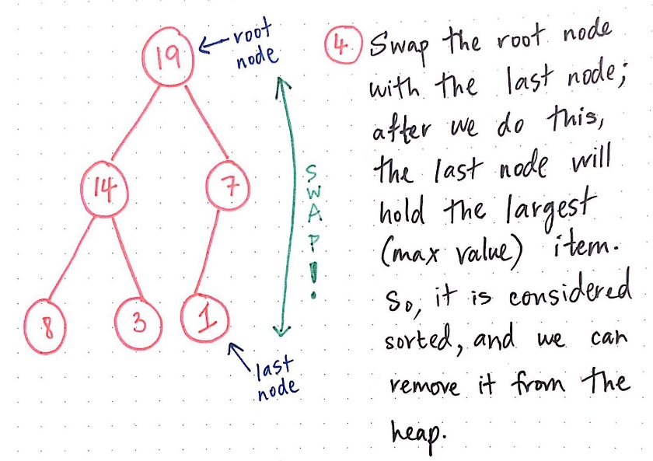
10.8 Heapsort
Heapsort Algorithm
Algorithm to Build a Heap
Analysis of Heapsort Algorithm
Code for Heapsort
10.8, pgs. 599-601

Slide 112
Heapsort
Merge sort time is O(n log n), but still requires, temporarily, n extra storage locations.
Heapsort is also O(n log n), but does not require any additional storage.
A max heap is used as its data structure with the largest value at the top.
Once we have a heap, we can remove one item at a time from the heap and place it at the bottom of the heap.
We then reheap by moving the larger of a node’s two children up the heap if needed, so the new heap will have the next largest item as its root.
As we continue to remove items from the heap, the heap size shrinks and the number of the removed items increases.
After we have removed the last element, the array will be sorted.

Slide 113
Heapsort
Max Heap?
Yes!
89
76
74
37
32
39
66
20
26
18
28
29
6

Slide 114
Heapsort
89
76
74
37
32
39
66
20
26
18
28
29
6

Slide 115
Heapsort
6
76
74
37
32
39
66
20
26
18
28
29
89

Slide 116
Heapsort
76
6
74
37
32
39
66
20
26
18
28
29
89

Slide 117
Heapsort
76
37
74
6
32
39
66
20
26
18
28
29
89

Slide 118
Heapsort
76
37
74
26
32
39
66
20
6
18
28
29
89

Slide 119
Heapsort
76
37
74
26
32
39
66
20
6
18
28
29
89

Slide 120
Heapsort
29
37
74
26
32
39
66
20
6
18
28
76
89

Slide 121
Heapsort
74
37
29
26
32
39
66
20
6
18
28
76
89

Slide 122
Heapsort
74
37
66
26
32
39
29
20
6
18
28
76
89

Slide 123
Heapsort
74
37
66
26
32
39
29
20
6
18
28
76
89

Slide 124
Heapsort
28
37
66
26
32
39
29
20
6
18
74
76
89

Slide 125
Heapsort
66
37
28
26
32
39
29
20
6
18
74
76
89

Slide 126
Heapsort
66
37
39
26
32
28
29
20
6
18
74
76
89

Slide 127
Heapsort
66
37
39
26
32
28
29
20
6
18
74
76
89

Slide 128
Heapsort
18
37
39
26
32
28
29
20
6
66
74
76
89

Slide 129
Heapsort
39
37
18
26
32
28
29
20
6
66
74
76
89

Slide 130
Heapsort
39
37
29
26
32
28
18
20
6
66
74
76
89

Slide 131
Heapsort
39
37
29
26
32
28
18
20
6
66
74
76
89

Slide 132
Heapsort
6
37
29
26
32
28
18
20
39
66
74
76
89

Slide 133
Heapsort
37
6
29
26
32
28
18
20
39
66
74
76
89

Slide 134
Heapsort
37
32
29
26
6
28
18
20
39
66
74
76
89

Slide 135
Heapsort
37
32
29
26
6
28
18
20
39
66
74
76
89

Slide 136
Heapsort
20
32
29
26
6
28
18
37
39
66
74
76
89

Slide 137
Heapsort
32
20
29
26
6
28
18
37
39
66
74
76
89

Slide 138
Heapsort
32
26
29
20
6
28
18
37
39
66
74
76
89

Slide 139
Heapsort
32
26
29
20
6
28
18
37
39
66
74
76
89

Slide 140
Heapsort
18
26
29
20
6
28
32
37
39
66
74
76
89

Slide 141
Heapsort
29
26
18
20
6
28
32
37
39
66
74
76
89

Slide 142
Heapsort
29
26
28
20
6
18
32
37
39
66
74
76
89

Slide 143
Heapsort
29
26
28
20
6
18
32
37
39
66
74
76
89

Slide 144
Heapsort
18
26
28
20
6
29
32
37
39
66
74
76
89

Slide 145
Heapsort
28
26
18
20
6
29
32
37
39
66
74
76
89

Slide 146
Heapsort
28
26
18
20
6
29
32
37
39
66
74
76
89

Slide 147
Heapsort
6
26
18
20
28
29
32
37
39
66
74
76
89

Slide 148
Heapsort
26
6
18
20
28
29
32
37
39
66
74
76
89

Slide 149
Heapsort
26
20
18
6
28
29
32
37
39
66
74
76
89

Slide 150
Heapsort
26
20
18
6
28
29
32
37
39
66
74
76
89

Slide 151
Heapsort
6
20
18
26
28
29
32
37
39
66
74
76
89

Slide 152
Heapsort
20
6
18
26
28
29
32
37
39
66
74
76
89

Slide 153
Heapsort
20
6
18
26
28
29
32
37
39
66
74
76
89

Slide 154
Heapsort
18
6
20
26
28
29
32
37
39
66
74
76
89

Slide 155
Heapsort
18
6
20
26
28
29
32
37
39
66
74
76
89

Slide 156
Heapsort
6
18
20
26
28
29
32
37
39
66
74
76
89

Slide 157
Heapsort
6
18
20
26
28
29
32
37
39
66
74
76
89

Slide 158
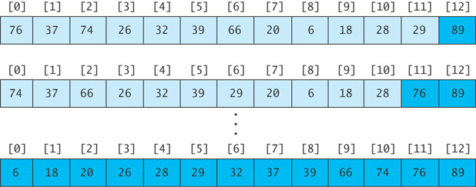
Revising the Heapsort Algorithm
If we implement the heap as an array
each element removed will be placed at the end of the array, and
the heap part of the array decreases by one element

Slide 159
Algorithm for In-Place Heapsort
Build a heap by rearranging the elements in an unsorted array.
1.1 while n is less than table.length
1.2 Increment n by 1. This inserts a new item into the heap
1.3 Restore the heap property
while the heap is not empty
Remove the first item from the heap by swapping it with the last item in the heap and restoring the heap property

Slide 160
Analysis of Heapsort
If we want to sort the sequence table bounded by the iterators first through last, we can consider the first item to be a heap of one item
We now consider the general case where the items in the sequence from table[first] through table[first + n - 1] form a heap;
Items from table[first + n] through table[last – 1] are not in the heap.
As each item is inserted, we must “reheap” to restore the heap property.
Because a heap of size n is a complete binary tree, it has log n levels
Building a heap requires finding the correct location for an item in a heap with log n levels
Each insert (or remove) is O(log n)
With n items, building a heap is O(n log n)
No extra storage is needed.

Slide 161
Code for Heapsort
#ifndef HEAPSORT_H_
#define HEAPSORT_H_
#include <algorithm>
/** Sort data in the specified range using heapsort. */
template<typename RI>
void heap_sort(RI first, RI last)
{
build_heap(first, last);
shrink_heap(first, last);
}
/** build_heap transforms the sequence into a heap. */
template<typename RI>
void build_heap(RI first, RI last)
{
int n = 1;
// Invariant: table[first] through table[first + n - 1] is a heap.
while (n < (last - first))
{
++n; // Add a new item to the heap and reheap.
RI child = first + n - 1;
RI parent = first + (child - first - 1) / 2; // Find parent.
while ((parent >= first) && (*parent < *child))
{
std::iter_swap(parent, child); // Exchange elements.
child = parent;
parent = first + (child - first - 1) / 2;
}
}
}

Slide 162
Code for Heapsort
/** shrink_heap transforms a heap into a sorted sequence. */
template<typename RI>
void shrink_heap(RI first, RI last)
{
RI n = last;
/* Invariant: [first] - [first + n - 1] is a heap. [first + n] - [last - 1] is sorted. */
while (n != first)
{
--n;
std::iter_swap(first, n); // swap top and last of heap
RI parent = first;
while (true)
{
int temp = 2 * (parent - first) + 1;
if (temp >= (n - first)) break; // No more children.
RI left_child = first + temp;
RI right_child = left_child + 1;
// Find the larger of the two children.
RI max_child = left_child;
if ((right_child < n) && (*left_child < *right_child)) max_child = right_child;
if (*parent < *max_child) // If the parent is smaller than the larger child
{
std::iter_swap(parent, max_child); // Swap the parent and child.
parent = max_child; // Continue at the child level.
}
else break; // Heap property is restored. Exit the loop.
}
}
}
#endif

Slide 163
Be Safe

