Slide 1
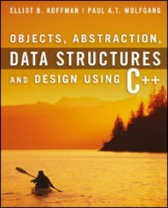
Welcome to
CS 235 Data Structures
Maps and Sets (31)
Chapter 9.2-3, pgs. 521-542

Slide 2
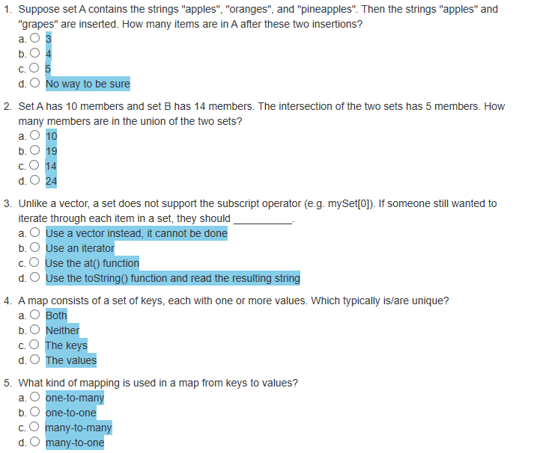
Attendance Quiz #30

Slide 3
Tip #31: Equality vs Equivalence
STL is packed in comparisons of objects to see if they have the same value.
Find – locate the first object of a particular value in a specified range.
Insert – add a new element to a set if not already in the set.
When are values "the same"?
Find's definition of "the same" is equality, which is based on operator==.
Set insert's definition of "the same" is equivalence, which is based on operator<.
Equal (operator==) returns true if "x == y", else false.
Equivalence (operator<) is based on the relative ordering of object values and returns true if neither object precedes the other, else false (ie. !(w1 < w2) && !(w2 < w1)).
Since a Dog is not less than a Cat and a Cat is not less than a Dog, then
A Dog and a Cat are considered equivalent (as an mammal).

Slide 4
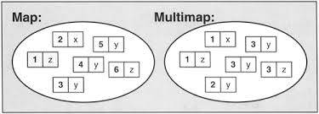
9.2 Maps and Multimaps
The map Functions
Defining the Compare Function
The multimap
9.2, pgs. 521-530

Slide 5
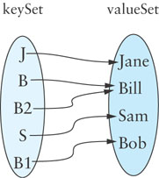
Maps
A map is effectively a set of key-value pairs whose values are accessed via the key (not key-value).
STL map keys are ordered (sorted) – iterators will return values in key sorted order.
STL unordered_map keys are not in any particular order with respect to either their keys.
The map is a template class that takes the following template parameters:
Key_Type: The type of the keys contained in the key set
Value_Type: The type of the values in the value set
Compare: A function class (functor) that determines the ordering of the keys (default is stl::less<K> ).
Allocator: The memory allocator for key objects; we will use the library-supplied default
(J, Jane)
(B, Bill)
(S, Sam)
(B1, Bob)
(B2, Bill)

Slide 6
Standard Library Class pair
The C++ standard library defines the class pair in the header <utility>.
This class is a simple grouping of two values typically of different types.
Since all of its members are public, it is declared as a struct.
template<typename T1, typename T2>
struct pair
{
T1 first;
T2 second;
// Construct a pair from two values.
pair(const T1& x, const T2& y) : first(x), second(y) {}
// Construct a default pair.
pair() : first(T1()), second(T2()) {}
// Construct an assignable pair
template<type Other_T1, type Other_T2>
pair(const pair<Other_T1, Other_T2>& other)
{
first = other.first;
second = other.second;
}
};

Slide 7
Standard Library Class pair
Pairs are used as the return type from functions that need to return two values, such as the element type for maps.
/** Function to create a pair object */
template<typename T1, typename T2>
make_pair(const T1& firstValue, const T2& secondValue)
{
return pair<T1&, T2&>(firstValue, secondValue);
}
Comparing pair objects is needed for insertion in a map.
/** Less-than operator */
template<typename T1, typename T2>
bool operator<(pair<T1, T2>& lhs, pair<T1, T2>& rhs)
{
return (lhs.first < rhs.first) ||
(!(rhs.first < lhs.first) && (lhs.second < rhs.second));
}

Slide 8
Defining the Compare Function
The default Compare template parameter is the Key_Type’s less-than operator.
If Key_Type is a primitive type or the string class, the < operator is defined.
All other types must define a less-than function pointer or class functor.
Let us assume that we want to use the class Person, with data fields family_name and given_name to be the key in a map.
The family_name should determine the ordering of Person objects.
If two Person objects have the same family_name, then we need to use the given_name.
struct Compare_Person
{
bool operator()(const Person& lhs, const Person& rhs)
{
if (lhs.family_name < rhs.family_name) return true;
return ((lhs.family_name == rhs.family_name) &&
(lhs.given_name < rhs.given_name));
}
}

Slide 9
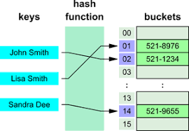
9.3 Hash Tables
Hash Codes and Index Calculation
Functions for Generating Hash Codes
Open Addressing
Open Addressing
Traversing a Hash Table
Deleting an Item Using Open Addressing
Reducing Collisions by Expanding the Table Size
Reducing Collisions Using Quadratic Probing
Problems with Quadratic Probing
Chaining
Performance of Hash Tables
9.3, pgs. 530-541

Slide 10
Ordered / Unordered Sets and Maps
The C++ standard library uses a special type of binary search tree, called a balanced binary search tree, to implement the ordered set and map classes.
This provides access to items in O(log n) time.
Sets and maps can also be implemented using a data structure known as a hash table, which has some advantages over balanced search trees.
The goal of hash table is to be able to access an entry based on its key value, not its location.
We want to be able to access an entry directly through its key value, rather than by having to determine its location first by searching for the key value in an array.
The "order of elements" may change when the container is modified (upon insertion/deletion).
Using a hash table enables us to retrieve an entry in constant time (on average, O(1)).

Slide 11
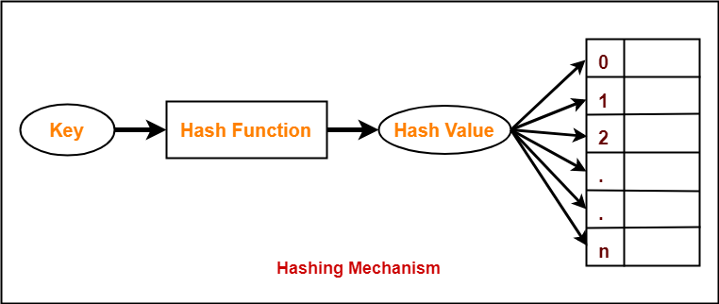
Hash Codes and Index Calculation
The basis of hashing is to transform the item’s key value into an integer value (its hash code) which is then transformed into a table index.

Slide 12
Hash Codes and Index Calculation
If a text contains only ASCII values, which are the first 128 Unicode values, we could use a table of size 128 and let its location in the table
int index = ascii_char
be the index of the character we are seeking the table.
However, what if all 65,536 Unicode characters were allowed?
If you assume that on average 100 characters were used, you could use a table of 200 characters and compute the index by:
int index = uni_char % 200
. . . | . . .
65 | A, 8
66 | B, 2
67 | C, 3
68 | D, 4
69 | E, 12
70 | F, 2
71 | G, 2
72 | H, 6
73 | I, 7
74 | J, 1
75 | K, 2
. . . | . . .

Slide 13
Hash Codes and Index Calculation
If a text contains this snippet:
. . . mañana (tomorrow), I'll finish my program. . .
Given the following Unicode values:
Hexadecimal | Decimal | Name | Character
0x0029 | 41 | right parenthesis | )
0x00F1 | 241 | small letter n with tilde | ñ
The indices for letters 'ñ' and ')' are both 41
41 % 200 = 41 and 241 % 200 = 41
This is called a collision; we will discuss how to deal with collisions shortly.

Slide 14
Generating Hash Codes
For strings, simply summing the char values of all characters returns the same hash code for "sign" and "sing".
One algorithm that has shown good results uses the following formula:
s₀ x 31^{(n-1)} + s₁ x 31^{(n-2)} + … + s_{n-1}
where s_{i} is the i^{th} character of the string of length n.
“Cat” has a hash code of:
'C' x 312 + 'a' x 31 + 't' = 67,510
31 is a prime number, and prime numbers generate relatively few collisions.

Slide 15
Generating Hash Codes
In most applications, a key will consist of strings of letters or digits (such as a Social Security Number, an email address, or a partial ID) rather than a single character.
The number of possible key values is much larger than the table size.
Generating good hash codes typically is an experimental process.
The goal is a random distribution of values.
Simple algorithms sometimes generate lots of collisions.
Although the hash function result appears to be random and gives a random distribution of keys, keep in mind that the calculation is deterministic.
You always get the same hash code for a particular key.
If the object is not already present in the table, the probability that the table slot with this index is empty is proportional to how full the table is.
A good hash function should be relatively simple and efficient to compute - doesn't make sense to use an O(n) hash function to avoid doing an O(n) search.

Slide 16
Open Addressing
One way to organize hash tables is called Open addressing.
In open addressing, linear probing is used to access an item (type Entry_Type*) in a hash table
If the index calculated for an item's key is occupied by an item with that key, we have found the item.
Else, increment the index by one (wrapping around as needed.)
Keep incrementing until you find the key or a NULL entry (if the table is not full).
How do you know when to stop searching if the table is full and you have not found the correct value?
Stop when the index value for the next probe is the same as the hash code value for the object.
Or ensure that the table is never full by increasing its size after an insertion when its load factor exceeds a specified threshold.

Slide 17
Hash Code Insertion Example
Tom
Abe
Harry
Sam
Pete
Name | hash_fcn() | hash_fcn()%5
"Tom" | 84274 | 4
"Abe" | 65604 | 4
"Harry" | 69496448 | 3
"Sam" | 82879 | 4
"Pete" | 2484038 | 3
[0]
[1]
[2]
[3]
[4]
Tom

Slide 18
Hash Code Insertion Example
Abe
Harry
Sam
Pete
Name | hash_fcn() | hash_fcn()%5
"Tom" | 84274 | 4
"Abe" | 65604 | 4
"Harry" | 69496448 | 3
"Sam" | 82879 | 4
"Pete" | 2484038 | 3
[0]
[1]
[2]
[3]
Abe
[4]
Tom

Slide 19
Hash Code Insertion Example
Harry
Sam
Pete
Name | hash_fcn() | hash_fcn()%5
"Tom" | 84274 | 4
"Abe" | 65604 | 4
"Harry" | 69496448 | 3
"Sam" | 82879 | 4
"Pete" | 2484038 | 3
[0]
Abe
[1]
[2]
[3]
Abe
[4]
Tom

Slide 20
Hash Code Insertion Example
Harry
Sam
Pete
Name | hash_fcn() | hash_fcn()%5
"Tom" | 84274 | 4
"Abe" | 65604 | 4
"Harry" | 69496448 | 3
"Sam" | 82879 | 4
"Pete" | 2484038 | 3
[0]
Abe
[1]
[2]
[3]
Harry
[4]
Tom

Slide 21
Hash Code Insertion Example
Sam
Pete
Name | hash_fcn() | hash_fcn()%5
"Tom" | 84274 | 4
"Abe" | 65604 | 4
"Harry" | 69496448 | 3
"Sam" | 82879 | 4
"Pete" | 2484038 | 3
[0]
Abe
[1]
[2]
[3]
Harry
Sam
[4]
Tom

Slide 22
Hash Code Insertion Example
Pete
Name | hash_fcn() | hash_fcn()%5
"Tom" | 84274 | 4
"Abe" | 65604 | 4
"Harry" | 69496448 | 3
"Sam" | 82879 | 4
"Pete" | 2484038 | 3
Sam
[0]
Abe
[1]
[2]
[3]
Harry
Sam
[4]
Tom

Slide 23
Hash Code Insertion Example
Pete
Name | hash_fcn() | hash_fcn()%5
"Tom" | 84274 | 4
"Abe" | 65604 | 4
"Harry" | 69496448 | 3
"Sam" | 82879 | 4
"Pete" | 2484038 | 3
Sam
[0]
Abe
[1]
Sam
[2]
[3]
Harry
[4]
Tom

Slide 24
Hash Code Insertion Example
Pete
Name | hash_fcn() | hash_fcn()%5
"Tom" | 84274 | 4
"Abe" | 65604 | 4
"Harry" | 69496448 | 3
"Sam" | 82879 | 4
"Pete" | 2484038 | 3
[0]
Abe
[1]
Sam
[2]
Pete
[3]
Harry
[4]
Tom

Slide 25
Hash Code Insertion Example
Name | hash_fcn() | hash_fcn()%5
"Tom" | 84274 | 4
"Abe" | 65604 | 4
"Harry" | 69496448 | 3
"Sam" | 82879 | 4
"Pete" | 2484038 | 3
[0]
Abe
[1]
Sam
[2]
[3]
Harry
Pete
[4]
Tom

Slide 26
Hash Code Insertion Example
Name | hash_fcn() | hash_fcn()%5
"Tom" | 84274 | 4
"Abe" | 65604 | 4
"Harry" | 69496448 | 3
"Sam" | 82879 | 4
"Pete" | 2484038 | 3
Pete
[0]
Abe
[1]
Sam
[2]
[3]
Harry
[4]
Tom

Slide 27
Hash Code Insertion Example
Name | hash_fcn() | hash_fcn()%5
"Tom" | 84274 | 4
"Abe" | 65604 | 4
"Harry" | 69496448 | 3
"Sam" | 82879 | 4
"Pete" | 2484038 | 3
[0]
Abe
Pete
[1]
Sam
[2]
[3]
Harry
[4]
Tom

Slide 28
Hash Code Insertion Example
Name | hash_fcn() | hash_fcn()%5
"Tom" | 84274 | 4
"Abe" | 65604 | 4
"Harry" | 69496448 | 3
"Sam" | 82879 | 4
"Pete" | 2484038 | 3
[0]
Abe
Pete
[1]
Sam
[2]
Pete
[3]
Harry
[4]
Tom
Retrieval of "Tom" or "Harry" takes one step, O(1)
Because of collisions, retrieval of the others requires a linear search

Slide 29
Hash Code Insertion Example
Name | hash_fcn() | hash_fcn()%11
"Tom" | 84274 | 3
"Abe" | 65604 | 0
"Harry" | 69496448 | 10
"Sam" | 82879 | 5
"Pete" | 2484038 | 7
[0]
Abe
[1]
[2]
[3]
Tom
[4]
[5]
Sam
[6]
[7]
Pete
[8]
The best way to reduce the possibility of collision (and reduce linear search retrieval time because of collisions) is to increase the table size
[9]
[10]
Harry
You cannot traverse a hash table in a meaningful way since the sequence of stored values is arbitrary.

Slide 30
Given the hash function values to the right, fill in the hashed table values using a) linear probing, and b) quadratic probing.
Linear Probing
h(28) = 28
h(47) = 47
h(20) = 20
h(36) = 36
h(43) = 43
h(23) = 23
h(25) = 25
h(54) = 54
0
1
2
3
4
5
6
7
8
9
10
% 11 = 6
54
% 11 = 3
23
% 11 = 9
% 11 = 3 → 4
47
% 11 = 10
36
% 11 = 1
25
% 11 = 3 → 5
28
% 11 = 10 → 0
20
43

Slide 31
9.3 Hash Tables
Reducing Collisions by Expanding the Table Size
Reducing Collisions Using Quadratic Probing
9.3, pgs. 530-541

Slide 32
Quadratic Probing
Linear probing tends to form clusters of keys in the hash table, causing longer search chains.
Quadratic probing can reduce the effect of clustering.
Resolve collisions with a quadratic series (H+1², H+2², H+3², H+4²}, ..., H+k²)
For example, if an item has a hash code of 5, successive values of index will be 6 (5+1), 9 (5+4), 14 (5+9), 21 (5 +16), . . .
0
1
2
3
4
5
6
Capacity = 7
48
Insert | Hash | Probes
76
76%7 = 6
1
12
40
40%7 = 5
1
55
48
48%7 = 6
2
12
12%7 = 5
3
55
55%7 = 6
3
40
76

Slide 33
Given the hash function values to the right, fill in the hashed table values.
a) Linear probing
Linear Probing
Quadratic Probing
h(28) = 28 % 11 = 6
h(47) = 47 % 11 = 3
h(20) = 20 % 11 = 9
h(36) = 36 % 11 = 3 -> 4
h(43) = 43 % 11 = 10
h(23) = 23 % 11 = 1
h(25) = 25 % 11 = 3 -> 5
h(54) = 54 % 11 = 10 -> 0
0 | 54
1 | 23
2
3 | 47
4 | 36
5 | 25
6 | 28
7
8
9 | 20
10 | 43
54
0
1
2
3
4
5
6
7
8
9
10
23
47
36
b) Quadratic probing
h(28) = 28 % 11 = 6
h(47) = 47 % 11 = 3
h(20) = 20 % 11 = 9
h(36) = 36 % 11 = 3
h(43) = 43 % 11 = 10
h(23) = 23 % 11 = 1
h(25) = 25 % 11 = 3
h(54) = 54 % 11 = 10
28
25
-> 4
20
-> 4 -> 7
43
-> 0

Slide 34
Deleting an Item w/Open Addressing
When an item is deleted, you cannot simply set its table entry to null.
If we search for an item that may have collided with the deleted item, we may conclude incorrectly that it is not in the table.
0 | 54
1 | 23
2
3 | 47
4 | 36
5 | 25
6 | 28
7
8
9 | 20
10 | 43
28 →
×
Instead, store a dummy value or mark the location as available, but previously occupied.
deleted
Deleted items reduce search efficiency which is partially mitigated if they are marked as available.
You cannot replace a deleted item with a new item until you verify that the new item is not in the table.

Slide 35
Rehashing
To reduce collisions, use a prime number for the size of the table.
A fuller table results in more collisions, so, when a hash table becomes sufficiently full, a larger table should be allocated and the entries reinserted.
You must reinsert (rehash) values into the new table; do not simply transfer values as some search chains which were wrapped may break.
Deleted items are not reinserted, which saves space and reduces the length of some search chains.
Algorithm for Rehashing
Allocate a new hash table with twice the capacity of the original.
Reinsert each old table entry that has not been deleted into the new hash table.
Reference the new table instead of the original.

Slide 36
Be Safe

