Slide 1
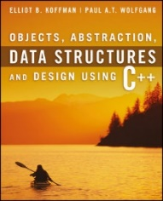
Welcome to
CS 235 Data Structures
Maps and Sets (30)
Chapter 9.1, pgs. 512-521

Slide 2
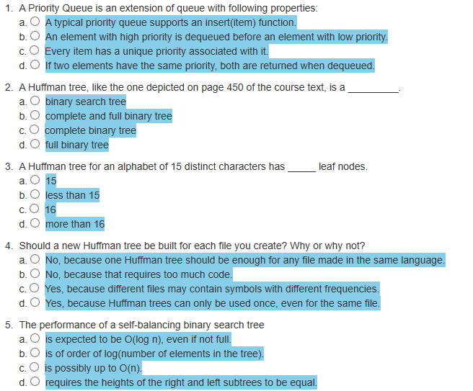
Attendance Quiz #29

Slide 3
Tip #30: Solving Compiler Errors
When you get any compiler error in MS Visual Studio, then in the Error List Panel, you will see ERROR CODE along corresponding error.
Enter that ERROR Code with keyword "MSDN" in GOOGLE, and you will get a link on MSDN.
In that link, you will find every detail on that error and information on how to fix it.
For other compilers, you can often search for the name of the compiler followed by the error message.

Slide 4
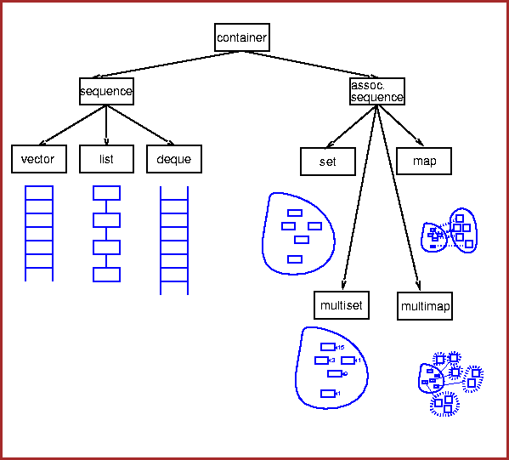
Sets and Maps
Chapter 9

Slide 5
Chapter Objectives
To understand the C++ set and map containers and how to use them.
To learn about hash coding and its use to facilitate efficient search and retrieval.
To study two forms of hash tables — open addressing and chaining
understand their relative benefits and performance trade-offs.
learn how to implement both hash table forms.
To be introduced to the implementation of maps and sets.
To see how two earlier applications can be implemented more easily using maps objects for data storage.

Slide 6
Chapter Objectives
To understand the C++ set and map containers and how to use them.
To learn about hash coding and its use to facilitate efficient search and retrieval.
To study two forms of hash tables — open addressing and chaining
understand their relative benefits and performance trade-offs.
learn how to implement both hash table forms.
To be introduced to the implementation of maps and sets.
To see how two earlier applications can be implemented more easily using maps objects for data storage.

Slide 7
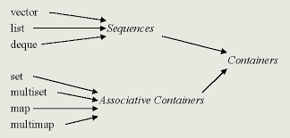
9.1 Associative Container Requirements
The Set Abstraction
The Set Functions
The multiset
Standard Library Class pair
9.1, pgs. 512-520

Slide 8
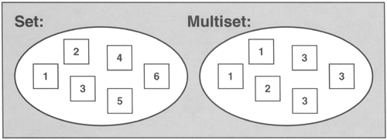
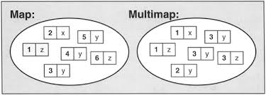
Introduction
Sequential containers:
Searching for a particular value in a sequential container is generally O(n). (An exception is a binary search for a sorted object, which is O(log n).)
Sequential containers include vector, list, and deque.
Associative containers:
Elements of associate containers are not indexed but must have unique key.
Do not reveal the order of insertion of items.
Elements follow a strict weak ordering using binary relation <.
Enable efficient search and retrieval of information (O(log n), O(1)).
Allow removal of elements without moving other elements around.
Associative containers include the set, multiset, map, and multimap.

Slide 9
Associative Container Requirements
Associative containers refer to a group of class templates in the STL library that implement ordered and unordered associative arrays.
Being STL templates, associate containers can be used to store arbitrary elements, such as integers or custom classes.
Associative container characteristics:
Key uniqueness:
in map and set each key must be unique.
multimap and multiset do not have this restriction.
Element composition:
In set and multiset each element is key; there are no mapped values.
In map and multimap each element is composed from a key and a mapped value.
Element ordering:
Elements follow a strict weak ordering.
Elements are accessible thru iterators.

Slide 10
Daily Life Examples Of Sets
A set is a collection of well-defined objects.
Sets are the term used in mathematics for a collection of objects.
We all have a group of some objects, collection of our favorite things, sets of books, a list of cities and countries in our life...
Sets in our daily live:
Kitchen: Plates are kept separate from bowls and cups. Sets of similar utensils are kept separately.
School Bags: Sets of notebooks and textbooks are kept separately.
Shopping Malls: Clothing and food courts shops are on different floors.
Playlists: Different playlists for rock songs, classical or any other genre.
Rules: There are disciplinary rules, rules for leave, hostel rules, timing rules.
House of Representatives: Members belonging to various departments have to sit separately from other departments (ie, the legal and finance departments don't sit intermixed with each other).

Slide 11
Introduction
Sequential containers:
Searching for a particular value in a sequential container is generally O(n). (An exception is a binary search for a sorted object, which is O(log n).)
Sequential containers include vector, list, and deque.
We consider another part of the container framework, the associative containers:
Are not indexed but must have unique key.
Do not reveal the order of insertion of items.
Elements follow a strict weak ordering using binary relation <.
Enable efficient search and retrieval of information.
Allow removal of elements without moving other elements around.
Associative containers include the set, multiset, map, and multimap.

Slide 12
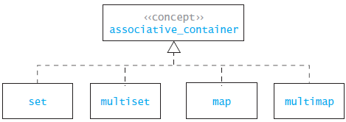
Associative Containers
A set is an associative container that contains no duplicate elements.
A multiset is a set that may contain duplicate elements.
A map is a collection of unique name-value pairs.
A multimap is a map that may contain duplicate keys.

Slide 13
Associative Container Requirements
Associative containers refer to a group of class templates in the STL library that implement ordered and unordered associative arrays.
Being STL templates, associate containers can be used to store arbitrary elements, such as integers or custom classes.
Associative container characteristics:
Key uniqueness: in map and set each key must be unique. multimap and multiset do not have this restriction.
Element composition: in map and multimap each element is composed from a key and a mapped value. In set and multiset each element is key; there are no mapped values.
Element ordering: elements follow a strict weak ordering accessible thru iterators.

Slide 14
A playlist of songs: you categorized different songs in the different playlists by finding relations between them.
Organizing your notebooks: you are a student then you must use this.
Categories article: you are a blogger, you have a fine set of articles.
Creating team: you are an organizer of your company, you have different sets of different people for different works.
Shopping: you are in a mall shopping for some grocery having a set of things that you want to buy.
Party organizer: you are an event organizer who have a set of events on your list.

Slide 15
The set Abstraction
Operations on sets include:
Testing for membership
Example: Is {5} in {1, 3, 5, 7} ?
true
Adding elements
Example: Insert {10} in {1, 3, 5, 7} equals
{1, 3, 5, 7, 10}
Removing elements
Example: Remove {5} from {1, 3, 5, 7, 10} equals
{1, 3, 7, 10}
Size of membership
Example: How many in {1, 3, 5, 7} ?
4
The union of two sets A, B is a set whose elements belong either to A or B or to both A and B.
Example: {1, 3, 5, 7} ∪ {2, 3, 4, 5} is
{1, 2, 3, 4, 5, 7}
The intersection of sets A, B is the set whose elements belong to both A and B.
Example: {1, 3, 5, 7} ∩ {2, 3, 4, 5} is
{3, 5}
The difference of sets A, B is the set whose elements belong to A but not to B.
Examples: {1, 3, 5, 7} – {2, 3, 4, 5} is
{1,7}
Set A is a subset of set B if every element of set A is also an element of set B.
Example: {1, 3, 5, 7} ⊂ {1, 2, 3, 4, 5, 7} is
true

Slide 16
The set Template Class
The set and multiset are implementations of the Set ADT.
The set is a template class that takes the following template parameters:
template< class Key_Type,
class Compare = std::less<Key>,
class Allocator = std::allocator<Key> >
class set;
where
Key_Type: The type of the item contained in the set.
Compare: A function class (functor) that determines the ordering of the keys. (Default is the less-than operator.)
Allocator: The container uses an allocator object to dynamically handle its storage needs. (We will use the library supplied default.)
Although not a requirement, C++ stores items in a set as ordered by their Compare function.
If you iterate through a set, you get a sorted list of the contents.

Slide 17
The set Default Parameters
class Compare
The elements of a set are ordered using the compare operator< or a user supplied class compare functor.
Two elements, a and b are considered equivalent if
(!(a < b) && !(b < a)) or
(!comp(a, b) && !comp(b, a)).
The set elements are always ordered according to this same criterion (operator< or comp).
class Allocator
Allocators handle all the requests for allocation and deallocation of memory for a given container.
List, set, and map containers change size during the execution of a program using some form of dynamic memory allocation.
Programs with frequent allocations of small amounts of memory may benefit from specialized user defined allocators, both in terms of running time and memory footprint.

Slide 18
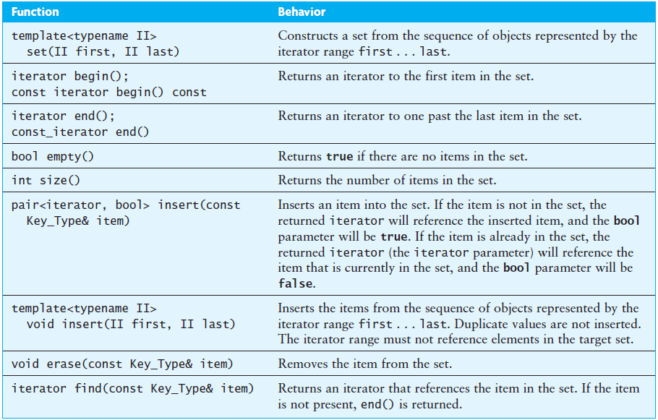
The set Functions

Slide 19
<algorithm>
The header <algorithm> defines a collection of functions especially designed to be used on ranges of elements.
A range is any sequence of objects that can be accessed through iterators or pointers, such as an array or an instance of some of the STL containers.
The elements are compared using operator< and considered equivalent if
(!(a < b) && !(b < a)) or (!comp(a, b) && !comp(b, a)).
The elements in the ranges are ordered according to this same criterion (operator< or comp).
Function | Behavior
set_union | Union of two sorted ranges.
set_difference | Difference of two sorted ranges.
set_intersection | Intersection of two sorted ranges.

Slide 20
Standard Library Class inserter
The iterator adaptor class inserter constructs an insert iterator used to insert new elements into container in successive locations starting at the iterator position iter.
Used by algorithms to insert elements into a container (rather than overwriting existing elements).
inserter takes two arguments:
a container
an iterator within the container
And returns a container iterator.
Each insertion appends the next element to the current end of the container.
template <class Container, class Iterator>
insert_iterator<Container> inserter(Container& c, Iterator i);

Slide 21
The set Union Function
Forms the set union of the elements in the sorted sequence [first1...last1) and the elements in the sorted sequence [first2...last2).
The return value is an output iterator to the initial position of the range where the resulting union set sequence is stored.
The elements are compared using operator<.
template <class IIter1, class IIter2, class OIter>
OIter set_union (IIter1 first1, IIter1 last1,
IIter2 first2, IIter2 last2,
OIter result);
Union:
set<string> set1;
set<string> set2;
set<string> set_u;
string data1[] = { "Apples", "Oranges", "Pineapples" };
string data2[] = { "Peaches", "Apples", "Grapes" };
set1.insert(data1, data1 + 3);
set2.insert(data2, data2 + 3);
set_union(set1.begin(), set1.end(), set2.begin(), set2.end(), inserter(set_u, set_u.begin()));
cout << "set1 + set2 is " << set_u << endl;
set1 + set2 is {Apples, Grapes, Oranges, Peaches, Pineapples}

Slide 22
Difference/Intersection Functions
Difference
set<string> set1;
set<string> set2;
set<string> set_d;
string data1[] = { "Apples", "Oranges", "Pineapples" };
string data2[] = { "Peaches", "Apples", "Grapes" };
set1.insert(data1, data1 + 3);
set2.insert(data2, data2 + 3);
set_difference(set1.begin(), set1.end(), set2.begin(), set2.end(), inserter(set_d, set_d.begin()));
cout << "set1 - set2 is " << set_d << endl;
set1 - set2 is {Oranges, Pineapples}
Intersection:
set<string> set1;
set<string> set2;
set<string> set_i;
string data1[] = { "Apples", "Oranges", "Pineapples" };
string data2[] = { "Peaches", "Apples", "Grapes" };
set1.insert(data1, data1 + 3);
set2.insert(data2, data2 + 3);
set_intersection(set1.begin(), set1.end(), set2.begin(), set2.end(), inserter(set_i, set_i.begin()));
cout << "set1 * set2 is " << set_i << endl;
set1 * set2 is {Apples}

Slide 23
Sets
#include <iostream>
#include <string>
#include "set_functions.h"
using namespace std;
int main()
{
set<string> set1;
set<string> set2;
set<string> set_u;
set<string> set_d;
set<string> set_i;
string data1[] = { "JA", "BB", "ZA", "QA", "DC", "RJ", "MJ", "AD", "AC", "RA" };
string data2[] = { "GQ", "AC", "AD" };
set1.insert(data1, data1 + 10);
set2.insert(data2, data2 + 3);
set_union(set1.begin(), set1.end(), set2.begin(), set2.end(), inserter(set_u, set_u.begin()));
cout << "set1 + set2 is " << set_u << endl;
set_difference(set1.begin(), set1.end(), set2.begin(), set2.end(), inserter(set_d, set_d.begin()));
cout << "set1 - set2 is " << set_d << endl;
set_intersection(set1.begin(), set1.end(), set2.begin(), set2.end(), inserter(set_i, set_i.begin()));
cout << "set1 * set2 is " << set_i << endl;
return 0;
}
/** Insertion (<<) operator. */
template<typename T>
ostream& operator<<(ostream& out, const set<T>& a_set)
{
string prefix = "{";
for (set<T>::const_iterator iter = a_set.begin(); iter != a_set.end(); ++iter)
{
out << prefix << *iter;
prefix = ", ";
}
return out << "}";
}
set1 + set2 is
set1 - set2 is
set1 * set2 is
{AC, AD, BB, DC, GQ, JA, MJ, QA, RA, RJ, ZA}
{BB, DC, JA, MJ, QA, RA, RJ, ZA}
{AC, AD}

Slide 24
The multiset
The multiset is the same as the set except that it does not impose the requirement that the items be unique.
The insert function always inserts a new item, and duplicate items are retained.
However, the erase function removes all occurrences of the specified item because there may be duplicates.
The functions lower_bound and upper_bound can be used to select the group of entries that match a desired value.
If the item is present, both functions return iterators :
lower_bound returns an iterator to the first occurrence of the specified value.
upper_bound returns an iterator to the smallest item that is larger than the specified value.
The desired entries are between the iterators returned by these two functions.
If the item is not present, both upper_bound and lower_bound return an iterator to the smallest element that is larger than the specified entry.

Slide 25
The multiset
The following function determines the number of occurrences of the string target in multiset<string> words_set:
int count_occurrences(const multiset<string>& words_set, const string& target)
{
multiset<string>::const_iterator first_iter = words_set.lower_bound(target);
multiset<string>::const_iterator last_iter = words_set.upper_bound(target);
int count = 0;
multiset<string>::const_iterator iter = first_iter;
while (iter != last_iter)
{
++count;
++iter;
)
return count;
}

Slide 26
Multisets
#include <iostream>
#include <string>
#include "multiset_functions.h"
using namespace std;
int main()
{
multiset<string> set1;
multiset<string> set2;
multiset<string> set_u;
multiset<string> set_d;
multiset<string> set_i;
string data1[] = { "JA", "BB", "ZA", "QA", "DC", "RJ", "MJ", "AD", "AC", "RA" };
string data2[] = { "GQ", "GQ", "ZA" };
set1.insert(data1, data1 + 10);
set2.insert(data2, data2 + 3);
set_union(set1.begin(), set1.end(), set2.begin(), set2.end(), inserter(set_u, set_u.begin()));
cout << "set1 + set2 is " << set_u << endl;
set_difference(set1.begin(), set1.end(), set2.begin(), set2.end(), inserter(set_d, set_d.begin()));
cout << "set1 - set2 is " << set_d << endl;
set_intersection(set1.begin(), set1.end(), set2.begin(), set2.end(), inserter(set_i, set_i.begin()));
cout << "set1 * set2 is " << set_i << endl; return 0;
}
/** Insertion (<<) operator. */
template<typename T>
ostream& operator<<(ostream& out, const multiset<T>& a_set)
{
string prefix = "{";
for (multiset<T>::const_iterator iter = a_set.begin(); iter != a_set.end(); ++iter)
{
out << prefix << *iter;
prefix = ", ";
}
return out << "}";
}
set1 + set2 is
set1 - set2 is
set1 * set2 is
{AC, AD, BB, DC, GQ, GQ, JA, MJ, QA, RA, RJ, ZA}
{AC, AD, BB, DC, JA, MJ, QA, RA, RJ}
{ZA}

Slide 27
Comparison of vectors and sets
 | Vectors | Sets
insert
you must specify the location where the item is to be inserted.
Position argument is a “hint” to speed up the insertion, but the exact position where the item goes is not under the caller’s control.
An iterator that points to the first of the newly inserted element.
In addition to the iterator referencing the inserted item, the set’s insert function returns a bool value indicating whether the item was inserted.
subscript operator function (operator[])
No subscript operator function (operator[]), therefore, elements cannot be accessed by index.
iterators
iterate and change through all its elements using an iterator object.
Must be type const_iterator - can’t change a set’s contents using an iterator.

Slide 28
Be Safe

