Slide 1
Welcome to
CS 235 Data Structures
Trees, 8.1 (25)

Slide 2
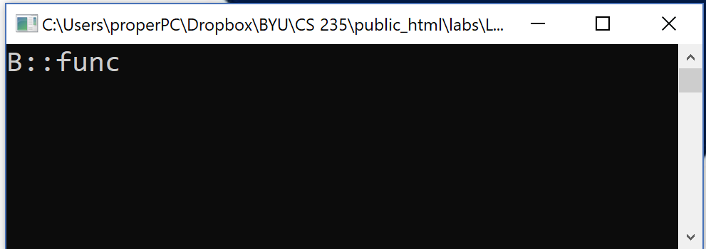
Tip #25: Compiler Warnings
Many programmers routinely ignore compiler warnings.
If the problem were serious, it would be an error, right?
Not so in C++! Sloppy programming may lead to erroneous program behavior, followed by a lot of difficult debugging.
#include <iostream>
using namespace std;
class B
{
public:
virtual void func() const { cout << "B::func"; }
};
class D : public B
{
public:
virtual void func() { cout << "D::func"; }
};
warning: D::func() hides B:func()
"Of course, that's what it's supposed to do!"
int main()
{
B* d = new D();
d->func();
return 0;
}
A compiler warning signals a potentially serious problem in your code.
Take compiler warnings seriously and strive to compile warning-free at the maximum warning level supported by your compiler.

Slide 3
Follow-up Questions...
How many recursion calls are made with 10 Towers of Hanoi disks?
What is a blob?
How does the order of recursive search effect the backtracking results? Is the solution unique?
2¹⁰ = 1024
A collection of cells with a common value.
A binary large object (BLOB) is a collection of concentrated data that's stored on a file in a database or on a specific program.
Although the name itself can sound complex, it relates to compressed binary data.
A different solution could result.
Backtracking finds the first solution.

Slide 4
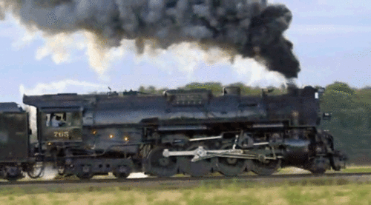
Lab 06 – Railroad

Slide 5
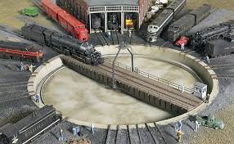
Lab 06 - Railroad
Create a railroad train station that uses a central turntable and roundhouses to store train cars as well as changes the order of cars entering and leaving the station.
Cars may enter the train station if the turntable is empty.
From the turntable cars can be moved to a "stack" roundhouse facility (LIFO) or a "queue" roundhouse facility (FIFO).
Train cars leave the train station by moving from the turntable to a "vector" of outbound cars.
Station 235
What objects (classes)?
Cars
Station
Stack, Queue, Vector
How to describe interactions?
UML
Stack
Queue
Vector
Incoming Cars
Outgoing Cars

Slide 6
Car
Vector<T>
<<interface>>
DequeInterface<T>
-id_:unsigned int
-container__:Deque<T>
+Car()
+Car(const unsigned int&)
+~Car()
+operator==(const Car&):bool
+operator!=(const Car&):bool
+toString() const:string
+Vector()
+~Vector()
+push_back(const T&):void
+pop_back():void
+back():T&
+size():size_t
+at(size_t):T&
+toString() const:string
+static const size_t
DEFAULT_CAPACITY = 4
+DequeInterface()
+~DequeInterface()
+push_front(const T&):void
+push_back(const T&):void
+pop_front():void
+pop_back():void
+front():T&
+back():T&
+size():size_t
+empty() const:bool
+at(size_t):T&
+toString() const:string
Station<T>
-train_:Vector<T>
-stack_:Stack<T>
-queue_:Queue<T>
-turnTableCar_:T
-empty:bool
Queue<T>
-container__:Deque<T>
+Queue()
+~Queue()
+push(const T&):void
+pop():void
+top():T&
+size():size_t
+at(size_t):T&
+toString() const:string
+Station()
+~Station()
+addCar(const T&):string
+removeCar():string
+topCar():string
+sizeTrain():string
+addStack():string
+removeStack():string
+topStack():string
+sizeStack():string
+addQueue():string
+removeQueue():string
+topQueue():string
+sizeQueue():string
+find(const T&):string
+toString() const:string
Deque<T>
-capacity:size_t
-num_items:size_t
-front_index:size_t
-rear_index:size_t
-the_data:T*
+Deque()
+~Deque()
+push_front(const T&):void
+push_back(const T&):void
+pop_front():void
+pop_back():void
+front():T&
+back():T&
+size():size_t
+empty() const:bool
+at(size_t):T&
+toString() const:string
-reallocate():void
Stack<T>
-container__:Deque<T>
+Stack()
+~Stack()
+push(const T&):void
+pop():void
+top():T&
+size():size_t
+at(size_t):T&
+toString() const:string

Slide 7
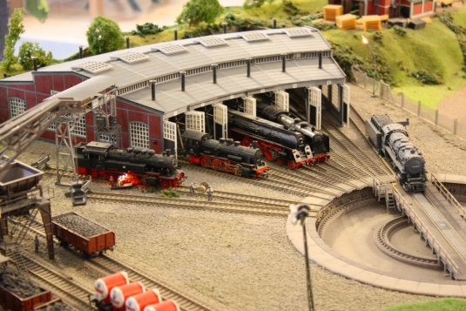
L06 – Railroad Wrapper Classes
Input Commands
Station 235
Station<T>
"Add:station xx"
"Add:stack"
"Add:queue"
"Remove:station"
"Remove:stack"
"Remove:queue"
"Top:station"
"Top:stack"
"Top:queue"
"Size:stack"
"Size:queue"
"Size:train"
"Find xx"
"Queue"
"Stack"
"Train"
string addCar(const T&);
string addStack();
string addQueue();
string removeCar();
string removeStack();
string removeQueue();
string topCar();
string topStack();
string topQueue();
string sizeStack();
string sizeQueue();
string sizeTrain();
string find(const T&);
string queueToString();
string stackToString();
string vectorToString();
string toString();
Vector<T>, Queue<T>, Stack<T>
void push(const T&);
void pop();
void top();
size_t size();
T& at(size_t);
string toString() const;
<<interface>>
DequeInterface<T>
Deque<T>
void push_front(const T&);
void push_back(const T&);
void pop_front();
void pop_back();
T& front();
T& back();
size_t size();
bool empty() const;
T& at(size_t);
string toString() const;
typedef struct Car car_t;

Slide 8
Circular Array as a Queue Container
While the time efficiency of using a r double-linked list to implement a queue is “acceptable”, there are however some inefficiencies:
Storage space is increased when using a linked list due to references (links) stored in the nodes.
Pointer arithmetic used to add/delete from the list takes time.
A contiguous array implementation also is “acceptable” and it mitigates space and pointer inefficiencies, but:
While insertion at rear of array is constant time O(1), removal from the front is linear time O(n).
While removal from rear of array is constant time O(1), insertion at the front is linear time O(n).
How can we avoid these inefficiencies and still use an array to implement our queue?

Slide 9
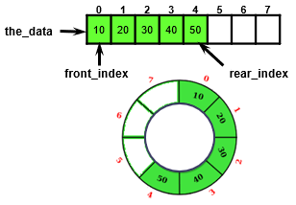
Circular Array ADT Queue Design
A Circular Array ADT Queue uses an object with four size_t type data members:
size_t capacity;
size_t num_items;
size_t front_index;
size_t rear_index;
And a pointer to the data member, the_data to point to a dynamically-allocated array
T* the_data;
And a default array allocation size
#define DEFAULT_CAPACITY 8

Slide 10
Queue<string>
capacity
num_items
front_index
rear_index
the_data
#define DEFAULT_CAPACITY 4
template<typename T>
class Queue
{
private:
size_t capacity;
size_t num_items;
size_t front_index;
size_t rear_index;
T* the_data;
4
0
0
3
front_index
0
1
2
3
Queue(void) :
capacity(DEFAULT_CAPACITY),
num_items(0),
front_index(0),
rear_index(DEFAULT_CAPACITY - 1),
the_data(new T[DEFAULT_CAPACITY]) {}
rear_index
circular array
(strings)

Slide 11
Queue<string>::push(const T& item)
push("Maybe")
capacity
num_items
front_index
rear_index
the_data
Maybe
4
0
1
void push(const T& item)
{
if (num_items == capacity)
{
reallocate();
}
num_items++;
rear_index = (rear_index + 1) % capacity;
the_data[rear_index] = item;
}
0
3
0
front_index
0
1
2
3
rear_index
circular array
(strings)

Slide 12
Queue<string>::push(const T& item)
push("Now")
capacity
num_items
front_index
rear_index
the_data
Now
4
1
2
void push(const T& item)
{
if (num_items == capacity)
{
reallocate();
}
num_items++;
rear_index = (rear_index + 1) % capacity;
the_data[rear_index] = item;
}
0
0
1
rear_index
0
1
2
3
front_index
Maybe
circular array
(strings)

Slide 13
Queue<string>::push(const T& item)
push("is")
capacity
num_items
front_index
rear_index
the_data
is
4
2
3
void push(const T& item)
{
if (num_items == capacity)
{
reallocate();
}
num_items++;
rear_index = (rear_index + 1) % capacity;
the_data[rear_index] = item;
}
0
1
2
front_index
0
1
2
3
Maybe
rear_index
Now
circular array
(strings)

Slide 14
Queue<string>::push(const T& item)
push("the")
capacity
num_items
front_index
rear_index
the_data
the
4
3
4
void push(const T& item)
{
if (num_items == capacity)
{
reallocate();
}
num_items++;
rear_index = (rear_index + 1) % capacity;
the_data[rear_index] = item;
}
0
2
3
front_index
0
1
2
3
Maybe
Now
rear_index
is
circular array
(strings)

Slide 15
Queue<string>::pop()
capacity
num_items
front_index
rear_index
the_data
pop()
4
4
3
void pop()
{
num_items--;
front_index = (front_index + 1) % capacity;
return;
}
0
1
3
front_index
0
1
2
3
Maybe
Now
is
rear_index
the
circular array
(strings)

Slide 16
Queue<string>::push(const T& item)
push("time")
capacity
num_items
front_index
rear_index
the_data
time
4
3
4
void push(const T& item)
{
if (num_items == capacity)
{
reallocate();
}
num_items++;
rear_index = (rear_index + 1) % capacity;
the_data[rear_index] = item;
}
1
3
0
0
1
2
3
Maybe
front_index
Now
is
rear_index
the
circular array
(strings)

Slide 17
reallocate
capacity
num_items
front_index
rear_index
the_data
push("for")
4
4
void push(const T& item)
{
if (num_items == capacity)
{
reallocate();
}
num_items++;
rear_index = (rear_index + 1) % capacity;
the_data[rear_index] = item;
}
1
0
rear_index
0
1
2
3
time
front_index
Now
is
the
circular array
(strings)

Slide 18
reallocate
capacity
num_items
front_index
rear_index
the_data
push("for")
4
4
new_capacity
old
i
new_data
8
void reallocate()
{
size_t new_capacity = 2 * capacity;
T* new_data = new T[new_capacity];
size_t old = front_index;
for (size_t i = 0; i < num_items; ++i)
{
new_data[i] = the_data[old];
old = (old + 1) % capacity;
}
front_index = 0;
rear_index = num_items – 1;
capacity = new_capacity;
swap(the_data, new_data);
delete[] new_data;
}
1
3
2
1
0
0
4
2
1
0
rear_index
0
1
2
3
0
1
2
3
4
5
6
7
time
Now
front_index
Now
is
is
the
the
time
circular array
(strings)

Slide 19
reallocate
capacity
num_items
front_index
rear_index
the_data
push("for")
4
8
4
new_capacity
old
i
new_data
8
void reallocate()
{
size_t new_capacity = 2 * capacity;
T* new_data = new T[new_capacity];
size_t old = front_index;
for (size_t i = 0; i < num_items; ++i)
{
new_data[i] = the_data[old];
old = (old + 1) % capacity;
}
front_index = 0;
rear_index = num_items – 1;
capacity = new_capacity;
swap(the_data, new_data);
delete[] new_data;
}
1
0
0
0
4
3
rear_index
0
1
2
3
0
1
2
3
4
5
6
7
time
Now
front_index
Now
is
is
the
the
time
circular array
(strings)

Slide 20
reallocate
capacity
num_items
front_index
rear_index
the_data
push("for")
8
4
new_capacity
old
i
new_data
8
void reallocate()
{
size_t new_capacity = 2 * capacity;
T* new_data = new T[new_capacity];
size_t old = front_index;
for (size_t i = 0; i < num_items; ++i)
{
new_data[i] = the_data[old];
old = (old + 1) % capacity;
}
front_index = 0;
rear_index = num_items – 1;
capacity = new_capacity;
swap(the_data, new_data);
delete[] new_data;
}
0
0
3
4
rear_index
0
1
2
3
0
1
2
3
4
5
6
7
time
Now
front_index
Now
is
is
the
the
time
circular array
(strings)

Slide 21
reallocate
capacity
num_items
front_index
rear_index
the_data
push("for")
8
4
new_capacity
old
i
new_data
8
void reallocate()
{
size_t new_capacity = 2 * capacity;
T* new_data = new T[new_capacity];
size_t old = front_index;
for (size_t i = 0; i < num_items; ++i)
{
new_data[i] = the_data[old];
old = (old + 1) % capacity;
}
front_index = 0;
rear_index = num_items – 1;
capacity = new_capacity;
swap(the_data, new_data);
delete[] new_data;
}
0
0
3
4
front_index
0
1
2
3
4
5
6
7
Now
0
time
is
1
Now
the
2
is
rear_index
time
3
the

Slide 22
Queue<string>::push(const T& item)
push("for")
capacity
num_items
front_index
rear_index
the_data
for
8
4
5
void push(const T& item)
{
if (num_items == capacity)
{
reallocate();
}
num_items++;
rear_index = (rear_index + 1) % capacity;
the_data[rear_index] = item;
}
0
3
4
front_index
0
1
2
3
4
5
6
7
Now
is
the
rear_index
time

Slide 23
Queue<string>::push(const T& item)
push("for")
capacity
num_items
front_index
rear_index
the_data
for
8
4
5
void push(const T& item)
{
if (num_items == capacity)
{
reallocate();
}
num_items++;
rear_index = (rear_index + 1) % capacity;
the_data[rear_index] = item;
}
0
3
4
front_index
0
1
2
3
4
5
6
7
Now
is
the
time
rear_index
for

Slide 24
#include <iostream>
#include <string>
#include <sstream>
#include <fstream>
#include <exception>
using namespace std;
#include "Car.h"
#include "Station.h"
int main(int argc, char* argv[])
{
ifstream in(argv[1]);
ostream& out = (argc > 2) ? *(new ofstream(argv[2])) : cout;
Station<Car>* station = new Station<Car>();
for (string line; getline(in, line);)
{
if (line.size() == 0) continue;
out << line;
try
{
if (line.substr(0, 11) == "Add:station") { }
else if (line.substr(0, 9) == "Add:stack") { }
else if (line.substr(0, 9) == "Add:queue") { }
else if (line.substr(0, 14) == "Remove:station") { }
else if (line.substr(0, 12) == "Remove:stack") { }
else if (line.substr(0, 12) == "Remove:queue") { }
else if (line.substr(0, 11) == "Top:station") { }
else if (line.substr(0, 9) == "Top:stack") { }
else if (line.substr(0, 9) == "Top:queue") { }
else if (line.substr(0, 10) == "Size:stack") { }
else if (line.substr(0, 10) == "Size:queue") { }
else if (line.substr(0, 10) == "Size:train") { }
else if (line.substr(0, 4) == "Find") { }
else if (line.substr(0, 5) == "Queue") { }
else if (line.substr(0, 5) == "Stack") { }
else if (line.substr(0, 5) == "Train") { }
else { out << "????? " << "[" << line << "]"; }
}
catch (exception& e) { out << e.what(); }
out << endl;
}
delete station;
if (&out != &cout) delete(&out);
in.close();
return 0;
}
#ifndef STATION_H
#define STATION_H
#include "Stack.h"
#include "Queue.h"
#include "Vector.h"
template <typename T>
class Station
{
private:
Vector<T> train_;
Stack<T> stack_;
Queue<T> queue_;
T turnTableCar_;
public:
Station() {}
~Station() {}
string addCar(const T&) { return string("addCar"); }
string removeCar() { return string("removeCar"); }
string topCar() { return string("topCar"); }
string sizeTrain() { return string("1"); }
string addStack() { return string("addStack"); }
string removeStack() { return string("removeStack"); }
string topStack() { return string("topStack"); }
string sizeStack() { return string("1"); }
string addQueue() { return string("addQueue"); }
string removeQueue() { return string("removeQueue"); }
string topQueue() { return string("topQueue"); }
string sizeQueue() { return string("sizeQueue"); }
string find(const T&) { return string("find"); }
// toString functions
string vectorToString() const { return string("vectorToString"); }
string queueToString() const { return string("queueToString"); }
string stackToString() const { return string("stackToString"); }
};
#endif
#ifndef DEQUE_H
#define DEQUE_H
#include "DequeInterface.h"
template <typename T>
class Deque
{
private:
T* data;
public:
Deque() {}
~Deque() = default;
/** Insert item at front of deque */
virtual void push_front(const T& value) { return; }
/** Insert item at rear of deque */
virtual void push_back(const T& value) { return; }
/** Remove the front item of the deque */
virtual void pop_front(void) { return; }
/** Remove the rear item of the deque */
virtual void pop_back(void) { return; }
/** Return the front item of the deque */
virtual T& front(void) { return data[0]; }
/** Return the rear item of the deque */
virtual T& back(void) { return data[0]; }
/** Return the number of items in the deque */
virtual size_t size(void) { return 0; }
/** Return true if deque is empty */
virtual bool empty(void) { return true; }
/** Return item in deque at index (0 based) */
virtual T& at(size_t index) { return data[0]; }
/** Return the deque items */
virtual std::string toString(void)
{ return string("deque.toString()"); }
};
#endif
#ifndef STACK_H
#define STACK_H
#include "Deque.h"
template <typename T>
class Stack
{
private:
Deque<T> stack_;
public:
};
#endif
#ifndef VECTOR_H
#define VECTOR_H
#include "Deque.h"
template <typename T>
class Vector
{
private:
Deque<T> vector_;
public:
};
#endif
#ifndef QUEUE_H
#define QUEUE_H
#include "Deque.h"
template <typename T>
class Queue
{
private:
Deque<T> queue_;
public:
};
#endif
#ifndef CAR_H
#define CAR_H
struct Car
{
Car() {}
Car(string s) {}
~Car() = default;
bool operator==(const Car) {}
};
#endif

Slide 25
Trees
Chapter 8

Slide 26
Chapter Objectives
To learn how to use a tree to represent a hierarchical organization of information
To learn how to use recursion to process trees
To understand the different ways of traversing a tree
To understand the differences between binary trees, binary search trees, and heaps
To learn how to implement binary trees, binary search trees, and heaps using linked data structures and arrays
To learn how to use a binary search tree to store information so that it can be retrieved in an efficient manner
To learn how to use a Huffman tree to encode characters using fewer bits than ASCII or Unicode, resulting in smaller files and reduced storage requirements

Slide 27
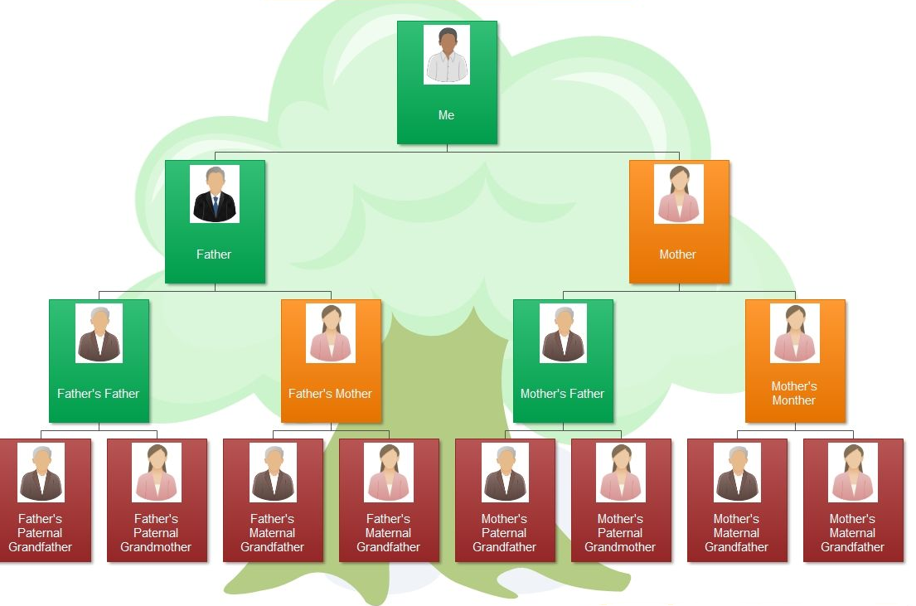
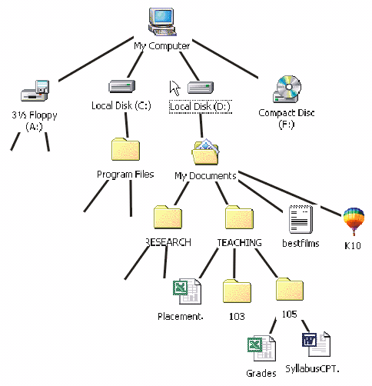
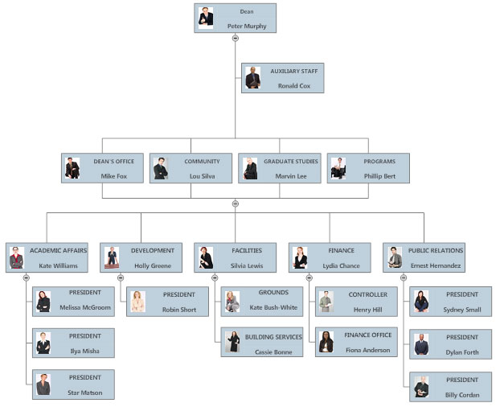
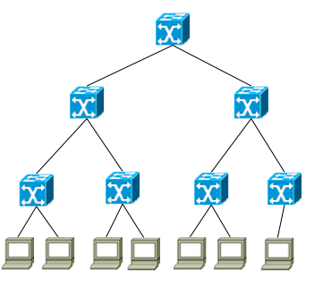
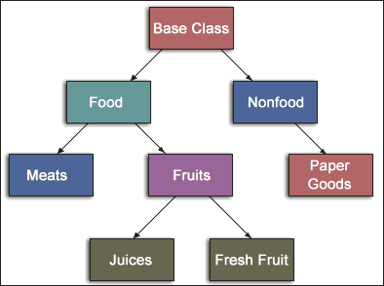
Trees - Introduction
All previous data organizations we've studied are linear—each element can have only one predecessor and one successor.
Accessing all elements in a linear sequence is O(n).
Trees are nonlinear and hierarchical.
Tree nodes can have multiple successors (but only one predecessor).
Trees can represent hierarchical organizations of information:
Class hierarchy
Disk directory and subdirectories
Business organizations
Networking topologies
Family organizations

Slide 28
Trees - Introduction
Trees are recursive data structures because they can be defined recursively.
Many methods to process trees are written recursively.
post-order
pre-order
in-order
This chapter focuses on the binary tree.
In a binary tree each element has two successors.
Binary trees can be represented by arrays and by linked data structures.
Searching a binary search tree, generally is more efficient than linearly searching an ordered list—O(log n) versus O(n).

Slide 29
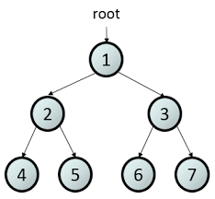
8.1 Tree Terminology and Applications
Tree Terminology
Binary Trees
Some Types of Binary Trees
Fullness and Completeness
General Trees
8.1, pgs. 447-453

Slide 30
Tree Terminology
A tree is a hierarchical data structure of elements or nodes, with each node linked to its descendants.

Slide 31
Tree Terminology
A tree is a hierarchical data structure of elements or nodes, with each node linked to its descendants.
The node at the top of a tree is called the root
The link from a node to its descendant is called a branch
Dog
A node is a parent of its immediate descendant nodes
Cat
Wolf
Descendants of a parent node are called its children
Bear
Nodes that have the same parent are siblings
A node that has no children is called a leaf node
A subtree of a node is a tree whose root is a child of that node

Slide 32
Tree Terminology
Each node in a tree has exactly one parent, except for the root node which has no parent.
Leaf nodes also are known as external nodes, and non-leaf nodes are known as internal nodes.
A generalization of the parent-child relationship is the ancestor-descendant relationship.
The depth of a node is the number of nodes from the root (defined recursively):
If a node is the root of a tree, its depth is 0.
If a node is not the root of a tree, its depth
is 1 + the depth of its parent.
Depth 0
Height 3
Level 1
Dog
Depth 1
Height 1
Level 2
Cat
Pig
Depth 1
Height 2
Level 2
The height of a node is the number of nodes in the longest path from the node to a leaf node.
Depth 2
Height 1
Level 3
Wolf
The level of a node is its depth + 1.

Slide 33
Fullness, Predecessor, Successor
Every node in a binary tree has at most 2 children.
Each node contains
Data
Pointer to left child (T_{L})
Pointer to right child (T_{R}).
7
1
10
0
3
9
12
A full binary tree is a binary tree where all internal nodes have exactly 2 children.
2
5
11
13
A node predecessor is the left right-most node.
4
6
A node successor is the right left-most mode.
Root Successor
Root Predecessor

Slide 34
Completeness
Height: 4
Level: 1
7
Note: not a full binary tree as node 9 only has 1 child.
Height: 3
Level: 2
3
10
Height: 2
Level: 3
1
5
9
11
Height: 1
Level: 4
0
2
4
6
8
A complete binary tree of height h
is filled (has a value) down to level (h – 1) and,
at level h, any un-filled nodes are to the right.
Also, with a complete binary tree,
All nodes down to level (h – 2) have two children.
If a node at level (h – 1) has one child, it is a left child and all nodes to the left have two children.

Slide 35
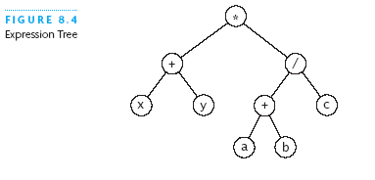
Expression Tree
Each node contains an operator or an operand.
Operands are stored in leaf nodes.
Parentheses are not stored in the tree because the tree structure dictates the order of operand evaluation.
Operators in nodes at higher tree levels are evaluated after operators in nodes at lower sub-tree levels.
(x + y) * ((a + b) / c)

Slide 36
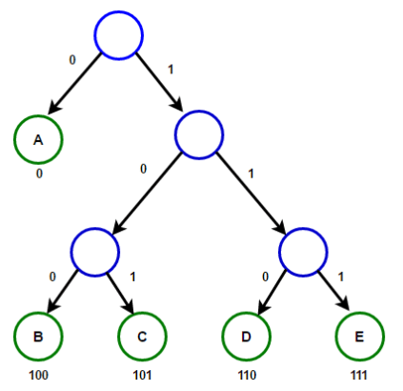
Huffman Tree
A Huffman tree represents Huffman codes for characters that might appear in a text file.
As opposed to ASCII or Unicode, Huffman code uses different numbers of bits to encode letters; more common characters use fewer bits.
Many programs that compress text files use Huffman codes.

Slide 37
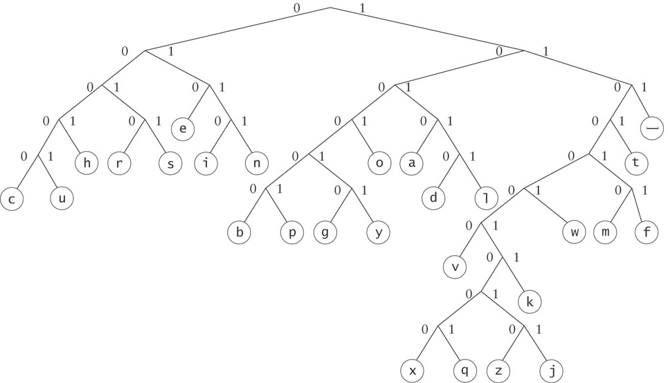
Huffman Tree
To form a code, traverse the tree from the root to the chosen character, appending 0 if you branch left, and 1 if you branch right.
Examples:
e : 010
d : 10110

Slide 38
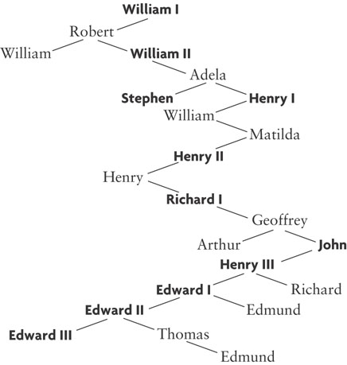
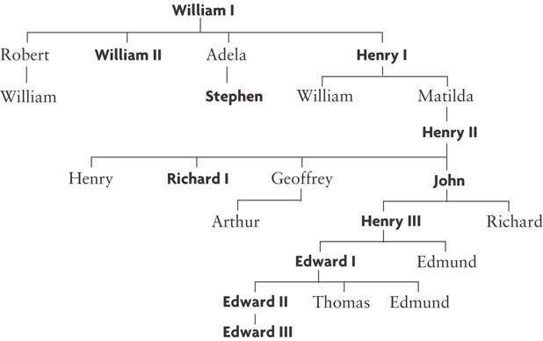
General Trees
In general, any tree can be represented using a binary tree.
Children
Siblings
Children
Siblings
Children
Siblings
Children
The left branch of a node is the oldest child, and each right branch is connected to the next younger sibling (if any).
Siblings
Children
Siblings
Siblings

Slide 40
Tip #26: Constructor Do's and Don't
Avoid throwing exceptions from constructors or destructors.
The lifetime of an object is said to begin when the constructor runs to completion and ends right when the destructor is called.
If the constructor throws, then the destructor is not called.
You should particularly avoid half-constructing an object and then relying on users of your class to detect construction failure by testing flag variables of some sort.
Such design most assuredly would result in memory leaks.
Calling virtual functions from a constructor or destructor is dangerous and should be avoided.
The Base type(s) must be constructed prior to a Derived type.
Any virtual calls are treated as calls to methods in the class of the currently executing constructor or destructor.
You most assuredly would be accessing uninitialized derived data.

Slide 41
Where are there Memory Leaks?
#include <iostream>
using namespace std;
template <typename T>
class Deque
{
private:
size_t size_;
T* the_data;
public:
Deque() : size_(0), the_data(new T[10]) {};
void push(const T& item) { the_data[size_++] = item; }
friend ostream& operator<<(ostream& os, Deque<T>& d)
{ for (size_t i = 0; i < d.size_; ++i)
os << " " << d.the_data[i];
return os;
}
};
template <typename T>
class Vector
{
private:
Deque<T> deque_;
public:
void push_back(const T& item) { deque_.push(item); }
friend ostream& operator<<(ostream& os, Vector<T>& v)
{ return os << v.deque_; }
};
template <typename T>
class Station
{
private:
Vector<T> vector_;
public:
void addCar(const T& item) { vector_.push_back(item); }
friend ostream& operator<<(ostream& os, Station<T>& s);
{ return os << s.vector_; }
};
int main()
{
Station<Car> station;
station.addCar(*new Car(888));
station.addCar(*new Car(999));
station.addCar(*new Car(666));
cout << station;
return 0;
}

Slide 42
Where are there Memory Leaks?
#include <iostream>
using namespace std;
template <typename T>
class Deque
{
private:
size_t size_;
T* the_data;
public:
Deque() : size_(0), the_data(new T[10]) {};
void push(const T& item) { the_data[size_++] = item; }
friend ostream& operator<<(ostream& os, Deque<T>& d)
{ for (size_t i = 0; i < d.size_; ++i)
os << " " << d.the_data[i];
return os;
}
};
template <typename T>
class Vector
{
private:
Deque<T> deque_;
public:
void push_back(const T& item) { deque_.push(item); }
friend ostream& operator<<(ostream& os, Vector<T>& v)
{ return os << v.deque_; }
};
template <typename T>
class Station
{
private:
Vector<T> vector_;
public:
void addCar(const T& item) { vector_.push_back(item); }
friend ostream& operator<<(ostream& os, Station<T>& s);
{ return os << s.vector_; }
};
int main()
{
Station<Car> station;
Car* new car1(888);
Car* new car2(999);
Car* new car3(666);
station.addCar(*car1);
station.addCar(*car2);
station.addCar(*car3);
cout << station;
return 0;
}

Slide 43
Where are there Memory Leaks?
#include <iostream>
using namespace std;
template <typename T>
class Deque
{
private:
size_t size_;
T* the_data;
public:
Deque() : size_(0), the_data(new T[10]) {};
void push(const T& item) { the_data[size_++] = item; }
friend ostream& operator<<(ostream& os, Deque<T>& d)
{ for (size_t i = 0; i < d.size_; ++i)
os << " " << d.the_data[i];
return os;
}
};
template <typename T>
class Vector
{
private:
Deque<T> deque_;
public:
void push_back(const T& item) { deque_.push(item); }
friend ostream& operator<<(ostream& os, Vector<T>& v)
{ return os << v.deque_; }
};
template <typename T>
class Station
{
private:
Vector<T> vector_;
public:
void addCar(const T& item) { vector_.push_back(item); }
friend ostream& operator<<(ostream& os, Station<T>& s);
{ return os << s.vector_; }
};
int main()
{
Station<Car> station;
Car car1(888);
Car car2(999);
Car car3(666);
station.addCar(car1);
station.addCar(car2);
station.addCar(car3);
cout << station;
return 0;
}
What is being stored?

Slide 44
Tree Terminology
Each node in a tree has exactly one parent, except for the root node which has no parent.
Leaf nodes also are known as external nodes, and non-leaf nodes are known as internal nodes.
A generalization of the parent-child relationship is the ancestor-descendant relationship.
The depth of a node is the number of nodes from the root (defined recursively):
If a node is the root of a tree, its depth is 0.
If a node is not the root of a tree, its depth
is 1 + the depth of its parent.
Depth 0
Height 3
Level 1
Dog
Depth 1
Height 1
Level 2
Cat
Pig
Depth 1
Height 2
Level 2
The height of a node is the number of nodes in the longest path from the node to a leaf node.
Depth 2
Height 1
Level 3
Wolf
The level of a node is its depth + 1.

Slide 45
Fullness, Predecessor, Successor
Every node in a binary tree has at most 2 children.
Each node contains
Data
Pointer to left child (T_{L})
Pointer to right child (T_{R}).
7
1
10
0
3
9
12
A full binary tree is a binary tree where all internal nodes have exactly 2 children.
2
5
11
13
A node predecessor is the left right-most node.
4
6
A node successor is the right left-most mode.
Root Successor
Root Predecessor

Slide 46
Completeness
Height: 4
Level: 1
7
Note: not a full binary tree as node 9 only has 1 child.
Height: 3
Level: 2
3
10
Height: 2
Level: 3
1
5
9
11
Height: 1
Level: 4
0
2
4
6
8
A complete binary tree of height h
is filled (has a value) down to level (h – 1) and,
at level h, any un-filled nodes are to the right.
Also, with a complete binary tree,
All nodes down to level (h – 2) have two children.
If a node at level (h – 1) has one child, it is a left child and all nodes to the left have two children.

Slide 47
3
6
10
✓
✓
4
6
10
Tree Height:
Root Predecessor:
Root Successor:
Full | ◻
Complete | ◻
Tree Height:
Root Predecessor:
Root Successor:
Full | ◻
Complete | ◻
8
8
4
12
4
12
2
6
10
14
2
6
10
14
11
15
4
7
10
✓
✓
Tree Height:
Root Predecessor:
Root Successor:
Full | ◻
Complete | ◻
4
7
9
✓
Tree Height:
Root Predecessor:
Root Successor:
Full | ◻
Complete | ◻
8
8
4
12
4
12
2
6
10
14
2
6
10
14
1
3
5
7
5
7
9
11
13
15
Tree Height:
Root Predecessor:
Root Successor:
Full | ◻
Complete | ◻
Tree Height:
Root Predecessor:
Root Successor:
Full | ◻
Complete | ◻
4
4
10
4
6
10
✓
8
8
4
12
4
12
2
10
14
2
6
10
14
1
15
1
3
5

Slide 48
Follow-up Questions...
What is contained in a binary tree node?
What would a binary tree look like if the root predecessor and successor are the same node?
Where are operators and operands in an expression tree?
Data
Pointer to left child (T_{L})
Pointer to right child (T_{R}).
A tree with only 1 element.
Operands are stored in internal nodes.
Operands are stored in leaf nodes.

Slide 49
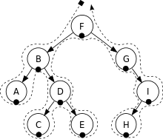
8.2 Tree Traversals
Visualizing Tree Traversals
Traversals of Binary Search Trees and Expression Trees
8.2, pgs. 454-455

Slide 50
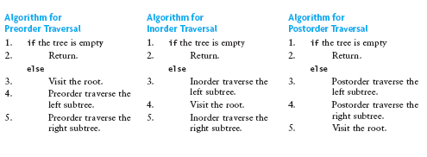
Recursive Tree Traversals
We want to determine the nodes of a tree by their relationship.
We can do this by walking through the tree in a prescribed order and visiting the nodes as they are encountered
This process is called tree traversal
Three common kinds of tree traversal
Preorder: visit root node, traverse T_{L} , traverse T_{R}
Inorder: traverse T_{L} , visit root node, traverse T_{R}
Postorder: traverse T_{L} , traverse T_{R} , visit root node

Slide 51
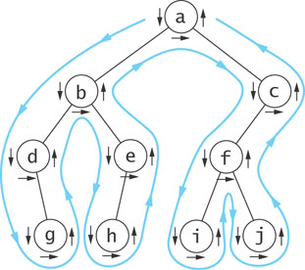
Visualizing Tree Traversals
You can visualize a tree traversal by imagining a mouse that walks along the edge of the tree.
If the mouse always keeps the tree to the left, it will trace a route known as the Euler tour.
The Euler tour is the path traced in blue in the figure on the right.

Slide 52
Visualizing Tree Traversals
If the mouse follows an Euler tour route (blue path) and visits each node before traversing its subtrees (shown by the downward pointing arrows), then we get a pre-order traversal.
pre_order_traversal(node)
if node is NULL return
visit node
pre_order_traversal(node.left)
return pre_order_traversal(node.right)
The sequence in this example is:
a
b
d
g
e
h
c
f
i
j

Slide 53
Visualizing Tree Traversals
If we record a node as the mouse returns after traversing its left subtree (shown by horizontal black arrows in the figure) we get an in-order traversal.
in_order_traversal(node)
if node is NULL return
in_order_traversal(node.left)
visit node
return in_order_traversal(node.right)
The sequence in this example is:
d
g
b
h
e
a
i
f
j
c

Slide 54
Visualizing Tree Traversals
If we record each node as the mouse last encounters it, we get a post-order traversal (shown by the upward pointing arrows).
post_order_traversal(node)
if node is NULL return
post_order_traversal(node.left)
post_order_traversal(node.right)
visit node
return
The sequence in this example is:
g
d
h
e
b
i
j
f
c
a

Slide 55
Visualizing Tree Traversals
If we record each node by height within the tree, we get a level-order (breadth first) traversal.
Algorithm: For each node, first visit the node, then queue (FIFO) its child nodes.
a
b
c
Create an empty queue.
Enqueue root.
while queue not empty
a) Dequeue node.
b) Visit node->data.
c) Enqueue node’s children.
d
e
f
g
h
i
j
The sequence in this example is:
a
b
c
d
e
f
g
h
i
j

Slide 56
Quiz A
Level-order:
In-order:
Pre-order:
Post-order:
A
A
B
C
D
E
F
G
H
I
J
K
L
M
B
C
D
E
F
G
D
B
H
E
L
I
M
A
F
C
J
G
K
H
I
J
K
A
B
D
E
H
I
L
M
C
F
G
J
K
L
M
D
H
L
M
I
E
B
F
J
K
G
C
A

Slide 57
Quiz B
Level-order:
In-order:
Pre-order:
Post-order:
A
A B F C D G J E H K M I L
B
F
C
D
G
J
C E I B D H A G L K F J M
E
H
K
M
A B C E I D H F G K L J M
I
L
I E C H D B L K G M J F A

Slide 58
Traversal of Expression Tree
An in-order traversal of an expression tree results in the sequence x + y * a + b / c
A post-order traversal of an expression tree results in the sequence x y + a b + c / *
The postfix or reverse polish form.
Operators follow operands.
A pre-order traversal of an expression tree results in the sequence * + x y / + a b c
This is the prefix form of the expression.
Operators precede operands.
*
+
/
x
y
+
c
a
b
Note: in-order traversal of an expression tree requires sub-tree parentheses:
(x + y) * ((a + b) / c)

Slide 59
Be Safe

