Slide 1
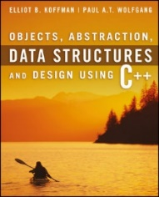
Welcome to
CS 235 Data Structures
Queues/Deques, 6.5 (21)

Slide 2
Tip #21: Constness
What does it mean for a member function to be const?
Bitwise constness (also known as physical constness).
A member function is const if and only if it doesn't modify any of the object's data members (excluding static members.)
Easy for the compiler to detect violations - just look for assignments to data members.
Logical constness.
A member function that modifies what a pointer points to is bitwise constness but not logical constness.
Sometimes there is requirement to modify one or more data members of class/struct by a const function even though you don’t want the function to update other members of class.
The solution is simple: take advantage of C++'s const-related wiggle room storage class specifier know as mutable.
Adding the keyword mutable before an object variable declaration allows a const function to change the object member.

Slide 3
ptr1
ptr1
ptr1
ptr1
∅
other
head
Node
next = _____ data = "Sam"
Node
next = _____ data = "Harry"
Node
next = _____ data = "Jim"
∅
ptr2
ptr2
ptr2
ptr2
this
head
Node
next = _____ data = "Sam"
Node
next = _____ data = "Harry"
Node
next = _____ data = "Jim"
∅
∅
∅
∅
LinkedList<string> myLink1;
LinkedList<string> myLink2 = myLink1;
Same as:
LinkedList<string> myLink2(myLink1);
/** Deep copy constructor */
LinkedList<T>(const LinkedList<T>& other) : head_(NULL)
{
Node* ptr1 = other.head_;
Node** ptr2 = &head_;
while (ptr1 != NULL)
{
*ptr2 = new Node(ptr1->data, NULL);
ptr2 = &((*ptr2)->next);
ptr1 = ptr1->next;
}
return;
}

Slide 4
Follow-up Questions...
Where are queues used today?
Why is a dynamic circular array queue better than an adapted vector or doubly linked list?
Reallocating an array requires what kind of copy operations?
A web-site which serves files to thousands of users.
CPU jobs must be batched up and then scheduled.
We wait in queues at check-out counters in grocery stores.
We wait in queues to enter movie theaters.
We wait in queues to drive on a turnpike.
We wait in queues to ride on a roller coaster.
An adapted vector is Ο(n) for pop and front functions, circular array is Ο(1) for both operations.
A node in a double-linked list stores two pointers, a node in a circular array stores just the data.
All dynamic objects require deep copy constructors and assignment operators.

Slide 5
Where Is All This Data Coming From?
Big data comes from myriad different sources, such as
business transaction systems,
customer databases,
medical records,
internet clickstream logs,
machine-generated data,
mobile applications,
social networks,
scientific research repositories,
real-time data sensors (IoT).
transaction data.
“Where is all this data coming from?”
Humans have created more data in the past two years than in the history of the human race combined.
With 2.5 quintillion bytes of data being created every day, it is expected that volume of data will double every two years.
Roughly 74 zettabytes was created in 2021 (that’s 74 trillion gigabytes) and is predicted to reach 175 zettabytes by 2025.
For the average Fortune 1000 company, a 10% increase in data accessibility will get them more than $65 million in additional net income.

Slide 7
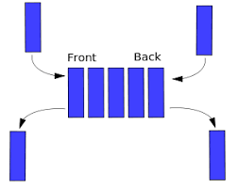
6.4 The Deque
Specification of the Deque
Implementing the Deque Using a Circular Array
The Standard Library Implementation of the Deque
6.4, pgs. 376-380

Slide 8
Deque ADT
A deque (or double-ended queue) is an abstract data type that generalizes a queue, for which elements can be added to or removed from either the front (head) or back (tail).
A deque (EIEO) differs from the queue (FIFO) abstract data type or First-In-First-Out List, whose elements can only be added to one end.
Restricted deques are of two types:
An input-restricted deque (IRDeque) is one where deletion can be made from both ends, but insertion can be made at one end only.
An output-restricted deque (ORDeque) is one where insertion can be made at both ends, but deletion can be made from one end only.
The C++ standard library defines the class std::deque to be a sequence that, like the std::vector, that supports random-access iterators (not supported by either the stack or the queue) in addition to constant-time insertion and removal from either end.

Slide 9
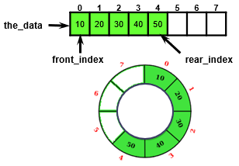
Review: Circular Array ADT Queue Design
A Circular Array ADT Queue uses an object with four size_t type data members:
size_t capacity;
size_t num_items;
size_t front_index;
size_t rear_index;
And a pointer to the data member, the_data to point to a dynamically-allocated array
T* the_data;
And a default array allocation size
#define DEFAULT_CAPACITY 8

Slide 10
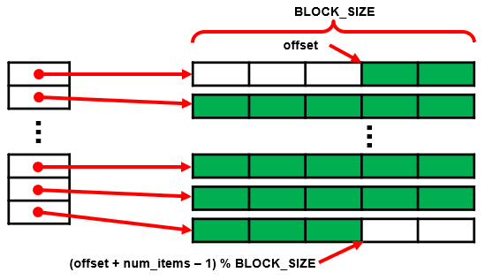
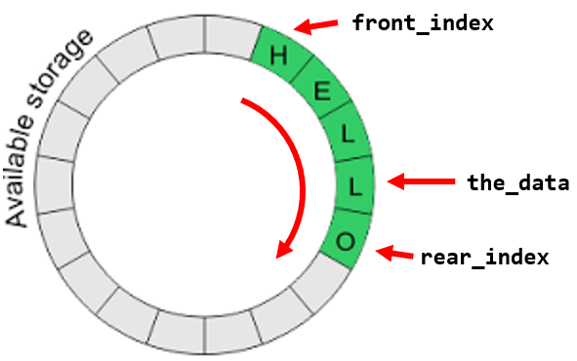
STL Implementation of the Deque
Array implementations of a deque:
Store the deque contents in a common circular buffer (array) and only resize when the buffer becomes full.
Resizing's are amortized but can be expensive.
Allocate deque contents from the center of the underlying array and resize the underlying array when either end is reached.
This approach may require more frequent resizing's and waste more space, particularly when elements are only inserted at one end.
Use for Railroad Lab!
Store contents in multiple smaller fixed-size dynamically allocated arrays, allocating additional arrays at the beginning or end as needed.
Indexing is implemented by keeping a dynamic circular array (CArray) containing pointers to each of the smaller arrays.

Slide 11
STL Implementation of the Deque
The original designers of the STL library chose to use the rather elaborate deque implementation (multiple smaller fixed-size dynamically allocated arrays) rather than simply using a circular array because of the cost of reallocation.
Even though the cost of push_front and push_back array reallocations is amortized for constant-time, the reallocation can take a significant amount of time.
Storing single objects in the circular array could work, but dynamically allocating small/single objects has a significant space overhead.
By storing only pointers in the circular array, the cost of reallocation is significantly reduced, because copying a pointer is a simple operation.
Thus, by allocating an array of objects, we minimize this space overhead and minimize the cost of the reallocation.
For large collections of large objects, the deque can be used instead of the vector to minimize space overhead and the cost of reallocation.

Slide 12
Review: Dynamic Multi-dimensional Arrays
Since C++ doesn’t allow a stack allocated array of a class whose size is not constant, we need to dynamically allocate memory for the array.
Dynamic arrays use pointers.
Memory for a dynamic array comes from the heap.
Consider the following:
int main(int argc, char* argv[])
{
int rows, cols;
string line = "4 5";
istringstream iss(line);
iss >> rows >> cols;
int **a = new int*[rows];
for(int i = 0; i < rows; ++i)
a[i] = new int[cols];
a[3][4] = 100;
return 0;
}
a[0][0] | a[0][1] | a[0][2] | a[0][3] | a[0][4]
a[0]
a[1]
a[2]
a[3]
a[1][0] | a[1][1] | a[1][2] | a[1][3] | a[1][4]
a[2][0] | a[2][1] | a[2][2] | a[2][3] | a[2][4]
a[3][0] | a[3][1] | a[3][2] | a[3][3] | a[3][4]

Slide 13
The Data Fields for the Deque
/** Returns an item referenced by an index.
@param i the index
@return A reference to deque[i]
*/
template<typename Item_Type>
Item_Type& deque<Item_Type>::operator[](size_t i)
{
if (i >= num_items) throw std::out_of_range("Invalid index");
size_t queue_index = (offset + i) / BLOCK_SIZE;
size_t block_index = (offset + i) % BLOCK_SIZE;
return the_data[queue_index][block_index];
}
Index operator of CArray
block index

Slide 14
The push_back Function
/** Pushes an item onto the back of the deque.
@param item The item to be inserted.
*/
template<typename Item_Type>
void deque<Item_Type>::push_back(const Item_Type& item)
{
size_t capacity = the_data.size() * BLOCK_SIZE;
// Determine if the capacity needs to be increased.
if ((num_items + offset) == capacity)
{
the_data.push_back(new Item_Type[BLOCK_SIZE]);
}
// Use index operator to insert item
num_items++;
(*this)[num_items - 1] = item;
}

Slide 15
The pop_front Function
/** Removes the front item from the deque. */
template<typename Item_Type>
void deque<Item_Type>::pop_front()
{
offset++;
if (offset == BLOCK_SIZE)
{
delete[] the_data.front();
the_data.pop_front();
offset = 0;
}
num_items--;
return;
}
BLOCK_SIZE | 5
offset | 4
num_items | 23
the_data
...
22 | 0 | 12 | 56 | 123
45 | 2 | 89 | 20 | 21
...
0
45
5
22

Slide 16
BLOCK_SIZE | 5
offset | 3
num_items | 23
the_data
22 | 0 | 12 | 56 | 123
45 | 2 | 89 | 20 | 21
32 | 78 | 23 | 80 | 9
12 | 1 | 76 | 45 | 32
57 | 52 | 96 | 17 | 24
6 | 23 | 3 | 3 | 99
/** Return front item from the deque. */
template<typename Item_Type>
Item_Type& deque<Item_Type>::front()
{
return (*this)[0];
}
/** Return back item from the deque. */
template<typename Item_Type>
Item_Type& deque<Item_Type>::back()
{
return (*this)[num_items – 1];
}
/** Return a reference to indexed item. */
template<typename Item_Type>
Item_Type& deque<Item_Type>::operator[](size_t i)
{
size_t block_index = (offset + i) / BLOCK_SIZE;
size_t data_index = (offset + i) % BLOCK_SIZE;
return the_data[block_index][data_index];
}
What is the value of myDeque[13]?
What is the value of myDeque.front()?
What is the value of myDeque.back()?
Push 10, 30, 4, 82, 12, 14. Draw the resulting dequeue. How many blocks?

Slide 17
BLOCK_SIZE | 5
offset | 3
num_items | 23
the_data
22 | 0 | 12 | 56 | 123
45 | 2 | 89 | 20 | 21
32 | 78 | 23 | 80 | 9
12 | 1 | 76 | 45 | 32
57 | 52 | 96 | 17 | 24
6 | 23 | 3 | 3 | 99
29
6 | 10 | 30 | 4 | 82
12 | 14 | xx | xx | xx
/** Return front item from the deque. */
template<typename Item_Type>
Item_Type& deque<Item_Type>::front()
{
return (*this)[0];
}
/** Return back item from the deque. */
template<typename Item_Type>
Item_Type& deque<Item_Type>::back()
{
return (*this)[num_items – 1];
}
/** Return a reference to indexed item. */
template<typename Item_Type>
Item_Type& deque<Item_Type>::operator[](size_t i)
{
size_t block_index = (offset + i) / BLOCK_SIZE;
size_t data_index = (offset + i) % BLOCK_SIZE;
return the_data[block_index][data_index];
}
What is the value of myDeque[13]?
What is the value of myDeque.front()?
What is the value of myDeque.back()?
Push 10, 30, 4, 82, 12, 14. Draw the resulting dequeue. How many blocks?
1
block_index = (3 + 13) / 5 = 3
data_index = (3 + 13) % 5 = 1 the_data[3][1] = 1
56
block_index = (3 + 0) / 5 = 0
data_index = (3 + 0) % 5 = 3 the_data[0][3] = 56
6
block_index = (3 + 23 - 1) / 5 = 5
data_index = (3 + 23 - 1) % 5 = 0 the_data[5][0] = 6
7

Slide 18
Follow-up Questions...
What is a deque?
How does a deque differ from queue?
How does a deque differ from a IRDeque and ORDeque?
A deque (double-ended queue) is an abstract data type that generalizes a queue, for which elements can be added to or removed from either the front (head) or back (tail).
A deque differs from the queue abstract data type or First-In-First-Out List (FIFO), where elements can only be added to one end (EIEO).
An input-restricted deque (IRDeque) is one where deletion can be made from both ends, but insertion can be made at one end only.
An output-restricted deque (ORDeque) is one where insertion can be made at both ends, but deletion can be made from one end only.

Slide 19
Tip #22: Keep Fit To Program Better
It may seem obvious, but it is 100% true:
int main(void)
{
Exercise you("Your name here");
do
{
you.do_pushups(25);
you.do_situps(30);
you.lift_weights(100);
if (you.tired(time("10:00 pm"))
{
you.rest_for_a_while(hours(7));
}
you.work_for_awhile();
} while (!finished);
return 0;
}
If a programmer exercises regularly, he/she can program better because:
You don't have to worry about physical problems like stiffness or boredom.
You'll feel better about yourself.
Improves your mental health, mood, thinking, judgement, ...

Slide 20
Tip #22: = default; or { }
#include <iostream>
using namespace std;
class A
{
public:
A() {}
int i;
};
class B
{
public:
B() = default;
int i;
};
int main()
{
A a = A();
B b = B();
cout<< endl << "user-defined: " << a.i;
cout << endl << "default: " << b.i;
return 0;
}
The class B constructor defined with B() = default; is considered not-user defined.
This means the value-initialization
B b = B(); // () triggers value-initialization
is a special kind of initialization that doesn't use a normal constructor but results in a zero-initialization for built-in types.
The class A constructor defined by A() {} is considered user defined and no compiler generated constructor is called.
To value-initialize an object of type T means:
— if T is a (possibly cv-qualified) class type (Clause 9) with a user-provided constructor (12.1), then the default constructor for T is called (and the initialization is ill-formed if T has no accessible default constructor);
— if T is a (possibly cv-qualified) non-union class type without a user-provided constructor, then the object is zero-initialized and, if T’s implicitly-declared default constructor is non-trivial, that constructor is called.
— if T is an array type, then each element is value-initialized; — otherwise, the object is zero-initialized.
C++ Standard n3337 § 8.5/7.

Slide 21
Follow-up Questions...
How are Vector, Queue, and Stack containers implemented with a deque?
How is a CArray used in a modified dynamic circular deque implementation?
What problem does a modified dynamic circular array deque mitigate?
All of them are wrapper classes of a deque – they encapsulate / contain a deque and use its functionality to define the class' behavior.
A dynamic circular (CArray) stores pointers to smaller fixed-size dynamically allocated arrays that are added at the beginning or end as needed.
When only using a circular array, the cost of reallocation can take a significant amount of time.
By storing only pointers in the circular array,
the cost of reallocation is significantly reduced because copying a pointer is a simpler operation.
the amortized constant-time insertion/removal is optimized – both in time and space.

Slide 22
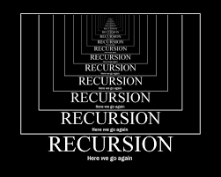
Chapter 7 Recursion

Slide 23
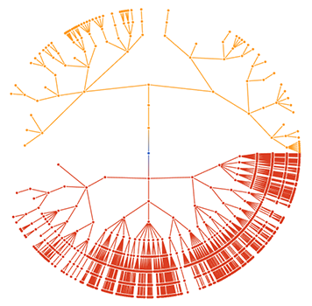
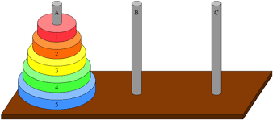
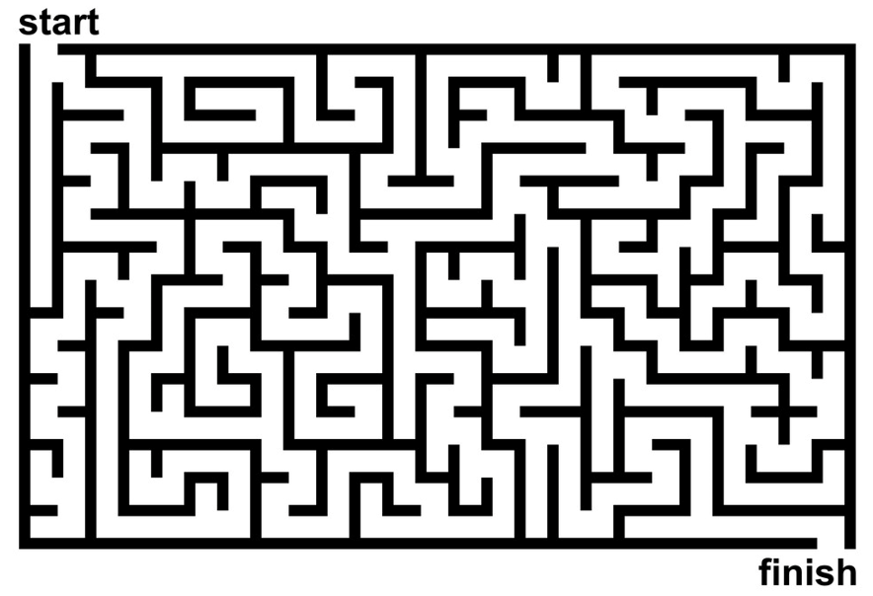
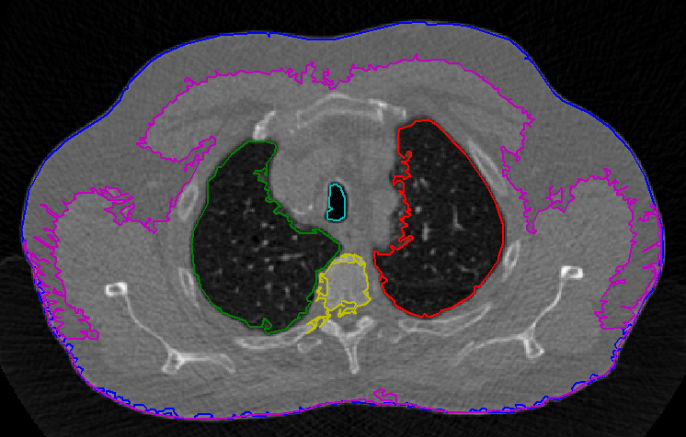
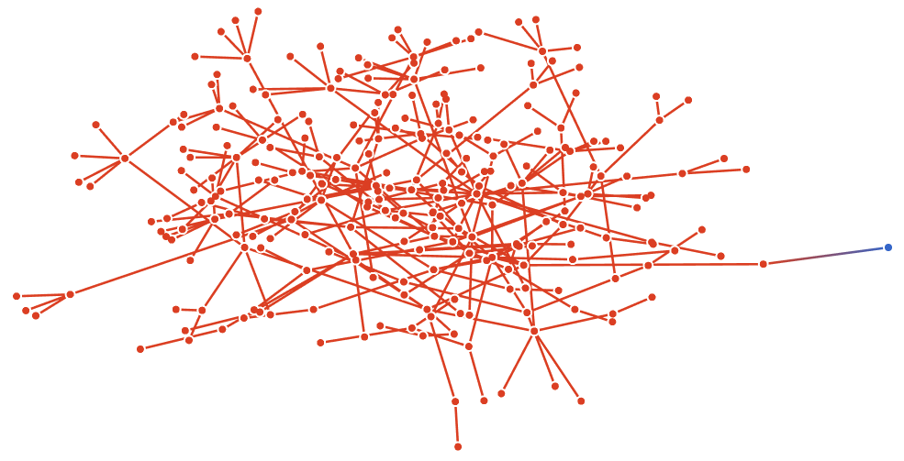
Objectives
To understand how to think recursively.
To learn how to trace a recursive function.
To learn how to write recursive algorithms and functions for searching vectors.
To understand how to use recursion to solve the Towers of Hanoi problem.
To understand how to use recursion to process two-dimensional images.
To learn how to apply backtracking to solve search problems such as finding a path through a maze.

Slide 24
Outcomes
Recursion can solve many programming problems that are difficult to conceptualize and solve linearly.
In the field of artificial intelligence, recursion often is used to write programs that exhibit intelligent behavior:
playing games of chess.
proving mathematical theorems.
recognizing patterns, and so on.
Recursive algorithms can
compute factorials.
compute a greatest common divisor.
find a path through a maze.
process data structures (strings, vectors, linked lists, etc.).
search efficiently using a binary search.

Slide 25
7.1 Recursive Thinking
Steps to Design a Recursive Algorithm
Proving That a Recursive Function Is Correct
Tracing a Recursive Function
The Stack and Activation Frames
7.1, pgs. 404-411

Slide 26
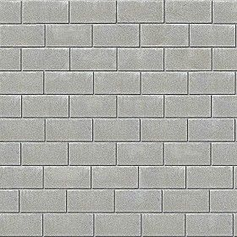
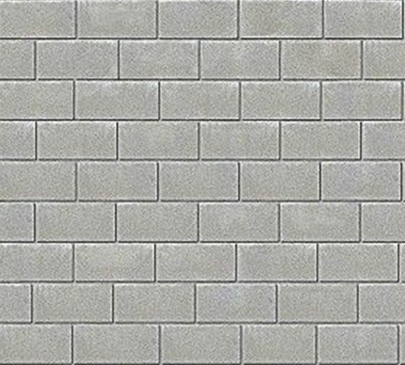
How To Build A 10-foot Wall?

Slide 27
Recursive Thinking
Recursion is a problem-solving approach that generates simpler solutions to certain kinds of problems that are difficult to solve by other means.
Recursion reduces a problem into one or more simpler versions of itself.
For example, consider searching for a target value in a sorted vector:
We compare the target to the middle element and, if the middle element does not match the target, search either the elements before the middle element or the elements after the middle element.
Instead of searching n elements, we search n/2 elements.
Find 23
2 | 5 | 8 | 12 | 16 | 23 | 38 | 56 | 72 | 91
23 > 16, 2nd half
2 | 5 | 8 | 12 | 16 | 23 | 38 | 56 | 72 | 91
23 < 56, 1st half
2 | 5 | 8 | 12 | 16 | 23 | 38 | 56 | 72 | 91
Found 23, Return 5
2 | 5 | 8 | 12 | 16 | 23 | 38 | 56 | 72 | 91

Slide 28
Recursive Thinking
General Recursive Algorithm:
Step 1 involves a test for what is called the base case: a value of n for which the problem can be solved easily
Whenever a split occurs, we revisit Step 1 for each new problem to see whether it is a base case or a recursive case
if problem can be solved directly for the current value of n
2. then Solve it.
else
3. Recursively apply the algorithm to one or more problems
involving smaller values of n.
4. Combine the solutions to the smaller problems to get the
solution to the original problem.
Because the value of n for each recursive case is smaller than the original value of n, each recursive case makes progress towards a base case
Step 3 is the recursive case, because there we recursively apply the algorithm

Slide 29
Design a Recursive Algorithm
Design:
Recognize a base case and provide a solution to it.
Devise a strategy to split the problem into smaller versions of itself while making progress toward a base case.
Combine the solutions to the smaller problems to solve the larger problem.
Find the length of a string:
/** Recursive function for length of string
@param str The string
@return The length of the string
*/
int size(string str)
{
}
if (str == "") return 0;
return 1 + size(str.substr(1));

Slide 30
Writing Recursive Algorithms
Write recursive functions to print a string of characters (space delimited) forward (Example: H e l l o) and reverse (Example: o l l e H).
Hint: Use string function str.at() and str.substr().
/** Recursive function print_chars
post: Display in forward order
@param str The string
*/
void print_chars(string str)
{
}
/** Recursive function print_chars_reverse
post: Display in reverse order
@param str The string
*/
void print_chars_reverse(string str)
{
}
Write recursive functions to return length and copy of strings:
/** Recursive function string_length
post: The string length is returned
@param str The string
*/
int string_length(string str)
{
}
/** Recursive function string_copy
post: str2 is copied to str1
@param str The string
*/
void string_copy(string& str1, string str2)
{
}

Slide 31
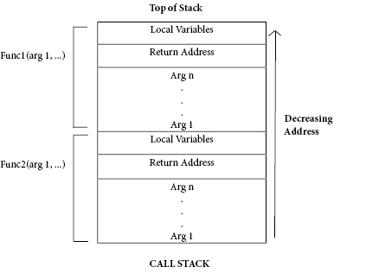
The Stack and Activation Frames
C++ maintains a stack on which it saves new information in the form of an activation frame.
The activation frame contains storage for
the return address of the calling function.
function arguments.
local variables (if any).
Whenever a new function is called (recursive or otherwise), C++ pushes a new activation frame onto the stack.

Slide 32
Tracing a Recursive Function
The process of returning from recursive calls and computing the partial results is called unwinding the recursion.
#include <iostream>
using namespace std;
int size(string str)
{
if (str == "") return 0;
return 1 + size(str.substr(1));
}
int main()
{
cout << size("ace");
return 0;
}
cout << size("ace");
3
return 1 + size("ce")
2
return 1 + size("e")
1
return 1 + size("")
0

Slide 33
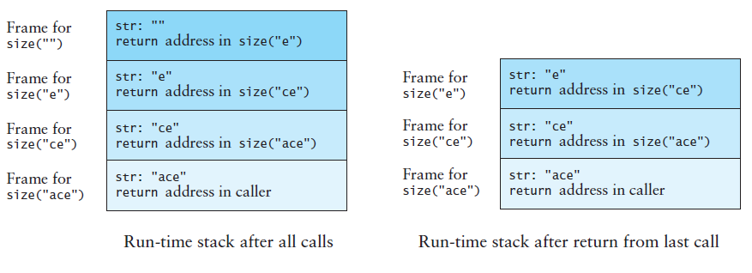
Run-Time Stack - Activation Frames
int main()
{
cout << size("ace");
return 0;
}
int size(string str)
{
if (str == "") return 0;
return size(str.substr(1));
}

Slide 34
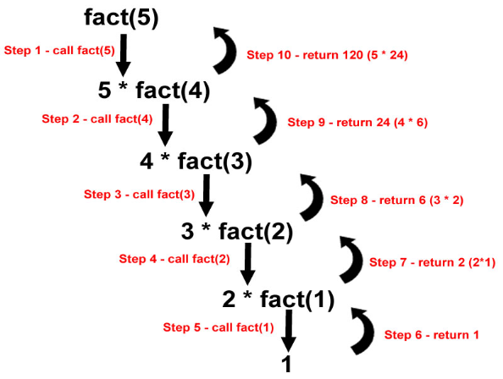
7.2 Recursive Definitions of Mathematical Formulas
Recursion Versus Iteration
Tail Recursion or Last-Line Recursion
Efficiency of Recursion
7.2, pgs. 412-419

Slide 35
Recursive Mathematical Formulas
Mathematicians often use recursive definitions of formulas that lead naturally to recursive algorithms
Examples include:
factorials
powers
greatest common divisors
sorts
x = factorial(4)
24
return 4 * factorial(3)
6
int factorial(int n)
{
if (n <= 1) return 1;
return (n * factorial(n – 1));
}
return 3 * factorial(2)
2
return 2 * factorial(1)
1

Slide 36
Calculating x^{n}
You can raise a number to a power that is greater than 0 by repeatedly multiplying the number by itself.
Recursive definition: x^{n} = x × x^{n-1}
Base case: x⁰ = 1
/** Recursive power function
@param x: The number
@param n: The exponent
@return x raised to the power n
*/
double power(double x, int n)
{
if (n == 0) return 1.0;
if (n > 0)
return x * power(x, n – 1);
else
return 1.0 / power(x, -n);
}
x = power(2.0, -3)
0.125
return 1.0 / power(2.0, 3)
8.0
return 2.0 * power(2.0, 2)
4.0
return 2.0 * power(2.0, 1)
2.0
return 2.0 * power(2.0, 0)
1.0

Slide 37
Trace the call stack of the following recursive Greatest-Common-Divisor function for gcd(30, 77).
/** Recursive Greatest Common Divisor function
@param m The larger number (m > 0)
@param n The smaller number (n > 0)
@return gcd of m and n
*/
int gcd(int m, int n)
{
if (m % n == 0) return n;
if (m < n) return gcd(n, m);
return gcd(n, m % n);
}
x = gcd(30, 77)
return |  | m |  | n
 | gcd( |  | , |  | )
 | gcd( |  | , |  | )
 | gcd( |  | , |  | )
 | gcd( |  | , |  | )
 | gcd( |  | , |  | )
 | gcd( |  | , |  | )

Slide 38
Calculating GCD Correct?
How do we verify that our algorithm is correct?
Base case correct?
The base case is “n is a divisor of m”
The solution is n (n is the greatest common divisor), which is correct
Does recursion make progress to base case?
Both arguments in each recursive call are smaller than in the previous call and
The new second argument is always smaller than the new first argument (m % n must be less than n)
Eventually a divisor will be found or the second argument will become 1 (which is a base case because it divides every integer)

Slide 39
Recursion Downside
Recursion downside
Base case never reached.
Factorial with a negative argument - throw an invalid_argument exception if n is negative.
You will eventually get a run-time error when there is no more memory available for your program to execute more function calls.
Error deep in recursion stack.
Recursion vs Iteration
There are similarities between recursion and iteration.
In iteration, a loop repetition condition determines whether to repeat the loop body or exit from the loop.
In recursion, the condition usually tests for a base case.
There is always an iterative solution to a problem that is solvable by recursion.
A recursive algorithm may be simpler than an iterative algorithm and thus easier to design, code, debug, and maintain.

Slide 40
Tail Recursion
Most of the recursive algorithms and functions so far are examples of tail recursion or last-line recursion.
In these algorithms, there is a single recursive call and it is the last line of the function, such as in the factorial function.
Straightforward process to turn a recursion function with a tail into an iterative solution:
/** Recursive factorial function */
int factorial(int n)
{
if (n <= 1) return 1;
return n * factorial(n – 1);
}
/** Iterative factorial function */
int factorial_iter(int n)
{
int result = 1;
for (int k = 1; k <= n; k++)
result = result * k;
return result;
}

Slide 41
Be Safe

