Slide 1
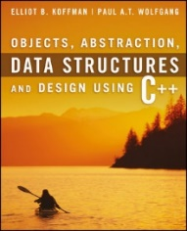
Welcome to
CS 235 Data Structures
Queues/Deques, 6.5 (21)

Slide 2
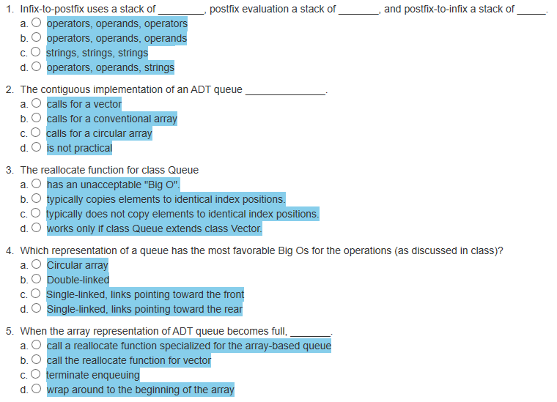
Attendance Quiz #20

Slide 3
Tip #21: Constness
What does it mean for a member function to be const?
Bitwise constness (also known as physical constness).
A member function is const if and only if it doesn't modify any of the object's data members (excluding static members.)
Easy for the compiler to detect violations - just look for assignments to data members.
Logical constness.
A member function that modifies what a pointer points to is bitwise constness but not logical constness.
Sometimes there is requirement to modify one or more data members of class/struct by a const function even though you don’t want the function to update other members of class.
The solution is simple: take advantage of C++'s const-related wiggle room storage class specifier know as mutable.
Adding the keyword mutable before an object variable declaration allows a const function to change the object member.

Slide 4
Using std::list as a Queue Container
#include <iostream>
#include <string>
#include <sstream>
#include <list>
using namespace std;
template<typename Item_Type>
class queue
{
private:
// Insert implementation-specific data fields
std::list<Item_Type> container;
public:
queue() {}
~queue() = default;
/** Pushes an item onto the back of the queue.
@param item The item to be inserted */
void push(const Item_Type& item) { return container.push_back(item); }
/** Returns a reference to the object at the front of the queue without removing it.
@return A reference to the object at the front of the queue */
Item_Type& front() { return container.front(); }
/** Returns a const reference to the object at the front of the queue without removing it.
@return A const reference to the object at the front of the queue */
const Item_Type& front() const { return container.front(); }
/** Removes the front item from the queue. */
void pop() { return container.pop_front(); }
/** Determines whether the queue is empty. */ /** Returns the number of items in the queue */
size_t size() const { return container.size(); }
bool empty() const { return container.empty(); }
friend ostream& operator<<(ostream& os, const queue<Item_Type>& q)
{
typename list<Item_Type>::const_iterator iter = q.container.cbegin();
while (iter != q.container.cend()) os << " " << *iter++;
return os;
}
}; // End class queue
Every function is delegated!

Slide 5
Where Is All This Data Coming From?
Big data comes from myriad different sources, such as
business transaction systems,
customer databases,
medical records,
internet clickstream logs,
machine-generated data,
mobile applications,
social networks,
scientific research repositories,
real-time data sensors (IoT).
transaction data.
“Where is all this data coming from?”
Humans have created more data in the past two years than in the history of the human race combined.
With 2.5 quintillion bytes of data being created every day, it is expected that volume of data will double every two years.
Roughly 74 zettabytes was created in 2021 (that’s 74 trillion gigabytes) and is predicted to reach 175 zettabytes by 2025.
For the average Fortune 1000 company, a 10% increase in data accessibility will get them more than $65 million in additional net income.

Slide 7
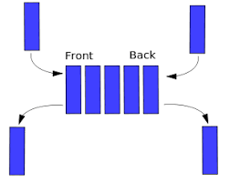
6.4 The Deque
Specification of the Deque
Implementing the Deque Using a Circular Array
The Standard Library Implementation of the Deque
6.4, pgs. 376-380

Slide 8
Deque ADT
A deque (or double-ended queue) is an abstract data type that generalizes a queue, for which elements can be added to or removed from either the front (head) or back (tail).
A deque (EIEO) differs from the queue (FIFO) abstract data type or First-In-First-Out List, whose elements can only be added to one end.
Restricted deques are of two types:
An input-restricted deque (IRDeque) is one where deletion can be made from both ends, but insertion can be made at one end only.
An output-restricted deque (ORDeque) is one where insertion can be made at both ends, but deletion can be made from one end only.
The C++ standard library defines the class std::deque to be a sequence that, like the std::vector, that supports random-access iterators (not supported by either the stack or the queue) in addition to constant-time insertion and removal from either end.

Slide 9
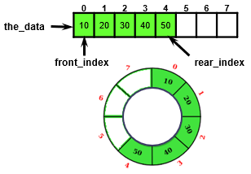
Review: Circular Array ADT Queue Design
A Circular Array ADT Queue uses an object with four size_t type data members:
size_t capacity;
size_t num_items;
size_t front_index;
size_t rear_index;
And a pointer to the data member, the_data to point to a dynamically-allocated array
T* the_data;
And a default array allocation size
#define DEFAULT_CAPACITY 8

Slide 10
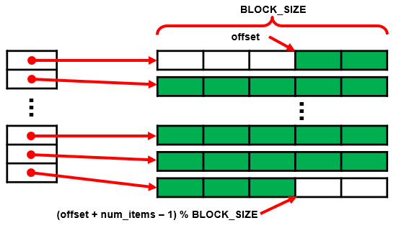
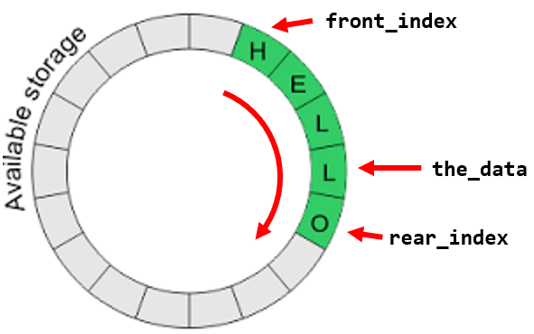
STL Implementation of the Deque
Array implementations of a deque:
Store the deque contents in a common circular buffer (array) and only resize when the buffer becomes full.
Resizing's are amortized but can be expensive.
Allocate deque contents from the center of the underlying array and resize the underlying array when either end is reached.
This approach may require more frequent resizing's and waste more space, particularly when elements are only inserted at one end.
Use for Railroad Lab!
Store contents in multiple smaller fixed-size dynamically allocated arrays, allocating additional arrays at the beginning or end as needed.
Indexing is implemented by keeping a dynamic circular array (CArray) containing pointers to each of the smaller arrays.

Slide 11
STL Implementation of the Deque
The original designers of the STL library chose to use the rather elaborate deque implementation (multiple smaller fixed-size dynamically allocated arrays) rather than simply using a circular array because of the cost of reallocation.
Even though the cost of push_front and push_back array reallocations is amortized for constant-time, the reallocation can take a significant amount of time.
Storing single objects in the circular array could work, but dynamically allocating small/single objects has a significant space overhead.
By storing only pointers in the circular array, the cost of reallocation is significantly reduced, because copying a pointer is a simple operation.
Thus, by allocating an array of objects, we minimize this space overhead and minimize the cost of the reallocation.
For large collections of large objects, the deque can be used instead of the vector to minimize space overhead and the cost of reallocation.

Slide 12
Review: Dynamic Multi-dimensional Arrays
Since C++ doesn’t allow a stack allocated array of a class whose size is not constant, we need to dynamically allocate memory for the array.
Dynamic arrays use pointers.
Memory for a dynamic array comes from the heap.
Consider the following:
int main(int argc, char* argv[])
{
int rows, cols;
string line = "4 5";
istringstream iss(line);
iss >> rows >> cols;
int **a = new int*[rows];
for(int i = 0; i < rows; ++i)
a[i] = new int[cols];
a[3][4] = 100;
return 0;
}
a[0][0] | a[0][1] | a[0][2] | a[0][3] | a[0][4]
a[0]
a[1]
a[2]
a[3]
a[1][0] | a[1][1] | a[1][2] | a[1][3] | a[1][4]
a[2][0] | a[2][1] | a[2][2] | a[2][3] | a[2][4]
a[3][0] | a[3][1] | a[3][2] | a[3][3] | a[3][4]

Slide 13
The Data Fields for the Deque
/** Returns an item referenced by an index.
@param i the index
@return A reference to deque[i]
*/
template<typename Item_Type>
Item_Type& deque<Item_Type>::operator[](size_t i)
{
if (i >= num_items) throw std::out_of_range("Invalid index");
size_t queue_index = (offset + i) / BLOCK_SIZE;
size_t block_index = (offset + i) % BLOCK_SIZE;
return the_data[queue_index][block_index];
}
Index operator of CArray
block index

Slide 14
The push_back Function
/** Pushes an item onto the back of the deque.
@param item The item to be inserted.
*/
template<typename Item_Type>
void deque<Item_Type>::push_back(const Item_Type& item)
{
size_t capacity = the_data.size() * BLOCK_SIZE;
// Determine if the capacity needs to be increased.
if ((num_items + offset) == capacity)
{
the_data.push_back(new Item_Type[BLOCK_SIZE]);
}
// Use index operator to insert item
num_items++;
(*this)[num_items - 1] = item;
}

Slide 15
The pop_front Function
/** Removes the front item from the deque. */
template<typename Item_Type>
void deque<Item_Type>::pop_front()
{
offset++;
if (offset == BLOCK_SIZE)
{
delete[] the_data.front();
the_data.pop_front();
offset = 0;
}
num_items--;
return;
}
BLOCK_SIZE | 5
offset | 4
num_items | 23
the_data
...
22 | 0 | 12 | 56 | 123
45 | 2 | 89 | 20 | 21
...
0
45
5
22

Slide 16
BLOCK_SIZE | 5
offset | 3
num_items | 23
the_data
22 | 0 | 12 | 56 | 123
45 | 2 | 89 | 20 | 21
32 | 78 | 23 | 80 | 9
12 | 1 | 76 | 45 | 32
57 | 52 | 96 | 17 | 24
6 | 23 | 3 | 3 | 99
29
6 | 10 | 30 | 4 | 82
12 | 14 | xx | xx | xx
/** Return front item from the deque. */
template<typename Item_Type>
Item_Type& deque<Item_Type>::front()
{
return (*this)[0];
}
/** Return back item from the deque. */
template<typename Item_Type>
Item_Type& deque<Item_Type>::back()
{
return (*this)[num_items – 1];
}
/** Return a reference to indexed item. */
template<typename Item_Type>
Item_Type& deque<Item_Type>::operator[](size_t i)
{
size_t block_index = (offset + i) / BLOCK_SIZE;
size_t data_index = (offset + i) % BLOCK_SIZE;
return the_data[block_index][data_index];
}
What is the value of myDeque[13]?
What is the value of myDeque.front()?
What is the value of myDeque.back()?
Push 10, 30, 4, 82, 12, 14. Draw the resulting dequeue. How many blocks?
1
block_index = (3 + 13) / 5 = 3
data_index = (3 + 13) % 5 = 1 the_data[3][1] = 1
56
block_index = (3 + 0) / 5 = 0
data_index = (3 + 0) % 5 = 3 the_data[0][3] = 56
6
block_index = (3 + 23 - 1) / 5 = 5
data_index = (3 + 23 - 1) % 5 = 0 the_data[5][0] = 6
7

Slide 17
Be Safe

