Slide 1
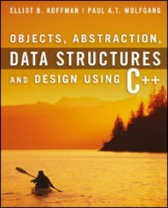
Welcome to
CS 235 Data Structures
Stacks, 5.4 (18)

Slide 2
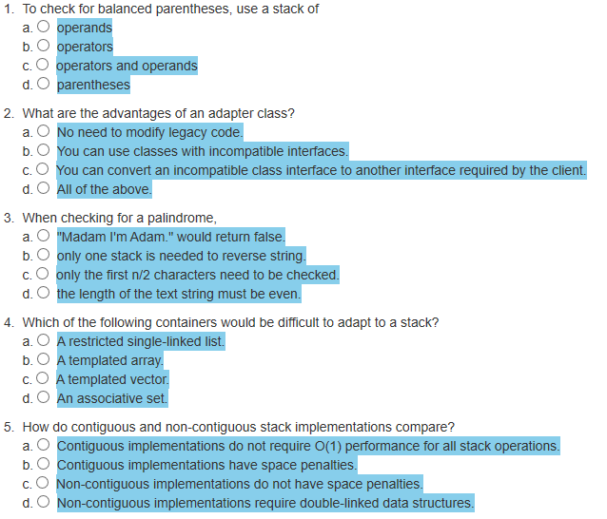
Attendance Quiz #17

Slide 3
Tip #18: Invalid Iterators
vector<int> v;
for (int i = 0; i < 10; ++i) v.push_back(i);
vector<int>::const_iterator old_begin = v.begin();
cout << "Adding more elements..." << endl;
for (int i = 0; i < 100; ++i) v.push_back(i*10);
vector<int>::const_iterator new_begin = v.begin();
What is output?
if (old_begin == new_begin)
cout << "Begin's are the same" << endl;
else
cout << "Begin's are DIFFERENT" << endl;
Do NOT hold pointer, references, or iterators to an element in a container after you've modified the container!

Slide 4
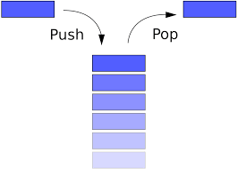
5.4 Additional Stack Applications
Case Study: Converting from Infix to Postfix
Case Study: Part 2: Converting Expressions with Parentheses
Chapter 5 – The Stack

Slide 5
Stack Abstract Data Type
A stack can be compared to a Pez dispenser
Only the top item can be accessed
You can extract only one item at a time
The top element in the stack is the last added to the stack (most recently).
The stack’s storage policy is Last-In, First-Out, or LIFO.
Only the top element of a stack is visible; therefore the number of operations performed by a stack are few:

Slide 6
Infix, Prefix and Postfix Expressions
Infix - the operator is in between the two operands.
prefix - all operators precede operands.
postfix - operators come after the corresponding operands.
Infix Expression | Prefix Expression | Postfix Expression
A + B * C + D | + + A * B C D | A B C * + D +
(A + B) * (C + D) | * + A B + C D | A B + C D + *
A * B + C * D | + * A B * C D | A B * C D * +
A + B + C + D | + + + A B C D | A B + C + D +

Slide 7
Postfix and infix notation
Postfix and infix notation
Expressions normally are written in infix form, but
Easier for a computer to evaluate an expression in postfix form since
No need to group sub-expressions in parentheses or
Worry about operator precedence.
Infix Expression | Postfix Expression | Value
4 * 7
4 7 *
28
4 * (7 + 2)
4 7 2 + *
36
(4 * 7) - 20
4 7 * 20 -
8
3 + ((4 * 7) / 2)
3 4 7 * 2 / +
17
Evaluate postfix expressions by
Saving operands on a stack until their associated operator is scanned,
Pop the operands and compute the result,
Push result back onto the stack.

Slide 8
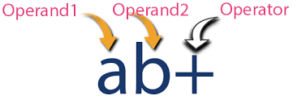
5.4 Additional Stack Applications
Case Study: Evaluating Postfix Expressions
Case Study: Converting from Infix to Postfix
Case Study: Part 2: Converting Expressions with Parentheses
5.4, pgs. 332-347

Slide 9
Converting from Infix to Postfix

Slide 10
Infix to Postfix
Initialize postfix to an empty string.
Initialize the operator stack to an empty stack.
Set balanced to true.
while balanced and there are more tokens in the infix string
Get the next token.
if next token is an operand
Append next token to postfix string.
else if next token is an opening operator
Push next token onto operator stack.
else if next token is a closing operator
Pop stack to postfix until closing operator (or stack empty).
if stack empty or close/open operators do not match
Set balanced to false.
else until next token is greater precedence than top of stack, Pop stack to postfix.
Push next token on operator stack.
Increment index.
Return balanced and stack is empty.`

Slide 11
Infix to Postfix Example
Infix Expression:
(w * [x + y] / z)
Postfix Expression:
0
1
2
3
4
5
6
7
8
9
10
(
(
w
*
[
x
+
y
]
/
z
)
(
balanced : true
index : 0
operator stack

Slide 12
Infix to Postfix Example
Infix Expression:
(w * [x + y] / z)
Postfix Expression:
w
0
1
2
3
4
5
6
7
8
9
10
(
(
w
*
[
x
+
y
]
/
z
)
(
balanced : true
index : 1
operator stack

Slide 13
Infix to Postfix Example
Infix Expression:
(w * [x + y] / z)
Postfix Expression:
w
0
1
2
3
4
5
6
7
8
9
10
(
(
w
*
[
x
+
y
]
/
z
)
*
(
balanced : true
index : 2
operator stack

Slide 14
Infix to Postfix Example
Infix Expression:
(w * [x + y] / z)
Postfix Expression:
w
0
1
2
3
4
5
6
7
8
9
10
(
(
w
*
[
x
+
y
]
/
z
)
[
*
(
balanced : true
index : 3
operator stack

Slide 15
Infix to Postfix Example
Infix Expression:
(w * [x + y] / z)
w
Postfix Expression:
x
0
1
2
3
4
5
6
7
8
9
10
(
(
w
*
[
x
+
y
]
/
z
)
[
*
(
balanced : true
index : 4
operator stack

Slide 16
Infix to Postfix Example
Infix Expression:
(w * [x + y] / z)
Postfix Expression:
w x
0
1
2
3
4
5
6
7
8
9
10
(
(
w
*
[
x
+
y
]
/
z
)
+
[
*
(
balanced : true
index : 5
operator stack

Slide 17
Infix to Postfix Example
Infix Expression:
(w * [x + y] / z)
y
Postfix Expression:
w x
0
1
2
3
4
5
6
7
8
9
10
(
(
w
*
[
x
+
y
]
/
z
)
+
[
*
(
balanced : true
index : 6
operator stack

Slide 18
Infix to Postfix Example
Infix Expression:
(w * [x + y] / z)
w x y
Postfix Expression:
+
0
1
2
3
4
5
6
7
8
9
10
(
(
w
*
[
x
+
y
]
/
z
)
+
[
[
]
*
(
balanced : true
index : 7
operator stack

Slide 19
Infix to Postfix Example
Infix Expression:
(w * [x + y] / z)
w x y +
Postfix Expression:
*
0
1
2
3
4
5
6
7
8
9
10
(
(
w
*
[
x
+
y
]
/
z
)
*
/
(
balanced : true
index : 8
operator stack

Slide 20
Infix to Postfix Example
Infix Expression:
(w * [x + y] / z)
z
Postfix Expression:
w x y + *
0
1
2
3
4
5
6
7
8
9
10
(
(
w
*
[
x
+
y
]
/
z
)
/
(
balanced : true
index : 9
operator stack

Slide 21
Infix to Postfix Example
Infix Expression:
(w * [x + y] / z)
/
w x y + * z
Postfix Expression:
*
0
1
2
3
4
5
6
7
8
9
10
(
(
w
*
[
x
+
y
]
/
z
)
(
)
/
(
balanced : true
index : 10
operator stack

Slide 22
Infix to Postfix Example
Infix Expression:
(w * [x + y] / z)
/
Postfix Expression:
w x y + * z
Postfix Expression
0
1
2
3
4
5
6
7
8
9
10
(
(
w
*
[
x
+
y
]
/
z
)
while balanced and there are more
...
Return balanced and stack is empty.
balanced : true
index : 11
operator stack

Slide 23
Infix: | [ 3 + 3 ]
Postfix:
Value:
Infix: | ( 5 )
Postfix:
Value:
Infix: | 40 * { 2 + 4 - ( 2 + 2 ) } - 4 / 5 / 6
Postfix:
Value:
Infix: | [ 3 + 2 + 13 ] / 4
Postfix:
Value:
Infix: | [ ( 3 + 4 ) * { 3 - 2 } - ( 2 / 2 ) ] + 24 / 3
Postfix:
Value:

Slide 24
Evaluating Postfix Expressions

Slide 25
Evaluating Postfix Expressions
4
4
7
*
20
-
1. Empty the operand stack
2. while there are more tokens
3. get the next token
4. if the first character of the token is a digit
5. push the token on the stack
6. else if the token is an operator
7. pop the right operand off the stack
8. pop the left operand off the stack
9. evaluate the operation
10. push the result onto the stack
11. pop the stack and return the result
4
operand stack

Slide 26
Evaluating Postfix Expressions
4
4
7
7
*
20
-
1. Empty the operand stack
2. while there are more tokens
3. get the next token
4. if the first character of the token is a digit
5. push the token on the stack
6. else if the token is an operator
7. pop the right operand off the stack
8. pop the left operand off the stack
9. evaluate the operation
10. push the result onto the stack
11. pop the stack and return the result
7
4
operand stack

Slide 27
Evaluating Postfix Expressions
4
4
7
*
7
*
20
-
1. Empty the operand stack
2. while there are more tokens
3. get the next token
4. if the first character of the token is a digit
5. push the token on the stack
6. else if the token is an operator
7. pop the right operand off the stack
8. pop the left operand off the stack
9. evaluate the operation
10. push the result onto the stack
11. pop the stack and return the result
7
4
operand stack

Slide 28
Evaluating Postfix Expressions
4
4
7
28
7
*
20
-
1. Empty the operand stack
2. while there are more tokens
3. get the next token
4. if the first character of the token is a digit
5. push the token on the stack
6. else if the token is an operator
7. pop the right operand off the stack
8. pop the left operand off the stack
9. evaluate the operation
10. push the result onto the stack
11. pop the stack and return the result
operand stack

Slide 29
Evaluating Postfix Expressions
4
4
7
7
*
20
20
-
1. Empty the operand stack
2. while there are more tokens
3. get the next token
4. if the first character of the token is a digit
5. push the token on the stack
6. else if the token is an operator
7. pop the right operand off the stack
8. pop the left operand off the stack
9. evaluate the operation
10. push the result onto the stack
11. pop the stack and return the result
28
operand stack

Slide 30
Evaluating Postfix Expressions
4
4
7
7
*
20
20
-
1. Empty the operand stack
2. while there are more tokens
3. get the next token
4. if the first character of the token is a digit
5. push the token on the stack
6. else if the token is an operator
7. pop the right operand off the stack
8. pop the left operand off the stack
9. evaluate the operation
10. push the result onto the stack
11. pop the stack and return the result
28
operand stack

Slide 31
Evaluating Postfix Expressions
-
4
4
7
7
*
20
-
20
28
1. Empty the operand stack
2. while there are more tokens
3. get the next token
4. if the first character of the token is a digit
5. push the token on the stack
6. else if the token is an operator
7. pop the right operand off the stack
8. pop the left operand off the stack
9. evaluate the operation
10. push the result onto the stack
11. pop the stack and return the result
20
28
operand stack

Slide 32
Evaluating Postfix Expressions
8
4
4
7
7
*
20
-
1. Empty the operand stack
2. while there are more tokens
3. get the next token
4. if the first character of the token is a digit
5. push the token on the stack
6. else if the token is an operator
7. pop the right operand off the stack
8. pop the left operand off the stack
9. evaluate the operation
10. push the result onto the stack
11. pop the stack and return the result
8
operand stack

Slide 33
Evaluating Postfix Expressions
=
4
4
7
7
*
20
-
1. Empty the operand stack
2. while there are more tokens
3. get the next token
4. if the first character of the token is a digit
5. push the token on the stack
6. else if the token is an operator
7. pop the right operand off the stack
8. pop the left operand off the stack
9. evaluate the operation
10. push the result onto the stack
11. pop the stack and return the result
8
operand stack

Slide 34
Evaluating Postfix Expressions
Test driver:
creates a Postfix_Evaluator object
reads one or more expressions and reports the result
catches the Syntax_Error exception.
exercises each path by using each operator
exercises each path through eval by trying different orderings and multiple occurrences of operators
Tests for syntax errors:
an operator without any operands
a single operand
an extra operand
an extra operator
a variable name
the empty string

Slide 35
Be Safe

