Slide 1

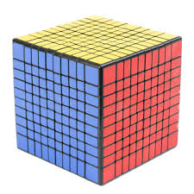
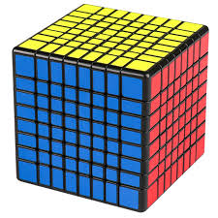
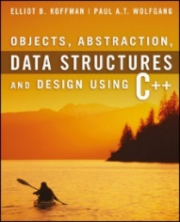
Welcome to
CS 235 Data Structures
Sequential Containers, 4.5 (13)
You are given a 10x10x10 cube composed of 1x1x1 "mini-cubes" glued together.
If the outer most layer falls off, will the resulting cube be more, less, or the same than ¾ the original cube?
1000 - 100 + 100 + 80 + 80 + 64 + 64 = 1000 – 488 = 512
Less than 3/4 the original cube!
Direct your answer to host only in chat box.

Slide 2

Welcome to
CS 235 Data Structures
Sequential Containers, 4.5 (13)

Slide 3



Wednesday, May 11, 2022
National Eat What You Want Day
Announcements…
  Deliverables:
    Lab 01: Grades Peer Reviews due Wednesday (05/11).
    Lab 02: SNAP due Wednesday (05/11)
    Lab 03: Linked List due Saturday (05/14)
  General:
    Direct emails to cs235ta@cs.byu.edu
    Sharing attendance quiz codes is dishonest.
    Please include netID when requesting help or reporting a problem!
For Today…
  4.6-10, pgs. 264-307
  4.7-8, pgs. 271-291
Quiz Code: zebra

Slide 4

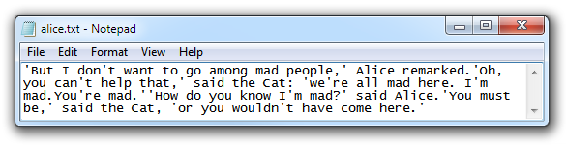
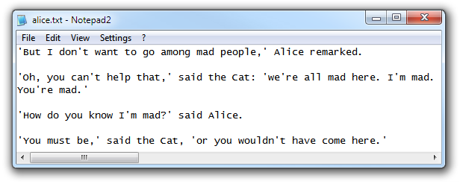
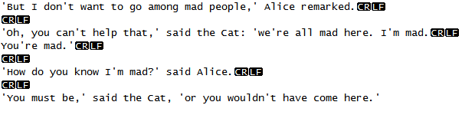
Tip #13: '\n' Confusion
Internally all applications use '\n' to indicate line termination.
But the line termination sequence is platform specific.
  Windows (DOS) uses CR and LF.
  Unix (Linux) uses LF.
  Mac (OSX) CR.
  2 additional formats:
    Unicode Line Separator (LS) and
    Unicode Paragraph Separator (PS).

Slide 5
Tip #13: Newline Confusion
The problem with platform specific line termination is
  The '\n' character is transformed into a platform specific sequence of character(s) when you write it to a file.
  The platform specific sequence is converted back to '\n' when the file is read.
The problem occurs when one writes files on one platform and reads them on another (as developing on Windows or Mac and auto-grading with g++).
  This normally isn't a problem when using only ">>" as it ignores newlines.
  But when you mix getline and ">>", you need to ignore the newlines that ">>" leaves behind.
Bad
cout << "Enter name: "; getline(cin, name); cout << "Enter city: "; cin >> city; cout << "Enter state: "; getline(cin, state);
Better
cout << "Enter name: "; getline(cin, name); cout << "Enter city: "; cin >> city; cin.ignore(); cout << "Enter state: "; getline(cin, state);
Best
cout << "Enter name: "; getline(cin, name); cout << "Enter city: "; getline(cin, city); cout << "Enter state: "; getline(cin, state);
Don't mix extraction operator with getline's!
Just use getline's!
Put a cin.ignore() after every cin >> so that there is never any rubbish in the stream.
Reads a blank line!

Slide 6
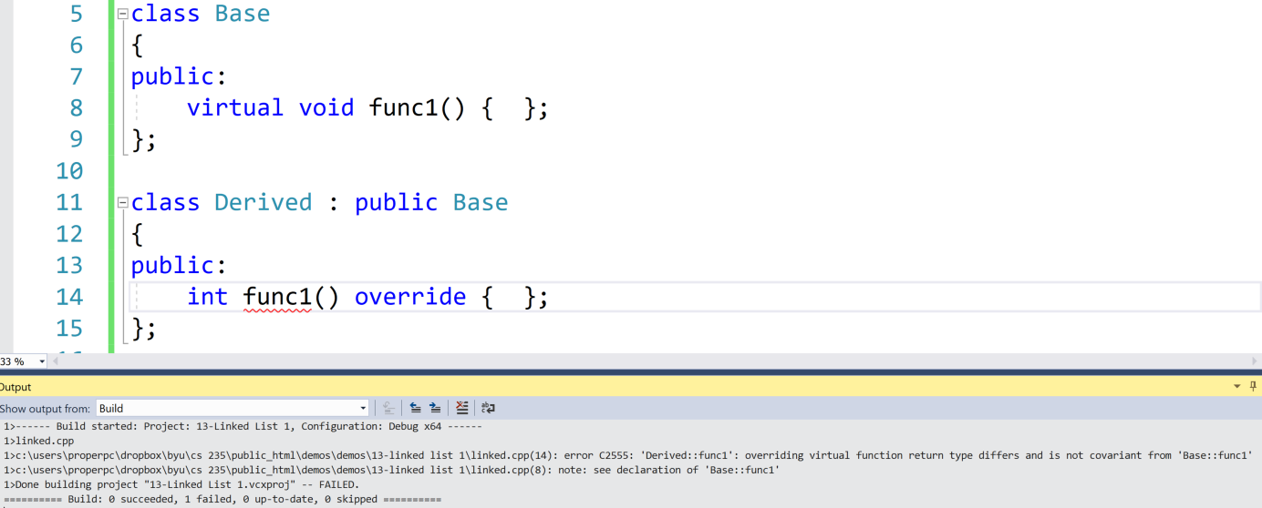
override
override is a C++11 identifier that only has meaning in the context of declaring / defining a virtual function and means that a method is an "override" of a method in a base class.
  override shows the reader of the code that "this is a virtual method, that is overriding a virtual method of the base class."
  The compiler knows that it's an override, so it can "check" that you are not altering / adding new methods that you think are overrides.
class Base
{
public:
virtual void func1() {...};
};
class Derived : public Base
{
public:
void func1() override {...};
};
If Derived::func1() signature doesn't equal Base::func1() signature, a compilation error will be generated because Derived::func1() does not override Base::func1().
Note: You don't need the override identifier to do virtual overriding in C++, it simply enforces that you are doing it properly.

Slide 7
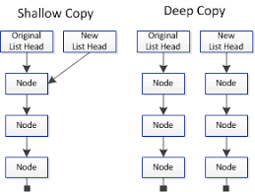
4.4 The Copy Constructor, Assignment Operator, and Destructor
Copying Objects and the Copy Constructor
Shallow Copy versus Deep Copy
Assignment Operator
The Destructor
4.4, pgs. 247-251

Slide 8
Copying Objects
Applications require that a copy of an object be an independent copy, which means being able to modify one of the objects without affecting the other.
  Copying of primitive types is straightforward—the values are duplicated and placed in the target locations (shallow).
  If the object references a dynamically allocated object, the memory allocated to that object must be freed (deep).
The Gang of Three Rule basically states that if a class defines one (or more) of the following, it should probably explicitly define all three:
  Copy constructor – create new object members from corresponding member constructors.
  Copy assignment operator – assign corresponding members from existing members.
  Destructor – call the destructors of all the object's class-type members.
The default constructors and assignment operators only do shallow copies.
  Destructors contain code that is run whenever an object is destroyed.
  An explicit deep copy constructor, assignment operator, and destructor must be created when a class contains pointers to dynamically allocated resources.

Slide 9
Shallow Copy
Referring back to our vector class, copying current_capacity and num_items fields create independent copies of the variables.
However, copying the pointer value the_data does not create an independent copy.
Copying a pointer this way is considered a shallow copy.
1
2
3
4
5
Vector<int> v1
num_items = 5 current_capacity = 8 int* the_data = _____
Vector<int> v2 = v1;
Vector<int> v2
num_items = 5 current_capacity = 8 int* the_data = _____

Slide 10
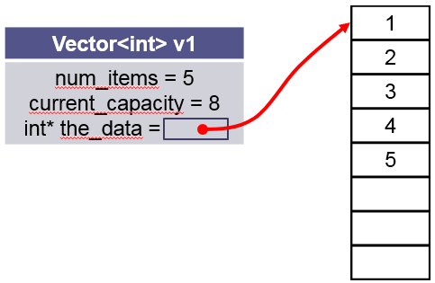
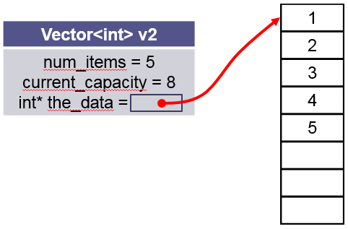
Deep Copy Constructor
We need to create an independent copy or a deep copy of the underlying array so that v1.the_data and v2.the_data point to different arrays, making vector v2 a deep copy of vector.
/** Make a (deep) copy of a vector.
@param other The vector to be copied
*/
Vector<T>(const Vector<T>& other)
: current_capacity(other.current_capacity),
num_items(other.num_items),
the_data(new T[other.current_capacity])
{
for (size_t i = 0; i < num_items; i++)
{
the_data[i] = other.the_data[i];
}
}

Slide 11
Deep Assignment Operator
/** Assign the contents of one vector to another.
@param other The vector to be assigned to this vector
@return This vector with a copy of the other vector's contents
*/
Vector<T>& operator=(const vector<T>& other)
{
// Make a copy of the other vector.
Vector<T> the_copy(other);
// Swap contents of self with the copy.
this->swap(the_copy);
// Return self (the copy will be deleted)
return *this;
}
Vector<int> v1();
Vector<int> v2();
v2 = v1;
this
other
Make a copy of v1 using the vector copy constructor (v1 → the_copy)
Exchange v2 (this) and the_copy (only exchange pointers) (v2 ←→ the_copy)
v2 is now the_copy (V1) and so return v2 (*this) (v2 ← v1)
Note: the_copy is deleted by the local destructor.

Slide 12
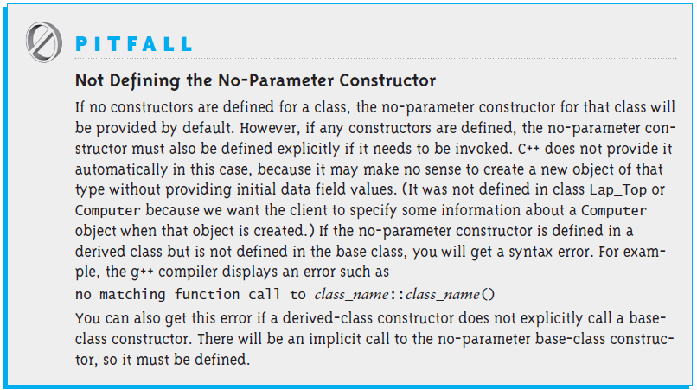
The No-Parameter Constructor
If the execution of any constructor in a derived class does not invoke a base class constructor, C++ automatically invokes the no-parameter constructor for the base class.
C++ does this to initialize the part of the object inherited from the base class before the derived class starts to initialize its part of the object.

Slide 13

Follow-up Questions...
Would you and your neighbor answer the following review questions:
What is a no parameter constructor?
What is a copy constructor?
When is the assignment operator used?
What is the difference between a deep and shallow copy?

Slide 14
Review Questions...
What is a no parameter constructor?
What is a copy constructor?
When is the assignment operator used?
What is the difference between a deep and shallow copy?
If no constructors are defined in a class, the no-parameter constructor for that class will be provided by default.
Special constructor for a class/struct that is used to make a copy of an existing class/struct instance.
  Initialize one object from another of the same type.
  Copy an object to pass it as an argument to a function.
  Copy an object to return it from a function.
  When the compiler generates a temporary object.
The assignment operator is used to assign one instance of a class to another.
A shallow copy copies all of the object member field values. (The default copy constructor and assignment operator make shallow copies.)
A deep copy copies all fields and makes copies of dynamically allocated memory pointed to by the fields.

Slide 15
C++ Interface
class Interface
{
public:
Interface(){}
virtual ~Interface(){}
virtual void myMethod() = 0; // pure virtual method
};
class MyClass : public Interface
{
private:
int myMember;
public:
MyClass(){}
~MyClass(){}
virtual void myMethod()
{
// myMethod implementation
};
};
int main(void)
{
Interface* myClass = new MyClass();
myClass->myMethod();
delete myClass;
return 0;
}
MyClass
Interface
When we create a Derived object, it contains a Base part (which is constructed first) and a Derived part (which is constructed second).
Inheritance implies an is-a relationship between two classes.
Since a Derived is-a Base, it is appropriate that Derived contain a Base part.

Slide 16
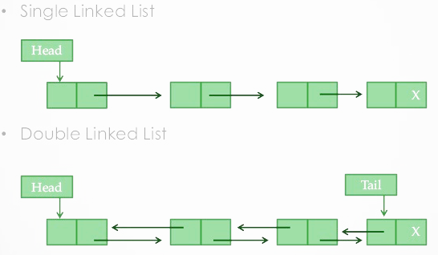
4.5 Single-Linked Lists and Double-Linked Lists
A List Node
Connecting Nodes
Inserting a Node in a List
Removing a Node
Traversing a Linked List
Double-Linked Lists
Creating a Double-Linked List Object
Circular Lists
4.5-7, pgs. 252-285

Slide 17
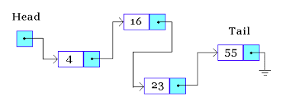
Lab 03 – Linked List

Slide 18





Lab 03 – Linked List
Linked lists are a common data structure in all object-oriented languages and will play a vital role in your activities as a programmer.
A forward linked list is a singly-linked list of node objects containing a value and a pointer to the next node.
  Only a head or first node pointer is maintained by the list.
  All list accesses begin with the head pointer.
Forward linked lists are useful containers for insertion and deletion operations in constant time.
Doubly linked lists contain three fields: two link fields (pointers to previous and next nodes in the sequence) and one data field.

Slide 19
Linked List Interface Template
//**** YOU MAY NOT MODIFY THIS DOCUMENT ****/
#ifndef LINKED_LIST_INTERFACE_H
#define LINKED_LIST_INTERFACE_H
#include <string>
template<typename T>
class LinkedListInterface
{
public:
LinkedListInterface(void) {}
virtual ~LinkedListInterface(void) {}
/** Insert Node at beginning of linked list */
virtual void push_front(const T& value) = 0;
/** Remove Node at beginning of linked list */
virtual void pop_front(void) = 0;
/** Return Node at beginning of linked list */
virtual T& front(void) = 0;
/** Return true if linked list size == 0 */
virtual bool empty(void) const = 0;
/** Remove all Nodes with value from linked list */
virtual void remove(const T& value) = 0;
/** Remove all Nodes from linked list */
virtual void clear(void) = 0;
/** Reverse Nodes in linked list */
virtual void reverse(void) = 0;
/** Return the number of nodes in the linked list */
virtual size_t size(void) const = 0;
/** Return contents of Linked List as a string */
virtual std::string toString(void) const = 0;
};
#endif // LINKED_LIST_INTERFACE_H
#ifndef LINKED_LIST_H
#define LINKED_LIST_H
using std::string;
using std::ostream;
/** Linked List */
template<typename T>
class LinkedList : public LinkedListInterface<T>
{
private:
struct Node
{
T data;
Node* next;
Node(const T& d) : data(d), next(NULL) {}
Node(const T& d, Node* n) : data(d), next(n) {}
};
Node* head;
public:
LinkedList() : head(NULL) { }
~LinkedList() { clear(); }
/** Insert Node at beginning of list */
virtual void push_front(T& value) { /*...*/ }
/** Remove Node at beginning of linked list */
virtual bool pop_front(void) { /*...*/ }
/* ... */
};
#endif // LINKED_LIST_H
LinkedListInterface.h
Must be publicly inherited by your LinkedList class.
**May not be modified**

Slide 20
Lab 03 – Linked List
COMMAND | DESCRIPTION | EXAMPLE
Clear | Delete all items in the linked list. void clear(void); | Clear OK Size 0
Empty | Output true if linked list empty, else false. bool empty(void); | Empty false Clear OK Empty true
Delete | Delete the first item in the linked list. Throw an error "Empty" if linked list is empty. void pop_front(void); | PrintList The quick brown fox jumped over the lazy dog. Delete OK PrintList quick brown fox jumped over the lazy dog. Clear OK Delete Empty!
First | Output the first item in the linked list. Throw an error "Empty" if linked list is empty. T& front(void); | PrintList The quick brown fox jumped over the lazy dog. First The Clear OK First Empty!
Insert <data>... | Insert item(s) at the head of the linked list void push_front(const T& value) ; | Insert men. good all for Insert time the is Now PrintList Now is the time for all good men.
PrintList PrintCopy | Output the contents of the linked list, space separated. Output "Empty!" if list is empty. string toString(void) const; | PrintList Now is the time for all good men. Clear OK PrintList Empty!
Remove <data> | Remove all like items from the linked list. Throw an error "Empty" if linked list is empty. void remove(const T& value); | PrintList The very brown fox jumped over the very lazy dog. Remove very PrintList The brown fox jumped over the lazy dog.
Reverse | Reverse the items in the linked list. Throw an error "Empty" if linked list is empty. void reverse(void); | PrintList fox brown quick very The Reverse OK PrintList The very quick brown fox Clear OK Reverse Empty!
Size | Return the number of Nodes in the list. size_t size(void) const; | Size 11
Copy | Make a deep copy of the current List. LinkedList<T>(const LinkedList<T>& other) LinkedList<T>& operator=(const LinkedList<T>& rhs) | Insert men. good all for Insert time the is Now Copy OK Clear OK PrintList Empty! PrintCopy Now is the time for all good men.

Slide 21
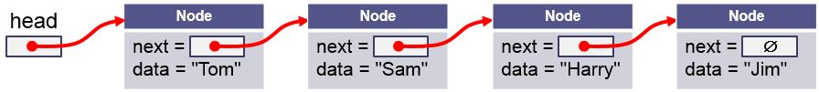
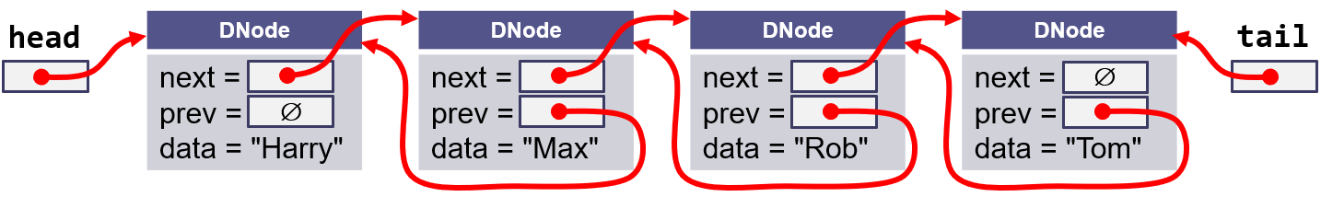
Lab 03 – Linked List (Bonus)
COMMAND | DESCRIPTION | EXAMPLE
Last | Output the list item in the linked list. Throw an error "Empty!" if linked list is empty. T& back(void); | PrintList The quick brown fox jumped over the lazy dog. Last dog. Clear OK First Empty!
Drop | Delete the last item in the linked list. Output "OK" if successful. Throw an error "Empty!" if linked list is empty. void pop_back(void); | PrintList The quick brown fox jumped over the lazy dog. Drop OK PrintList The quick brown fox jumped over the lazy Clear OK Delete Empty!
Append <data>... | Insert item(s) at the tail of the linked list void push_back(const T& value) ; | Append Now is the time for all good men. PrintList Now is the time for all good men.

Slide 22
Lab 03 – Linked List
Step 1 - Begin with a main function.
  Open for input argv[1] and for output argv[2].
  Add code to read and output input file.
  Parse input commands and output corresponding messages.
Step 2 - Design and implement a LinkedList template class.
  Create a LinkedList template class that inherits from LinkedListInterface class. Since LinkedListInterface is an abstract class, stub out all virtual functions so that there are no compiler errors. Include both .h files in your main file.
  Implement one function at a time and then test it before moving on to the next one. Try implementing more basic functions first, like toString and Insert.
  Create your own test case files to aid in your incremental testing.
Step 3 - If desired, implement the bonus double-linked list functions and commands.
Step 4 - When you've completed the incremental testing, test your program with the provided test cases.

Slide 23
Lab 03 – Linked List
Points | Requirement
10 | Basic linked list commands Insert, Clear, and PrintList commands are correctly implemented. (lab03_in_01.txt).
5 | Linked list Empty and Size commands are correctly implemented. (lab03_in_02.txt).
10 | Linked list Delete, First, and Remove commands are correctly implemented. (lab03_in_03.txt).
10 | Linked list Reverse command is correctly implemented. (lab03_in_04.txt).
10 | An error is thrown ("Empty!") when front(), pop_front(), or reverse() linked list methods are called with empty lists. A try-block in main catches and reports the error. Processing of input commands continues. (lab03_in_05.txt).
5 | Linked list Copy command is correctly implemented. (lab03_in_06.txt).
+10 Extra Credit | Double-linked list Last, Append, and Drop commands are correctly implemented. All singly-linked commands described above work properly. (lab03_in_07.txt).
-10 | Memory leaks, g++ compiler warnings, array out-of-bounds detected, or execution interactions.
 | Peer Review
2 | LinkedList is a template class and is derived from the pure abstract template class LinkedListInterface.
2 | A try-block in main catches and reports errors such as accesses to empty lists.
2 | All derived class objects have a public insertion (<<) operator.
2 | A user define deep assignment operator is called by the COPY command.

Slide 24


Slide 25


Welcome to
CS 235 Data Structures
Sequential Containers, 4.7-10 (14)
A snail can ascend two feet up a pole during the day.
However, during the night, the snail slips back down the pole one foot.
How many days is required for the snail to climb to the top of a ten foot pole?
9 Days!!
Direct your answer to host only in chat box.

Slide 26
Tip #14: eof in Loops
Anytime you see istream::eof() as a loop condition, the code is almost certainly wrong! Why??
Because iostream::eof will only return true after reading the end of the stream. (It does not indicate, that the next read will be the end of the stream.)
int data;
while(!inStream.eof())
{
// not end-of-file
inStream >> data;
// do stuff with data
}
instream →
... | 'T' | 'h' | 'e' | ' ' | 'E' | 'n' | 'd'
EOF
Only now will the read set the eof bit (as well as the fail bit), but we process the data variable.
Better
int data; while(inStream >> data) { // NOT end of stream // do stuff with good data }
Bad
int data; while(!inStream.eof()) { // not end-of-file inStream >> data; // do stuff with good(??) data }
Best
string line; while(getline(in, line)) { istringstream inStream(line); int data; inStream >> data; ... }
We can be sure that the read was successful – otherwise the stream operator>> would have returned false and the loop would not have been entered..

Slide 27
Follow-up Questions...
Would you and your neighbor answer the following review questions:
How are singly-linked list elements accessed?
What is the Big-O of:
  Linked list insertion (at beginning of list)
  Linked list insertion (in the middle of list)
  Linked list insertion (between two consecutive nodes)
  Linked list random access
  Linked list search
How do vectors compare in performance to lists?

Slide 28
Review Questions...
  How are singly-linked list elements accessed?
  What is the Big-O of:
    Linked list insertion (at beginning of list)
    Linked list insertion (in the middle of list)
    Linked list insertion (between two consecutive nodes)
    Linked list random access
    Linked list search
  How do vectors compare in performance to lists?
All list accesses begin with the head pointer.
Ο(1)
Ο(n)
Ο(1)
Ο(n)
Ο(n)
Generally, vectors outperform lists when considering
Traversal (lists lead to cache misses),
Insertion and Deletion (lists need to traverse to the point of insertion/deletion),
Storage (lists have 2 pointers per elements of overhead while vectors need just a little more memory than the actual elements need).

Slide 29
Vectors vs Lists
How do vectors compare in performance to lists?
Traversal:
List nodes are scattered everywhere in memory and hence list traversal leads to cache misses. But traversal of vectors is smooth.
Insertion and Deletion:
Average 50% of elements must be shifted when you do that to a Vector but caches are very good at that! But, with lists, you need to traverse to the point of insertion/deletion... so again... cache misses! And surprisingly vectors win this case as well!
Storage:
When you use lists, there are 2 pointers per elements(forward & backward) so a List is much bigger than a Vector! Vectors need just a little more memory than the actual elements need.

Slide 30
Double-Linked Lists
Limitations of a single-linked list include:
  Insertion at the front is O(1); insertion at other positions is O(n)
  Insertion is convenient only after a referenced node.
  Removing a node requires a reference to the previous node.
  We can traverse the list only in the forward direction.
We can overcome these limitations by adding a reference in each node to the previous node, creating a double-linked list.

Slide 31
The DNode Class
  template<typename T>
  class DLinkedList : public DLinkedListInterface<T>
  {
  private:
  struct DNode
  {
  T data;
  DNode* prev;
  DNode* next;
  DNode(const T& d, DNode* pv = NULL, DNode* nx = NULL)
  : data(d), prev(pv), next(nx) {}
  };
  DNode* head;
  DNode* tail;
  int num_items;
  public:
  /** ... */
  }
Each Dnode has a next and a prev link.
A Doubly Linked List has a head and tail pointer

Slide 32
push_front("Rob")
newNode
Case 1:
DNode
next = prev = data = "Rob"
∅
∅
head
tail
∅
∅
DNode* newNode = new DNode(item, NULL, head);
if (head != NULL) head->prev = newNode;
head = newNode;
if (tail == NULL) tail = newNode;

Slide 33
push_front("Rob")
Case 1:
head
DNode
next = prev = data = "Rob"
tail
∅
∅
DNode* newNode = new DNode(item, NULL, head);
if (head != NULL) head->prev = newNode;
head = newNode;
if (tail == NULL) tail = newNode;

Slide 34
push_front("Sam")
newNode
Case 2:
DNode
next = prev = data = "Sam"
∅
head
DNode
next = prev = data = "Rob"
tail
∅
∅
DNode* newNode = new DNode(item, NULL, head);
if (head != NULL) head->prev = newNode;
head = newNode;
if (tail == NULL) tail = newNode;

Slide 35
push_front("Sam")
newNode
Case 2:
DNode
next = prev = data = "Sam"
∅
head
DNode
next = prev = data = "Rob"
tail
∅
∅
DNode* newNode = new DNode(item, NULL, head);
if (head != NULL) head->prev = newNode;
head = newNode;
if (tail == NULL) tail = newNode;

Slide 36
push_front("Sam")
newNode
Case 2:
DNode
next = prev = data = "Sam"
∅
head
DNode
next = prev = data = "Rob"
tail
∅
∅
DNode* newNode = new DNode(item, NULL, head);
if (head != NULL) head->prev = newNode;
head = newNode;
if (tail == NULL) tail = newNode;

Slide 37
push_front("Sam")
Case 2:
head
DNode
next = prev = data = "Sam"
DNode
next = prev = data = "Rob"
tail
∅
∅
DNode* newNode = new DNode(item, NULL, head);
if (head != NULL) head->prev = newNode;
head = newNode;
if (tail == NULL) tail = head;

Slide 38
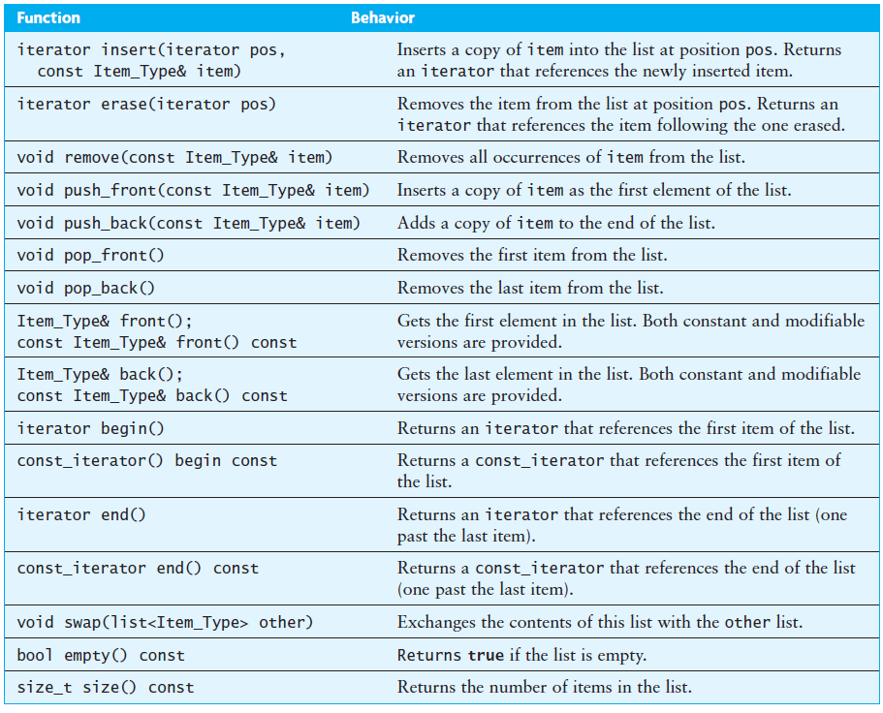
The list Class – Double-linked List

Slide 39
Ordered Insertion of "Rob"
newNode
DNode
next = prev = data = "Rob"
node_ptr
node_ptr
node_ptr
∅
∅
head
DNode
next = prev = data = "Harry"
DNode
next = prev = data = "Max"
DNode
next = prev = data = "Tom"
tail
∅
∅
Node* node_ptr = head; // find insertion point
while (node_ptr->data < "Rob")
node_ptr = node_ptr->next;
Node* newNode = new Node("Rob");
newNode->next = node_ptr; // Step 1

Slide 40
Ordered Insertion of "Rob"
newNode
DNode
next = prev = data = "Rob"
node_ptr
∅
head
DNode
next = prev = data = "Harry"
DNode
next = prev = data = "Max"
DNode
next = prev = data = "Tom"
tail
∅
∅
Node* node_ptr = head; // find insertion point
while (node_ptr->data < "Rob")
node_ptr = node_ptr->next;
Node* newNode = new Node("Rob");
newNode->next = node_ptr; // Step 1
node_ptr->prev->next = newNode; // Step 2

Slide 41
Ordered Insertion of "Rob"
newNode
DNode
next = prev = data = "Rob"
node_ptr
∅
head
DNode
next = prev = data = "Harry"
DNode
next = prev = data = "Max"
DNode
next = prev = data = "Tom"
tail
∅
∅
Node* node_ptr = head; // find insertion point
while (node_ptr->data < "Rob")
node_ptr = node_ptr->next;
Node* newNode = new Node("Rob");
newNode->next = node_ptr; // Step 1
node_ptr->prev->next = newNode; // Step 2
newNode->prev = node_ptr->prev; // Step 3

Slide 42
Ordered Insertion of "Rob"
newNode
DNode
next = prev = data = "Rob"
node_ptr
head
DNode
next = prev = data = "Harry"
DNode
next = prev = data = "Max"
DNode
next = prev = data = "Tom"
tail
∅
∅
Node* node_ptr = head; // find insertion point
while (node_ptr->data < "Rob")
node_ptr = node_ptr->next;
Node* newNode = new Node("Rob");
newNode->next = node_ptr; // Step 1
node_ptr->prev->next = newNode; // Step 2
newNode->prev = node_ptr->prev; // Step 3
node_ptr->prev = newNode; // Step 4

Slide 43
Ordered Insertion of "Rob"
newNode
DNode
next = prev = data = "Rob"
node_ptr
head
DNode
next = prev = data = "Harry"
DNode
next = prev = data = "Max"
DNode
next = prev = data = "Tom"
tail
∅
∅
Node* node_ptr = head; // find insertion point
while (node_ptr->data < "Rob")
node_ptr = node_ptr->next;
Node* newNode = new Node("Rob");
newNode->next = node_ptr; // Step 1
node_ptr->prev->next = newNode; // Step 2
newNode->prev = node_ptr->prev; // Step 3
node_ptr->prev = newNode; // Step 4

Slide 44
Delete "Rob"
node_ptr
node_ptr
node_ptr
head
DNode
next = prev = data = "Harry"
DNode
next = prev = data = "Max"
DNode
next = prev = data = "Rob"
DNode
next = prev = data = "Tom"
tail
∅
∅
Node* node_ptr = head; // find "Rob" point
while (node_ptr->data != "Rob")
node_ptr = node_ptr->next;
node_ptr->prev->next = node_ptr->next; // Step 1

Slide 45
Delete "Rob"
node_ptr
head
DNode
next = prev = data = "Harry"
DNode
next = prev = data = "Max"
DNode
next = prev = data = "Rob"
DNode
next = prev = data = "Tom"
tail
∅
∅
Node* node_ptr = head; // find "Rob" point
while (node_ptr->data != "Rob")
node_ptr = node_ptr->next;
node_ptr->prev->next = node_ptr->next; // Step 1
node_ptr->next->prev = node_ptr->prev; // Step 2

Slide 46
Delete "Rob"
node_ptr
head
DNode
next = prev = data = "Harry"
DNode
next = prev = data = "Max"
DNode
next = prev = data = "Rob"
DNode
next = prev = data = "Tom"
tail
∅
∅
Node* node_ptr = head; // find "Rob" point
while (node_ptr->data != "Rob")
node_ptr = node_ptr->next;
node_ptr->prev->next = node_ptr->next; // Step 1
node_ptr->next->prev = node_ptr->prev; // Step 2
Delete node_ptr; // Step 3

Slide 47
Delete "Rob"
head
DNode
next = prev = data = "Harry"
DNode
next = prev = data = "Max"
DNode
next = prev = data = "Tom"
tail
∅
∅
Node* node_ptr = head; // find "Rob" point
while (node_ptr->data != "Rob")
node_ptr = node_ptr->next;
node_ptr->prev->next = node_ptr->next; // Step 1
node_ptr->next->prev = node_ptr->prev; // Step 2
Delete node_ptr; // Step 3

Slide 48
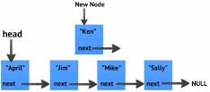
4.8 Application of the list Class
Case Study: Maintaining an Ordered List
4.8, pgs. 285-286

Slide 49
Application of the list Class
Problem
  We want to maintain this list so that it will be in alphabetical order even after students have added and dropped the course.
Analysis
  Develop a general Ordered_List class that can be used to store any group of objects that can be compared using the less-than operator.
Solution
  Write a new Ordered_List class that inherits (is-a) a C++ list class and over-ride all the list functions.
✗
  Write a new Ordered_List class that contains (has-a) a C++ list class.
    Use the list class to store the items.
    Use list functions where appropriate (delegation).
    Only write new functions where needed, namely insertion.

Slide 50
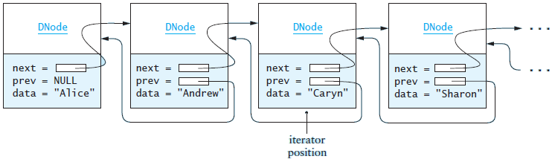
Ordered Linked List Insertion
Algorithm for Insertion
  Find the first item in the list that is greater than or equal to the item to be inserted
    Create an iterator that starts at the beginning of the list
    While the iterator is not at the end and the item at the iterator position is less than the item to be inserted
    Advance the iterator
  Insert the new item before this one.

Slide 51
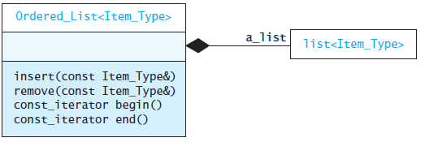
Delegation
Code for Insertion
Inside a declaration or a definition of a template, typename can be used to declare that a dependent name is a type.
void insert(const Item_Type& an_item)
{
// point to the first item >= an_item or the end
typename list<Item_Type>::iterator iter = a_list.begin();
// find insertion point
while (iter != a_list.end() && *iter < an_item) ++iter;
// now insert in list
a_list.insert(iter, an_item);
}
A delegate is a class or method that wraps a pointer or reference to an object instance, a member method of that object's class to be called on that object instance and provides a method to trigger that call.
Use Delegation for the Other Functions
void remove(const Item_Type& item)
{
a_list.remove(item);
}

Slide 52
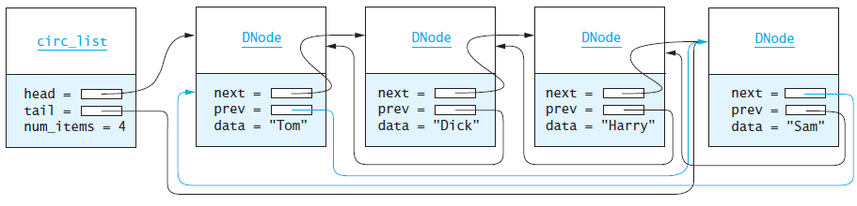
Circular Lists
Circular double-linked list:
  Link last node to the first node, and
  Link first node to the last node
We can also build single-linked circular lists:
  Traverse in forward direction only
  If we keep a pointer to tail, we can access the last element and the first element in O(1) time
Advantages:
  Continue to traverse even after passing the first or last node
  Visit all elements from any starting point
  Never fall off the end of a list
Disadvantage: The code must avoid an infinite loop!

Slide 53


Be Safe

