Slide 1
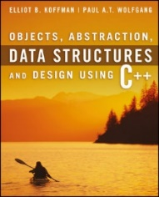
Welcome to
CS 235 Data Structures
Sequential Containers, 4.1-2 (11)

Slide 2
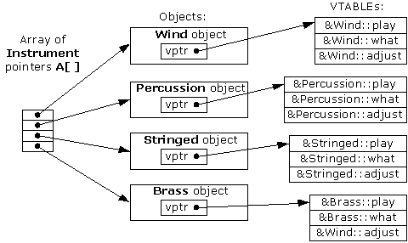
Tip #11: Virtual Functions
Polymorphism refers to being able to associate many meanings to one function name by means of a special mechanism known as virtual functions or late binding.
There are clear advantages to using virtual functions, so, why not make all member functions virtual?
The answer: There is overhead (execution and memory) to making a function virtual.
Virtual functions use more storage and make your program run slower than if functions were not virtual.
That is why the designers of C++ gave the programmer control over which member functions are virtual and which are not.
If you expect to need the advantages of a virtual member function, then by all means, make that member function virtual.
If you do not expect to need the advantages of a virtual function, then your program will run more efficiently if you do not make the member function virtual.
class Instrument
virtual void play() {}
class Wind : public Instrument
virtual void play() {}
class Percussion : public Instrument
virtual void play() {}
...
vector<Instrument*> instruments;
instruments.push_back(new Wind());
instruments.push_back(new Percussion());
for (size_t i; i < instruments.size(); ++i)
instruments[i]->play();

Slide 3
Lab 02 - SNAP

Slide 4
S.N.A.P Lab
Class design is type design - defining effective classes can be challenging.
Organize related data into structures (structs or classes).
Make a member function only if access to internals of a class is needed.
Minimize exposure of class members by making public for the general use, protected for derived classes and the remaining members should be private.
For the SNAP lab you are to design classes for a school database with has-a and is-a relationships that have natural syntax, intuitive semantics, and efficient memory allocation.
The class objects are populated from parsed input strings.
Use object inheritance, polymorphism, and function and operator overloading where needed.
All member data and internal functions are private.
All derived classes have a "toString" method with friend insertion ("<<") operator.
Use UML diagrams to describe your implementation.

Slide 5
Example SNAP Input/Output
Input Strings:
snap(12345,Charlie Brown,Manager,555-1234).
snap(67890,Lucy,Right Field,555-5678).
csg(CS101,12345,A).
csg(CS101,67890,B).
**Error: csgs(CS101,67890,B).
cdh(CS101,M,9AM).
cdh(CS101,W,9AM).
cr(CS101,1170 TMCB).
Vectors:
snap(12345,Charlie Brown,Manager,555-1234)
snap(67890,Lucy,Right Field,555-5678)
csg(CS101,12345,A)
csg(CS101,67890,B)
cdh(CS101,M,9AM)
cdh(CS101,W,9AM)
cr(CS101,1170 TMCB)
Course Grades:
CS101,Charlie Brown,A
CS101,Lucy,B
Student Schedules:
Charlie Brown, 12345, Manager, 555-1234
CS101 MW 9AM, 1170 TMCB
Lucy, 67890, Right Field, 555-5678
CS101 MW 9AM, 1170 TMCB
studentId, name, address, phone #
course, studentId, grade
Use try/catch to report Input Error
course, day, hour
course, room
List snap, csg, cdh, and cr objects stored in vectors
List course grades (in snap vector order) for all students.
List all student schedules (in csg vector order.)

Slide 6
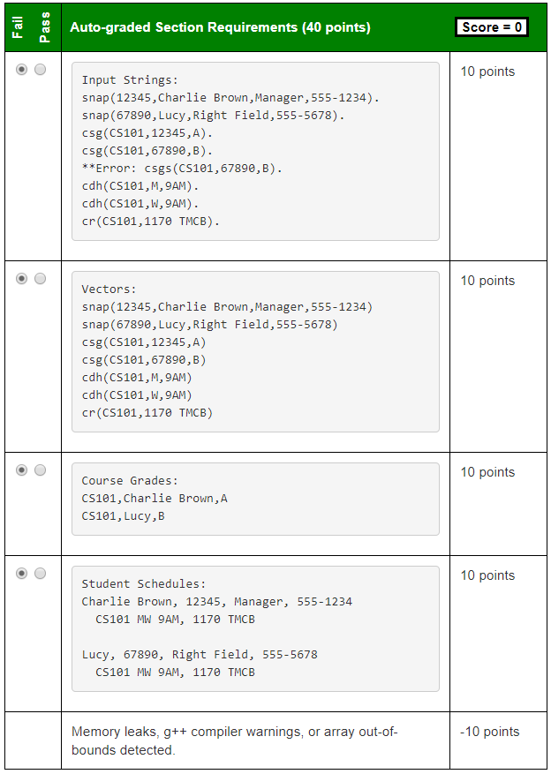
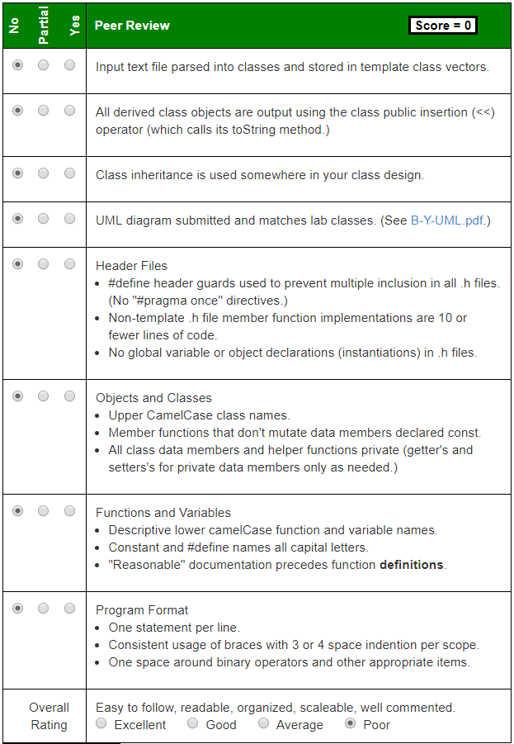
vector<Snap> snaps;
vector<Csg> csgs;
vector<Cdh> cdhs;
vector<Cr> crs;
studentId, name, address, phone #
course, studentId, grade
course, day, hour
course, room
string toString() const
{ stringstream out;
out << "snap(" << this->studentId;
out << "," << this->studentName;
out << "," << this->studentAddress;
out << "," << this->studentPhone << ")";
return out.str();
}
friend ostream& operator<< (ostream& os, const Snap& snap)
{
os << snap.toString();
return os;
}
Use try/catch to report Input Error
List snap, csg, cdh, and cr objects stored in vectors
List course grades (in snap vector order) for all students.
List all student schedules (in csg vector order.)
Create pdf or jpg of UML diagram – must be of reasonable size (< ~4M.) Zip pdf, or jpg in submission folder. Not required to include friends in UML diagram.

Slide 7
UML
Vehicle
Class Name
The data members and functions are listed by visibility, name, and type.
Visibility
A '-' indicates private visibility.
A '+' indicates public visibility.
A '#' indicates protected visibility.
Type
Data member, function parameter and return types appear after the name.
-vid:int
-make:string
Data Members
+Vehicle(mk:string, vid:int)
+~Vehicle()
+getVID():int
+getMake():string
+toString():string
Class Methods
public
private
is-a
Car
has-a
-model:string
-engine:Engine
Engine
+Car(mk:string, mdl:string,
vid:int, cyl:int)
+getModel():string
+getEngine():Engine&
+toString():string
-cylinders:int
+Engine(cyl:int)
+getCylinders():int
+toString():string

Slide 8
SNAP Inheritance
StudentId
Course
-int studID
-string course
+int getStudID()
+toString() const
+string getCourse()
+toString() const
SNAP
Csg
Cdh
Cr
-int studID
-string name
-string address
-string phone
-string course
-int studID
-string grade
-string course
-string day
-string hour
-string course
-string room
+string getCourse()
+string getRoom()
+toString() const
+string getCourse()
+int getStudID()
+string getGrade()
+toString() const
+string getCourse()
+string getDay()
+string getHour()
+toString() const
+int getStudID()
+string getName()
+string getAddr()
+string getPhone()
+toString() const

Slide 9
SNAP Inheritance
This process is known as refactoring and is often used in object-oriented design.
StudentID
Course
-int studID
-string course
+int getStudID()
+toString() const
+string getCourse()
+toString() const
SNAP
Csg
Cdh
Cr
-int studID
-string name
-string address
-string phone
-string course
-int studID
-string grade
-string course
-string day
-string hour
-string course
-string room
+string getCourse()
+string getRoom()
+toString() const
+string getCourse()
+int getStudID()
+string getGrade()
+toString() const
+string getCourse()
+string getDay()
+string getHour()
+toString() const
+int getStudID()
+string getName()
+string getAddr()
+string getPhone()
+toString() const
Please carefully read and follow the Lab requirements!

Slide 10
SNAP Inheritance
SchoolCourse
This process is known as refactoring and is often used in object-oriented design.
-string course
-int studID
+string getCourse()
+int getStudID()
+toString() const
SNAP
Csg
Cdh
Cr
-int studID
-string name
-string address
-string phone
-string course
-int studID
-string grade
-string course
-string day
-string hour
-string course
-string room
+string getCourse()
+string getRoom()
+toString() const
+string getCourse()
+int getStudID()
+string getGrade()
+toString() const
+string getCourse()
+string getDay()
+string getHour()
+toString() const
+int getStudID()
+string getName()
+string getAddr()
+string getPhone()
+toString() const
Please carefully read and follow the Lab requirements!

Slide 11
Public, Protected, Private Inheritance
class A
{
public:
int x;
protected:
int y;
private:
int z;
};
class B : public A
{
// x is public
// y is protected
// z is not accessible from B
};
class C : protected A
{
// x is protected
// y is protected
// z is not accessible from C
};
class D : private A
{
// x is private
// y is private
// z is not accessible from D
};
z is not accessible in any inherited class!
Classes B, C and D all contain the variables x, y and z. It is just question of access.
'private' is default for classes

Slide 12
The No-Parameter Constructor
If the execution of any constructor in a derived class does not invoke a base class constructor, C++ automatically invokes the no-parameter constructor for the base class.
C++ does this to initialize the part of the object inherited from the base class before the derived class starts to initialize its part of the object.

Slide 13
Follow-up Questions...
What is an abstract class/function?
What is multiple inheritance?
What is a friend declaration?
An abstract class is a class that has at least one pure virtual function and is designed to be a base class.
An abstract class cannot be instantiated (compilation error).
Classes inheriting an abstract class must provide the definitions for the pure virtual functions; otherwise, the subclass would become an abstract class itself.
Multiple inheritance refers the ability of a class to extend more than one class.
All the data fields for the derived class are inherited from its base classes.
The friend declaration allows a function external to a class to access the private members of that class (effectively making the friend function or class a member of the declaring class).
The class itself must declare who its friends are.
Friendship is not inherited and is not transitive - if a base class is a friend of a particular class, its derived classes are not automatically friends too.

Slide 14
Chapter 4
11 - Sequential Containers

Slide 15
Chapter 4 Objectives
To become familiar with the Standard Template Library (STL) and template classes.
To understand how to use a vector class and how to implement it using an array for storage.
To understand the difference between a shallow copy and deep copy.
To introduce linked list and study the differences between single-, double-, and circular linked list data structures.
To introduce structs.
So far, we’ve considered one data structure — the array.
The C++ developers have provided more tools for programmers by providing a rich set of data structures written as C++ template classes.
In this chapter we discuss the STL classes called sequences.

Slide 16
Sequence Classes
A sequence has the property that objects of the same type are stored in a linear manner and can be inserted or removed anywhere in the sequence.
Some sequences are indexed, which means their elements can be accessed in arbitrary order (called random access) using a subscript to select an element.
For other sequences you must start at the beginning and process the elements in order and use Iterators to facilitate sequential access and random access.
The STL sequence containers are:
array - represents a static contiguous array.
vector - represents a dynamic contiguous array.
forward_list - represents a singly-linked list.
list - represents a doubly-linked list.
deque - represents a double-ended queue.

Slide 17
4.1 Template Classes and the Vector
Vector
Specification of the vector Class
Function at and the Subscripting Operator
4.1, pgs. 232-236

Slide 18
Template Classes
A C++ template is literally a template or blueprint for creating a generic class or function of a specified type.
A template is not a class.
Using C++ templates avoids having to write nearly identical classes (int, float, etc.), but results in compiled code that is mostly as if we had written each version separately.
A C++ template uses "Instantiation-style polymorphism".
For example, the template MyClass<T> isn't really a generic class that can be compiled to code.
Only the result of instantiation of the template can be compiled.
As an example, the string class is an instantiation of the basic_string class template with a char type.
Strings are objects that represent sequences of characters.
basic_string supports all the operations of a sequence container.
string typedef basic_string<char> string;

Slide 19
C++ Templates
Templates allow functions and classes to be instantiated for generic (and user defined) data types without being rewritten for each one.
template <typename T1, typename T2>
class MyPair
{
private:
T1 first;
T2 second;
public:
MyPair(T1 f, T2 s) : first(f), second(s) { }
T1 getFirst() { return first; }
T2 getSecond() { return second; }
};
MyPair<string, int> myDog("Dog", 36);
MyPair<double, double> myFloats(3.0, 2.18);

Slide 20
The Vector
A vector is a template class based on a dynamic array which means you can select its elements in arbitrary order as determined by the subscript value.
In addition, a vector supports the following operations that an array does not:
Increase or decrease its length.
Insert an element at a specified position without writing code to shift the other elements to make room.
Remove an element at a specified position without writing code to shift the other elements to fill in the resulting gap.
Vectors are used most often when a programmer wants to add new elements to the end of a list but still needs the capability to access, in arbitrary order, the elements stored in the list.

Slide 21
A Vector Class Object
template<typename T>
class Vector
{
private:
// Data fields
/** The initial capacity of the array */
static const size_t INITIAL_CAPACITY = 8;
/** The current capacity of the array */
size_t current_capacity;
/** The current num_items of the array */
size_t num_items;
/** The array to contain the data */
T* the_data;
public:
// Member Functions
...
};
The size of a vector automatically increases as new elements are added, and the size decreases as elements are removed.
If an insertion is not at the end of the vector, the existing entries in the vector are shifted automatically to make room for the entry being inserted.
Similarly, if an element other than the last one is removed, the other entries are shifted automatically to close up the space that was vacated.
The number of elements a vector currently contains is returned by the member function size().
Each vector object has a capacity, which is the number of elements it can store.
When a vector’s size is equal to its capacity, the capacity is increased automatically.

Slide 22
String Vector
vector<string> my_vector;
my_vector.push_back("Bashful");
my_vector.push_back("Awful");
my_vector.push_back("Jumpy");
my_vector.push_back("Happy");
my_vector.insert(2, "Doc");
my_vector.push_back("Dopey");
my_vector.erase(1);
my_vector[2] = "Sneezy";

Slide 23
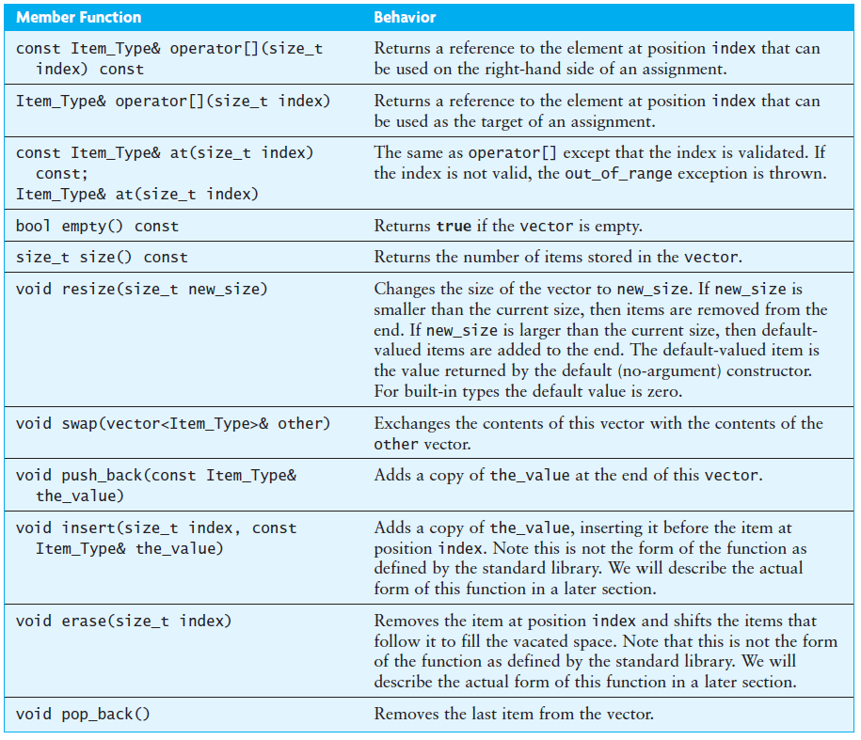
Specification of the vector Class
Because Item_Type is determined when the vector is created, the actual argument and return types for these functions may be different for different instantiations of the vector class.
Two entries for operator[] and member function at().
const values can’t be changed.
Function at validates the index.
The size_t type is an unsigned int; we use it here because all vector indexes must be nonnegative

Slide 24
Function at and Subscript Operator
The non-const operators reference an element of the vector whose value can be changed.
The const subscripting operator (“[ ]”) also returns a reference to element of the vector but the value cannot be changed.
Both of the following statements retrieve and display the value of element 2 of vector<int> v
cout << v[2];
cout << v.at(2);
Both of the following statements add 6 to the value of element 2 of vector v and assign that sum to element 3 of vector v
v[3] = v[2] + 6;
v.at(3) = v.at(2) + 6;
In these statements, the reference to element 2 retrieves a value of vector v that is not changed
In contrast, both references to element 3 change its value.
The function at validates the index (throws an exception on out-of-bounds).

Slide 25
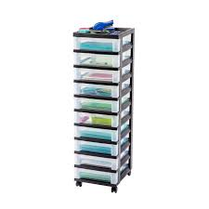
4.2 Applications of Vectors
4.2, pgs. 238-240

Slide 26
Vectors vs. Static Arrays
Vectors can grow, static arrays cannot.
If you use a vector to store enemies in a game, then the vector will grow as the number of enemies increase.
If you use a static array, then it must be large enough to contain the maximum possible number of enemies.
And that memory will be “used up” for the entire duration of the game.
Std::vectors work with STL algorithms which may save some time in coding certain effects.
Vectors pre-allocates space for future elements, so extra space required beyond what's necessary for the elements themselves is allocated.
Vector iterators are invalidated if you add or remove elements to or from the vector.

Slide 27
Traversing STL Vectors w/Iterators
Typically, iterators are used to access elements of a container in linear fashion.
int sum = 0;
vector<int> vec = { 1, 2, 3, 4, 5 };
using Iter = std::vector<int>::const_iterator;
for (Iter iter = vec.begin(); iter != vec.end(); ++iter)
{
sum += *iter;
}
Vector iterators are used with standard algorithms.
#include <numeric>
vector<int> vec = { 1, 2, 3, 4, 5 };
int sum = std::accumulate(vec.begin(), vec.end(), 0)
The advantage of using iterator is that you can apply the same pattern with other containers.

Slide 28
Tip #12: File Organization (Best Practice)
File extensions are only meaningful for the operating system.
Best practice states:
.h and .hpp files are for cross file data type declarations. They should have header guards and NEVER allocate (instantiate) any memory.
.cpp files are for memory allocations (ie, regular function code and global variables) as well as non-template class method definitions (implementation of method).
Class method definitions can be inside or outside the class declaration (using the resolution operator "::").
The class method definitions (implementation) can be in the .h file containing the declaration or a separate .cpp file (using the same name as the .h file.)
Often, one .h/.cpp file combination is used for each class.
If the class method definition (implementation) is more than 10 lines, the declaration and definition are combined to aid the compiler in possible in-lining of the function.
NOTE: The exception to the above recommendation is when creating a class template where the method declaration and definition MUST BE in the same file.

Slide 29
#include <iostream>
using namespace std;
#include "Dog.h"
int main()
{
Dog rover;
cout << rover.getBarks();
return 0;
}
#include <iostream>
using namespace std;
#include "Dog.h"
int main()
{
Dog rover;
cout << rover.getBarks();
return 0;
}
main.cpp
main.cpp
#ifndef DOG_H
#define DOG_H
class Dog
{
private:
int bark;
public:
Dog() : bark(0) {}
~Dog() {};
int getBarks() { return bark; }
int bigDog();
};
#endif
#ifndef DOG_H
#define DOG_H
class Dog
{
private:
int bark;
public:
Dog();
~Dog();
int getBarks();
int bigDog();
};
#endif
#ifndef DOG_H
#define DOG_H
class Dog
{
private:
int bark;
public:
Dog() : bark(0) {}
~Dog() {};
int getBarks() { return bark; }
int bigDog();
};
// Big function
int Dog::bigDog()
{
// >10 lines of code...
return 0;
}
#endif
Dog.h
Dog.h
10 or less
lines
more than 10 lines
#include "Dog.h"
Dog::Dog() : bark(0) {}
Dog::~Dog() {};
int Dog::getBarks() { return bark; }
// Big function
int Dog::bigDog()
{
// >10 lines of code...
return 0;
}
#include "Dog.h"
// Big function
int Dog::bigDog()
{
// >10 lines of code...
return 0;
}
Dog.cpp
✗
Dog.cpp
Templated classes require declarations and definitions to be in the same file (.h).

Slide 30
Follow-up Questions...
What is a C++ template?
Where is template method implementation defined?
Why is vector insert slower than vector push_back?
How are items contained in a vector accessed?
A template is a “pattern” that the compiler uses to generate a family of classes or functions.
In order for the compiler to generate the code, it must see both the template definition (not just declaration) and the specific types/whatever used to “fill in” the template in a single file.
Vectors store elements in a contiguous array and elements have to be moved to make room for the insertion.
push_back inserts the element at the end of the array.
Index operator [ ], at() function
operator *, iterator.

Slide 31
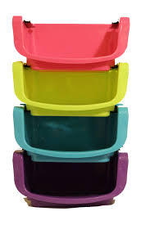
4.3 Implementation of a Vector Class
The Default Constructor
The swap Function
The Subscripting Operator
The push_back Function
The insert Function
The erase Function
The reserve Function
Performance of the KW::Vector
4.3, pgs. 240-246

Slide 32
A Vector Class Object
template<typename T>
class Vector
{
private:
// Data fields
/** The initial capacity of the array */
static const size_t INITIAL_CAPACITY = 8;
/** The current capacity of the array */
size_t current_capacity;
/** The current num_items of the array */
size_t num_items;
/** The array to contain the data */
T* the_data;
public:
// Member Functions
...
};
static means shared by all instances of Vector. const tells the compiler that no one can modify INITIAL_CAPACITY.
The physical size of the dynamic array (type size_t is an unsigned int) .
The number of data items stored is indicated by the data field num_items
The vector data is stored in a dynamic array of type T.

Slide 33
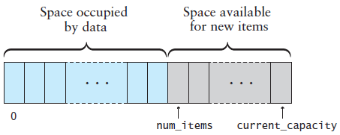
Vector Default Constructor
template<typename T>
class Vector
{
private:
// Data fields
...
public:
// Member Functions
/** Construct an empty vector w/default capacity */
Vector<T>() : current_capacity(INITIAL_CAPACITY),
the_data(new T[INITIAL_CAPACITY]),
num_items(0) {}
};
Initializer List:
current_capacity = INITIAL_CAPACITY;
the_data = new T[INITIAL_CAPACITY];
num_items = 0;

Slide 34
Vector at / Index Operator
template<typename T>
class Vector
{
private:
// Data fields
...
public:
/** Subscripting operator */
T& operator[](size_t index) { return the_data[index]; }
/** at member function */
T& at(size_t index)
{
if (index >= num_items) // Verify valid index.
{
throw std::out_of_range("index to operator[] is out of range");
}
return the_data[index];
}
};
Because this is a template class, all of the code must be in the header or in a file included by the header .
In the STL vector, only the at function validates the index.
The index is valid, so just use the index operator.

Slide 35
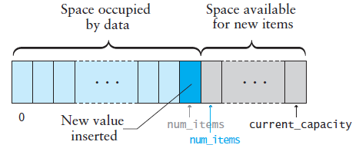
Vector push_back() Function
void push_back(const T& the_value)
{
// Make sure there is space for the new item.
if (num_items == current_capacity)
{
reserve(2 * current_capacity); // Double the capacity
}
// Insert the new item.
the_data[num_items] = the_value;
num_items++;
}
Requests the vector capacity to be double the current capacity.

Slide 36
Vector reserve() Function
The reserve function is called by push_back() and insert() functions if the vector size would exceed its capacity.
Requests the vector capacity to be at least enough to contain new_capacity elements.
void reserve(size_t new_capacity)
{
if (new_capacity > current_capacity)
{
T* new_data = new T[new_capacity];
for (size_t i = 0; i < num_items; i++)
new_data[i] = the_data[i];
delete[] the_data;
the_data = new_data;
current_capacity = new_capacity;
}
}
Copy old data to the new array.
Free old memory.
Point the vector to the new data.
Although reallocation is O(n), if we double an array of size n, then we can add n more items before another array copy is needed (which averages out to 1 copy per add, so reallocation is effectively an O(1) operation).
Hence, push_back() is performed in amortized constant time.

Slide 37
Vector insert() Function
void insert(size_t index, const T& the_value)
{
for (size_t i = num_items; i > index; i--) // Open a slot
{
the_data[i] = the_data[i - 1];
}
the_data[index] = the_value; // Insert new item
num_items++;
}
if (index > num_items) // Validate index.
{
throw std::out_of_range("Insert index is out of range");
}
if (num_items == current_capacity) // Check for room
{
reserve(2 * current_capacity); // Double the capacity
}

Slide 38
Vector erase() Function
void erase(size_t index)
{
// Validate index.
if (index > num_items)
{
throw std::out_of_range("Erase index is out of range");
}
// Move items below the removed one up.
for (size_t i = index + 1; i < num_items; i++)
{
the_data[i - 1] = the_data[i];
}
num_items--;
}

Slide 39
Performance of Vector
The functions operator[] and at are each a few lines of code and contain no loops - execute in constant time, or O(1).
If we insert into (or remove from) the middle of a vector, then at most n items have to be shifted, which is O(n).
What if we have to reallocate before we can insert?
Reallocation is O(n), but...
We wouldn't need to reallocate again for another n insertions.
Hence, we spread out the cost of reallocation so that effectively it is an O(1) operation (O(n) / n), so the insertion is still O(n) .
Even if we don’t spread out the cost of copying, the copy operation is still O(n), so the worst case merely doubles the cost.
The functions push_back() and insert() are performed in amortized constant time.

Slide 40
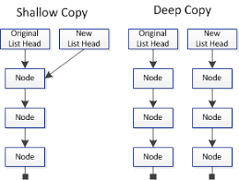
4.4 The Copy Constructor, Assignment Operator, and Destructor
Copying Objects and the Copy Constructor
Shallow Copy versus Deep Copy
Assignment Operator
The Destructor
4.4, pgs. 247-251

Slide 41
Copying Objects
Applications require that a copy of an object be an independent copy, which means being able to modify one of the objects without affecting the other.
Copying of primitive types is straightforward—the values are duplicated and placed in the target locations (shallow).
If the object references a dynamically allocated object, the memory allocated to that object must be freed (deep).
The Gang of Three Rule basically states that if a class defines one (or more) of the following, it should probably explicitly define all three:
Copy constructor – create new object members from corresponding member constructors.
Copy assignment operator – assign corresponding members from existing members.
Destructor – call the destructors of all the object's class-type members.
The default constructors and assignment operators only do shallow copies.
Destructors contain code that is run whenever an object is destroyed.
An explicit deep copy constructor, assignment operator, and destructor must be created when a class contains pointers to dynamically allocated resources.

Slide 42
Copy Constructor / Assignment Operator
To create an independent copy of an object, the
Copy constructor is called when a new object is created from an existing object:
MyClass t1, t2; // default constructor
MyClass t3 = t1; // copy constructor (t3 is new)
Assignment operator is called when an already initialized object is assigned a new value from another existing object.
t2 = t1; // assignment operator (t2 exists)
t2.operator=(t1); // assignment operator (equivalent)
Examples:
Dog butch("Butch"); // Parameterized constructor of butch
Dog skippy(); // Default constructor of skippy
skippy = butch; // assignment operator
The copy constructor is invoked automatically:
when an object is passed to a function by value.
when an object is returned from a function.
when an object is initialized with another object of the same class.
when the compiler generates a temporary object.

Slide 43
Shallow Copy
Referring back to our vector class, copying current_capacity and num_items fields create independent copies of the variables.
However, copying the pointer value the_data does not create an independent copy.
Copying a pointer this way is considered a shallow copy.
1
2
3
4
5
Vector<int> v1
num_items = 5 current_capacity = 8 int* the_data = _____
Vector<int> v2 = v1;
Vector<int> v2
num_items = 5 current_capacity = 8 int* the_data = _____

Slide 44
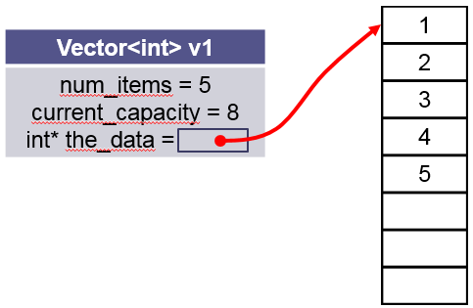
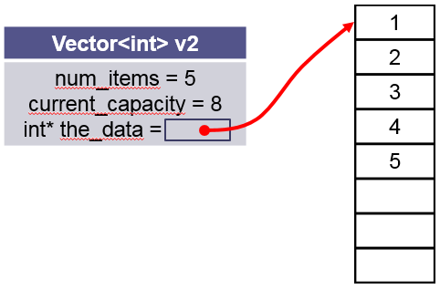
Deep Copy Constructor
We need to create an independent copy or a deep copy of the underlying array so that v1.the_data and v2.the_data point to different arrays, making vector v2 a deep copy of vector.
/** Make a (deep) copy of a vector.
@param other The vector to be copied
*/
Vector<T>(const Vector<T>& other)
: current_capacity(other.capacity),
num_items(other.num_items),
the_data(new T[other.current_capacity])
{
for (size_t i = 0; i < num_items; i++)
{
the_data[i] = other.the_data[i];
}
}

Slide 45
Deep Assignment Operator
/** Assign the contents of one vector to another.
@param other The vector to be assigned to this vector
@return This vector with a copy of the other vector's contents
*/
Vector<T>& operator=(const vector<T>& other)
{
// Make a copy of the other vector.
Vector<T> the_copy(other);
// Swap contents of self with the copy.
this->swap(the_copy);
// Return self (the copy will be deleted)
return *this;
}
Vector<int> v1();
Vector<int> v2();
v2 = v1;
this
other
Make a copy of v1 using the vector copy constructor (v1 → the_copy)
Exchange v2 (this) and the_copy (only exchange pointers) (v2 ←→ the_copy)
v2 is now the_copy (V1) and so return v2 (*this) (v2 ← v1)
Note: the_copy is deleted by the local destructor.

Slide 46
The Destructor
The purpose of the destructor is to undo what the constructor does.
The constructor takes a block of uninitialized memory and sets it to a valid state, thus creating an object.
When the destructor is finished, the object is in an invalid state and the memory it occupies can be reused for creating other objects.
If this is not done, the program will have memory leaks.
Each class has a default destructor, which effectively invokes the destructor for each data field.
If the pointer references a dynamically allocated object (such as the array referenced by pointer the_data), the memory allocated to that object must be freed.

Slide 47
Be Safe

