Slide 1
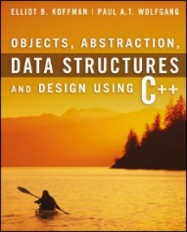
Welcome to
CS 235 Data Structures
Inheritance, 3.4-6 (10)

Slide 2
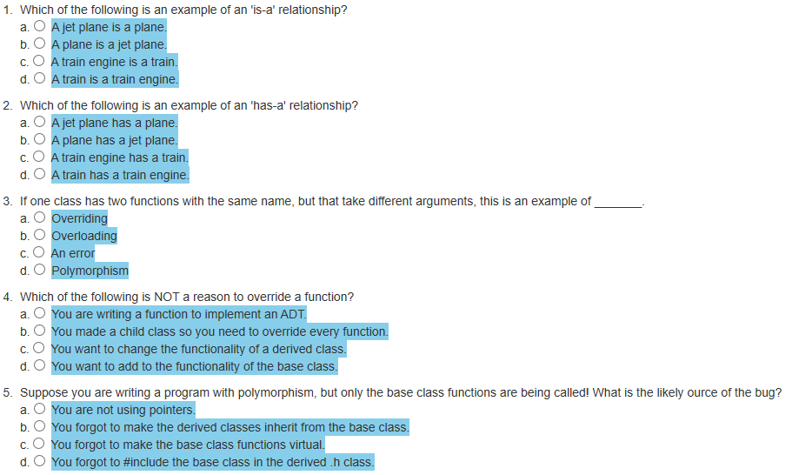
Attendance Quiz #09

Slide 3
Tip #10: Standard Integer typedefs
The actual size of integer types varies by implementation.
The standard only requires size relations between the data types (i.e., a long long is not smaller than long, which is not smaller than int, which is not smaller than short.)
A char's size is always the minimum supported data type; no other data types (except bit-fields) can be smaller.
The following pre-processor macros are defined in the header file <stdint.h>:
signed | unsigned | Description
int8_t | uint8_t | Integer type with a width of exactly 8, 16, 32, or 64 bits. For signed types, negative values are represented using 2's complement. No padding bits.
int16_t | uint16_t
int32_t | uint32_t
int64_t | uint64_t
 | std::size_t | Largest unsigned integer type. The size of any object in bytes. Widely used in the standard library to represent sizes, lengths, and counts.

Slide 4
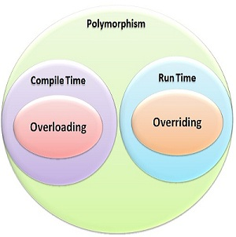
3.2 Member Function Overriding, Member Function Overloading, and Polymorphism
Member Function Overriding
Member Function Overloading
Virtual Functions and Polymorphism
3.2, pgs. 193-203

Slide 5
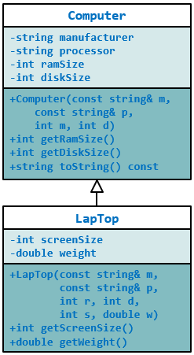
#ifndef COMPUTER_H_
#define COMPUTER_H_
#include <string>
#include <sstream>
using std::ostringstream;
using std::string;
using std::endl;
class Computer
{
private:
string manufacturer;
string processor;
int ramSize;
int diskSize;
public:
Computer(const string& m, const string& p, int r, int d) :
manufacturer(m), processor(p),
ramSize(r), diskSize(d) {}
~Computer() {}
int getRamSize() const { return ramSize; }
int getDiskSize() const { return diskSize; }
string toString() const
{
ostringstream sb;
sb << "Manufacturer: " << manufacturer
<< endl << "CPU: " << processor
<< endl << "RAM: " << ramSize << " Mbs"
<< endl << "Disk: " << diskSize << " Gbs";
return sb.str();
}
};
#endif
#ifndef LAP_TOP_H
#define LAP_TOP_H
#include <string>
#include <sstream>
#include "computer.h"
using std::string;
using std::ostringstream;
class LapTop : public Computer
{
private:
int screenSize;
double weight;
public:
LapTop(const string& m, const string& p, int r, int d,
int s, double w) :
Computer(m, p, r, d), // init Computer
screenSize(s), weight(w) {} // init LapTop
int getScreenSize() const { return screenSize; }
double getWeight() const { return weight; }
};
#endif
The constructor for class Lap_Top must begin by initializing the four data fields inherited from class Computer.
Because those data fields are private to the base class, C++ requires that they be initialized by a base class constructor

Slide 6
Member Function Overriding
Computer.cpp
Class LapTop have does not have a toString method.
#include <iostream>
#include <string>
#include "lapTop.h"
using namespace std;
int main(int argc, char* argv[])
{
Computer myComputer("HP", "I5", 16, 500);
LapTop yourComputer("Dell", "I7", 32, 1000, 15, 5);
cout << endl << "My computer:" << endl << myComputer.toString() << endl;
cout << endl << "Your computer:" << endl << yourComputer.toString() << endl;
return 0;
}
My computer:
Manufacturer: HP
CPU: I5
RAM: 16 Mbs
Disk: 500 Gbs
Your computer:
Manufacturer: Dell
CPU: I7
RAM: 32 Mbs
Disk: 1000 Gbs
Even though yourComputer is of type LapTop, the LapTop fields are not displayed; the call to toString() calls the toString() method inherited from Computer

Slide 7
Member Function Overriding
LapTop.h
LapTop.cpp
If class LapTop has its own toString member function, it will override the inherited member function and will be invoked by the member function call to toString().
#ifndef LAP_TOP_H
#define LAP_TOP_H
#include <string>
#include <sstream>
#include "computer.h"
using std::string;
using std::ostringstream;
class LapTop : public Computer
{
private:
int screenSize;
double weight;
public:
LapTop(const string& m,
const string& p,
int r, int d, int s, double w) :
Computer(m, p, r, d),
screenSize(s), weight(w) {}
int screenSize() const { return screenSize; }
double getWeight() const { return weight; }
string toString() const;
};
#endif
#include "lapTop.h"
#include <sstream>
using std::ostringstream;
using std::string;
using std::endl;
string LapTop::toString() const
{
ostringstream sb;
sb << Computer::toString()
<< endl << "Screen: "
<< screenSize << " inches"
<< endl << "Weight: "
<< weight << " lbs";
return sb.str();
}
We still call Computer's toString member function to output its contents.

Slide 8
Member Function Overriding
#include <iostream>
#include <string>
#include "lapTop.h"
using namespace std;
int main(int argc, char* argv[])
{
Computer myComputer("HP", "I5", 16, 500);
LapTop yourComputer("Dell", "I7", 32, 1000, 15, 5);
cout << endl << "My computer:" << endl << myComputer.toString() << endl;
cout << endl << "Your computer:" << endl << yourComputer.toString() << endl;
return 0;
}
My computer:
Manufacturer: HP
CPU: I5
RAM: 16 Mbs
Disk: 500 Gbs
Your computer:
Manufacturer: Dell
CPU: I7
RAM: 32 Mbs
Disk: 1000 Gbs
Screen: 15 inches
Weight: 5 lbs
Now the state of a laptop computer, complete with screen size and weight, is output when calling toString member function for class LapTop which overrides the inherited member function of Computer.

Slide 9
Virtual Functions and Polymorphism
#include <iostream>
#include <vector>
#include <string>
#include "lapTop.h"
using namespace std;
int main(int argc, char* argv[])
{
vector<Computer*> computers;
computers.push_back(new Computer("Acer", "I3", 8, 256));
computers.push_back(new LapTop("HP", "I5", 16, 500, 13, 6.5));
for (unsigned int i = 0; i < computers.size(); i++)
cout << endl << computers[i]->toString() << endl;
return 0;
}
Manufacturer: Acer
CPU: I3
RAM: 8 Mbs
Disk: 256 Gbs
Manufacturer: HP
CPU: I5
RAM: 16 Mbs
Disk: 500 Gbs
In C++, a pointer variable of a base-class type (general) can point to an object of a derived-class type (specific):
LapTop objects are Computer objects with more features.
But, where are the additional data members?

Slide 10
Virtual Functions and Polymorphism
class Computer
{
// ...
public:
// ...
virtual string toString() const;
};
#include <iostream>
#include <vector>
#include <string>
#include "lapTop.h"
using namespace std;
int main(int argc, char* argv[])
{
vector<Computer*> computers;
computers.push_back(new Computer("Acer", "I3", 8, 256));
computers.push_back(new LapTop("HP", "I5", 16, 500, 13, 6.5));
for (unsigned int i = 0; i < computers.size(); i++)
cout << endl << computers[i]->toString() << endl;
return 0;
}
Manufacturer: Acer
CPU: I3
RAM: 8 Mbs
Disk: 256 Gbs
Manufacturer: HP
CPU: I5
RAM: 16 Mbs
Disk: 500 Gbs
Screen: 13 inches
Weight: 6.5 lbs
By changing the declaration of the function toString in the class Computer (in Computer.h) to a virtual function, when it is called through a pointer (or reference) variable the actual member function will be determined at run time and based on the type of the object pointed to (or referenced).

Slide 11
Virtual Functions and Polymorphism
Polymorphism is an important concept of OOP.
Polymorphism is the quality of having many forms or many shapes.
Polymorphism enables the program to determine which member function to invoke at run time.
class Computer
{
// ...
public:
// ...
string toString() const;
};
class LapTop : public Computer
{
// ...
public:
// ...
string toString() const;
};
int main()
{
vector<Computer*> computers;
computers.push_back(new Computer(...));
computers.push_back(new LapTop(...));
cout computers[1]->toString();
}
At compile time, the C++ compiler cannot determine what type of object computers will point to.
class Computer
{
// ...
public:
// ...
virtual string toString() const;
};
class LapTop : public Computer
{
// ...
public:
// ...
virtual string toString() const;
};
int main()
{
vector<Computer*> computers;
computers.push_back(new Computer(...));
computers.push_back(new LapTop(...));
cout computers[1]->toString();
}
At run time, polymorphism and virtual functions allows the program to know which toString function to call.
Use a pointer(s) of type base class to pointer to your object.
Declare the function(s) in base class virtual.
BTW: It is good practice to include the virtual declaration in the derived classes too for documentation purposes.

Slide 12
Sundry Items...
Object instantiation
Pure abstract function
Abstract class
Multiple inheritance
Object slicing
Namespace
Using declaration
Friendship

Slide 13
The friend Declaration
The friend declaration allows a function external to a class to access the private members of that class.
The friend declaration gives the functions and classes it specifies access to the private and protected members of the class in which the friend declaration appears.
This effectively makes the named function or class a member of the declaring class.
The class itself must declare who its friends are.
Friendship is not inherited and is not transitive - if a base class is a friend of a particular class, its derived classes are not automatically friends too.

Slide 14
Friends
#include <iostream>
#include <string>
using namespace std;
class MyClass
{
private:
string name;
public:
MyClass(const string name) { this->name = name; }
~MyClass() = default;
};
int main(int argc, char* argv[])
{
MyClass me("Suzy Student");
cout << me << endl;
return 0;
}
Defines an independent insertion operator function that is a friend of MyClass.
friend ostream& operator<< (ostream& os, const MyClass& me)
{
os << "MyClass(" << me.name << ")";
return os;
}
The friend insertion operator function has access to MyClass’ private data members.
ostream ⊕ MyClass
Returns a reference to the output stream that has been modified.

Slide 15
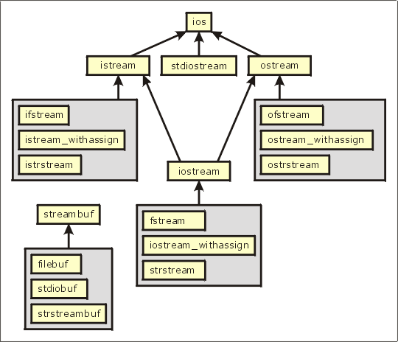
3.3 Abstract Classes, Assignment, and Casting in a Hierarchy
Referencing Actual Objects
Summary of Features of Actual Classes and Abstract Classes
Assignments in a Class Hierarchy
Casting in a Class Hierarchy
Case Study: Displaying Addresses for Different Countries
3.3, pgs. 203-206

Slide 16
Abstract Functions and Classes
An object is an instantiation of a class.
A pure abstract function is a virtual function that is declared in a class but has no body (definition).
A pure abstract function definition must be supplied by a derived concrete class.
A pure virtual function is created by using the pure specifier (= 0) as the definition of a virtual member function.
An abstract class is a class that has at least one pure abstract function and is designed to be a base class.
An abstract class cannot be instantiated (which would result in a compilation error).
Classes inheriting an abstract class must provide the definitions for the pure virtual functions; otherwise, the subclass would become an abstract class itself.
We use an abstract class when a base class defines attributes and functions that are common to derived classes.

Slide 17
Abstract Class Food.h
#ifndef FOOD_H_
#define FOOD_H_
class Food
{
private:
string name;
double calories;
public:
Food(const string& n, double c) : name(n), calories(c) {}
virtual ~Food() {}
virtual double percent_protein() const = 0;
virtual double percent_fat() const = 0;
virtual double percent_carbohydrates() const = 0;
};
#endif
These three abstract virtual functions impose the requirement that all derived classes implement these functions.
(We would expect a different function definition for each kind of food.)
A pure virtual function is specified in the class definition by using "= 0" in place of the function body.

Slide 18
Referencing Concrete Objects
Because class Food is abstract, we can’t create type Food objects; hence the following statement is invalid:
Food mySnack(); // compile time error!
We can use a type Food pointer variable to point to an actual object that belongs to a class derived from Food.
Food
If a Vegetable object is derived from Food, then Food is contained in Vegetable.
-name:string
-calories:double
+Food(string&, double)
+~Food()
+percent_protein():double
+percent_fat():double
+percent_carbohydrates():double
Thus, a pointer to Food can be used to reference a Vegetable.
The pointer variable mySnack (type pointer-to-Food) is legal:
Vegetable
+Vegetable(string&, double)
+~Vegetable()
+percent_protein():double
+percent_fat():double
+percent_carbohydrates():double
+getName():string
+getCalories:double
Food* mySnack = new Vegetable("Carrot Sticks", 0);

Slide 19
Assignments in a Class Hierarchy
C++ is what is known as a strongly typed language.
Operands have a type and operations can be performed only on operands of the same or compatible types.
This includes the assignment operation:
l-value = r-value
For the built-in types, the r-value must be of the same type as the l-value, or there must be a conversion defined to convert the r-value into a value that is the same type as the l-value.
For class types, the assignment operator may be overridden and overloaded.
Pointer types are an exception: A pointer variable (l-value) that is of type pointer-to-base class may point to a derived object (r-value).
However, the opposite is not legal:
Computer* computer = new LapTop( ... ); // Legal
LapTop* laptop = new Computer( ... ); // Illegal

Slide 20
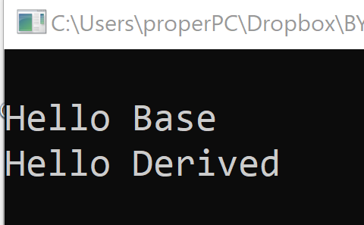
Object Slicing
#include <iostream>
#include <string>
using namespace std;
class Base
{
public:
virtual string toString()
{ return string("Hello Base"); }
};
class Derived : public Base
{
public:
virtual string toString()
{ return string("Hello Derived"); }
};
int main()
{
Base base = Derived();
cout << endl << base.toString();
Base* base_ptr = new Derived();
cout << endl << base_ptr->toString();
return 0;
}
In C++ programming, object slicing occurs when a derived class object (subclass) is copied (either by constructors or assignment operators) to a base class object (superclass).
The base copy will not have any of the member functions/variables defined in the derived class.
The derived class members will be "sliced off" and NOT replace the base class members.
This issue is not inherently unique to C++.
By using pointers, only the pointer is copied and not source object.

Slide 21
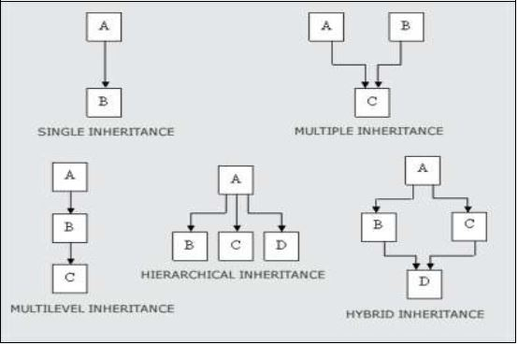
3.4 Multiple Inheritance
Refactoring the Employee and Student Classes
3.4, pgs. 210-212

Slide 22
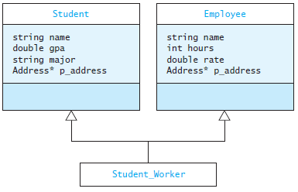
Multiple Inheritance
Multiple inheritance refers the ability of a class to extend more than one class.
In multiple inheritance, all the data fields for the derived class are inherited from its base classes.
For example, a university has many students who are full-time students and many employees who are full-time employees, but also some student employees.

Slide 23
Definition of Student_Worker
#ifndef STUDENT_WORKER_H_
#define STUDENT_WORKER_H_
#include <string>
#include "Employee.h"
#include "Student.h"
using std::string;
class StudentWorker : public Employee, public Student
{
public:
Student_Worker(const string& name,
Address* addr,
double rate,
const string& major) :
Employee(name, address, rate),
Student(name, address, major) {}
string to_string() const;
};
#endif
There is no argument given for data fields hours or gpa, so they are initialized to default values
The heading shows that class StudentWorker extends class Student and class Employee
The first initializes the Employee part
The constructor contains two initialization expressions separated by a comma
The second initializes the Student part

Slide 24
3.5 Namespaces and Visibility
Namespaces
Declaring a Namespace
The Global Namespace
The using Declaration and using Directive
Using Visibility to Support Encapsulation
The friend Declaration
3.5, pgs. 213-220

Slide 25
Namespaces
Namespaces are used to group collections of declarations into a functional unit.
The entire C++ standard library is contained in the namespace std.
By using namespaces, clashes between duplicate names are avoided.
An adventure game program may define the class map to represent the area where the action takes place.
The standard library also defines a class called map, which associates values with keys (discussed in Chapter 9).
To avoid clashes between the two map classes, we prefix the namespace name before the class name.

Slide 26
Declaring a Namespace
Declaration of a class map that has-a standard map:
#include <map> // Get definition of standard map
class map
{
private:
std::map the_map; // Declare a std map component
...
};
By defining our own namespace game and placing all the definitions associated with our program into a namespace,
namespace game
{
class map { ... };
}
we can declare objects of different classes:
std::map a_std_map; // A standard map
game::map a_game_map; // a game map

Slide 27
The using Declaration / Directive
The using declaration takes a name from the namespace in which it was declared and places it into the namespace where the using declaration appears.
EXAMPLE: using std::cout;
The qualified name (cout) is now a member of the namespace in which the using declaration appears.
The using directive takes all of the names from a given namespace and places them into the namespace where the using directive appears.
EXAMPLE: using namespace std;
All of the names defined in std now are defined as within the current namespace.
More than one namespace declaration with the same name will merge the identifiers.

Slide 28
Be Safe

Slide 29
The friend Declaration
The friend declaration allows a function external to a class to access the private members of that class.
The friend declaration gives the functions and classes it specifies access to the private and protected members of the class in which the friend declaration appears.
This effectively makes the named function or class a member of the declaring class.
The class itself must declare who its friends are.
Friendship is not inherited and is not transitive - if a base class is a friend of a particular class, its derived classes are not automatically friends too.

Slide 30
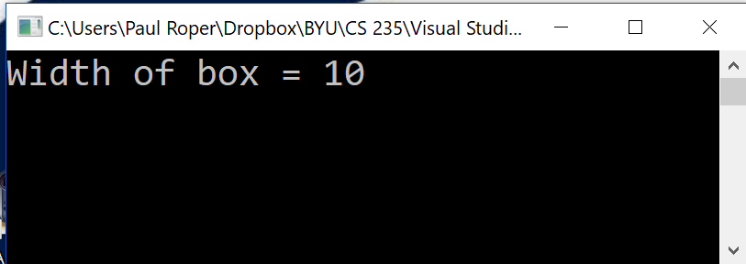
The friend Declaration
#include <iostream>
using namespace std;
class Box
{
private:
double width;
public:
friend void printWidth(Box box);
void setWidth(double wid) { width = wid; }
};
void printWidth(Box box)
{
cout << "Width of box = " << box.width << endl;
}
// Main function for the program
int main()
{
Box box;
box.setWidth(10.0);
printWidth(box);
return 0;
}
printWidth() is not a member function of any class,
but is a friend of Box class.
As a friend of box, printWidth can directly access any member of box.

Slide 31
Friends
#include <iostream>
#include <string>
using namespace std;
class MyClass
{
private:
string name;
public:
MyClass(const string name) { this->name = name; }
~MyClass() = default;
};
int main(int argc, char* argv[])
{
MyClass me("Suzy Student");
cout << me << endl;
return 0;
}
Defines an independent insertion operator function that is a friend of MyClass.
friend ostream& operator<< (ostream& os, const MyClass& me)
{
os << "MyClass(" << me.name << ")";
return os;
}
The friend insertion operator function has access to MyClass’ private data members.
ostream ⊕ MyClass
Returns a reference to the output stream that has been modified.

Slide 32
Follow up…
class MyClass
{
private:
string name;
public:
MyClass(const string n) : name(n) {}
~MyClass() = default;
friend ostream& operator<<
(ostream& lhs, const MyClass& rhs)
{
lhs << "MyClass(" << rhs.name << ")";
return lhs;
}
};
class MyClass
{
private:
string name;
public:
MyClass(const string n) : name(n) {}
~MyClass() = default;
string toString() const
{
ostringstream out;
out << "MyClass(" << name << ")";
return out.str();
}
friend ostream& operator<<
(ostream& lhs, const MyClass& rhs);
};
ostream& operator<<(ostream& lhs, const MyClass& rhs)
{
lhs << "MyClass(" << rhs.name << ")";
return lhs;
};
A friend function of a class has the same access privileges to private and protected data as the class member functions.
Befriended function has same access rights as MyClass member functions.
int main()
{
MyClass myClass("Paul");
cout << myClass;
return 0;
}

