Slide 1
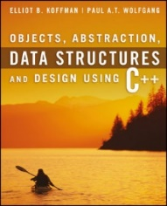
Welcome to
CS 235 Data Structures
Inheritance, 3.1-2 (09)

Slide 2
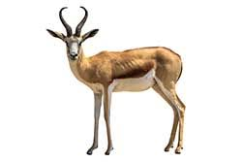
Friday, May 6, 2022
National Crepe Suzette Day
Announcements…
Lab 01: Grades Today.
Lab 01: Grades Peer Reviews due Tuesday (05/10).
Lab 02: SNAP due Tuesday, 05/10.
Please contact me at proper@cs.byu.edu (w/netid)
233 shopping days until Christmas.
For Today…
3.1-3, pgs. 186-210
3.4-6, pgs. 210-231
Next Time...
4.1-10, pgs. 232-306
Abstract Classes
Pure Abstract Functions
Multiple Inheritance
Namespaces
Friends
Quiz Code: antelope

Slide 3
Tip #09: Default Arguments
Default function parameters supply values when a user does not.
int add(int x, int y = 1) { return x + y; }
int main()
{
int result1 = add(5);
int result2 = add(5, 3);
return 0;
}
int add(int x, int y) { return x + y; }
int main()
{
int result1 = add(5); // Error
int result2 = add(5, 3);
return 0;
}
Advantages and Disadvantages.
In 99% of cases you don't need half of the function parameters.
With normal functions, default parameters can make code harder to read.
When refactoring, default parameters can be used to add functionality without breaking code.
Introduces problems reviewing or using code written by others - hidden parameters.
Some functions tend to have the same parameter values - default parameters supply those common values and also helps you see the "suggested" value.
**NOTE: google's coding style suggests avoiding them.

Slide 4
2.6 Efficiency of Algorithms
Big-O Notation
Comparing Performance
Algorithms with Exponential and Factorial Growth Rates
2.6, pgs. 170-179

Slide 5
Efficiency of Algorithms
Getting a precise measure of the performance of an algorithm is difficult.
We use the approximate effect of a change in the number of data items.
In this way we can see how an algorithm's execution time increases with respect to n, so we can compare two algorithms by examining their growth rate.
Even though computers are getting faster with larger memories, algorithm growth rates can be so large that no computer can solve the problem above a certain size.
Understanding how the execution time (and memory requirements) of an algorithm grows as a function of increasing input size gives programmers a tool for comparing various algorithms and determining how they will perform.
If the execution time stays the same regardless of the number of inputs, then the growth rate is constant or of order 1.
If the execution time approximately doubles when the number of inputs doubles, then the algorithm grows at a linear rate or a growth rate of order n.
If the execution time approximately quadruples when the number of inputs is doubled, then the algorithm grows at a quadratic rate or at a growth rate of order of n^{2.}

Slide 6
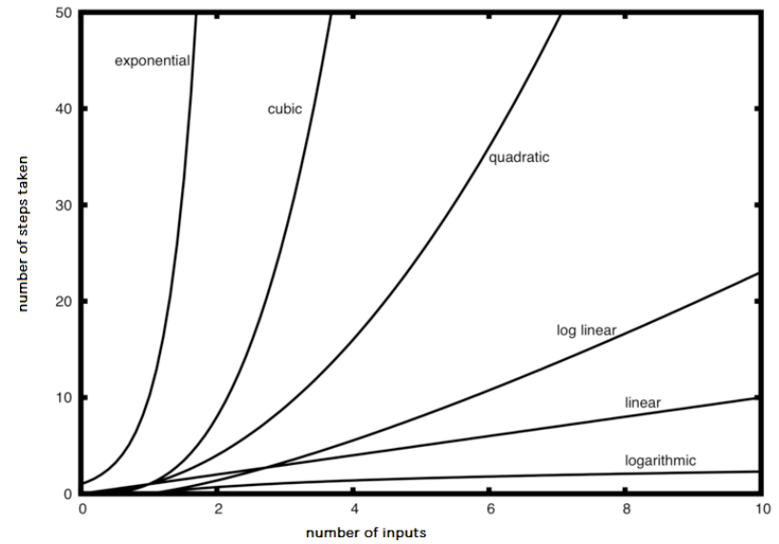
Big-O Notation
Computer scientists use the symbol O as an abbreviation for “order of magnitude” and is called big-O notation.
O(1) represents constant time
O(n) represents linear time
O(n × m) represents quadratic time
O(n²) also represents quadratic time
O(n log n) represents logarithmic time

Slide 7
Big-O Notation
A simple way to determine the big-O of an algorithm or program is to look at any loops and to see whether the loops are nested.
a single loop is O(n)
a nested loop is O(n²)
a nested loop in a nested loop is O(n³), and so on
The growth rate of f(n) will be determined by the fastest growing term, which is the one with the largest exponent.
In general, it is safe to ignore all constants and to drop the lower-order terms when determining the order of magnitude.
Basic Rules:
Nested loops are multiplied together.
Sequential loops are added.
Only the largest term is kept, all others are dropped.
Constants are dropped.
Conditional checks are constant (i.e., 1).

Slide 8
Big-O Example
void T(int n)
{
for(int i = 0; i < n; ++i)
{
for(int j = 0; j < n; ++j)
{
// Simple Statement;
}
}
for(int j = 0; j < n; ++j)
{
// Simple Statement 1;
// Simple Statement 2;
// Simple Statement 3;
}
// Simple Statement 1;
// ...
// Simple Statement 8;
// Simple Statement 9;
}
The outer loop will execute n times. The inner loop will execute n times for each outer loop iteration. (n²)
The loop will execute 3 Simple Statements n times. (3n)
Finally, 9 Simple Statements are executed. (9)
The relationship between processing time and n (the number of Simple Statements processed) is:
T(n) = n² + 3n + 9
The growth rate of f(n) will be determined by the fastest growing term, which is the one with the largest exponent.
In the example, an algorithm of O(n² + 3n + 9) is more simply expressed as O(n²).

Slide 9
What is the Big-O of the following:
// #1
for (int i = 0; i < n; ++i)
{
cout << i << endl;
}
// #5
for (int i = 0; i < size; ++i)
{
cout << arr[i] << endl;
}
for (int i = 0; i < size; ++i)
{
cout << arr[i] << endl;
}
O(n)
O(n)
// #2
{
cout << i << endl;
}
O(1)
// #3
for (int i = 0; i < n + 1; ++i)
{
for (int j = 1; j < n; j *= 2)
{
//do swap stuff, constant time
}
}
// #6
for (int i = 0; i < size; ++i)
{
cout << a[i] << endl;
}
for (int i = 0; i < size; ++i)
{
for (int j = 0; j < size; ++j)
{
cout << a[i] + a[j] << endl;
}
}
O(n²)
O(n log n)
// #4
int fib(int num)
{
if (num <= 1) return num;
return fib(num - 2) + fib(num - 1);
}
O(2^{n})

Slide 10
Follow-up Questions...
How does an IDE help me in program development?
What program assertions are most important in function development?
How is program efficiency measured?
Breakpoints.
Memory Inspection.
Single-Step Execution.
A pre-condition is an assertion about the state of the input data before the function is executed.
A post-condition is an assertion about the state of the output data when the function returns.
An invariant is a particular pre-condition of a procedure that is the same before and after the function is executed.
By the approximate effect of a change in the number of data items, n, that an algorithm processes.

Slide 11
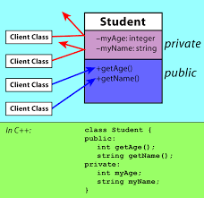
1.3 Defining C++ Classes
Class Definition
The public and private Parts
Class Implementation
Constructors
Modifier and Accessor Member Functions
Operators
Friends
Classes as Components of Other Classes
Array Data Fields
Documentation Style for Classes and Functions
1.4 Abstract Data Types, Interfaces, and Pre- and Post- conditions
Abstract Data Types (ADTs) and Interfaces
Contracts and ADTs
Pre-conditions and Post-conditions
1.3-4 Defining C++ Classes

Slide 12
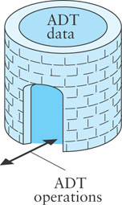
ADTs
An Abstract Data Type (ADT) is a mathematical model for data types.
A C++ class provides one way to implement an ADT.
A user interacts with an ADT thru the class public methods.
An ADT encapsulates data and methods and is a contract between the designer of the class, the implementor of the class, and the programmer who uses the class.
Any programmer who develops or uses an ADT class knows exactly what methods are available in that class and what operations they will perform.
Pre- and post- conditions are part of the contract between a call to a class method and the results of the method call.
A pre-condition is a statement of any assumptions or constraints on the method's input data that are expected to apply before the method is executed.
If a pre-condition is not met, there is no guarantee that the method will do what is expected.
A post-condition is a statement that describes the results after the method completes and returns.
When implementing an ADT, we document the pre-conditions and post-conditions in the documentation comments.

Slide 13
Class Access Specifiers
The private access specifier limits access of class members to the class definition.
Control access to an object's data.
Prevent improper use and processing of an object's data.
Allow change of private data representation without effecting programs that use the class.
The public access specifier exposes the public members of the class definition.
The protected access specifier gives access to the public and protected access members of a class to derived classes.
A friend function of a class has the same access privileges to private and protected data as the class member functions.
A friend function is declared by the class that is granting access, so friend functions are part of the class interface, like methods.
Since private members of a class are only accessible from within the class, a friend function must also be declared inside of a class but may be implemented outside of the class.
Even though the prototypes for friend functions appear in the class definition, friends are not member functions.

Slide 14
Classes
#include <iostream>
#include <string>
#include <sstream>
using namespace std;
class Dog
{
private:
string name;
public:
Dog(string n) : name(n) {}
~Dog() = default;
string toString() const
{
ostringstream os;
os << "Name = " << name;
return os.str();
}
};
int main(int argc, char* argv[])
{
Dog rover("Rover");
cout << endl << rover.toString();
return 0;
}
A class is a data type and a pattern for creating objects.
A class definition describes the names of the class operations and the internal data contents (the data members).
instance variables - each class instance (object) has its own storage, usually private to hide implementation details.
A class constructor is a public method called when an instance of the class is instantiated.
A class destructor is a public method called when an instance of the class is deleted.
EVERY CLASS HAS AT LEAST ONE CONSTRUCTOR / DESTRUCTOR!
Member functions (usually public) operate on any object of the class of which it is a member and have access to all the data members of the class object.
An object is instantiated by calling a constructor.

Slide 15
Class Operators
#include <iostream>
#include <string>
#include <sstream>
using namespace std;
class Dog
{
private:
string name;
int legs;
public:
Dog(string n) : name(n), legs(4) {}
~Dog() = default;
Dog& operator--() { --legs; return *this; }
Dog& operator()(string n) { name = n; return *this; }
string toString() const
{
ostringstream os;
os << "Name = " << name << " legs = " << legs;
return os.str();
}
};
int main(int argc, char* argv[])
{
Dog rover("Rover");
cout << rover.toString() << endl;
--rover;
cout << rover("Butch").toString() << endl;
return 0;
}
Initialization list of Dog object.
Pre-decrement operator decrements number of legs.
Function operator renames a Dog object.
Decrement number of Rover legs.
Rename object before calling toString function.

Slide 16
Friendship
class MyClass
{
private:
string name;
public:
MyClass(const string n) : name(n) {}
~MyClass() = default;
string toString() const
{
ostringstream out;
out << "MyClass(" << name << ")";
return out.str();
}
friend ostream& operator<<
(ostream& lhs, const MyClass& rhs);
};
ostream& operator<<(ostream& lhs, const MyClass& rhs)
{
lhs << "MyClass(" << rhs.name << ")";
return lhs;
};
class MyClass
{
private:
string name;
public:
MyClass(const string n) : name(n) {}
~MyClass() = default;
friend ostream& operator<<
(ostream& lhs, const MyClass& rhs)
{
lhs << "MyClass(" << rhs.name << ")";
return lhs;
}
};
Friendship is granted to an ostream insertion operator function.
A friend function of a class has the same access privileges to private and protected data as the class member functions.

Slide 17
Friendship
#include <iostream>
#include <string>
#include <sstream>
using namespace std;
class Dog
{
private:
string name;
public:
Dog(string n) : name(n) {}
~Dog() = default;
};
int main(int argc, char* argv[])
{
Dog rover("Rover");
cout << rover << endl;
return 0;
}
Defines an independent insertion operator function that is a friend of MyClass.
The friend insertion operator function has access to Dog’ private data members.
friend ostream& operator<< (ostream& os, const Dog& dog)
{
os << "Dog(" << dog.name << ")";
return os;
}
Returns a reference to the output stream that has been modified.
ostream ⊕ Dog

Slide 18
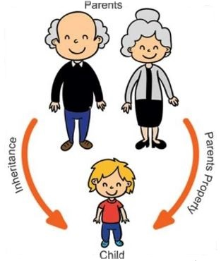
3.1 Introduction to Inheritance and Class Hierarchies
Is-a Versus Has-a Relationships
A Base Class and a Derived Class
Initializing Data Fields in a Derived Class
The No-Parameter Constructor
Protected Visibility for Base-Class Data Fields
3.1 Introduction to Inheritance and Class Hierarchies

Slide 19
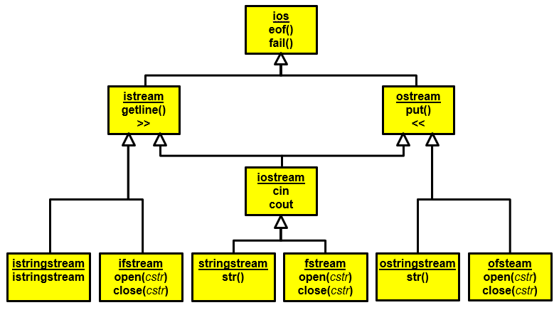
Inheritance and Class Hierarchies
Object-Oriented Programming (OOP) enables programmers to reuse previously written code saved as classes.
Code reuse reduces the time required to code new applications.
Previously written tested and debugged code enables new applications to be more reliable.
In OOP, a programmer can create a similar class by extending an existing class, rather than by writing an entirely new class.
The new class (called the derived class or subclass) can have additional data fields and member functions.
The derived class inherits the data fields and member functions of the original class (called the base class or superclass) or multiple parents.
A class hierarchy represents a set of hierarchically organized concepts.
Base classes typically act as interfaces.
Implementation inheritance
Interface inheritance.
If a base class is used as an interface, make it a pure abstract class.

Slide 20
Is-a Versus Has-a Relationships
The is-a relationship between classes means that every instance of one class is also an instance of the other class (but not the other way around).
A Ford is a vehicle, but not all vehicles are Fords.
The Ford class is derived from a Vehicle class.
The is-a relationship is represented in object oriented programming (OOP) by extending a class.
The has-a relationship (composition) between classes means that every instance of one class has one or more instances of the other class.
For example, a Ford vehicle has-a engine.
The has-a relationship is represented by declaring in a class a data field whose type is another class.

Slide 21
Is-a Versus Has-a Relationships
We can combine is-a and has-a relationships.
A Ford is-a vehicle and has-a engine.
The Ford inherits all the properties of a vehicle.
A vehicle has a VID, so a Ford does too because it is a vehicle.
C++ captures both the inheritance (is-a) relationship and the composition (has-a) relationship.
The part of the class heading following the colon specifies that Ford is a derived class of Vehicle.
class Ford : public Vehicle
{
private:
Engine engine; // Ford automobiles have an engine
public:
};
The Engine data field stores information for a Ford object.

Slide 22
Tip #10: Standard Integer typedefs
The actual size of integer types varies by implementation.
The standard only requires size relations between the data types (i.e., a long long is not smaller than long, which is not smaller than int, which is not smaller than short.)
A char's size is always the minimum supported data type; no other data types (except bit-fields) can be smaller.
The following pre-processor macros are defined in the header file <stdint.h>:
signed | unsigned | Description
int8_t | uint8_t | Integer type with a width of exactly 8, 16, 32, or 64 bits. For signed types, negative values are represented using 2's complement. No padding bits.
int16_t | uint16_t
int32_t | uint32_t
int64_t | uint64_t
 | std::size_t | Largest unsigned integer type. The size of any object in bytes. Widely used in the standard library to represent sizes, lengths, and counts.

Slide 23
Lab 02 - SNAP

Slide 24
S.N.A.P Lab
Class design is type design - defining effective classes can be challenging.
Organize related data into structures (structs or classes).
Make a member function only if access to internals of a class is needed.
Minimize exposure of class members by making public for the general use, protected for derived classes and the remaining members should be private.
For the SNAP lab you are to design classes for a school database with has-a and is-a relationships that have natural syntax, intuitive semantics, and efficient memory allocation.
The class objects are populated from parsed input strings.
Use object inheritance, polymorphism, and function and operator overloading where needed.
All member data and internal functions are private.
All classes have a "toString" method with friends for the insertion ("<<") operator.
Use UML diagrams to describe your implementation.

Slide 25
Example SNAP Input/Output
Input Strings:
snap(12345,Charlie Brown,Manager,555-1234).
snap(67890,Lucy,Right Field,555-5678).
csg(CS101,12345,A).
csg(CS101,67890,B).
**Error: csgs(CS101,67890,B).
cdh(CS101,M,9AM).
cdh(CS101,W,9AM).
cr(CS101,1170 TMCB).
Vectors:
snap(12345,Charlie Brown,Manager,555-1234)
snap(67890,Lucy,Right Field,555-5678)
csg(CS101,12345,A)
csg(CS101,67890,B)
cdh(CS101,M,9AM)
cdh(CS101,W,9AM)
cr(CS101,1170 TMCB)
Course Grades:
CS101,Charlie Brown,A
CS101,Lucy,B
Student Schedules:
Charlie Brown, 12345, Manager, 555-1234
CS101 MW 9AM, 1170 TMCB
Lucy, 67890, Right Field, 555-5678
CS101 MW 9AM, 1170 TMCB
studentId, name, address, phone #
course, studentId, grade
Use try/catch to report Input Error
course, day, hour
course, room
List snap, csg, cdh, and cr objects stored in vectors
List course grades (in snap vector order) for all students.
List all student schedules (in csg vector order.)

Slide 26
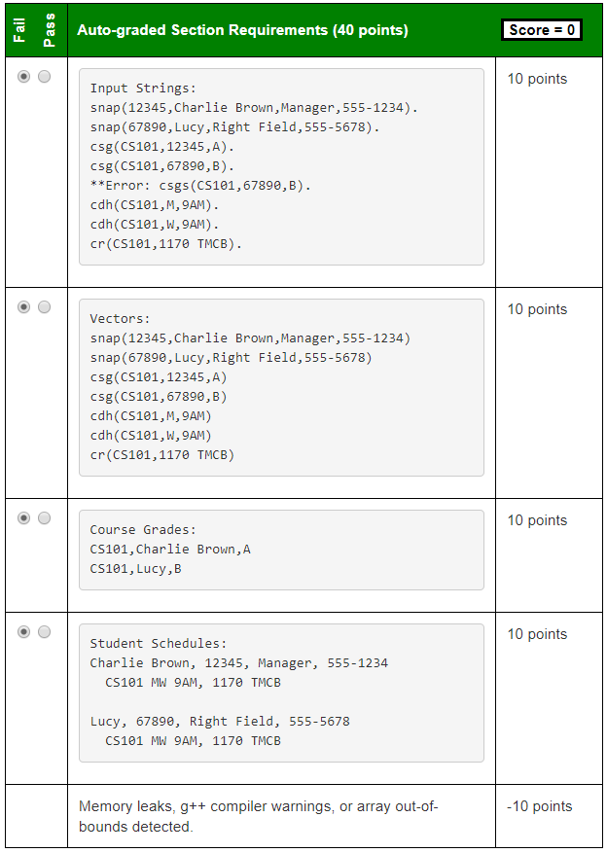
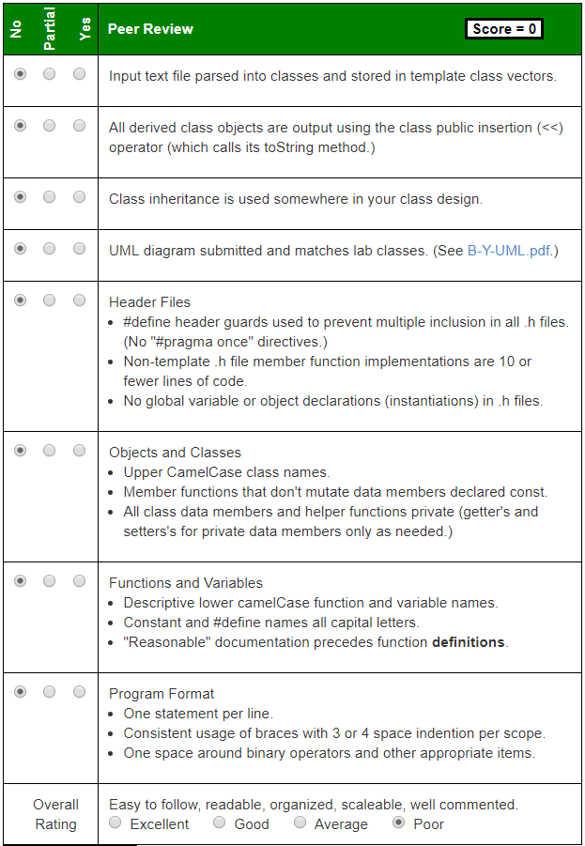
vector<Snap> snaps;
vector<Csg> csgs;
vector<Cdh> cdhs;
vector<Cr> crs;
studentId, name, address, phone #
course, studentId, grade
course, day, hour
course, room
string toString() const
{ stringstream out;
out << "snap(" << this->studentId;
out << "," << this->studentName;
out << "," << this->studentAddress;
out << "," << this->studentPhone << ")";
return out.str();
}
friend ostream& operator<< (ostream& os, const Snap& snap)
{
os << snap.toString();
return os;
}
Use try/catch to report Input Error
List snap, csg, cdh, and cr objects stored in vectors
List course grades (in snap vector order) for all students.
List all student schedules (in csg vector order.)
Create pdf or jpg of UML diagram – must be of reasonable size (< ~4M.) Zip pdf, or jpg in submission folder. Not required to include friends in UML diagram.

Slide 27
UML
Vehicle
Class Name
The data members and functions are listed by visibility, name, and type.
Visibility
A '-' indicates private visibility.
A '+' indicates public visibility.
A '#' indicates protected visibility.
Type
Data member, function parameter and return types appear after the name.
-vid:int
-make:string
Data Members
+Vehicle(mk:string, vid:int)
+~Vehicle()
+getVID():int
+getMake():string
+toString():string
Class Methods
public
private
is-a
Car
has-a
-model:string
-engine:Engine
Engine
+Car(mk:string, mdl:string,
vid:int, cyl:int)
+getModel():string
+getEngine():Engine&
+toString():string
-cylinders:int
+Engine(cyl:int)
+getCylinders():int
+toString():string

Slide 28
SNAP Inheritance
Student
Course
-int studID
-string course
+int getStudID()
+toString() const
+string getCourse()
+toString() const
SNAP
Csg
Cdh
Cr
-int studID
-string name
-string address
-string phone
-string course
-int studID
-string grade
-string course
-string day
-string hour
-string course
-string room
+string getCourse()
+string getRoom()
+toString() const
+string getCourse()
+int getStudID()
+string getGrade()
+toString() const
+string getCourse()
+string getDay()
+string getHour()
+toString() const
+int getStudID()
+string getName()
+string getAddr()
+string getPhone()
+toString() const

Slide 29
SNAP Inheritance
This process is known as refactoring and is often used in object-oriented design.
Student
Course
-int studID
-string course
+int getStudID()
+toString() const
+string getCourse()
+toString() const
SNAP
Csg
Cdh
Cr
-int studID
-string name
-string address
-string phone
-string course
-int studID
-string grade
-string course
-string day
-string hour
-string course
-string room
+string getCourse()
+string getRoom()
+toString() const
+string getCourse()
+int getStudID()
+string getGrade()
+toString() const
+string getCourse()
+string getDay()
+string getHour()
+toString() const
+int getStudID()
+string getName()
+string getAddr()
+string getPhone()
+toString() const
Please carefully read and follow the Lab requirements!

Slide 30
SNAP Inheritance
School
This process is known as refactoring and is often used in object-oriented design.
-string course
-int studID
+string getCourse()
+int getStudID()
+toString() const
SNAP
Csg
Cdh
Cr
-int studID
-string name
-string address
-string phone
-string course
-int studID
-string grade
-string course
-string day
-string hour
-string course
-string room
+string getCourse()
+string getRoom()
+toString() const
+string getCourse()
+int getStudID()
+string getGrade()
+toString() const
+string getCourse()
+string getDay()
+string getHour()
+toString() const
+int getStudID()
+string getName()
+string getAddr()
+string getPhone()
+toString() const
Please carefully read and follow the Lab requirements!

Slide 31
Public, Protected, Private Inheritance
class A
{
public:
int x;
protected:
int y;
private:
int z;
};
class B : public A
{
// x is public
// y is protected
// z is not accessible from B
};
class C : protected A
{
// x is protected
// y is protected
// z is not accessible from C
};
class D : private A
{
// x is private
// y is private
// z is not accessible from D
};
Classes B, C and D all contain the variables x, y and z. It is just question of access.
'private' is default for classes

Slide 32
The No-Parameter Constructor
If the execution of any constructor in a derived class does not invoke a base class constructor, C++ automatically invokes the no-parameter constructor for the base class.
C++ does this to initialize the part of the object inherited from the base class before the derived class starts to initialize its part of the object.

Slide 33
Follow-up Questions...
When are object constructors called?
What are the three types of constructors?
When is a copy constructor called?
It is called when an instance of the class is created. At the time of calling constructor, memory for the object is allocated in the memory. It is a special type of method which is used to initialize the object. Every time an object is created using the new() keyword, at least one constructor is called.
Default Constructor.
Parametrized Constructor.
Copy Constructor.
A copy constructor is a member function which initializes an object using another object of the same class. A copy constructor has the following general function prototype:
ClassName (const ClassName& old_obj);

Slide 34
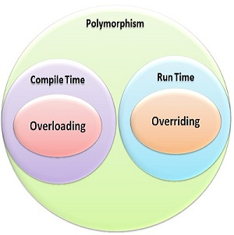
3.2 Member Function Overriding, Member Function Overloading, and Polymorphism
Member Function Overriding
Member Function Overloading
Virtual Functions and Polymorphism
3.2, pgs. 193-203

Slide 35
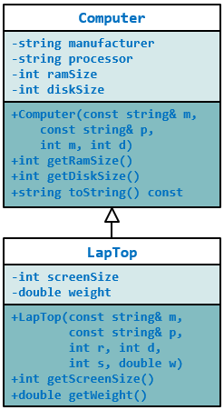
#ifndef COMPUTER_H_
#define COMPUTER_H_
#include <string>
#include <sstream>
using std::ostringstream;
using std::string;
using std::endl;
class Computer
{
private:
string manufacturer;
string processor;
int ramSize;
int diskSize;
public:
Computer(const string& m, const string& p, int r, int d) :
manufacturer(m), processor(p),
ramSize(r), diskSize(d) {}
~Computer() {}
int getRamSize() const { return ramSize; }
int getDiskSize() const { return diskSize; }
string toString() const
{
ostringstream sb;
sb << "Manufacturer: " << manufacturer
<< endl << "CPU: " << processor
<< endl << "RAM: " << ramSize << " Mbs"
<< endl << "Disk: " << diskSize << " Gbs";
return sb.str();
}
};
#endif
#ifndef LAP_TOP_H
#define LAP_TOP_H
#include <string>
#include <sstream>
#include "computer.h"
using std::string;
using std::ostringstream;
class LapTop : public Computer
{
private:
int screenSize;
double weight;
public:
LapTop(const string& m, const string& p, int r, int d,
int s, double w) :
Computer(m, p, r, d), // init Computer
screenSize(s), weight(w) {} // init LapTop
int getScreenSize() const { return screenSize; }
double getWeight() const { return weight; }
};
#endif
The constructor for class Lap_Top must begin by initializing the four data fields inherited from class Computer.
Because those data fields are private to the base class, C++ requires that they be initialized by a base class constructor

Slide 36
Member Function Overriding
Computer.cpp
Class LapTop have does not have a toString method.
#include <iostream>
#include <string>
#include "lapTop.h"
using namespace std;
int main(int argc, char* argv[])
{
Computer myComputer("HP", "I5", 16, 500);
LapTop yourComputer("Dell", "I7", 32, 1000, 15, 5);
cout << endl << "My computer:" << endl << myComputer.toString() << endl;
cout << endl << "Your computer:" << endl << yourComputer.toString() << endl;
return 0;
}
My computer:
Manufacturer: HP
CPU: I5
RAM: 16 Mbs
Disk: 500 Gbs
Your computer:
Manufacturer: Dell
CPU: I7
RAM: 32 Mbs
Disk: 1000 Gbs
Even though yourComputer is of type LapTop, the LapTop fields are not displayed; the call to toString() calls the toString() method inherited from Computer

Slide 37
Member Function Overriding
LapTop.h
LapTop.cpp
If class LapTop has its own toString member function, it will override the inherited member function and will be invoked by the member function call to toString().
#ifndef LAP_TOP_H
#define LAP_TOP_H
#include <string>
#include <sstream>
#include "computer.h"
using std::string;
using std::ostringstream;
class LapTop : public Computer
{
private:
int screenSize;
double weight;
public:
LapTop(const string& m,
const string& p,
int r, int d, int s, double w) :
Computer(m, p, r, d),
screenSize(s), weight(w) {}
int screenSize() const { return screenSize; }
double getWeight() const { return weight; }
string toString() const;
};
#endif
#include "lapTop.h"
#include <sstream>
using std::ostringstream;
using std::string;
using std::endl;
string LapTop::toString() const
{
ostringstream sb;
sb << Computer::toString()
<< endl << "Screen: "
<< screenSize << " inches"
<< endl << "Weight: "
<< weight << " lbs";
return sb.str();
}
We still call Computer's toString member function to output its contents.

Slide 38
Member Function Overriding
#include <iostream>
#include <string>
#include "lapTop.h"
using namespace std;
int main(int argc, char* argv[])
{
Computer myComputer("HP", "I5", 16, 500);
LapTop yourComputer("Dell", "I7", 32, 1000, 15, 5);
cout << endl << "My computer:" << endl << myComputer.toString() << endl;
cout << endl << "Your computer:" << endl << yourComputer.toString() << endl;
return 0;
}
My computer:
Manufacturer: HP
CPU: I5
RAM: 16 Mbs
Disk: 500 Gbs
Your computer:
Manufacturer: Dell
CPU: I7
RAM: 32 Mbs
Disk: 1000 Gbs
Screen: 15 inches
Weight: 5 lbs
Now the state of a laptop computer, complete with screen size and weight, is output when calling toString member function for class LapTop which overrides the inherited member function of Computer.

Slide 39
Virtual Functions and Polymorphism
#include <iostream>
#include <vector>
#include <string>
#include "lapTop.h"
using namespace std;
int main(int argc, char* argv[])
{
vector<Computer*> computers;
computers.push_back(new Computer("Acer", "I3", 8, 256));
computers.push_back(new LapTop("HP", "I5", 16, 500, 13, 6.5));
for (unsigned int i = 0; i < computers.size(); i++)
cout << endl << computers[i]->toString() << endl;
return 0;
}
Manufacturer: Acer
CPU: I3
RAM: 8 Mbs
Disk: 256 Gbs
Manufacturer: HP
CPU: I5
RAM: 16 Mbs
Disk: 500 Gbs
In C++, a pointer variable of a base-class type (general) can point to an object of a derived-class type (specific):
LapTop objects are Computer objects with more features.
But, where are the additional data members?

Slide 40
Virtual Functions and Polymorphism
class Computer
{
// ...
public:
// ...
virtual string toString() const;
};
#include <iostream>
#include <vector>
#include <string>
#include "lapTop.h"
using namespace std;
int main(int argc, char* argv[])
{
vector<Computer*> computers;
computers.push_back(new Computer("Acer", "I3", 8, 256));
computers.push_back(new LapTop("HP", "I5", 16, 500, 13, 6.5));
for (unsigned int i = 0; i < computers.size(); i++)
cout << endl << computers[i]->toString() << endl;
return 0;
}
Manufacturer: Acer
CPU: I3
RAM: 8 Mbs
Disk: 256 Gbs
Manufacturer: HP
CPU: I5
RAM: 16 Mbs
Disk: 500 Gbs
Screen: 13 inches
Weight: 6.5 lbs
By changing the declaration of the function toString in the class Computer (in Computer.h) to a virtual function, when it is called through a pointer (or reference) variable the actual member function will be determined at run time and based on the type of the object pointed to (or referenced).

Slide 41
Virtual Functions and Polymorphism
Polymorphism is an important concept of OOP.
Polymorphism is the quality of having many forms or many shapes.
Polymorphism enables the program to determine which member function to invoke at run time.
class Computer
{
// ...
public:
// ...
string toString() const;
};
class LapTop : public Computer
{
// ...
public:
// ...
string toString() const;
};
int main()
{
vector<Computer*> computers;
computers.push_back(new Computer(...));
computers.push_back(new LapTop(...));
cout computers[1]->toString();
}
At compile time, the C++ compiler cannot determine what type of object computers will point to.
class Computer
{
// ...
public:
// ...
virtual string toString() const;
};
class LapTop : public Computer
{
// ...
public:
// ...
virtual string toString() const;
};
int main()
{
vector<Computer*> computers;
computers.push_back(new Computer(...));
computers.push_back(new LapTop(...));
cout computers[1]->toString();
}
At run time, polymorphism and virtual functions allows the program to know which toString function to call.
Use a pointer(s) of type base class to pointer to your object.
Declare the function(s) in base class virtual.
BTW: It is good practice to include the virtual declaration in the derived classes too for documentation purposes.

Slide 42
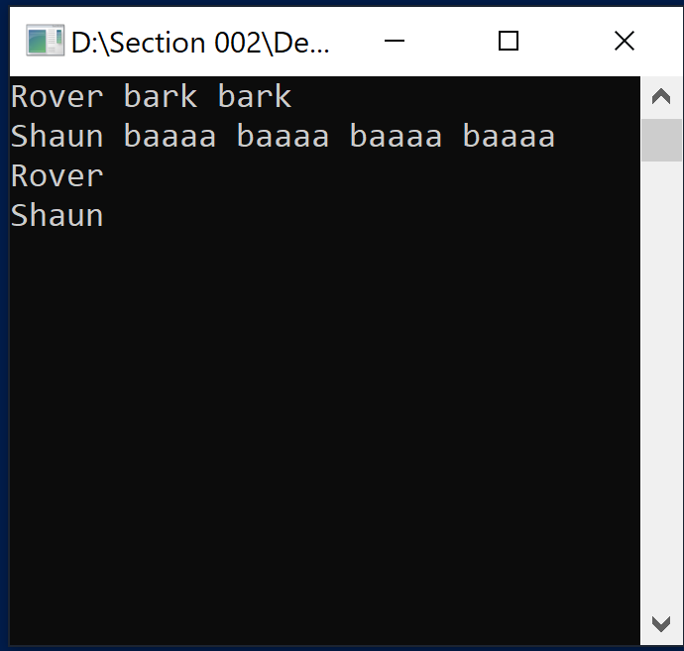
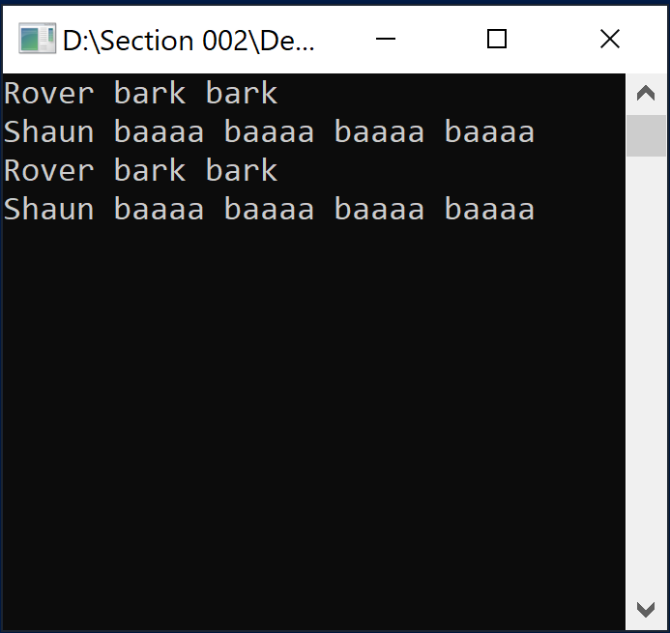
Follow up...
#include <iostream>
#include <sstream>
#include <vector>
using namespace std;
class Animal
{
private:
string name;
public:
Animal(string n) : name(n) {}
~Animal() = default;
string toString() const
{
ostringstream os;
os << name;
return os.str();
}
};
class Dog : public Animal
{
private:
int bark;
public:
Dog(string n, int b) : Animal(n), bark(b) {}
~Dog() = default;
string toString() const
{
ostringstream os;
os << Animal::toString();
for (int i = 0; i < bark; ++i) os << " bark";
return os.str();
}
};
class Sheep : public Animal
{
private:
int baaaa;
public:
Sheep(string n, int b) : Animal(n), baaaa(b) {}
~Sheep() = default;
string toString() const
{
ostringstream os;
os << Animal::toString();
for (int i = 0; i < baaaa; ++i)
os << " baaaa";
return os.str();
}
};
int main()
{
Dog rover("Rover", 2);
Sheep sheep("Shaun", 4);
cout << rover.toString() << endl;
cout << sheep.toString() << endl;
vector<Animal*> animal;
animal.push_back(&rover);
animal.push_back(&sheep);
for (size_t i = 0; i < animal.size(); ++i)
{
cout << animal[i]->toString() << endl;
}
return 0;
}
Here is the "Dog and Pony" code (I mean "Dog and Sheep"...)
There is a problem with the output. Can you figure it out?
virtual string toString() const

Slide 43
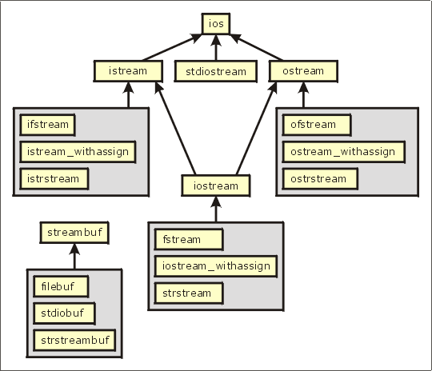
3.3 Abstract Classes, Assignment, and Casting in a Hierarchy
Referencing Actual Objects
Summary of Features of Actual Classes and Abstract Classes
Assignments in a Class Hierarchy
Casting in a Class Hierarchy
Case Study: Displaying Addresses for Different Countries
3.3, pgs. 203-206

Slide 44
Abstract Functions and Classes
An object is an instantiation of a class.
A pure abstract function is a virtual function that is declared in a class but has no body (definition).
A pure abstract function definition must be supplied by a derived concrete class.
A pure virtual function is created by using the pure specifier (= 0) as the definition of a virtual member function.
An abstract class is a class that has at least one pure abstract function and is designed to be a base class.
An abstract class cannot be instantiated (which would result in a compilation error).
Classes inheriting an abstract class must provide the definitions for the pure virtual functions; otherwise, the subclass would become an abstract class itself.
We use an abstract class when a base class defines attributes and functions that are common to derived classes.

Slide 45
Abstract Class Food.h
#ifndef FOOD_H_
#define FOOD_H_
class Food
{
private:
string name;
double calories;
public:
Food(const string& n, double c) : name(n), calories(c) {}
virtual ~Food() {}
virtual double percent_protein() const = 0;
virtual double percent_fat() const = 0;
virtual double percent_carbohydrates() const = 0;
};
#endif
These three abstract virtual functions impose the requirement that all derived classes implement these functions.
(We would expect a different function definition for each kind of food.)
A pure virtual function is specified in the class definition by using "= 0" in place of the function body.

Slide 46
Referencing Concrete Objects
Because class Food is abstract, we can’t create type Food objects; hence the following statement is invalid:
Food mySnack(); // compile time error!
We can use a type Food pointer variable to point to an actual object that belongs to a class derived from Food.
Food
If a Vegetable object is derived from Food, then Food is contained in Vegetable.
-name:string
-calories:double
+Food(string&, double)
+~Food()
+percent_protein():double
+percent_fat():double
+percent_carbohydrates():double
Thus, a pointer to Food can be used to reference a Vegetable.
The pointer variable mySnack (type pointer-to-Food) is legal:
Vegetable
+Vegetable(string&, double)
+~Vegetable()
+percent_protein():double
+percent_fat():double
+percent_carbohydrates():double
+getName():string
+getCalories:double
Food* mySnack = new Vegetable("Carrot Sticks", 0);

Slide 47
Assignments in a Class Hierarchy
C++ is what is known as a strongly typed language.
Operands have a type and operations can be performed only on operands of the same or compatible types.
This includes the assignment operation:
l-value = r-value
For the built-in types, the r-value must be of the same type as the l-value, or there must be a conversion defined to convert the r-value into a value that is the same type as the l-value.
For class types, the assignment operator may be overridden and overloaded.
Pointer types are an exception: A pointer variable (l-value) that is of type pointer-to-base class may point to a derived object (r-value).
However, the opposite is not legal:
Computer* computer = new LapTop( ... ); // Legal
LapTop* laptop = new Computer( ... ); // Illegal

Slide 48
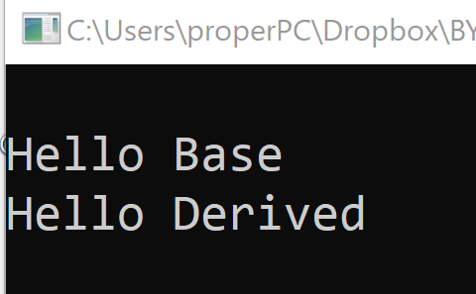
Object Slicing
#include <iostream>
#include <string>
using namespace std;
class Base
{
public:
virtual string toString()
{ return string("Hello Base"); }
};
class Derived : public Base
{
public:
virtual string toString()
{ return string("Hello Derived"); }
};
int main()
{
Base base = Derived();
cout << endl << base.toString();
Base* base_ptr = new Derived();
cout << endl << base_ptr->toString();
return 0;
}
In C++ programming, object slicing occurs when a derived class object (subclass) is copied (either by constructors or assignment operators) to a base class object (superclass).
The base copy will not have any of the member functions/variables defined in the derived class.
The derived class members will be "sliced off" and NOT replace the base class members.
This issue is not inherently unique to C++.
By using pointers, only the pointer is copied and not source object.

Slide 49
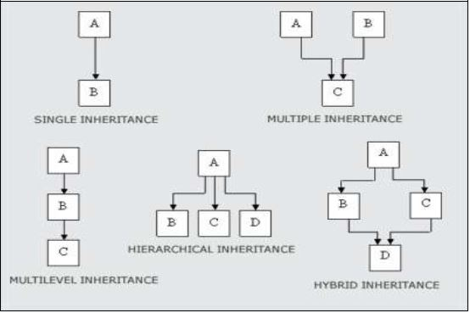
3.4 Multiple Inheritance
Refactoring the Employee and Student Classes
3.4, pgs. 210-212

Slide 50
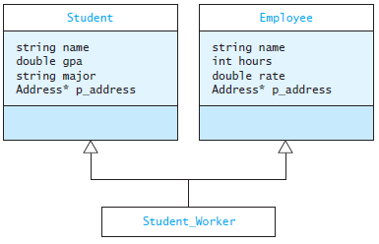
Multiple Inheritance
Multiple inheritance refers the ability of a class to extend more than one class.
In multiple inheritance, all the data fields for the derived class are inherited from its base classes.
For example, a university has many students who are full-time students and many employees who are full-time employees, but also some student employees.

Slide 51
Definition of Student_Worker
#ifndef STUDENT_WORKER_H_
#define STUDENT_WORKER_H_
#include <string>
#include "Employee.h"
#include "Student.h"
using std::string;
class StudentWorker : public Employee, public Student
{
public:
Student_Worker(const string& name,
Address* addr,
double rate,
const string& major) :
Employee(name, address, rate),
Student(name, address, major) {}
string to_string() const;
};
#endif
There is no argument given for data fields hours or gpa, so they are initialized to default values
The heading shows that class StudentWorker extends class Student and class Employee
The first initializes the Employee part
The constructor contains two initialization expressions separated by a comma
The second initializes the Student part

Slide 52
3.5 Namespaces and Visibility
Namespaces
Declaring a Namespace
The Global Namespace
The using Declaration and using Directive
Using Visibility to Support Encapsulation
The friend Declaration
3.5, pgs. 213-220

Slide 53
Namespaces
Namespaces are used to group collections of declarations into a functional unit.
The entire C++ standard library is contained in the namespace std.
By using namespaces, clashes between duplicate names are avoided.
An adventure game program may define the class map to represent the area where the action takes place.
The standard library also defines a class called map, which associates values with keys (discussed in Chapter 9).
To avoid clashes between the two map classes, we prefix the namespace name before the class name.

Slide 54
Declaring a Namespace
Declaration of a class map that has-a standard map:
#include <map> // Get definition of standard map
class map
{
private:
std::map the_map; // Declare a std map component
...
};
By defining our own namespace game and placing all the definitions associated with our program into a namespace,
namespace game
{
class map { ... };
}
we can declare objects of different classes:
std::map a_std_map; // A standard map
game::map a_game_map; // a game map

Slide 55
The using Declaration / Directive
The using declaration takes a name from the namespace in which it was declared and places it into the namespace where the using declaration appears.
EXAMPLE: using std::cout;
The qualified name (cout) is now a member of the namespace in which the using declaration appears.
The using directive takes all of the names from a given namespace and places them into the namespace where the using directive appears.
EXAMPLE: using namespace std;
All of the names defined in std now are defined as within the current namespace.
More than one namespace declaration with the same name will merge the identifiers.

Slide 56
Be Safe

