Slide 1
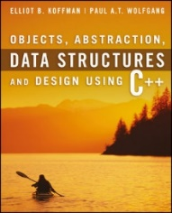
Welcome to
CS 235 Data Structures
Program Correctness, 2.1-3 (07)

Slide 2
Tip #07: The Rule of Seven
There is a rule of nature commonly known as the 'Rule of Seven'.
The number of information chunks that short-term memory can comfortably handle.
Grouping situations where control is optimized around the seven mark.
Grouping of leaves on plants,
Number of digits in a phone number,
Seven churches, seven angles, seven seals, seven deadly sins...
A simple application of the rule of seven in programming is
Functions with up to seven chunks of code, each containing seven statements.
Results a reasonable function size of around 49 lines.
The actual grouping count in many situations is actually rather inexact, and an extension to this rule is 'seven, plus or minus two'.
Thus, if the size of a group is steadily increasing, when it gets to ten it can be broken into two independent groups of five, each of which now fits back into the bottom end of the five to nine range.
Applying this rule of seven extension to the reasonable function size example gives a function size range of between 25 and 100 lines.

Slide 3
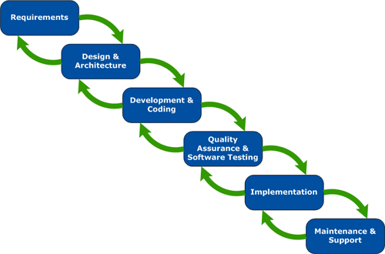
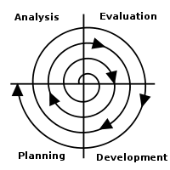
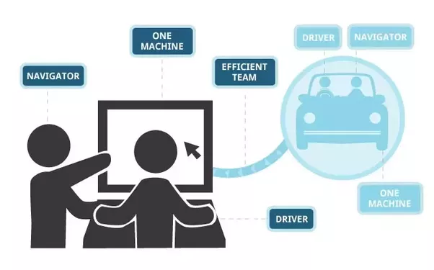
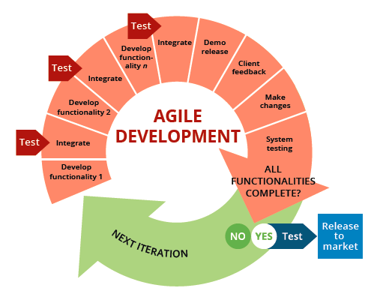
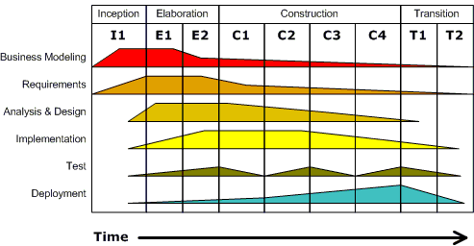
Software Development
Waterfall
Spiral
Extreme
Agile
Unified or Core Flow Model

Slide 4
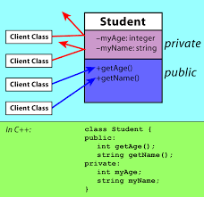
1.3 Defining C++ Classes
Class Definition
The public and private Parts
Class Implementation
Constructors
Modifier and Accessor Member Functions
Operators
Friends
Classes as Components of Other Classes
Array Data Fields
Documentation Style for Classes and Functions
1.3 Defining C++ Classes

Slide 5
Classes
#include <iostream>
#include <string>
#include <sstream>
using namespace std;
class Person
{
private:
string name;
int age;
public:
Person::Person(string name, int age)
{
this->name = name;
this->age = age;
}
~Person() = default;
string getName() const { return name; }
int getAge() const { return age; }
string toString() const
{
ostringstream out;
out << name << "(" << age << ")";
return out.str();
}
};
A class is a data type and a pattern for creating objects.
A class definition describes the names of the class operations and the internal data contents (the data members).
instance variables - each class instance (object) has its own storage, usually private to hide implementation details.
instance constructors / destructors – called when class is instantiated (local or new) and deleted (out of scope or deleted).
Member functions (usually public) operate on any object of the class of which it is a member and have access to all the data members of the class object.

Slide 6
Class Access Specifiers
The private access specifier limits access of class members to the class definition.
Control access to an object's data.
Prevent improper use and processing of an object's data.
Allow change of private data representation without effecting programs that use the class.
The public access specifier exposes the public members of the class definition.
The protected access specifier gives access to the public and protected access members of a class to derived classes.
A friend function of a class has the same access privileges to private and protected data as the class member functions.
A friend function is declared by the class that is granting access, so friend functions are part of the class interface, like methods.
Since private members of a class are only accessible from within the class, a friend function must also be declared inside of a class but may be implemented outside of the class.
Even though the prototypes for friend functions appear in the class definition, friends are not member functions.

Slide 7
Friends
#include <iostream>
#include <string>
using namespace std;
class MyClass
{
private:
string name;
public:
MyClass(const string name) { this->name = name; }
~MyClass() = default;
friend ostream& operator<< (ostream& os, const MyClass& me)
{
os << "MyClass(" << me.name << ")";
return os;
}
};
int main(int argc, char* argv[])
{
MyClass me("Suzy Student");
cout << me << endl;
return 0;
}
Each member function has an implicit parameter named this whose value is a pointer to the object with which the member function was called.
Defines an independent insertion operator function that is a friend of MyClass.
The friend insertion operator function has access to MyClass’ private data members.
Returns a reference to the output stream that has been modified.

Slide 8
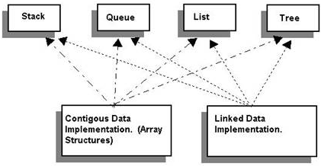
1.4 Abstract Data Types, Interfaces, and Pre- and Post- conditions
Abstract Data Types (ADTs) and Interfaces
Contracts and ADTs
Pre-conditions and Post-conditions
1.4, pgs 98-101

Slide 9
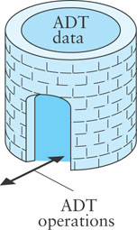
ADTs
An Abstract Data Type (ADT) is a mathematical model for data types.
A C++ class provides one way to implement an ADT.
A user interacts with an ADT thru the class public methods.
An ADT encapsulates data and methods and is a contract between the designer of the class, the implementor of the class, and the programmer who uses the class.
Any programmer who develops or uses an ADT class knows exactly what methods are available in that class and what operations they will perform.
Pre- and post- conditions are part of the contract between a call to a class method and the results of the method call.
A pre-condition is a statement of any assumptions or constraints on the method's input data that are expected to apply before the method is executed.
If a pre-condition is not met, there is no guarantee that the method will do what is expected.
A post-condition is a statement that describes the results after the method completes and returns.
When implementing an ADT, we document the pre-conditions and post-conditions in the documentation comments.

Slide 10
Follow-up Questions...
Name some common software development methods and what are the common software life cycles?
What are pre and post conditions?
How is an ADT used in software development?
Waterfall, Extreme, Spiral, Agile, Unified or Core Flow Model.
Planning, Requirements, Analysis and Design, Implementation, Unit and Integration Testing, Operation and Maintenance.
A pre-condition is a statement of any assumptions or constraints on the method's input data that are expected to apply before the method is executed. If a pre-condition is not met, there is no guarantee that the method will do what is expected.
A post-condition is a statement that describes the results after the method completes and returns.
An ADT is a contract between the class implementor and the programmer who uses the class. A programmer who uses an ADT class knows exactly what methods are available in that class and what operations they will perform (and does not need to coordinate with the implementer of the class).

Slide 11
2.1 Program Defects and "Bugs''
Syntax Errors
Run-time Errors
Logic Errors
2.1, pgs. 130-137

Slide 12
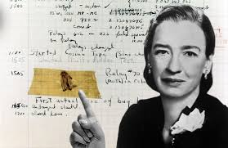
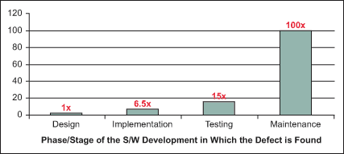
Program Defects and "Bugs"
The term "bug" refers to a software defect.
Debugging is a commonly used term for removing defects.
Easier to eliminate defects by careful design than through testing.
Testing is used to show that a program is correct, but
it is difficult to determine how much testing needs to be done.
testing can never demonstrate the complete absence of defects.
complete testing in some environments (missile control software, nuclear power plant controls) is very difficult.
You may encounter three kinds of defects or errors:
Syntax errors,
Run-time errors or exceptions,
Logic errors.

Slide 13
Syntax Errors
Syntax errors are mistakes in using the grammar (syntax) of the C++ language.
The C++ compiler will detect most syntax errors during compilation.
Some common syntax errors:
Omitting or misplacing braces that bracket compound statements.
Invoking a member function that is not defined for the object to which it is applied.
Not declaring a variable before using it.
Providing multiple declarations of a variable.
Not assigning a value to a local variable before referencing it.
Not returning a value from a function whose result type is not void.
Unfortunately, the compiler may not detect syntax errors that are the result of typographical errors, such as using = when you intended to use ==.

Slide 14
Run-time Errors
Run-time errors occur during program execution when the computer or the C++ run-time library detects an operation that it knows to be incorrect.
Most run-time errors cause the operating system or run-time library to issue an error message and halt the program.
Different computers, operating systems, and compilers handle these errors differently.
Some common run-time errors include:

Slide 15
Logic Errors
A logic error occurs when the programmer or analyst
makes a mistake in the design of a class.
makes a mistake in the design of a class function.
has implemented an algorithm incorrectly.
uses an incorrect algorithm.
The C++ code will compile and run, but will not meet the specifications—it will produce incorrect results.
Most logic errors do not cause syntax or run-time errors and, consequently, are difficult to find.
Test cases can help find logic errors.
Test cases allow the programmer to compare actual program output with the expected results.
Software professionals must be diligent in detecting and correcting logic errors.

Slide 16
2.2 Exceptions
Ways to Indicate an Error
The throw Statement
Uncaught Exceptions
Catching and Handling Exceptions with try and catch Blocks
Standard Exceptions
The Exception Class Hierarchy
Catching All Exceptions
2.2, pgs. 138-147

Slide 17
To Error is Human
What to do with an error:
Return a special value.
Use a bool return value to indicate success or failure.
Set a global variable.
Print an error message.
Print an error message and exit the program.
Put an input or output stream in a fail state.
The first three options allow the user of a function to respond to the error.
To err is human…
But to really screw up,
you need a computer!

Slide 18
Exceptions
An alternate way to indicate an error, especially if there are several possible errors, is through the use of exceptions.
Exceptions are used to signal that an error has occurred during the execution of a program.
You can insert code in your program that throws an exception when a particular kind of error occurs.
When an exception is thrown, the normal flow of execution is interrupted and control transfers to another part of the program.
An exception handler allows the user to catch or handle the exception.

Slide 19
Exception Handling
The exception object can be of any type.
The standard library includes standard exception classes.
User defined exceptions can be of any data type.
If an exception is thrown and not caught, then the program aborts and an error message is displayed.
To avoid uncaught exceptions, enclose the code segment within a try block followed by catch block(s) that catch and handle thrown exceptions.
Code within a try block is referred to as protected code.
More than one catch block can follow a try block.
Each catch block handles a different kind of exception.
They are checked in the order in which they appear.
Check specific exception before more general exceptions.

Slide 20
When To Use try-catch Blocks
When an error event happens routinely and could be considered part of normal execution, handle without throwing exceptions.
Use try-catch blocks
Around code that can potentially (and unexpectedly) generate an exception.
Prevent and recover from application crashes.
Throw an exception when your program can identify an external problem that prevents execution.
Compared to error reporting via return-codes and if statements, using try / catch / throw is likely to result in code
that has fewer bugs,
is less expensive to develop,
and has faster time-to-market.
Constructors and Destructors
DO: Constructors don't have a return type, so it's not possible to use return codes, therefore throw an exception.
DON'T: Destructors should never throw an exception because of stack unwinding.

Slide 21
2.3 Testing Programs
Structured Walkthroughs
Levels and Types of Testing
Preparations for Testing
Testing Tips for Program Systems
Developing the Test Data
Testing Boundary Conditions
Who Does the Testing?
Stubs
Drivers
Testing a Class
Using a Test Framework
Regression Testing
Integration Testing
2.3, pgs. 148-159

Slide 22
Testing Programs
Even after all syntax and run-time errors are removed and a program executes through to normal completion, there is a possibly that undetected logic errors exist.
The "best" kind of logic error is one that occurs in an area of the program that always runs.
The "worst" kind of logic error is in an obscure part of the code that is executed infrequently.
Testing Techniques:
Structured walkthroughs.
Testing at various levels.
Blackbox / whitebox testing.
Test boundary conditions.
Regression testing.

Slide 23
Regression Testing
Regression testing is re-running functional and non-functional tests to ensure that previously developed and tested software still performs after a change.
Bug fixes
Software enhancements
Configuration changes
Electronic component changes.
As software is updated or changed, or reused on a modified target, emergence of old/new faults is quite common.
A fix gets lost through poor revision control practices.
A fix for a problem will be "fragile" - narrow vs. general case.
A fix in one area inadvertently causes a software bug in another area.
Some feature redesign makes the same mistakes that were made in the original implementation of the feature.
It is considered good coding practice, when a bug is located and fixed, to record a test that exposes the bug and re-run that test regularly after subsequent changes to the program.

Slide 24
Follow-up Questions...
When is the use of a try-catch blocks appropriate?
What are some of the common testing techniques used to find and remove logic errors?
What is regression testing?
Yes No
◻ ◻ An error event that happens routinely and is part of normal execution.
◻ ◻ Around code that can potentially (and unexpectedly) generate an exception.
◻ ◻ Prevent and recover from application crashes.
◻ ◻ When your program identifies an external problem that prevents execution.
◻ ◻ When a function doesn't have a return type (constructors).
◻ ◻ Destructor exceptions with stack unwinding.
✓
✓
✓
✓
✓
✓
Structured walkthroughs.
Testing at various levels.
Blackbox / whitebox testing.
Test boundary conditions.
Regression testing.
Regression testing is re-running functional and non-functional tests to ensure that previously developed and tested software still performs after a change.

Slide 25
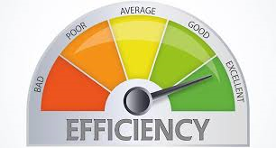
2.6 Efficiency of Algorithms
Big-O Notation
Comparing Performance
Algorithms with Exponential and Factorial Growth Rates
2.6, pgs. 170-179

Slide 26
Efficiency of Algorithms
Getting a precise measure of the performance of an algorithm is difficult.
We can try to approximate the effect of a change in the number of data items, n, that an algorithm processes.
In this way we can see how an algorithm's execution time increases with respect to n, so we can compare two algorithms by examining their growth rate.
For many problems there are algorithms that are relatively obvious but inefficient.
Even though computers are getting faster, with larger memories, algorithm growth rates can be so large that no computer can solve the problem above a certain size.

Slide 27
Big-O Notation
Consider the following functions with respect to execution:
1 time
int i = sqrt(n);

Slide 28
Big-O Notation
Consider the following functions with respect to execution:
1 time
int i = sqrt(n);
n times
for (int i = 0; i < n; ++i)
{
// Statement(s)
}

Slide 29
Big-O Notation
Consider the following functions with respect to execution:
1 time
int i = sqrt(n);
n times
for (int i = 0; i < n; ++i)
{
for (int j = 0; j < m; ++j)
{
// Statement(s)
}
}
(n × m) times

Slide 30
Big-O Notation
Consider the following functions with respect to execution:
1 time
int i = sqrt(n);
n times
for (int i = 0; i < n; ++i)
{
for (int j = 0; j < n; ++j)
{
// Statement(s)
}
}
(n × m) times
(n × n) times

Slide 31
Big-O Notation
Consider the following functions with respect to execution:
1 time
int i = sqrt(n);
n times
for (int i = 0; i < n; ++i)
{
for (int j = i; j < n; ++j)
{
// Statement(s)
}
}
(n × m) times
(n × n) times
(n × (n / 2)) times

Slide 32
Big-O Notation
Consider the following functions with respect to execution:
1 time
int i = sqrt(n);
n times
for (int i = 0; i < n; ++i)
{
for (int j = 1; j <= n; j *= 2)
{
// Statement(s)
}
}
(n × m) times
(n × n) times
(n × (n / 2)) times
(n × log₂ n) times

Slide 33
Big-O Notation
Consider the following functions with respect to execution:
1 time
int i = sqrt(n);
n times
for (int i = 0; i < n; ++i)
{
for (int j = 0; j < n; ++j)
{
for (int k = 0; k < n; ++k)
{
// Statement(s)
}
}
}
(n × m) times
(n × n) times
(n × (n / 2)) times
(n × log₂ n) times
(n × n × n) times

Slide 34
Big-O Notation
Understanding how the execution time (and memory requirements) of an algorithm grows as a function of increasing input size gives programmers a tool for comparing various algorithms and determining how they will perform.
If the execution time stays the same regardless of the number of inputs, then the growth rate is constant or of order 1.
If the execution time approximately doubles when the number of inputs, n, doubles, then the algorithm grows at a linear rate or a growth rate of order n.
If the execution time is approximately quadrupled when the number of inputs is doubled, then the algorithm grows at a quadratic rate or at a growth rate of order of n^{2.}

Slide 35
Big-O Notation
The previous examples illustrate execution growth rates:
1 time
n times
(n × m) times
(n²) times, (n × (n / 2)) times
(n log n) times.
Computer scientists use the notation
O(1) to represent the first case (constant time)
O(n) to represent the second case (linear time)
O(n × m) to represent the third case (quadratic time)
O(n²) to represent the fourth (quadratic time)
O(n log n) to represent the fifth case (logarithmic time)
The symbol O can be thought of as an abbreviation for “order of magnitude” and is called big-O notation.

Slide 36
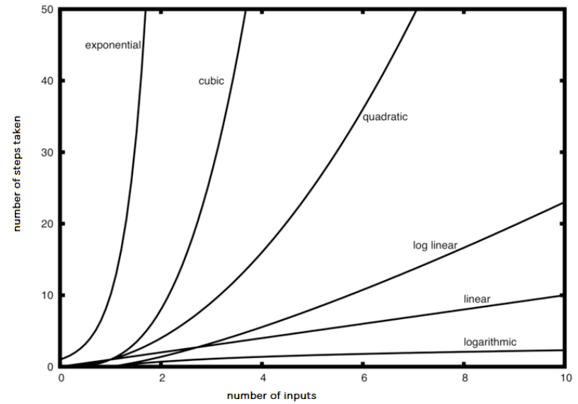

Slide 37
Big-O Notation
A simple way to determine the big-O of an algorithm or program is to look at any loops and to see whether the loops are nested.
Assuming that the loop body consists only of simple statements,
a single loop is O(n)
a nested loop is O(n²)
a nested loop in a nested loop is O(n³), and so on
The growth rate of f(n) will be determined by the fastest growing term, which is the one with the largest exponent.
In general, it is safe to ignore all constants and to drop the lower-order terms when determining the order of magnitude.

Slide 38
Big-O Example
void T(int n)
{
for(int i = 0; i < n; ++i)
{
for(int j = 0; j < n; ++j)
{
// Simple Statement;
}
}
for(int j = 0; j < n; ++j)
{
// Simple Statement 1;
// Simple Statement 2;
// Simple Statement 3;
}
// Simple Statement 1;
// ...
// Simple Statement 8;
// Simple Statement 9;
}
The outer loop will execute n times. The inner loop will execute n times for each outer loop iteration. (n²)
We can conclude that the relationship between processing time and n (the number of Simple Statements processed) is:
T(n) = n² + 3n + 9
The growth rate of f(n) will be determined by the fastest growing term, which is the one with the largest exponent. In the example, an algorithm of O(n² + 3n + 9) is more simply expressed as O(n²).
The loop will execute 3 Simple Statements n times. (3n)
Finally, 9 Simple Statements are executed. (9)

Slide 39
Growth Rate
The growth rate of f(n) will be determined by the fastest growing term, which is the one with the largest exponent.
An algorithm of O(n² + 3n + 9) complexity is more simply expressed as O(n²).
In general, it is safe to ignore all constants and to drop the lower-order terms when determining the order of magnitude.
Basic Rules:
Nested loops are multiplied together.
Sequential loops are added.
Only the largest term is kept, all others are dropped.
Constants are dropped.
Conditional checks are constant (i.e. 1).

Slide 40
Formal Definition of Big-O
An algorithm of
O(n² + 3n + 9)
is more simply expressed as
O(n²)
3 × n²
For c = 3 and n > n₀
c × T(n) >= f(n)
n² + 3n + 9

Slide 41
What is the Big-O of the following:
// #1
for (int i = 0; i < n; ++i)
{
cout << i << endl;
}
// #5
for (int i = 0; i < size; ++i)
{
cout << arr[i] << endl;
}
for (int i = 0; i < size; ++i)
{
cout << arr[i] << endl;
}
O(n)
O(n)
// #2
{
cout << i << endl;
}
O(1)
// #3
for (int i = 0; i < n + 1; ++i)
{
for (int j = 1; j < n; j *= 2)
{
//do swap stuff, constant time
}
}
// #6
for (int i = 0; i < size; ++i)
{
cout << a[i] << endl;
}
for (int i = 0; i < size; ++i)
{
for (int j = 0; j < size; ++j)
{
cout << a[i] + a[j] << endl;
}
}
O(n²)
O(n log n)
// #4
int fib(int num)
{
if (num <= 1) return num;
return fib(num - 2) + fib(num - 1);
}
O(2^{n})

Slide 42
Be Safe

