Slide 1
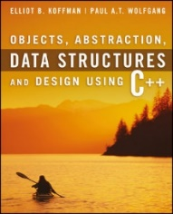
Welcome to
CS 235 Data Structures
C++ Primer (03)
P.2-3, pgs. 7-16

Slide 2
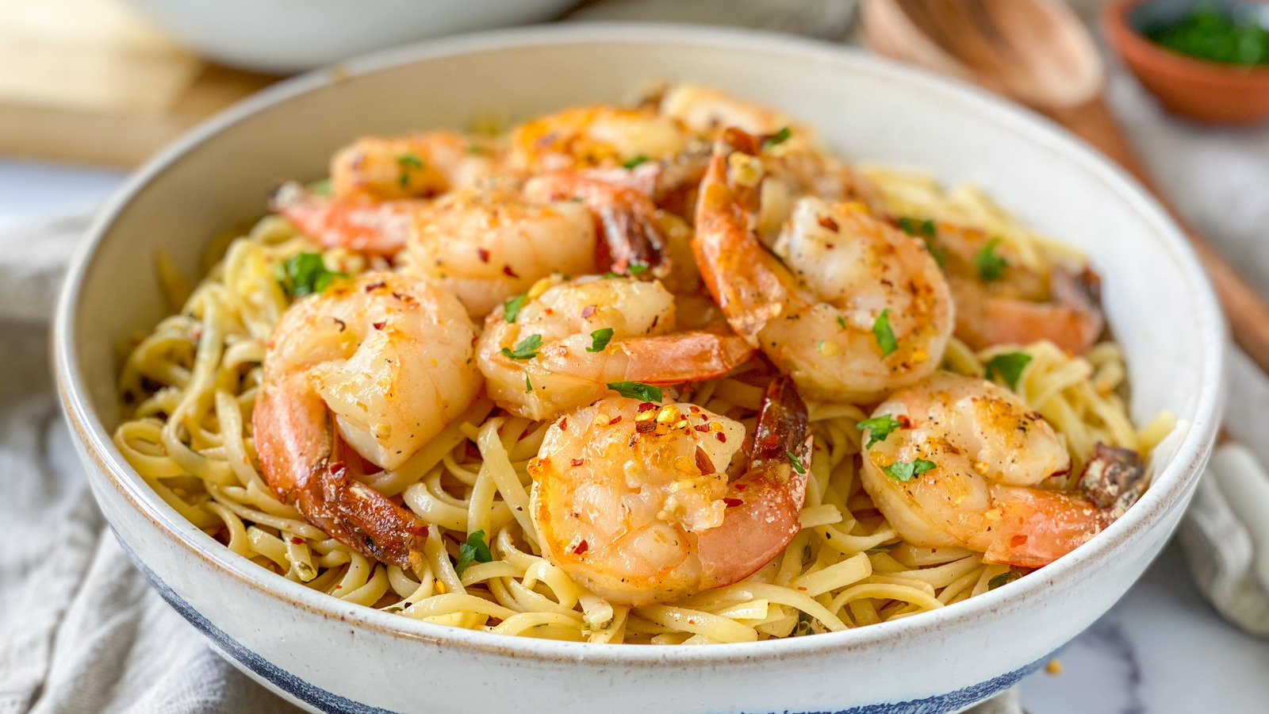
Friday, April 29, 2022
National Shrimp Scampi Day
Announcements…
Pre-exam thru next Wednesday (05-04)
Credit if taken, 0% if not (score is irrelevant).
Lab 00: Hello World
Zipped file contains ONLY .cpp, .h, .jpg, and/or .pdf files
Attendance Quizzes
Extra credit
∞ Retries, but only 1 submission
Open day of class and the next day only!
Use proper@cs.byu.edu (with netid) if you want a reply from me.
TA's and Help Queue.
For Today…
C++ Primer, P.2-3, pgs. 7-16
Quiz Code: rabbit

Slide 3
Anything Wrong?
A.h
B.h
htest.cpp
class A
{
int x;
};
#include "B.h"
int main()
{
A a;
B b;
}
class A
{
int x;
};
#include "A.h"
class B
{
A a;
};
class A
{
int x;
};
class A
{
int x;
};
class B
{
A a;
};
int main()
{
A a;
B b;
}
#include "A.h"
#include "B.h"
int main()
{
A a;
B b;
}
Redefinition of class A
Running g++ htest.cpp results in the following error:
In file included from B.h:1, from htest.cpp:2:
A.h:2: error: redefinition of 'class A'
A.h:2: error: previous definition of 'class A'
The class A is being defined twice, once when it is included in htest.cpp and once when it is included into B.h which is included in htest.cpp.

Slide 4
Tip #03: C Header Files
A.h
B.h
htest.cpp
#ifndef A_H_
#define A_H_
class A
{
int x;
};
#endif
#ifndef B_H_
#define B_H_
#include "A.h"
class B
{
A a;
};
#endif
#include "A.h"
#include "B.h"
int main()
{
A a;
B b;
}
Use header guards on all .h and .hpp files!
While "#pragma once" is supported across most compilers, it is not part of the C++ standard.
Header guards are conditional compilation directives that take the following form:
#ifndef FILE_NAME_H_
#define FILE_NAME_H_
...
#endif // FILE_NAME_H_

Slide 5
Follow-up Questions...
Why is C++ the language used in CS 235?
What are the essential parts of an algorithm?
What is the difference between a compiler and an interpreter?
CS majors need to know what's "under the hood".
C++ is a compiled object-oriented programming language.
Students study encapsulation, inheritance, and polymorphism.
C++ programmers are highly sought after and are paid very well.
Finiteness.
Definiteness.
Effective computability.
A compiler "translates" text into machine code (an executable).
An interpreter interprets source code.
Compiled code executes on a computer.
Only the interpreter executes on a computer.

Slide 6
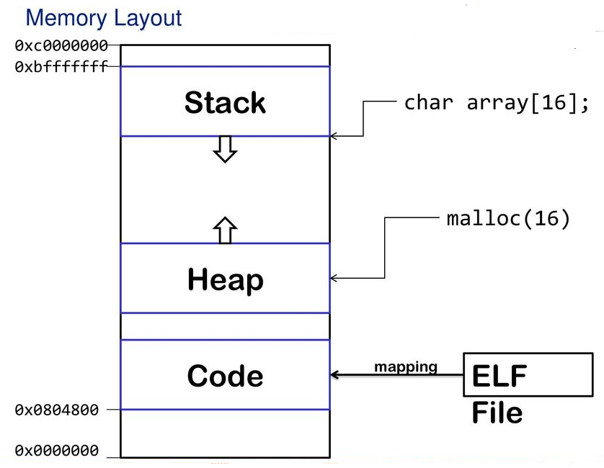
C++ Memory Model

Slide 7
C++ Memory Model
The C++ memory model is an abstract machine for which the C++ programming language is defined.
Simplified memory model (closely related to how a real computer memory looks.)
Memory is one or more contiguous sequences of bytes.
A byte is a sequence of 8 or more bits and "bit" is a unit of storage large enough to hold one of two values.
Each byte is associated with a unique identifier known as its address.
Computer memory is classified as
Writable or non-writable.
Executable or non-executable.
Initialized or uninitialized.
High Address |  | Environment variables
 | Stack | Managed automatically by compiler
 | Dynamic Data (Heap) | malloc/free new/delete
 | Static Data (global variables) | Un-initialized
 | Initialized Data (global variables, literals) | Initialized to zero by O.S.
Low Address | Program Code | Read from program file by O.S.
Managed automatically by compiler
(writable, non-executable)
High
Address
Available Memory
Managed by programmer
(writable, non-executable)
Created by programmer
(readable, non-executable)
Initialized when program starts
(readable, non-executable)
Read from a program file by exec (executable)
Low
Address

Slide 8
C++ Memory Model
High Address |  | Environment variables
 | Stack | Managed automatically by compiler
 | Dynamic Data (Heap) | malloc/free new/delete
 | Static Data (global variables) | Un-initialized
 | Initialized Data (global variables, literals) | Initialized to zero by O.S.
Low Address | Program Code | Read from program file by O.S.
#include <iostream>
using namespace std;
int x;
int main(int argc, char* argv[])
{
int y;
int* z = (int*)new int[10];
return 0;
}
z
10 ints

Slide 9
Resolution Operator
Resolution Operator
The :: (scope resolution) operator is used to qualify hidden names so that you can still use them.
You can use the unary scope operator if a namespace scope or global scope name is hidden by an explicit declaration of the same name in a block or class.
Use cases of the Binary scope resolution operator:
class Vehicle
{
public:
void drive() { cout << "Vehicle"; }
};
class Car
{
public:
void drive() { cout << "Car"; }
};
class BMW : public Car, public Vehicle
{
// BMW specific functions.
};
int main(int arc, char* argv[])
{
BMW bmw;
bmw.drive(); // ERROR!
bmw.Car::drive(); // Drive Car
bmw.Vehicle::drive(); // Drive Vehicle
}
class Car
{
public:
void drive() { cout << "Car"; }
};
class BMW : public Car
{
public:
void drive() { cout << "BMW"; }
};
int main(int argc, char* argv[])
{
BMW bmw;
bmw.drive(); // Drive BMW
bmw.Car::drive(); // Drive Car
}
class Car
{
public:
static int car_var;
};
int Car::car_var = 99;
int car_var = 1000;
int main()
{
cout << Car::car_var;
Car::car_var = 10;
cout << Car::car_var;
cout << ::car_var;
return 0;
}
To define your functions outside the class.
class Car
{
public:
void drive();
};
void Car::drive()
{
// Driving logic.
}
To resolve ambiguity between two functions with same template which are derived from different classes.
To override the overridden function.
To access static / global data members.

Slide 10
You try it…
#include <iostream>
using namespace std;
int apple = 1;
int main(int argc, char* argv[])
{
{
int apple = 3;
cout << apple << endl; // (a)
{
cout << apple << endl; // (b)
cout << :: apple << endl; // (c)
apple = 2;
}
cout << apple << endl; // (d)
}
{
cout << apple << endl; // (e)
}
return 0;
}
3 – local to current scope
3 – also local to current scope
1 – use resolution operator to
access global variable
2 – main's local scope
1 – only global apple is in scope

Slide 11
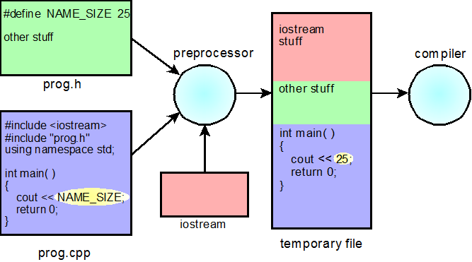
P.2 Preprocessor Directives and Macros
Removing Comments
Macros
Conditional Compilation
More on the #include Directive
P.2 Preprocessor Directives and Macros

Slide 12
C/C++ Preprocessor
Directive | Description
#define | Substitutes a preprocessor macro
#include | Inserts a particular header from another file
#undef | Undefines a preprocessor macro
#ifdef | Returns true if this macro is defined
#if | Tests if a compile time condition is true
#else | The alternative for #if
#elif | #else and #if in one statement
#endif | Ends preprocessor condition
#error | Prints error message on stderr
#pragma | Issues special commands to the compiler, using a standardized method
#warning | Compiler emits a diagnostic containing the remaining tokens in the directive
#line | Set the __FILE__ and __LINE__ macros of the line following the directive
#define MAX_STUDENTS 1000
#define MAX(x,y) (x < y ? x : y)
#include <iostream>
#include "snap.h"
#if 0
// don’t compile
#else
// compile
#endif

Slide 13
Conditional Compilation
Six preprocessor directives are available to control blocks of conditional compilation.
Begin directives are #if, #ifdef, and #ifndef.
Alternative blocks use #else, and #elif.
End of block marked by #endif.
If the condition is true (non-zero), then all lines between the matching #else (or #elif) and the #endif directive are ignored and not passed to the compiler.
Use constant-expressions.
Compilation time inclusion/exclusion (not run-time).
Ensure defined/default values.
Unlike /* */, these directives can be nested.
Useful for keeping old code around for future reference.
#if true #if true
. .
. .
. .
#elif true .
. #else
. #if false
. .
#endif .
.
#endif
#endif

Slide 14
P.3 C++ Control Statements
Sequence and Compound Statements
Selection and Repetition Control
Nested if Statements
The switch Statement
P.3 C++ Control Statements

Slide 15
Control Statements
Control
Statement
Selection
Iteration
Jump
if
if-else
switch
for
while
do
break
continue
return

Slide 16
Switch
A switch statement allows a variable to be tested for equality against a list of values or case.
The switch/case expressions must have an integral or enumerated type.
Statements following a case will execute until a break statement (or end of switch.)
An optional default case usually appears at the end of the switch.
switch example | if-else equivalent
switch (x) { case 1: case 2: case 3: cout << "1, 2, or 3"; break; default: cout << "Not 1, 2, or 3"; } | if ((x == 1) || (x == 2) || (x == 3)) { cout << "1, 2, or 3"; } else { cout << "Not 1, 2, or 3"; }

Slide 17
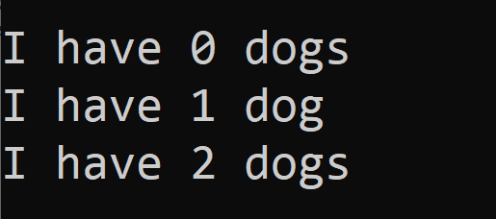
Conditional Expressions
Conditional expression (C++ multiplexor operation)
Format:
<boolean> ? <true expression> : <false expression>
y
z
x ? y : z
0
1
x
x ? y : z
This expression returns the value of y if x != 0, otherwise it returns the value of z.
Examples
for (int dogs = 0; dogs < 3; ++dogs)
cout << endl << "I have " << dogs << " dog" << ((dogs == 1) ? "" : "s");
ostream& out = (argc > 2) ? *(new ofstream(argv[2])) : cout;

Slide 18
Main Function Arguments

Slide 19
Argc and argv
#include <iostream>
#include <fstream>
#include <string>
using namespace std;
int main(int argc, char* argv[])
{
if (argc < 2) return 1;
ifstream in(argv[1]);
if (!in) return 1;
ostream& out = (argc > 2) ? *(new ofstream(argv[2])) : cout;
if (!out) return 2;
string line;
while (in >> line)
{
out << line << endl;
}
if (&out != &cout) delete(&out);
in.close();
return 0;
}
argc:
3
p | r | o | g | r | a | m | . | e | x | e | ∅
argv:
i | n | . | t | x | t | ∅
∅
o | u | t | . | t | x | t | ∅
Open argv[1] for input.
Open argv[2] for output if argc > 2,
else use cout for output.
>>program.exe in.txt out.txt
argv[0]
argv[1]
argv[2]

Slide 20
Tip #04: Chunking
A primary method that the brain uses to help it absorb more information is called 'chunking'.
One chunk is a recognizable piece of information that be fitted into one of the 'slots' in short-term memory.
Chunking makes block structured languages like C/C++ natural to use.
The program is a single chunk, which is divided and subdivided into smaller and smaller chunks.
Each chunk is visibly and logically distinguishable.
Lay out code in chunks
Groups of statements which together perform an identifiable act, should be chunked.
Items which are close together form a visual chunk and have an implied association.
Vertical white space (form feeds and blank lines) can be used not only to separate chunks but also to show relationships between chunks.
By recognizing chunks and making them stand out, code can be made more readable which means more maintainable.
Un-chunked List:
Bread
Ice cream
Milk
Tomatoes
Eggs
Butter
Apples
English muffins
Frozen vegetables
Lettuce
Cream
Bananas
Chunked List:
Frozen Foods Bakery
Ice cream Bread
Frozen vegetables Bagels
Dairy Fruits / Vegetables
Milk Tomatoes
Eggs Apples
Butter Lettuce
Cream Bananas
Notes:
Consider newspapers and magazines articles. The heading is big and visible. The article itself tends to be fairly brief. Paragraphs are small. If the article is more than a few lines long, it is broken up with sub headings, out-of-context quotes, pictures, etc. It is delimited with blank and solid lines. Everything possible is done to break it up and give the brain time to stop and take in each piece of the message.

Slide 21
Follow-up Questions...
What memory data structure is used to store function arguments?
What memory data structure is used to store run-time persistent objects?
What memory data structure is used to store global variables and literals?
What memory data structure is used to store function definitions?
What memory data structure is used to store local variables?
High Address | Environment (System)
 | Stack
 | Free Space
 | Dynamic Data (Heap)
 | Static Data
Low Address | Program Code
Stack.
Dynamic Data (heap).
Static Data.
Program Code.
Stack.

Slide 22
C++ Translation Units
A translation unit is the basic unit of compilation in C++.
It consists of the contents of a single source file, plus the contents of any header files directly or indirectly included by it, minus those lines that were ignored using conditional preprocessing statements.
A single translation unit can be compiled into an object file, library, or executable program.
Objects have shared access across multiple translation units as follows:
Non-statically-scoped objects (like classes or functions) are shared across multiple translation units.
The keyword static limits scope to the translation unit.
Global variables can be shared via the extern keyword.

Slide 23
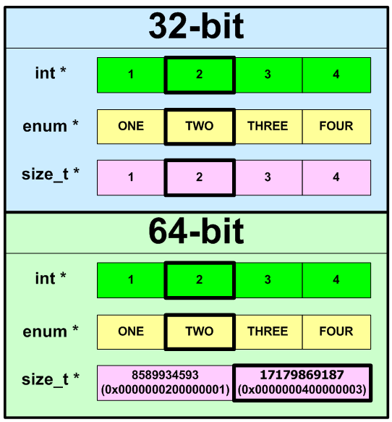
P.4 Primitive Data Types and Class Types
Primitive Data Types
Primitive-Type Variables
Operators
Postfix and Prefix Increment
Type Compatibility
P.4 Primitive Data Types and Class Types

Slide 24
C++ Data Types
An object is fundamentally an area of the computer’s memory containing data of some kind (data type).
How the object is stored
What operations are legal on the object.
C++ Data Types
Primitive Data Types
User Defined Types
Derived Types
struct
class
union
enum
(array)
typedef
function
pointer
reference
Integral Types
Floating Types
void
char
short
int
long
bool
wchar_t
float
double
long double

Slide 25
Operator Precedence/Associativity
OPERATORS | ASSOCIATIVITY
( ) [ ] -> . | left to right
! ~ ++ -- + - * & (type) sizeof | right to left
* / % | left to right
+ - | left to right
<< >> | left to right
< <= > >= | left to right
== != | left to right
& | left to right
^ | left to right
| | left to right
&& | left to right
|| | left to right
?: | right to left
= += -= *= /= %= &= ^= |= <<= >>= | right to left
, | left to right
Unary operators associate right to left.

Slide 26
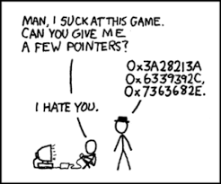
P.5 Objects, Pointers, and References
Object Lifetimes
Pointers
The Null Pointer
Dynamically Created Objects
References
P.5 Objects, Pointers, and References

Slide 27
Pointers
A pointer is a memory address.
With pointers
functions can indirectly access variables.
functions can modify the arguments passed by the caller function.
sophisticated data structures can grow and shrink at run-time.
Arrays and pointers are closely related.
Array pointers enable us to process groups of data such as vectors, lists, and strings.
A pointer variable contains a memory address.
Associated with a pointer variable is the type of value to which it points.
The asterisk (*) indicates that the following identifier is a pointer variable.
The ampersand (&) returns a pointer (address) to the following identifier.
int var = 10;
10
20
var:
30
int *ptr = &var;
*ptr = 20;
ptr:
int **p_ptr = &ptr;
**p_ptr = 30;
p_ptr:

Slide 28
Dynamic Objects
When any C++ object is created
Storage must be allocated for the object (static, stack, or heap).
The constructor is called to initialize that storage.
The destructor is called to release object storage.
Stack
Dynamic Data (Heap)
Static data (global variables)
Program Code
With local objects, the compiler decides
where the object is stored (stack),
when the object is constructed (declaration), and
when the object is destroyed (goes out of scope).
With dynamic objects, the programmer decides
where the object is stored (heap),
when the object is constructed (new operator), and
when the object is destroyed (delete operator).
Pointers are always used to refer to dynamically created objects.
{
int size = 4;
int* myInts = new int[size];
}
size:
4
myInts:
size

Slide 29
P.6 Functions
Function Declarations
Call by Value
Call by Reference
Operator Functions
Class Member Functions and Implicit Parameters
P.6 Functions

Slide 30
Call by Value
#include <iostream>
using std::cout;
void swap(int x, int y)
{
int temp = x;
x = y;
y = temp;
}
int main()
{
int a = 10;
int b = 20;
swap(a, b);
cout << "a = " << a << endl;
cout << "b = " << b << endl;
return 0;
}
Function name
Stack
return
a 10
Activation
record
b 20
Function parameters
return
Function return type
x 10
-- 20
Activation
record
y 20
-- 10
Function arguments
temp --
-- 10
Call by value means a copy of a function's argument object is passed to the function.

Slide 31
Pointers vs References
Pointers and references use one variable to access another variable.
A pointer variable holds the memory address of another variable.
A pointer variable is dereferenced (access to the memory location pointed to) with the "*" operator.
A reference variable is an alias, that is, another name for an already existing variable.
A reference, like a pointer is also implemented by storing the address of an object.
A reference can be thought of as a constant pointer with automatic indirection (the compiler will apply the * operator for you).
A variable is declared as reference by putting ‘&’ between the reference type and the variable name in the declaration.
int a;
int b;
ptr_a:
✗
ref_a:
int *ptr_a = &a;
ptr_a = &b;
int &ref_a = a;
✗
b:
a:
ref_a = b;

Slide 32
Pointers vs References
void swap(int* x, int* y)
{
int temp = *x;
*x = *y;
*y = temp;
}
int main()
{
int a = 10;
int b = 20;
swap(&a, &b);
cout << "a = " << a << endl;
cout << "b = " << b << endl;
return 0;
}
void swap(int& x, int& y)
{
int temp = x;
x = y;
y = temp;
}
int main()
{
int a = 10;
int b = 20;
swap(a, b);
cout << "a = " << a << endl;
cout << "b = " << b << endl;
return 0;
}

Slide 33
Call by Reference
#include <iostream>
using std::cout;
void swap(int& x, int& y)
{
int temp = x;
x = y;
y = temp;
}
int main()
{
int a = 10;
int b = 20;
swap(a, b);
cout << "a = " << a << endl;
cout << "b = " << b << endl;
return 0;
}
Stack
return
a 10
-- 20
b 20
-- 10
return
&x
&y
temp --
-- 10
Call by reference means a reference (implied pointer) to the argument object is passed to the function.

Slide 34
References vs Pointers
Similarities
Both references and pointers can be used to change the values of function parameters.
Both can save your program from making a copy of a big object that is passed as an argument to a function or returned from a function.
Differences
A reference variable must be initialized when declared and cannot be changed to a reference another object (cannot be reseated) – not very useful!
You can not take the address of a reference.
You can not create an array of references or declare a reference to a reference.
References cannot be void or NULL. (Pointers are often made NULL to indicate that they are not pointing to any valid thing.)
Hence,
Pointers are more flexible.
Reference variables are safer (no wild pointers) and easier to use.

Slide 35
Call by Constant Reference
Call by Value
The function argument can be an object or an expression.
A copy of the argument is pushed on the stack and becomes a local function parameter variable.
Any changes to the function parameter will not be reflected in the actual function argument.
Call by Reference
The function argument can only be an object (not an expression.)
The function parameter becomes a reference (pointer) to the actual argument.
Any changes to the formal function parameter will be reflected in the actual argument.
Call by Constant Reference
While it is more efficient to call by reference, the caller may not want the value of the argument to be changed.
A function can guarantee that argument will not be changed by declaring the parameter to be a constant reference.
int countFrequency(char c, const string& s);

Slide 36
Operator Functions
C++ allows us to define class types that behave as if they were primitive types by overloading class operators.
Operator overloading is resolved by signature.
Can't invent operators (e.g., ** for exponentiation.)
Must have same number of arguments as built-in types (except for operator() ).
Some operators are off limits (".", "?:", sizeof, and "::")
+ -
* /
% ^
& |
~ !
= <
> ,
+= -=
*= /=
%= ^= &= |=
<< >>
>>= <<=
== !=
<= >= && ||
++ --
->* ->
( ) [ ]
Return Data Type
Reserved Keyword
1st Operand (*this)
2nd Operand (&myClass)
int myClass::operator++();
bool myClass::operator==(const myClass&) const;
string operator+(const string&, const string&);
Class Name
myClass operator++
(unary pre-increment)

Slide 37
Be Safe
Quiz Code: lion

Slide 38
#include <iostream>
#include <string>
#include <sstream>
using namespace std;
class Dog
{
private:
int legs;
public:
Dog(int legs) { this->legs = legs; }
~Dog() = default;
Dog& operator++() { ++this->legs; return *this; }
string toString() const
{
ostringstream out;
out << "Legs = " << this->legs;
return out.str();
}
};
int main(int argc, char* argv[])
{
Dog dog(5);
cout << dog.toString() << endl;
++dog;
cout << dog.toString() << endl;
return 0;
}

Slide 39
#include <iostream>
#include <string>
#include <sstream>
using namespace std;
class Dog
{
private:
int legs;
public:
Dog(int legs) { this->legs = legs; }
~Dog() = default;
int getLegs() { return legs; }
Dog& operator++() { ++this->legs; return *this; }
string toString() const
{
ostringstream out;
out << "Dog legs = " << this->legs;
return out.str();
}
};
class Cat
{
private:
int legs;
public:
Cat(int legs) { this->legs = legs; }
~Cat() = default;
int getLegs() { return legs; }
Cat& operator++() { ++this->legs; return *this; }
string toString() const
{
ostringstream out;
out << "Cat legs = " << this->legs;
return out.str();
}
};
string operator+(Dog& d, Cat& c)
{
ostringstream out;
out << "Dog + Cat legs = " << d.getLegs() + c.getLegs();
return out.str();
}
int main(int argc, char* argv[])
{
Dog dog(5);
cout << dog.toString() << endl;
++dog;
cout << dog.toString() << endl;
Cat cat(5);
cout << cat.toString() << endl;
cout << dog + cat << endl;
return 0;
}

