Slide 1
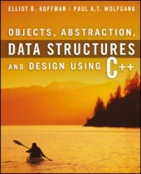
Welcome to
CS 235 Data Structures
Maps and Sets (33)
Chapter 9.5-6, pgs. 555-564

Slide 2
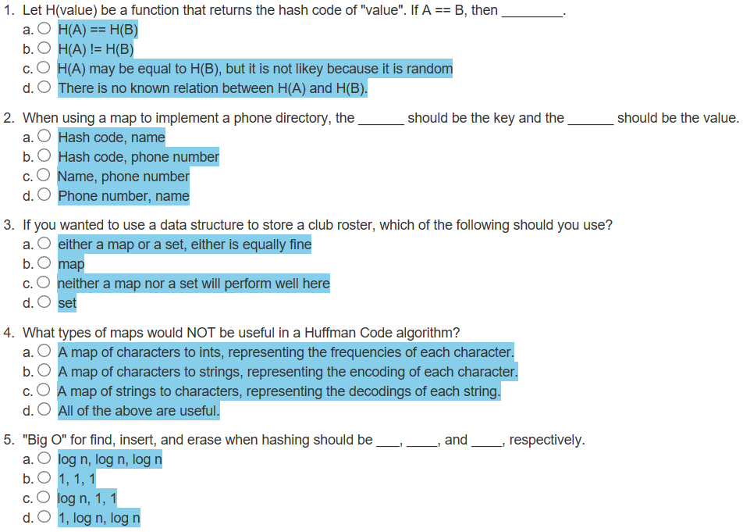
Attendance Quiz #32

Slide 3
Tip #33: Very Late?
Is someone’s junior year very late to learn programming?
Yes, give up…
Or you can take the advice of this wise Chinese proverb:
“The best time to plant a tree was 20 years ago. The second best time is now.”
Remember:
You are still young - You have most of your life ahead of you.
Regardless of what field or trade you pick up, you WILL have to learn something new, whether you like it or not.
So, why not learn something that interests you?

Slide 4
Iterator
BST<int>
Node* root_;
Iterator
Node* root_; int index_ = 0;
begin()
8
8
8
5
end()
Iterator
Node* root_; int index_ = 7;
3
3
3
3
9
9
9
9
2
2
2
1
4
4
4
4
12
12
12
BST<int>::Iterator iter = bst.begin();
BST<int>::Iterator end_iter = bst.end();
if (iter == end_iter) out << " Empty";
while (iter != end_iter)
{
out << " " << *iter;
++iter;
}
12
11
11
11
11
?

Slide 5
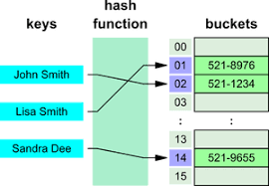
9.3 Hash Tables
Problems with Quadratic Probing
Chaining
Performance of Hash Tables
9.3, pgs. 530-541

Slide 6
Quadratic Probing
Linear probing tends to form clusters of keys in the hash table, causing longer search chains.
Quadratic probing can reduce the effect of clustering.
Resolve collisions with a quadratic series (H+1², H+2², H+3², H+4²}, ..., H+k²)
For example, if an item has a hash code of 5, successive values of index will be 6 (5+1), 9 (5+4), 14 (5+9), 21 (5 +16), . . .
0
1
2
3
4
5
6
0
1
2
3
4
5
6
Capacity = 7
48
48
Insert | Hash | Linear | Quad
12
76
76%7 = 6
1
1
55
12
40
40%7 = 5
1
1
55
48
48%7 = 6
2
2
12
12%7 = 5
4
3
40
40
55
55%7 = 6
4
3
76
76

Slide 7
Problems with Quadratic Probing
Quadratic probing can reduce the effect of clustering, but is expensive:
Index, Index + 1², Index + 2², Index + 3², ... , Index + k²
An efficient way to calculate the next quadratic probe index is:
k += 2;
index = (index + k) % table.size();
For example, if the hash index is 5, quadratic probes would be:
5, 6 ( 5 + 1), 9 (5 + 1 + 3), 14 (5 + 1 + 3 + 5), 21 (5 + 1 + 3 + 5 + 7), …
Other open addressing problems:
An item can't be inserted even when the table is not full.
The program gets stuck in an infinite loop searching for an empty slot.
If the table size is a prime number and it is never more than half full, getting stuck in an infinite search loop will never happen.
However, requiring a half empty table wastes a lot of memory.

Slide 8
Chaining
Chaining is an alternative to open addressing.
Each table element references a linked list that contains all of the items that hash to the same table index.
The linked list often is called a bucket
The approach sometimes is called bucket hashing
Hash Bucket
node
node
[0] | NULL
[1] | NULL
[2] | NULL
[3] | NULL
[4] | NULL
next =
data =
∅
next =
data =
∅
"Pete"
"Zack"
node
node
node
next =
data =
∅
next =
data =
∅
next =
data =
∅
"Abe"
"Dan"
"Tom"

Slide 9
Chaining
Advantages relative to open addressing:
Only items that have the same value for their hash codes are examined when looking for an object.
You can store more elements in the table than the number of table slots (indices).
Once you determine an item is not present, you can insert it at the beginning or end of the list.
To remove an item, you simply delete it; you do not need to replace it with a dummy item or mark it as deleted.
Load factor has the greatest effect on hash table performance.
Load factor is the number of filled cells divided by the table size.
The lower the load factor, the better the performance as there is a smaller chance of collision when a table is sparsely populated.
If there are no collisions, performance for search and retrieval is O(1) regardless of table size.

Slide 10
Given the hash function values to the right, fill in the table values using chaining.
Chaining
h(28) = 28
h(47) = 47
h(20) = 20
h(36) = 36
h(41) = 41
h(23) = 23
h(25) = 25
h(53) = 53
0
1
2
3
4
5
6
7
8
9
10
node
next =
data =
∅
"23"
node
node
node
next =
data =
∅
next =
data =
∅
next =
data =
∅
"47"
"36"
"25"
node
next =
data =
∅
"28"
node
next =
data =
∅
∅
"41"
node
node
next =
data =
∅
next =
data =
∅
"20"
"53"

Slide 11
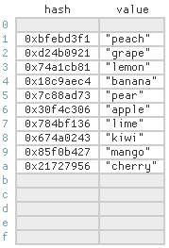
9.5 Implementation Considerations for the hash_map
Defining the Hash Function Class
The hash_map::iterator and hash_map::const_iterator
9.5, pgs. 555-558

Slide 12
Class Template Specialization
Class templates are meta-classes - specifications for generating instantiated classes based on parameters.
C++ supports template specialization of class templates when some of the template parameters are preset.
A generic map is templated for a key data type and a value data type.
While the key data type might be used in all mappings, different mapped value types might require different implementations.
myMap<string, string> map2;
/** Generic map template class */
template <typename Key, typename Value>
class myMap {};
myMap<string, set> map3;
/** Explicit (or full) template specialization */
template <>
class myMap<string, string> {};
myMap<string, int> map1;
/** Partial template specialization */
template <typename Key>
class myMap<Key, set> {};

Slide 13
Hash Class (Functor) Specialization
/** Explicit (full) Hash Function Template */
template<typename Key_Type>
struct hash {};
No implementation is provided for the explicit hash function class.
/** Specialization for string: s0 x 31^(n-1) + s2 x 31^(n-1) + ... + sn-1 */
template<>
struct hash<std::string>
{
size_t operator()(const std::string& s)
{
size_t result = 0;
for (size_t i = 0; i < s.length(); i++) result *= 31 + s[i];
return result;
}
};
Instead, specializations are provided for built-in types and library-defined types such as int and string.
/** Specialization for int */
template<>
struct hash<int>
{
size_t operator()(int i) { return size_t(4262999287U * i); }
};

Slide 14
Be Safe

