Slide 1
Welcome to
CS 235 Data Structures
Trees, 8.2 (26)

Slide 2
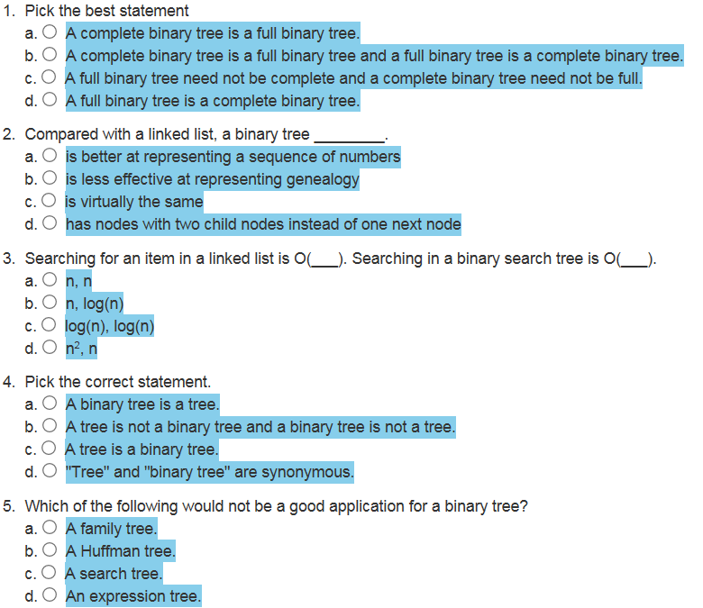
Attendance Quiz #25

Slide 3
Tip #26: Constructor Do's and Don't
Avoid throwing exceptions from constructors or destructors.
The lifetime of an object is said to begin when the constructor runs to completion and ends right when the destructor is called.
If the constructor throws, then the destructor is not called.
You should particularly avoid half-constructing an object and then relying on users of your class to detect construction failure by testing flag variables of some sort.
Such design most assuredly would result in memory leaks.
Calling virtual functions from a constructor or destructor is dangerous and should be avoided.
The Base type(s) must be constructed prior to a Derived type.
Any virtual calls are treated as calls to methods in the class of the currently executing constructor or destructor.
You most assuredly would be accessing uninitialized derived data.

Slide 4
Are there Memory Leaks?
#include <iostream>
using namespace std;
template <typename T>
class Deque
{
private:
size_t size_;
T* the_data;
public:
Deque() : size_(0), the_data(new T[10]) {};
void push(const T& item) { the_data[size_++] = item; }
friend ostream& operator<<(ostream& os, Deque<T>& d)
{ for (size_t i = 0; i < d.size_; ++i)
os << " " << d.the_data[i];
return os;
}
};
template <typename T>
class Vector
{
private:
Deque<T> deque_;
public:
void push_back(const T& item) { deque_.push(item); }
friend ostream& operator<<(ostream& os, Vector<T>& v)
{ return os << v.deque_; }
};
template <typename T>
class Station
{
private:
Vector<T> vector_;
public:
void addCar(const T& item) { vector_.push_back(item); }
friend ostream& operator<<(ostream& os, Station<T>& s);
{ return os << s.vector_; }
};
int main()
{
Station<Car> station;
station.addCar(*new Car(888));
station.addCar(*new Car(999));
station.addCar(*new Car(666));
cout << station;
return 0;
}

Slide 5
Are there Memory Leaks?
#include <iostream>
using namespace std;
template <typename T>
class Deque
{
private:
size_t size_;
T* the_data;
public:
Deque() : size_(0), the_data(new T[10]) {};
void push(const T& item) { the_data[size_++] = item; }
friend ostream& operator<<(ostream& os, Deque<T>& d)
{ for (size_t i = 0; i < d.size_; ++i)
os << " " << d.the_data[i];
return os;
}
};
template <typename T>
class Vector
{
private:
Deque<T> deque_;
public:
void push_back(const T& item) { deque_.push(item); }
friend ostream& operator<<(ostream& os, Vector<T>& v)
{ return os << v.deque_; }
};
template <typename T>
class Station
{
private:
Vector<T> vector_;
public:
void addCar(const T& item) { vector_.push_back(item); }
friend ostream& operator<<(ostream& os, Station<T>& s);
{ return os << s.vector_; }
};
int main()
{
Station<Car> station;
Car* new car1(888);
Car* new car2(999);
Car* new car3(666);
station.addCar(*car1);
station.addCar(*car2);
station.addCar(*car3);
cout << station;
return 0;
}

Slide 6
Are there Memory Leaks?
#include <iostream>
using namespace std;
template <typename T>
class Deque
{
private:
size_t size_;
T* the_data;
public:
Deque() : size_(0), the_data(new T[10]) {};
void push(const T& item) { the_data[size_++] = item; }
friend ostream& operator<<(ostream& os, Deque<T>& d)
{ for (size_t i = 0; i < d.size_; ++i)
os << " " << d.the_data[i];
return os;
}
};
template <typename T>
class Vector
{
private:
Deque<T> deque_;
public:
void push_back(const T& item) { deque_.push(item); }
friend ostream& operator<<(ostream& os, Vector<T>& v)
{ return os << v.deque_; }
};
template <typename T>
class Station
{
private:
Vector<T> vector_;
public:
void addCar(const T& item) { vector_.push_back(item); }
friend ostream& operator<<(ostream& os, Station<T>& s);
{ return os << s.vector_; }
};
int main()
{
Station<Car> station;
Car car1(888);
Car car2(999);
Car car3(666);
station.addCar(car1);
station.addCar(car2);
station.addCar(car3);
cout << station;
return 0;
}
What is being stored?

Slide 7
Tree Terminology
Each node in a tree has exactly one parent, except for the root node which has no parent.
Leaf nodes also are known as external nodes, and non-leaf nodes are known as internal nodes.
A generalization of the parent-child relationship is the ancestor-descendant relationship.
The depth of a node is the number of nodes from the root (defined recursively):
If a node is the root of a tree, its depth is 0.
If a node is not the root of a tree, its depth
is 1 + the depth of its parent.
Depth 0
Height 3
Level 1
Dog
Depth 1
Height 1
Level 2
Cat
Pig
Depth 1
Height 2
Level 2
The height of a node is the number of nodes in the longest path from the node to a leaf node.
Depth 2
Height 1
Level 3
Wolf
The level of a node is its depth + 1.

Slide 8
Fullness, Predecessor, Successor
Every node in a binary tree has at most 2 children.
Each node contains
Data
Pointer to left child (T_{L})
Pointer to right child (T_{R}).
7
1
10
0
3
9
12
A full binary tree is a binary tree where all internal nodes have exactly 2 children.
2
5
11
13
A node predecessor is the left right-most node.
4
6
A node successor is the right left-most mode.
Root Successor
Root Predecessor

Slide 9
Completeness
Height: 4
Level: 1
7
Note: not a full binary tree as node 9 only has 1 child.
Height: 3
Level: 2
3
10
Height: 2
Level: 3
1
5
9
11
Height: 1
Level: 4
0
2
4
6
8
A complete binary tree of height h
is filled (has a value) down to level (h – 1) and,
at level h, any un-filled nodes are to the right.
Also, with a complete binary tree,
All nodes down to level (h – 2) have two children.
If a node at level (h – 1) has one child, it is a left child and all nodes to the left have two children.

Slide 10
3
6
10
✓
✓
4
6
10
Tree Height:
Root Predecessor:
Root Successor:
Full | ◻
Complete | ◻
Tree Height:
Root Predecessor:
Root Successor:
Full | ◻
Complete | ◻
8
8
4
12
4
12
2
6
10
14
2
6
10
14
11
15
4
7
10
✓
✓
Tree Height:
Root Predecessor:
Root Successor:
Full | ◻
Complete | ◻
4
7
9
✓
Tree Height:
Root Predecessor:
Root Successor:
Full | ◻
Complete | ◻
8
8
4
12
4
12
2
6
10
14
2
6
10
14
1
3
5
7
5
7
9
11
13
15
Tree Height:
Root Predecessor:
Root Successor:
Full | ◻
Complete | ◻
Tree Height:
Root Predecessor:
Root Successor:
Full | ◻
Complete | ◻
4
4
10
4
6
10
✓
8
8
4
12
4
12
2
10
14
2
6
10
14
1
15
1
3
5

Slide 11
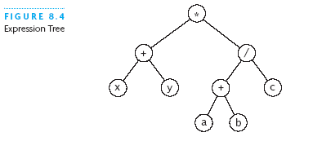
Expression Tree
Each node contains an operator or an operand.
Operands are stored in leaf nodes.
Parentheses are not stored in the tree because the tree structure dictates the order of operand evaluation.
Operators in nodes at higher tree levels are evaluated after operators in nodes at lower sub-tree levels.
(x + y) * ((a + b) / c)

Slide 12
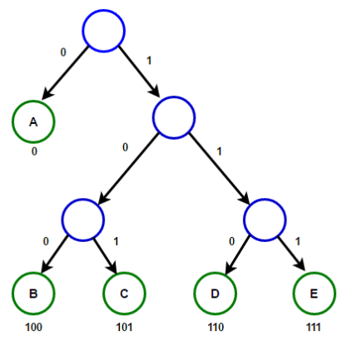
Huffman Tree
A Huffman tree represents Huffman codes for characters that might appear in a text file.
As opposed to ASCII or Unicode, Huffman code uses different numbers of bits to encode letters; more common characters use fewer bits.
Many programs that compress text files use Huffman codes.

Slide 13
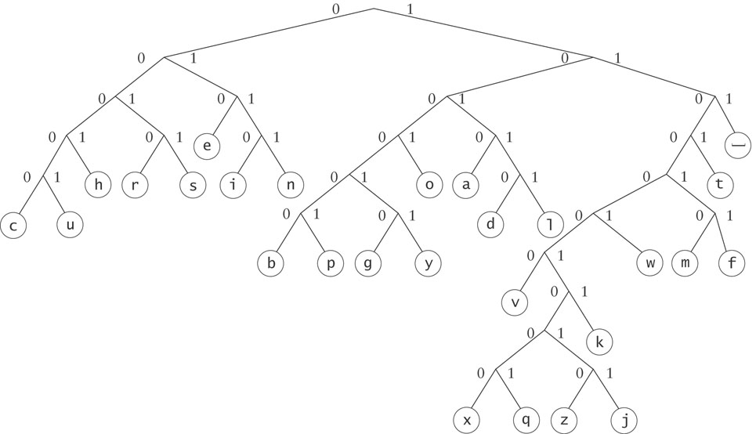
Huffman Tree
To form a code, traverse the tree from the root to the chosen character, appending 0 if you branch left, and 1 if you branch right.
Examples:
e : 010
d : 10110

Slide 14
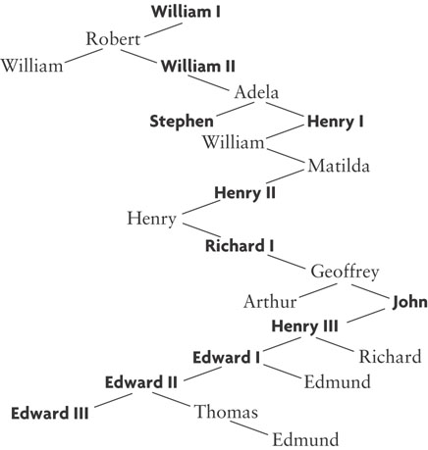
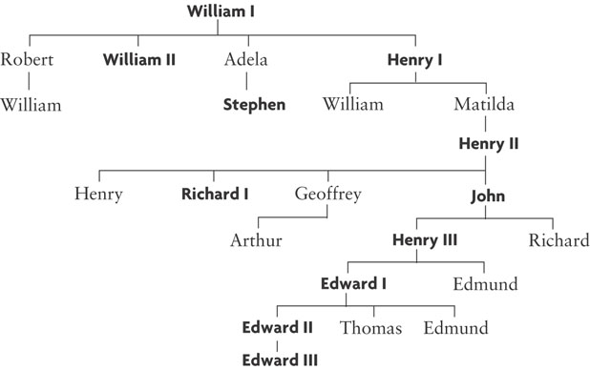
General Trees
In general, any tree can be represented using a binary tree.
Children
Siblings
Children
Siblings
Children
Siblings
Children
The left branch of a node is the oldest child, and each right branch is connected to the next younger sibling (if any).
Siblings
Children
Siblings
Siblings

Slide 15
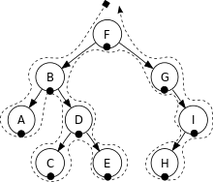
8.2 Tree Traversals
Visualizing Tree Traversals
Traversals of Binary Search Trees and Expression Trees
8.2, pgs. 454-455

Slide 16
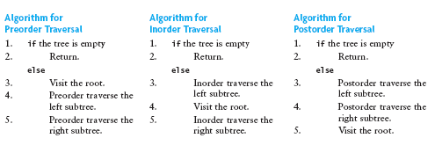
Recursive Tree Traversals
We want to determine the nodes of a tree by their relationship.
We can do this by walking through the tree in a prescribed order and visiting the nodes as they are encountered
This process is called tree traversal
Three common kinds of tree traversal
Preorder: visit root node, traverse T_{L} , traverse T_{R}
Inorder: traverse T_{L} , visit root node, traverse T_{R}
Postorder: traverse T_{L} , traverse T_{R} , visit root node

Slide 17
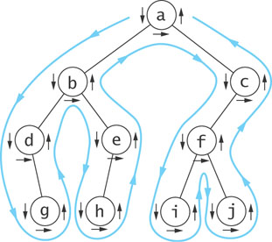
Visualizing Tree Traversals
You can visualize a tree traversal by imagining a mouse that walks along the edge of the tree.
If the mouse always keeps the tree to the left, it will trace a route known as the Euler tour.
The Euler tour is the path traced in blue in the figure on the right.

Slide 18
Visualizing Tree Traversals
If the mouse follows an Euler tour route (blue path) and visits each node before traversing its subtrees (shown by the downward pointing arrows), then we get a pre-order traversal.
pre_order_traversal(node)
if node is NULL return
visit node
pre_order_traversal(node.left)
return pre_order_traversal(node.right)
The sequence in this example is:
a
b
d
g
e
h
c
f
i
j

Slide 19
Visualizing Tree Traversals
If we record a node as the mouse returns after traversing its left subtree (shown by horizontal black arrows in the figure) we get an in-order traversal.
in_order_traversal(node)
if node is NULL return
in_order_traversal(node.left)
visit node
return in_order_traversal(node.right)
The sequence in this example is:
d
g
b
h
e
a
i
f
j
c

Slide 20
Visualizing Tree Traversals
If we record each node as the mouse last encounters it, we get a post-order traversal (shown by the upward pointing arrows).
post_order_traversal(node)
if node is NULL return
post_order_traversal(node.left)
post_order_traversal(node.right)
visit node
return
The sequence in this example is:
g
d
h
e
b
i
j
f
c
a

Slide 21
Visualizing Tree Traversals
If we record each node by height within the tree, we get a level-order (breadth first) traversal.
Algorithm: For each node, first visit the node, then queue (FIFO) its child nodes.
a
b
c
Create an empty queue.
Enqueue root.
while queue not empty
a) Dequeue node.
b) Visit node->data.
c) Enqueue node’s children.
d
e
f
g
h
i
j
The sequence in this example is:
a
b
c
d
e
f
g
h
i
j

Slide 22
Quiz A
Level-order:
In-order:
Pre-order:
Post-order:
A
A
B
C
D
E
F
G
H
I
J
K
L
M
B
C
D
E
F
G
D
B
H
E
L
I
M
A
F
C
J
G
K
H
I
J
K
A
B
D
E
H
I
L
M
C
F
G
J
K
L
M
D
H
L
M
I
E
B
F
J
K
G
C
A

Slide 23
Quiz B
Level-order:
In-order:
Pre-order:
Post-order:
A
A B F C D G J E H K M I L
B
F
C
D
G
J
C E I B D H A G L K F J M
E
H
K
M
A B C E I D H F G K L J M
I
L
I E C H D B L K G M J F A

Slide 24
Traversal of Expression Tree
An in-order traversal of an expression tree results in the sequence x + y * a + b / c
A post-order traversal of an expression tree results in the sequence x y + a b + c / *
The postfix or reverse polish form.
Operators follow operands.
A pre-order traversal of an expression tree results in the sequence * + x y / + a b c
This is the prefix form of the expression.
Operators precede operands.
*
+
/
x
y
+
c
a
b
Note: in-order traversal of an expression tree requires sub-tree parentheses:
(x + y) * ((a + b) / c)

Slide 25
Be Safe

