Slide 1
Welcome to
CS 235 Data Structures
Trees, 8.1 (25)

Slide 2
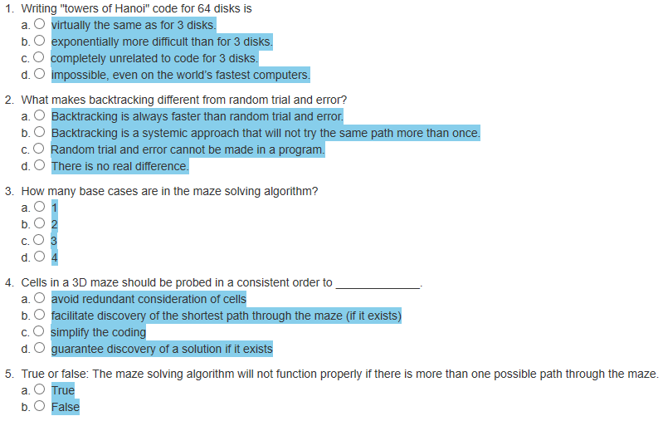
Attendance Quiz #24

Slide 3
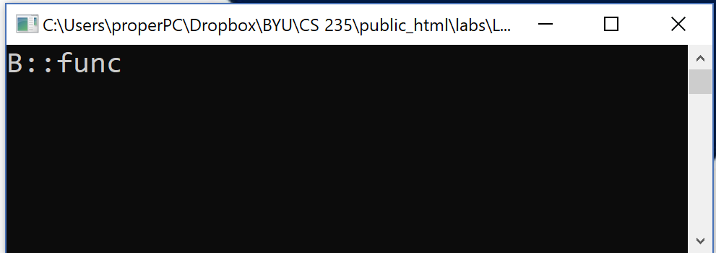
Tip #25: Compiler Warnings
Many programmers routinely ignore compiler warnings.
If the problem were serious, it would be an error, right?
Not so in C++! Sloppy programming may lead to erroneous program behavior, followed by a lot of difficult debugging.
#include <iostream>
using namespace std;
class B
{
public:
virtual void func() const { cout << "B::func"; }
};
class D : public B
{
public:
virtual void func() { cout << "D::func"; }
};
warning: D::func() hides B:func()
"Of course, that's what it's supposed to do!"
int main()
{
B* d = new D();
d->func();
return 0;
}
A compiler warning signals a potentially serious problem in your code.
Take compiler warnings seriously and strive to compile warning-free at the maximum warning level supported by your compiler.

Slide 4
Trees
Chapter 8

Slide 5
Chapter Objectives
To learn how to use a tree to represent a hierarchical organization of information
To learn how to use recursion to process trees
To understand the different ways of traversing a tree
To understand the differences between binary trees, binary search trees, and heaps
To learn how to implement binary trees, binary search trees, and heaps using linked data structures and arrays
To learn how to use a binary search tree to store information so that it can be retrieved in an efficient manner
To learn how to use a Huffman tree to encode characters using fewer bits than ASCII or Unicode, resulting in smaller files and reduced storage requirements

Slide 6
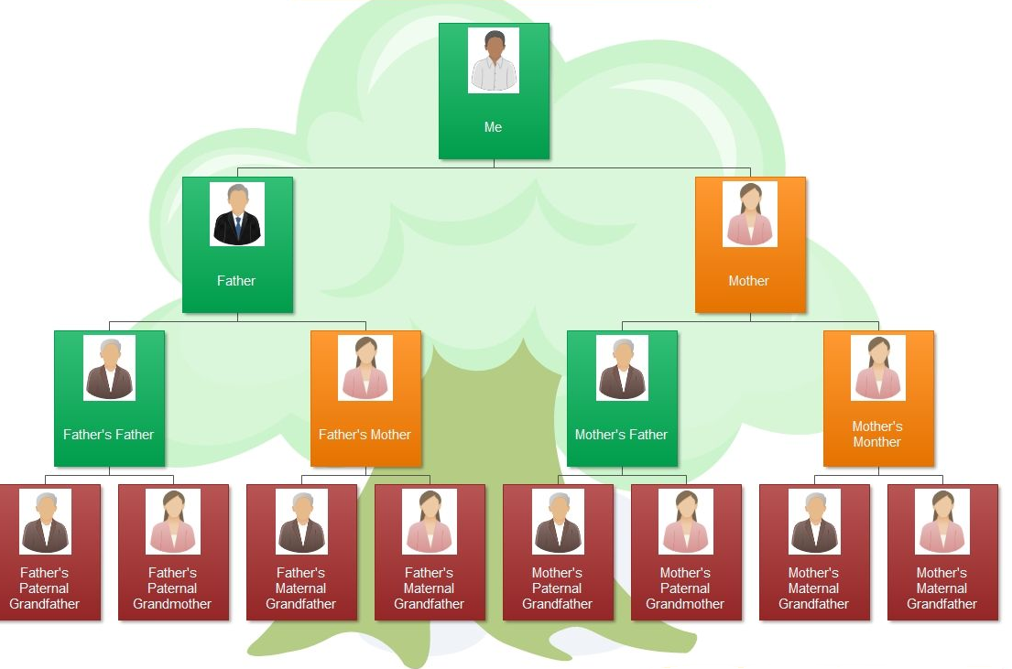
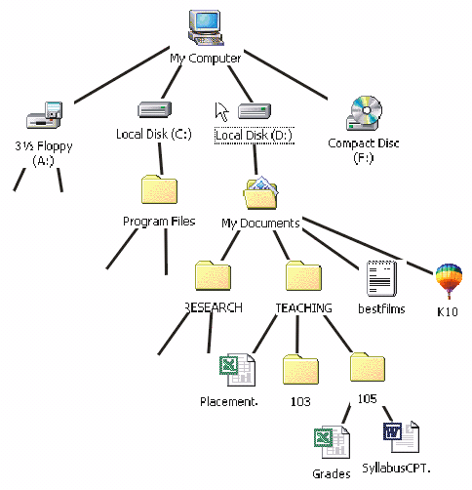
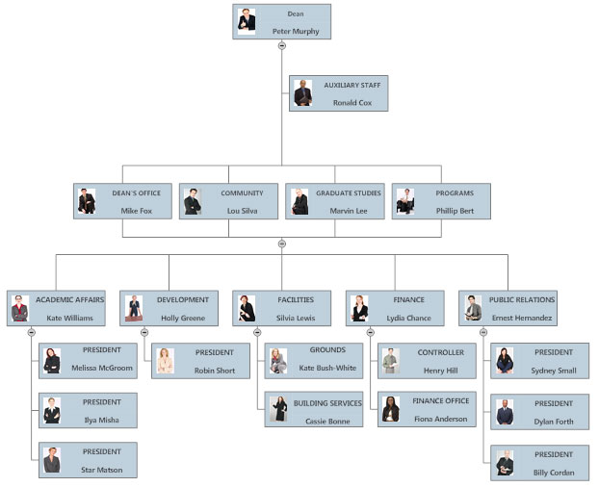
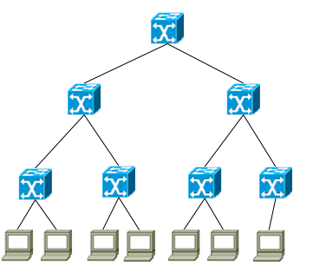
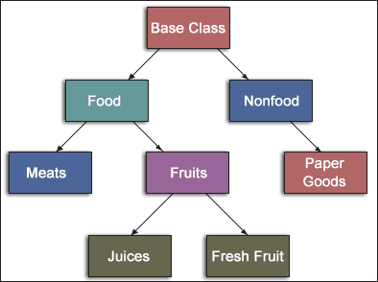
Trees - Introduction
All previous data organizations we've studied are linear—each element can have only one predecessor and one successor.
Accessing all elements in a linear sequence is O(n).
Trees are nonlinear and hierarchical.
Tree nodes can have multiple successors (but only one predecessor).
Trees can represent hierarchical organizations of information:
Class hierarchy
Disk directory and subdirectories
Business organizations
Networking topologies
Family organizations

Slide 7
Trees - Introduction
Trees are recursive data structures because they can be defined recursively.
Many methods to process trees are written recursively.
post-order
pre-order
in-order
This chapter focuses on the binary tree.
In a binary tree each element has two successors.
Binary trees can be represented by arrays and by linked data structures.
Searching a binary search tree, generally is more efficient than linearly searching an ordered list—O(log n) versus O(n).

Slide 8
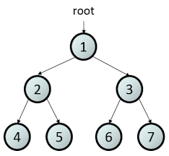
8.1 Tree Terminology and Applications
Tree Terminology
Binary Trees
Some Types of Binary Trees
Fullness and Completeness
General Trees
8.1, pgs. 447-453

Slide 9
Tree Terminology
A tree is a hierarchical data structure of elements or nodes, with each node linked to its descendants.

Slide 10
Tree Terminology
A tree is a hierarchical data structure of elements or nodes, with each node linked to its descendants.
The node at the top of a tree is called the root
The link from a node to its descendant is called a branch
Dog
A node is a parent of its immediate descendant nodes
Cat
Wolf
Descendants of a parent node are called its children
Bear
Nodes that have the same parent are siblings
A node that has no children is called a leaf node
A subtree of a node is a tree whose root is a child of that node

Slide 11
Tree Terminology
Each node in a tree has exactly one parent, except for the root node which has no parent.
Leaf nodes also are known as external nodes, and non-leaf nodes are known as internal nodes.
A generalization of the parent-child relationship is the ancestor-descendant relationship.
The depth of a node is the number of nodes from the root (defined recursively):
If a node is the root of a tree, its depth is 0.
If a node is not the root of a tree, its depth
is 1 + the depth of its parent.
Depth 0
Height 3
Level 1
Dog
Depth 1
Height 1
Level 2
Cat
Pig
Depth 1
Height 2
Level 2
The height of a node is the number of nodes in the longest path from the node to a leaf node.
Depth 2
Height 1
Level 3
Wolf
The level of a node is its depth + 1.

Slide 12
Fullness, Predecessor, Successor
Every node in a binary tree has at most 2 children.
Each node contains
Data
Pointer to left child (T_{L})
Pointer to right child (T_{R}).
7
1
10
0
3
9
12
A full binary tree is a binary tree where all internal nodes have exactly 2 children.
2
5
11
13
A node predecessor is the left right-most node.
4
6
A node successor is the right left-most mode.
Root Successor
Root Predecessor

Slide 13
Completeness
Height: 4
Level: 1
7
Note: not a full binary tree as node 9 only has 1 child.
Height: 3
Level: 2
3
10
Height: 2
Level: 3
1
5
9
11
Height: 1
Level: 4
0
2
4
6
8
A complete binary tree of height h
is filled (has a value) down to level (h – 1) and,
at level h, any un-filled nodes are to the right.
Also, with a complete binary tree,
All nodes down to level (h – 2) have two children.
If a node at level (h – 1) has one child, it is a left child and all nodes to the left have two children.

Slide 14
3
6
10
✓
✓
4
6
10
Tree Height:
Root Predecessor:
Root Successor:
Full | ◻
Complete | ◻
Tree Height:
Root Predecessor:
Root Successor:
Full | ◻
Complete | ◻
8
8
4
12
4
12
2
6
10
14
2
6
10
14
11
15
4
7
10
✓
✓
Tree Height:
Root Predecessor:
Root Successor:
Full | ◻
Complete | ◻
4
7
9
✓
Tree Height:
Root Predecessor:
Root Successor:
Full | ◻
Complete | ◻
8
8
4
12
4
12
2
6
10
14
2
6
10
14
1
3
5
7
5
7
9
11
13
15
Tree Height:
Root Predecessor:
Root Successor:
Full | ◻
Complete | ◻
Tree Height:
Root Predecessor:
Root Successor:
Full | ◻
Complete | ◻
4
4
10
4
6
10
✓
8
8
4
12
4
12
2
10
14
2
6
10
14
1
15
1
3
5

Slide 15
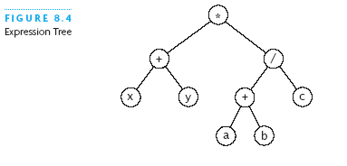
Expression Tree
Each node contains an operator or an operand.
Operands are stored in leaf nodes.
Parentheses are not stored in the tree because the tree structure dictates the order of operand evaluation.
Operators in nodes at higher tree levels are evaluated after operators in nodes at lower sub-tree levels.
(x + y) * ((a + b) / c)

Slide 16
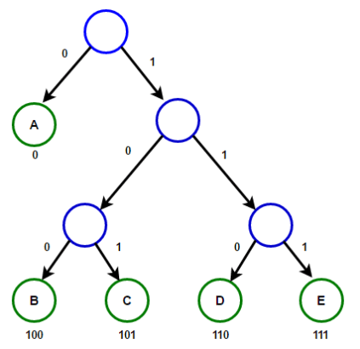
Huffman Tree
A Huffman tree represents Huffman codes for characters that might appear in a text file.
As opposed to ASCII or Unicode, Huffman code uses different numbers of bits to encode letters; more common characters use fewer bits.
Many programs that compress text files use Huffman codes.

Slide 17
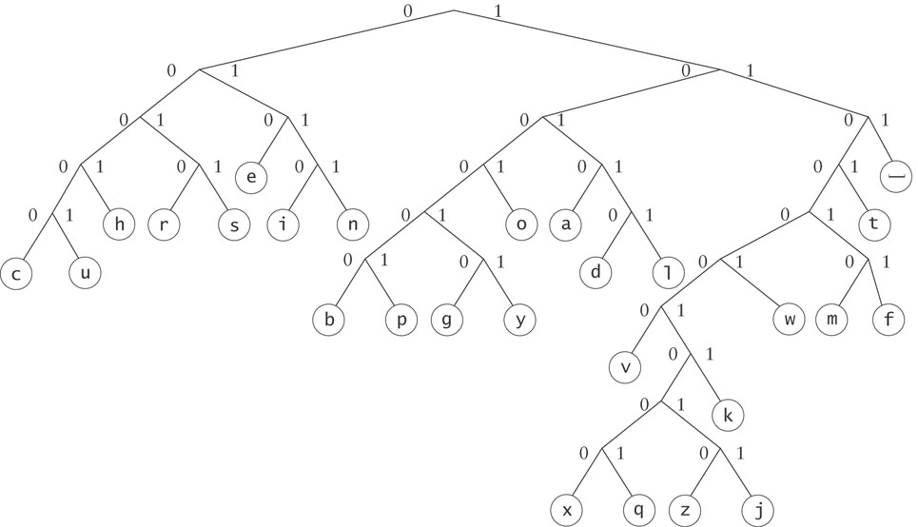
Huffman Tree
To form a code, traverse the tree from the root to the chosen character, appending 0 if you branch left, and 1 if you branch right.
Examples:
e : 010
d : 10110

Slide 18
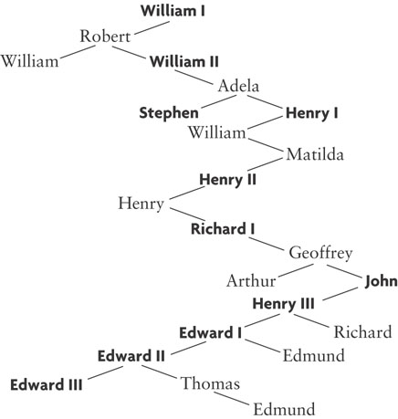
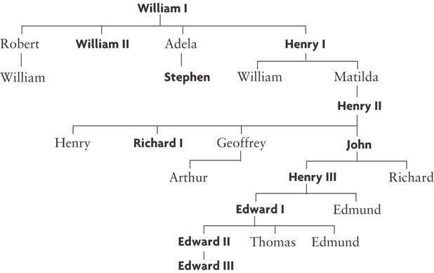
General Trees
In general, any tree can be represented using a binary tree.
Children
Siblings
Children
Siblings
Children
Siblings
Children
The left branch of a node is the oldest child, and each right branch is connected to the next younger sibling (if any).
Siblings
Children
Siblings
Siblings

Slide 19
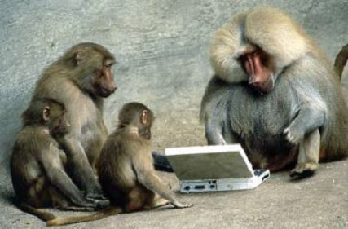
Be Safe

