Slide 1
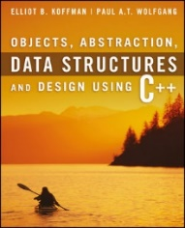
Welcome to
CS 235 Data Structures
Queues/Deques, 6.4-5 (20)

Slide 2
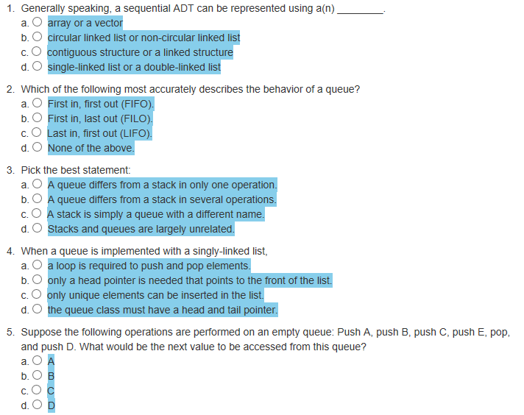
Attendance Quiz #19

Slide 3
Tip #20: KISS is Better!
What does the following code fragment do?
a ^= b;
b ^= a;
a ^= b;
You're right! Swaps a and b.
REALLY fast.
Generic.
No temp.
BUT, is it worth the obfuscation?
int temp = b;
b = a;
a = temp;
More often than not,...
Clarity is better than cleverness.
Readability is better than pretentious display of ability.

Slide 4
"Path of Least Resistance"
"The great learner expects resistance and overcomes it….
Some learning has been easy for you.
But more often your enemy has been discouragement.
You may try to avoid that by choosing to learn only what is easy for you, looking for the path of least resistance.
But the great learner expects difficulty as part of learning and is determined to work through it."
Henry B. Eyring, BYU Speeches, A Child of God;

Slide 5
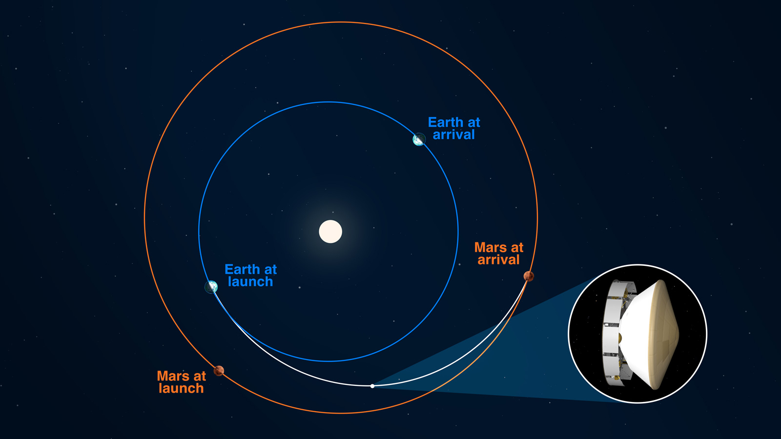
Perseverance Mars, February 18, 2021
18 February 2021
30 July 2021
“We’ve got 2 million lines of software code running. Hundreds of thousands of electronic parts, miles of copper conductors, more than 70 pyrotechnic devices that all have to fire,” said Matt Wallace, Jet Propulsion Laboratory’s Perseverance deputy project manager, in a news conference Wednesday. “All systems must operate with sub-second precision for all this to work,” he said. On Mars, Wallace noted, “there are no retries.”

Slide 6
C++ STL List
The original Standard Template Library (STL) had both:
Doubly-linked list<T, Alloc> and
Singly-linked slist<T, Alloc>.
When C++ adopted parts of STL into the C++ standard library in 1994, it only adopted list, and not slist.
From C++98 to C++11, slist was available in various non-standard extensions, like gcc’s __gnu_cxx::slist, sometimes with additional extensions, like in boost.
The proposal to add a singly-linked list to C++ was filed in 2007 (n2231) and made it in time for C++11.
As of 2011, the C++ standard library has both kinds of lists:
Doubly-linked std::list and
Singly-linked std::forward_list (renamed because everyone already had some sort of slist).

Slide 7
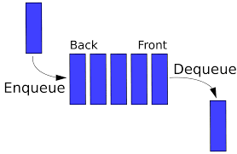
6.1 The Queue Abstract Data Type
A Queue of Customers
A Print Queue
The Unsuitability of a "Print Stack''
Specification of the Queue ADT
6.2 Maintaining a Queue of Customers
6.1, pgs. 358-362

Slide 8
Queue Abstract Data Type
The queue, like the stack, is a widely used data structure, but differs from a stack in one important way
a stack is LIFO list – Last-In, First-Out
while a queue is FIFO list – First-In, First-Out
Computing examples:
A web-site which serves files to thousands of users.
CPU jobs must be batched up and then scheduled.
In a breadth-first ("shallowest"-first) search of a graph.
Super computers for synchronizing parallel execution of threads.
The producer–consumer who share a common buffer as a queue.
Other real-world examples:
We wait in queues at check-out counters in grocery stores.
We wait in queues to enter movie theaters.
We wait in queues to drive on a turnpike.
We wait in queues to ride on a roller coaster.

Slide 9
Specification for a Queue Interface
Because only the front element of a queue is visible, the operations performed by a queue are few in number.
We need to be able to retrieve the front element, remove the front element, push a new element onto the queue, and test for an empty queue, all in constant time (Ο(1)).
The queuing functions are all defined in the header file for the STL container queue, <queue>.

Slide 10
Maintaining a Queue of Customers
#include <iostream>
#include <queue>
#include <string>
using namespace std;
const string choices[] =
{ "push", "front", "pop", "queue", "quit" };
enum { PUSH, FRONT, POP, QUEUE, QUIT, END };
int main()
{
queue<string> customers;
string name;
string option;
cout << "Welcome to the customer queue";
do
{
cout << endl << "Select option: ";
getline(cin, option);
switch (option[0] - '0')
{
// ------------------------------------------>>>>>>
case QUIT:
cout << "Leaving customer queue";
break;
}
} while (option[0] - '0' != QUIT);
return 0;
}
case PUSH:
cout << "Enter new customer name: ";
getline(cin, name);
customers.push(name);
break;
case FRONT:
if (customers.empty()) break;
cout << "Customer " << customers.front();
cout << " is next in line";
break;
case POP:
if (customers.empty()) break;
cout << "Customer " << customers.front();
cout << " removed from the line";
customers.pop();
break;
case QUEUE:
cout << "Customers (" << customers.size() << "):";
for (int i = 0; i < customers.size(); ++i)
{
cout << " " << customers.front();
customers.push(customers.front());
customers.pop();
}
break;
default:
cout << "Options:";
for (int i = 0; i < END; ++i)
cout << endl << " " << i << ": " << choices[i];
break;

Slide 11
Maintaining a Queue of Customers
#include <iostream>
#include <queue>
#include <string>
using namespace std;
const string choices[] =
{ "push", "front", "pop", "queue", "quit" };
enum { PUSH, FRONT, POP, QUEUE, QUIT, END };
int main()
{
queue<string> customers;
string name;
string option;
cout << "Welcome to the customer queue";
do
{
cout << endl << "Select option: ";
getline(cin, option);
switch (option[0] - '0')
{
// ------------------------------------------>>>>>>
case QUIT:
cout << "Leaving customer queue";
break;
}
} while (option[0] - '0' != QUIT);
return 0;
}
case PUSH:
cout << "Enter new customer name: ";
getline(cin, name);
customers.push(name);
break;
case FRONT:
if (customers.empty()) break;
cout << "Customer " << customers.front();
cout << " is next in line";
break;
case POP:
if (customers.empty()) break;
cout << "Customer " << customers.front();
cout << " removed from the line";
customers.pop();
break;
case QUEUE:
cout << "Customers (" << customers.size() << "):";
for (int i = 0; i < customers.size(); ++i)
{
cout << " " << customers.front();
customers.push(customers.front());
customers.pop();
}
break;
default:
cout << "Options:";
for (int i = 0; i < END; ++i)
cout << endl << " " << i << ": " << choices[i];
break;

Slide 12
Maintaining a Queue of Customers
#include <iostream>
#include <queue>
#include <string>
using namespace std;
const string choices[] = { "push", "front", "pop", "size", "quit" };
enum { PUSH, FRONT, POP, SIZE, QUIT };
const int num_choices = 5;
int main()
{
queue<string> customers;
string name;
int choice_num = 0;
do
{
cout << endl << "Options:" << endl;
for (int i = 0; i < num_choices; i++)
{
cout << " " << i << ": ";
cout << choices[i] << endl;
}
cout << "Select option: ";
cin >> choice_num;
←-------INSERT HERE--------
} while (choice_num != QUIT);
return 0;
}
switch (choice_num)
{
case PUSH:
cout << "Enter new customer name: ";
cin >> name;
customers.push(name);
break;
}
case FRONT:
cout << "Customer " << customers.front();
cout << " is next in line" << endl;
break;
case POP:
cout << "Customer " << customers.front();
cout << " removed from the line" << endl;
customers.pop();
break;
case SIZE:
cout << "Size of line is ";
cout << customers.size() << endl;
break;
case QUIT:
cout << "Leaving customer queue" << endl;
break;
default:
cout << "Invalid selection" << endl;
break;

Slide 13
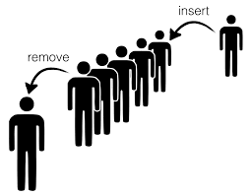
6.3 Implementing the Queue ADT
Using std::list as a Container for a Queue
Using a Single-Linked List to Implement the Queue ADT
Using a Circular Array for Storage in a Queue
Comparing the Three Implementations
Exercises for Section 6.3
6.3, pgs. 365-376

Slide 14
std::list as a Queue Container
The standard library defines the queue as a template class that contains any of the sequential containers (list or vector).
Like the stack class, the queue is said to be an adapter class because it adapts the functions available in another class to the interface that a client expects (by giving different names to functions with essentially the same operations).
Since the sequential container list provides the push_back and pop_front functions, it can be adapted to a queue.
For example, if a list is used as the container object,
queue::push would correspond to list::push_back. (Note: A singly-linked list requires a tail pointer in addition to the head.)
queue::front would correspond to list::front.
queue::pop would correspond to list::pop_front.
This is called “delegation”.

Slide 15
Using std::list as a Queue Container
#include <iostream>
#include <string>
#include <sstream>
#include <list>
using namespace std;
template<typename Item_Type>
class queue
{
private:
// Insert implementation-specific data fields
std::list<Item_Type> container;
public:
queue() {}
~queue() = default;
/** Pushes an item onto the back of the queue.
@param item The item to be inserted */
void push(const Item_Type& item) { return container.push_back(item); }
/** Returns a reference to the object at the front of the queue without removing it.
@return A reference to the object at the front of the queue */
Item_Type& front() { return container.front(); }
/** Returns a const reference to the object at the front of the queue without removing it.
@return A const reference to the object at the front of the queue */
const Item_Type& front() const { return container.front(); }
/** Removes the front item from the queue. */
void pop() { return container.pop_front(); }
/** Determines whether the queue is empty. */ /** Returns the number of items in the queue */
size_t size() const { return container.size(); }
bool empty() const { return container.empty(); }
friend ostream& operator<<(ostream& os, const queue<Item_Type>& q)
{
typename list<Item_Type>::const_iterator iter = q.container.cbegin();
while (iter != q.container.cend()) os << " " << *iter++;
return os;
}
}; // End class queue
The quque adapts the list container!
Every function is delegated!

Slide 16
Circular Array as a Queue Container
While the time efficiency of using a r double-linked list to implement a queue is “acceptable”, there are however some inefficiencies:
Storage space is increased when using a linked list due to references (links) stored in the nodes.
Pointer arithmetic used to add/delete from the list takes time.
A contiguous array implementation also is “acceptable” and it mitigates space and pointer inefficiencies, but:
While insertion at rear of array is constant time O(1), removal from the front is linear time O(n).
While removal from rear of array is constant time O(1), insertion at the front is linear time O(n).
How can we avoid these inefficiencies and still use an array to implement our queue?

Slide 17
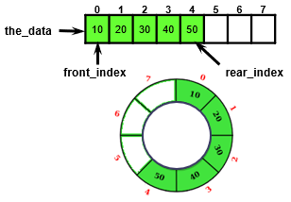
Circular Array ADT Queue Design
A Circular Array ADT Queue uses an object with four size_t type data members:
size_t capacity;
size_t num_items;
size_t front_index;
size_t rear_index;
And a pointer to the data member, the_data to point to a dynamically-allocated array
T* the_data;
And a default array allocation size
#define DEFAULT_CAPACITY 8

Slide 18
Queue<string>
capacity
num_items
front_index
rear_index
the_data
#define DEFAULT_CAPACITY 4
template<typename T>
class Queue
{
private:
size_t capacity;
size_t num_items;
size_t front_index;
size_t rear_index;
T* the_data;
4
0
0
3
front_index
0
1
2
3
Queue(void) :
capacity(DEFAULT_CAPACITY),
num_items(0),
front_index(0),
rear_index(DEFAULT_CAPACITY - 1),
the_data(new T[DEFAULT_CAPACITY]) {}
rear_index
circular array
(strings)

Slide 19
Queue<string>::push(const T& item)
push("Maybe")
capacity
num_items
front_index
rear_index
the_data
Maybe
4
0
1
void push(const T& item)
{
if (num_items == capacity)
{
reallocate();
}
num_items++;
rear_index = (rear_index + 1) % capacity;
the_data[rear_index] = item;
}
0
3
0
front_index
0
1
2
3
rear_index
circular array
(strings)

Slide 20
Queue<string>::push(const T& item)
push("Now")
capacity
num_items
front_index
rear_index
the_data
Now
4
1
2
void push(const T& item)
{
if (num_items == capacity)
{
reallocate();
}
num_items++;
rear_index = (rear_index + 1) % capacity;
the_data[rear_index] = item;
}
0
0
1
rear_index
0
1
2
3
front_index
Maybe
circular array
(strings)

Slide 21
Queue<string>::push(const T& item)
push("is")
capacity
num_items
front_index
rear_index
the_data
is
4
2
3
void push(const T& item)
{
if (num_items == capacity)
{
reallocate();
}
num_items++;
rear_index = (rear_index + 1) % capacity;
the_data[rear_index] = item;
}
0
1
2
front_index
0
1
2
3
Maybe
rear_index
Now
circular array
(strings)

Slide 22
Queue<string>::push(const T& item)
push("the")
capacity
num_items
front_index
rear_index
the_data
the
4
3
4
void push(const T& item)
{
if (num_items == capacity)
{
reallocate();
}
num_items++;
rear_index = (rear_index + 1) % capacity;
the_data[rear_index] = item;
}
0
2
3
front_index
0
1
2
3
Maybe
Now
rear_index
is
circular array
(strings)

Slide 23
Queue<string>::pop()
capacity
num_items
front_index
rear_index
the_data
pop()
4
4
3
void pop()
{
num_items--;
front_index = (front_index + 1) % capacity;
return;
}
0
1
3
front_index
0
1
2
3
Maybe
Now
is
rear_index
the
circular array
(strings)

Slide 24
Queue<string>::push(const T& item)
push("time")
capacity
num_items
front_index
rear_index
the_data
time
4
3
4
void push(const T& item)
{
if (num_items == capacity)
{
reallocate();
}
num_items++;
rear_index = (rear_index + 1) % capacity;
the_data[rear_index] = item;
}
1
3
0
0
1
2
3
Maybe
front_index
Now
is
rear_index
the
circular array
(strings)

Slide 25
reallocate
capacity
num_items
front_index
rear_index
the_data
push("for")
4
4
void push(const T& item)
{
if (num_items == capacity)
{
reallocate();
}
num_items++;
rear_index = (rear_index + 1) % capacity;
the_data[rear_index] = item;
}
1
0
rear_index
0
1
2
3
time
front_index
Now
is
the
circular array
(strings)

Slide 26
reallocate
capacity
num_items
front_index
rear_index
the_data
push("for")
4
4
new_capacity
old
i
new_data
8
void reallocate()
{
size_t new_capacity = 2 * capacity;
T* new_data = new T[new_capacity];
size_t old = front_index;
for (size_t i = 0; i < num_items; ++i)
{
new_data[i] = the_data[old];
old = (old + 1) % capacity;
}
front_index = 0;
rear_index = num_items – 1;
capacity = new_capacity;
swap(the_data, new_data);
delete[] new_data;
}
1
3
2
1
0
0
4
2
1
0
rear_index
0
1
2
3
0
1
2
3
4
5
6
7
time
Now
front_index
Now
is
is
the
the
time
circular array
(strings)

Slide 27
reallocate
capacity
num_items
front_index
rear_index
the_data
push("for")
4
8
4
new_capacity
old
i
new_data
8
void reallocate()
{
size_t new_capacity = 2 * capacity;
T* new_data = new T[new_capacity];
size_t old = front_index;
for (size_t i = 0; i < num_items; ++i)
{
new_data[i] = the_data[old];
old = (old + 1) % capacity;
}
front_index = 0;
rear_index = num_items – 1;
capacity = new_capacity;
swap(the_data, new_data);
delete[] new_data;
}
1
0
0
0
4
3
rear_index
0
1
2
3
0
1
2
3
4
5
6
7
time
Now
front_index
Now
is
is
the
the
time
circular array
(strings)

Slide 28
reallocate
capacity
num_items
front_index
rear_index
the_data
push("for")
8
4
new_capacity
old
i
new_data
8
void reallocate()
{
size_t new_capacity = 2 * capacity;
T* new_data = new T[new_capacity];
size_t old = front_index;
for (size_t i = 0; i < num_items; ++i)
{
new_data[i] = the_data[old];
old = (old + 1) % capacity;
}
front_index = 0;
rear_index = num_items – 1;
capacity = new_capacity;
swap(the_data, new_data);
delete[] new_data;
}
0
0
3
4
rear_index
0
1
2
3
0
1
2
3
4
5
6
7
time
Now
front_index
Now
is
is
the
the
time
circular array
(strings)

Slide 29
reallocate
capacity
num_items
front_index
rear_index
the_data
push("for")
8
4
new_capacity
old
i
new_data
8
void reallocate()
{
size_t new_capacity = 2 * capacity;
T* new_data = new T[new_capacity];
size_t old = front_index;
for (size_t i = 0; i < num_items; ++i)
{
new_data[i] = the_data[old];
old = (old + 1) % capacity;
}
front_index = 0;
rear_index = num_items – 1;
capacity = new_capacity;
swap(the_data, new_data);
delete[] new_data;
}
0
0
3
4
front_index
0
1
2
3
4
5
6
7
Now
0
time
is
1
Now
the
2
is
rear_index
time
3
the

Slide 30
Queue<string>::push(const T& item)
push("for")
capacity
num_items
front_index
rear_index
the_data
for
8
4
5
void push(const T& item)
{
if (num_items == capacity)
{
reallocate();
}
num_items++;
rear_index = (rear_index + 1) % capacity;
the_data[rear_index] = item;
}
0
3
4
front_index
0
1
2
3
4
5
6
7
Now
is
the
rear_index
time

Slide 31
Queue<string>::push(const T& item)
push("for")
capacity
num_items
front_index
rear_index
the_data
for
8
4
5
void push(const T& item)
{
if (num_items == capacity)
{
reallocate();
}
num_items++;
rear_index = (rear_index + 1) % capacity;
the_data[rear_index] = item;
}
0
3
4
front_index
0
1
2
3
4
5
6
7
Now
is
the
time
rear_index
for

Slide 32
Comparing Queue Implementations
All three implementations (list, vector, circular array) of the Queue ADT are O(1).
Although reallocating an array is an O(n) operation, it is amortized over n items, so the cost per item is O(1).
Linked-list implementations require more storage than arrays because of the extra space required for links.
C++ stores a copy of the data for a queue element in each node plus the links to the next/previous nodes.
a node in a double-linked list stores two pointers.
a node in a circular array stores just the data.
A circular array that is filled to capacity requires half the storage of a single linked list to store the same number of elements (assuming that the data type requires the same amount of storage as a pointer).
However, if the array were just reallocated, half the array would be empty, so it would require the same storage as a single-linked list.

Slide 33
Be Safe

