Slide 1
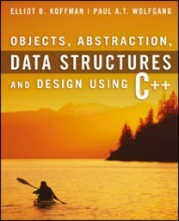
Welcome to
CS 235 Data Structures
Stacks, 5.2-3 (17)

Slide 2
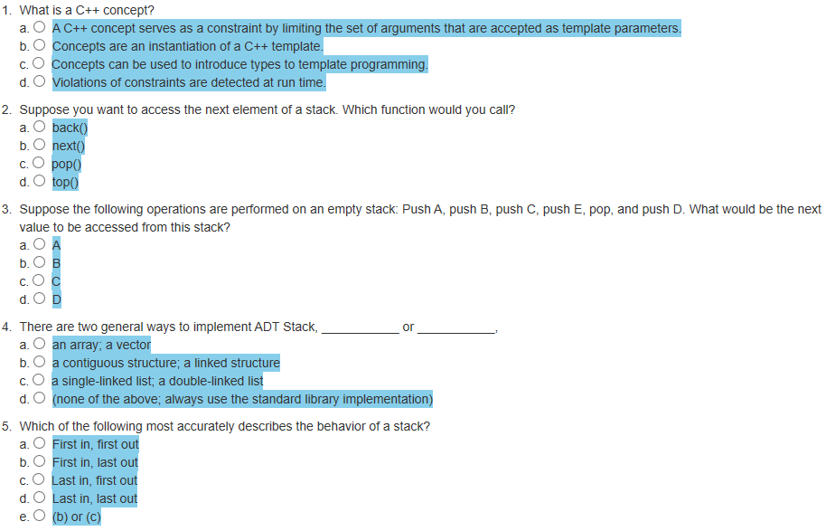
Attendance Quiz #16

Slide 3
Tip #17: Iterator end();
How does STL guarantee that end will always point to one past the last element in container?
The STL does not guarantee this behavior!
What's one past the last element in a set or a map?
The "end is one past the last element" thing is just a logical concept.
Exactly how this behavior is achieved depends on the implementation.
Don't take it too literally.
end() might be implemented as you intuitively expect or not!
What do we know about the STL iterators?
begin() returns an iterator referring to the first element in the container.
If the container is empty, then begin() == end().
end() returns an iterator which is the "past-the-end" value for the container and is NOT a member of the container.
List<int>::Iterator iter = myList.begin();
List<int>::Iterator end_iter = myList.end();
if (iter == end_iter) cout << " Empty";
for (; iter != end_iter; ++iter) cout << " " << *iter;

Slide 4
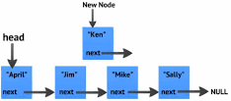
4.9 Standard Library Containers
Common Features of Containers
Sequences
Associative Containers
Vector Implementation Revisited
4.9, pgs. 292-295

Slide 5
Standard Library Containers
The C++ standard uses the term container to represent a class that can contain objects.
The term concept is used to represent the set of common requirements for a container:
C++ defines a common interface for all containers and then splits the set of containers into sequential containers and associative containers.
Common requirements unique to these subsets are also defined and the individual containers have their own additional requirements.
Although a list and a vector have several member functions in common, they are not polymorphically, but can be used interchangeably by generic algorithms.
In a sequential container, at any given time each element has a particular position relative to the other items in the container.
items in a sequence (ie., a vector or a list) follow some linear arrangement.
In an associative container, on the other hand, there is no particular position for each item in the container.
An item is accessed by its value, rather than by its position.

Slide 6
4.10 Standard Library Algorithms and Function Objects
The find Function
The Algorithm Library
The swap Function
Function Objects
4.10, pgs. 297-307

Slide 7
The Algorithm Library
The standard library contains many useful template functions defined in the header <algorithm>, that use a pair of iterators to define the sequence of input values.
Some of them also take function objects (known as functors) as parameters.
The template functions perform fairly standard operations on containers, such as
Applying the same function to each element (for_each)
Copying values from one container to another (copy)
Searching a container for a target value (find, find_if)
Sorting a container (sort)
Summing container values (accumulate)
Apply function to container objects (transform)
This fragment uses std::find with vector and iterator:
vector<int> myvector = { 10, 20, 30, 40, 50 };
vector<int>::iterator it;
it = find(myvector.begin(), myvector.end(), 30);
if (it != myvector.end()) cout << "Element found in myvector: " << *it << endl;
else cout << "Element not found in myvector" << endl;

Slide 8
Function | Behavior
template<typename II, typename F> F for_each(II first, II last, F fun) | Applies the function fun to each object in the sequence. The function fun is not supposed to modify its argument. The iterator argument II is required to be an input iterator. This means that the sequence is traversed only once.
template<typename FI> FI min_element(FI first, FI last) template<typename FI> FI max_element(FI first, FI last) | Finds the min/max element in the sequence FI; first..last. FI is a forward iterator.
template<typename II, typename OI> OI copy(II first, II last, OI result) | Copies the sequence first..last into result..(result + (last - first)). II is an input iterator, and OI is an output iterator.
template<typename T> void swap(T& a, T& b) | Exchanges the contents of a and b.
template<typename BI> void reverse(BI first, BI last) | Reverses the sequence first..last. BI is a bidirectional iterator.
template<typename RI> void random_shuffle(RI first, RI last) | Randomly rearranges the contents of first..last. RI is a random-access iterator.
template<typename II, typename T> T accumulate(II first, II last, T init) | Computes init plus the sum of the elements in first..last. Note that this function is defined in the header <numeric>.
template<typename II, typename T> II find(II first, II last, T target) | Finds the first occurrence of target in the sequence. If not found, last is returned.

Slide 9
Function | Behavior
template<typename II, typename P> II find_if(II first, II last, P pred) | Finds the first occurrence of an item in the sequence for which function pred returns true. If not found, last is returned.
template<typename II, typename OI, typename OP> OI transform(II first, II last, OI result, OP op) | Applies op to each element of the sequence first..last and places the result in result..(result + (last - first)).
template<typename II1, typename II2, typename OI, typename BOP> OI transform(II1 first1, II1 last1, II2 first2, OI result, BOP bin_op) | Applies bin_op to each pair of elements of the sequences first1..last1 and first2..(first2 + (last1 - first1)) and places the result in result..(result + (last1 - first1))
template<typename RI> void sort(RI first, RI last) | Sorts the contents of first..last based on the less-than operator applied to pairs of elements.
template<typename RI, typename COMP> void sort(RI first, RI last, COMP comp) | Sorts the contents of first..last based on the binary operator COMP (a function operator). COMP is a function class that takes two arguments and returns a bool.
template<typename II1, typename II2> bool equal(II1 first1, II1 last1, II2 first2) template<typename II1, typename II2, typename BP> bool equal(II1 first1, II1 last2, II2 first2, BP pred) | Compares each element in the sequence first1..last1 to the corresponding elements in the sequence first2..first2 + (last1 - first1). If they are all equal, then this returns true. The second form uses the function object pred to perform the comparison.

Slide 10
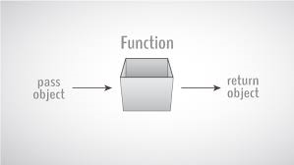
Function Objects

Slide 11
Function Objects (functors)
The function call operator (operator()) can be overloaded by a class.
A class that overloads this operator is called a function class and an object of such a class is called a function object (or functor.)
As an example, we may want to find a value divisible by another value. We can create a function class Divisible_By whose constructor takes the divisor as an argument:
Data field divisor stores the number we want to divide by
class Divisible_By
{
private:
int divisor;
public:
Divisible_By(int d) : divisor(d) {}
bool operator()(int x)
{
return x % divisor == 0;
}
};
Divisible_By divBy(3);
if (divBy(30))
cout << endl << "30 is divisible by 3";
else
cout << endl << "30 is NOT divisible by 3";
if (divBy(10))
cout << endl << "10 is divisible by 3";
else
cout << endl << "10 is NOT divisible by 3";
The definition of operator() tests the remainder resulting from the division of the function argument (int x) by the value of divisor
The expression Divisible_By(3) creates a function object that returns true if the argument passed to it is divisible by 3
The expression Divisible_By(5) creates a function object that tests for integers divisible by 5

Slide 12
Function Objects (functor)
template<typename II, typename P> II find_if(II first, II last, P pred) | Finds the first occurrence of an item in the sequence for which function pred returns true. If not found, last is returned.
Template parameters II (Input Iterator) are placeholders for container iterators; template parameter P is a placeholder for a function class object with an operator() that returns a bool value.
// Find all numbers divisible by 3 in myList.
list<int>::iterator iter = myList.begin();
while (1)
{
iter = find_if(iter, myList.end(), Divisible_By(3));
if (iter != myList.end())
{
cout << *iter++ << " is divisible by 3" << endl;
continue;
}
cout << "There are no more numbers divisible by 3" << endl;
break;
}

Slide 13
5.1 The Stack Abstract Data Type
Specification of the Stack Abstract Data Type
5.1, pgs. 312-315

Slide 14
Abstract Data Type
An Abstract Data Type (ADT) is
A mathematical model for a data type as seen from a users point of view.
In contrast to data structures, which are concrete representations of data, as seen from the implementers point of view, not the users.
ADT's support abstraction, encapsulation, and information hiding.
A user implementation of an ADT has:
private data hidden inside the class,
a collection of public operations to manipulate the data, and
additional private operations hidden inside the class.
Abstract Data Types are focused on what, not how (they’re framed declaratively, and do not specify algorithms or data structures).
ADTs provide a way for us to formally define reusable modules in a way that is mathematically sound, precise, and unambiguous.

Slide 15
Abstract Data Type
Examples of common built-in ADTs:
boolean
Values: true and false
Operations: and, or, not, nand, etc.
integer
Values: Whole numbers between MIN and MAX values
Operations: add, subtract, multiply, divide, etc.
Examples of common user-defined ADTs:
vector
Values: Vector elements (ie., vector of X's,…)
Operations: initialize, push_back, pop_back, at, erase, swap, size, etc.
list
Values: Vector elements (ie., vector of X's,…)
Operations: initialize, front, back, size, merge, sort, etc.
stack
Values: Stack elements (ie., stack of X's,…)
Operations: push, pop, top, empty size.

Slide 16
The Stack
Chapter 5 Objectives:
To learn about the stack data type and how to use its four functions: push, pop, top, and empty.
To understand how C++ implements a stack.
To learn how to implement a stack using an underlying array or linked list.
To see how to use a stack to perform various applications, including finding palindromes, testing for balanced (properly nested) parentheses, and evaluating arithmetic expressions.
Stacks are Specialized Lists
A client using a list can access any element, remove any element, and insert an element anywhere in the list.
A client using a stack can access (and remove) only the most recently inserted element and can insert an element only at the “top” of the stack.
Stacks are among the most commonly used data structures in computer science.

Slide 17
Stack Abstract Data Type
A stack can be compared to a Pez dispenser
Only the top item can be accessed
You can extract only one item at a time
The top element in the stack is the last added to the stack (most recently).
The stack’s storage policy is Last-In, First-Out, or LIFO.
Only the top element of a stack is visible; therefore the number of operations performed by a stack are few:

Slide 18
A Stack of Strings
stack<string> names;
names.push("Rich");
names.push("Debbie");
names.push("Robin");
names.push("Dustin");
names.push("Jonathan");
cout << names.empty();
string last = names.top();
names.pop();
names.push("Philip");

Slide 19
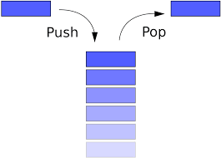
5.2 Stack Applications
5.3 Implementing a Stack
Chapter 5 – The Stack

Slide 20
5.2 Stack Applications
Case Study: Finding Palindromes
Case Study: Testing Expressions for Balanced Parentheses
5.2, pgs. 315-325

Slide 21
Finding Palindromes
Palindrome: a string that reads identically in either direction, letter by letter (ignoring case, spaces, and punctuation).
Bombard a drab mob
Anne, I vote more cars race Rome to Vienna.
Solution:
If we scan the input string from left to right and push each character in the input string onto a stack of characters, we can form the reverse of the string by popping the characters and joining them together in the order that they come off the stack.
For example:
The stack at left contains the string “llama mall“.
If we pop them off and join them together, we get "l" + "l" + "a" + "m" + "a" + "m" + "a" + "l" + "l", or the string "llama mall".
When the stack is empty, we can compare the string we formed with the original.
If they are the same, the original string is a palindrome.
l
l
a
m
a
m
a
l
l

Slide 22
Palindrome Functor
#include <string>
#include <stack>
using std::string;
class Palindrome
{
private:
string palindrome;
public:
Palindrome(const string& str)
: palindrome(str) {}
bool operator()()
{
stack<char> myStack;
string reverse;
for (int i = 0; i < palindrome.size(); ++i)
{
palindrome[i] = tolower(palindrome[i]);
myStack.push(palindrome[i]);
}
while (!myStack.empty())
{
reverse += myStack.top();
myStack.pop();
}
return reverse == palindrome;
}
};
#include <iostream>
#include "palindrome.h"
using namespace std;
int main()
{
string myString = "kayaka";
Palindrome myPalindrome(myString);
cout << "\"" << myString << "\" is ";
if (!myPalindrome()) cout << "not ";
cout << "a palindrome";
return 0;
}
Palindrome Functor
Push lower case palindrome characters onto stack.
Pop characters off stack and append in reverse order.
Compare strings.

Slide 23
Testing
Test the Palindrome_Finder class using the following inputs (equivalent classes):
A single character (always a palindrome)
Multiple characters in one word
Multiple words
Different cases
Even-length strings
Odd-length strings
An empty string (considered a palindrome)
Other Questions
Null string?
Phrase palindromes?
Punctuation?

Slide 24
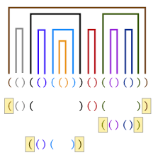
5.2 Stack Applications
Balanced Parentheses
5.2, pgs. 315-325

Slide 25
Balanced Expressions
When analyzing arithmetic expressions, it is important to determine if an expression is balanced with respect to grouping items with brackets (parentheses).
( ) parentheses or "round brackets".
[ ] "square brackets" or "box brackets".
{ } braces or "curly brackets".
The expression below is balanced:
(w * (x + y) / z – (p / (r - q)))
The problem is complicated if braces or brackets are used in conjunction with parentheses.
The expression below is not balanced:
(w * [x + y) / z – [p / {r – q}])
An expression is balanced if each subexpression starts with an open bracket symbol, ends with a close bracket symbol, and the bracket symbols are pairs.

Slide 26
Design
Algorithm for Function is_balanced
1. Create an empty stack of characters.
2. Assume that the expression is balanced (balanced is true).
3. Set index to 0.
4. while balanced is true and index < the expression’s length
5. Get the next character in the data string.
6. if the next character is an opening parenthesis
7. Push it onto the stack.
8. else if the next character is a closing parenthesis
9. Pop the top of the stack.
10. if stack was empty or top does not match the closing parenthesis
11. Set balanced to false.
12. Increment index.
13. Return true if balanced is true and the stack is empty.

Slide 27
Balanced Parentheses Example
Expression:
(w * [x + y] / z)
0
1
2
3
4
5
6
7
8
9
10
(
(
w
*
[
x
+
y
]
/
z
)
(
balanced : true
index : 0
bracket stack
(chars)

Slide 28
Balanced Parentheses Example
Expression:
(w * [x + y] / z)
0
1
2
3
4
5
6
7
8
9
10
(
(
w
*
[
x
+
y
]
/
z
)
(
balanced : true
index : 1
bracket stack
(chars)
2

Slide 29
Balanced Parentheses Example
Expression:
(w * [x + y] / z)
0
1
2
3
4
5
6
7
8
9
10
(
(
w
*
[
x
+
y
]
/
z
)
[
(
balanced : true
index : 3
bracket stack
(chars)

Slide 30
Balanced Parentheses Example
Expression:
(w * [x + y] / z)
0
1
2
3
4
5
6
7
8
9
10
(
(
w
*
[
x
+
y
]
/
z
)
[
]
[
(
Matches! Balanced still true
balanced : true
index : 4
bracket stack
(chars)
6
7
5

Slide 31
Balanced Parentheses Example
Expression:
(w * [x + y] / z)
0
1
2
3
4
5
6
7
8
9
10
(
(
w
*
[
x
+
y
]
/
z
)
(
)
(
Matches! Balanced still true
balanced : true
index : 8
bracket stack
(chars)
9
10

Slide 32
Balanced Parentheses Example
Expression:
(w * [x + y] / z)
⬅ Balanced Expression!
0
1
2
3
4
5
6
7
8
9
10
(
(
w
*
[
x
+
y
]
/
z
)
Balanced && isEmpty()!
balanced : true
index : 10
bracket stack
(chars)
11

Slide 33
Implementation
/** Program to check an expression for balanced parentheses. */
#include <iostream>
#include <string>
#include <stack>
using namespace std;
const string OPEN = "([{"; // set of opening parentheses
const string CLOSE = ")]}"; // corresponding closing parentheses.
/** Function to determine if open parentheses */
bool is_open(char ch)
{
return OPEN.find(ch) != string::npos;
}
/** Function to determine if closing parentheses */
bool is_close(char ch)
{
return CLOSE.find(ch) != string::npos;
}
npos is a static member constant value with the greatest possible value for an element of type size_t.

Slide 34
Implementation
bool is_balanced(const string& expression)
{
stack<char> s;
bool balanced = true;
string::const_iterator iter = expression.begin();
while (balanced && (iter != expression.end()))
{
++iter;
}
return balanced && s.empty();
}
Input: Reference to expression string
Output: true if balance, else false
char next_ch = *iter;
if (is_open(next_ch)) s.push(next_ch);
else
{
}
Use iterator to process expression
if (is_close(next_ch))
{
if (s.empty()) balanced = false;
else
{
char top_ch = s.top();
s.pop();
balanced = (OPEN.find(top_ch) == CLOSE.find(next_ch));
}
}
Push opening parenthesis' on stack
Compare top-of-stack open index with next_ch closing index.
if different, set balanced false.

Slide 35
Implementation
/** Main function to test is_balanced. */
int main()
{
string expression;
cout << endl << "Enter an expression: ";
while (getline(cin, expression))
{
if (expression == "") break;
cout << expression;
if (is_balanced(expression))
{
cout << " is balanced" << endl;
}
else
{
cout << " is not balanced" << endl;
}
cout << endl << "Enter another expression: ";
}
return 0;
}

Slide 36
Testing
Use equivalent classes to provide a variety of input expressions displaying the result true or false.
Try several levels of nested parentheses.
Try nested parentheses with corresponding parentheses not of the same type.
Try unbalanced parentheses.
Try no parentheses at all!
PITFALL:
If you attempt to pop an empty stack your program will probably halt and report a run-time error.
The nature of the error message will depend on the compiler and operating system.
It is possible that no error is reported at all. You can guard against this error by testing for a nonempty stack before calling top or pop.

Slide 37
[ ( 3 + 4 ) * [ { 3 - 2 } - ( 2 / 2 ) ] + 24 ] / 3
[
[
[
[
[
[
[
[
[
(
[
[
[
[
[
{
(
3 % { 7 - ( 2 / [ ( 5 – 81 ) ] } + 1 )
{
{
{
{
{
{
(
(
(
(
(
[
[
[
(

Slide 38
5.3 Implementing a Stack
Adapter Classes and the Delegation Pattern
Revisiting the Definition File stack.h
Implementing a Stack as a Linked Data Structure
Comparison of Stack Implementations
5.3, pgs. 325-331

Slide 39
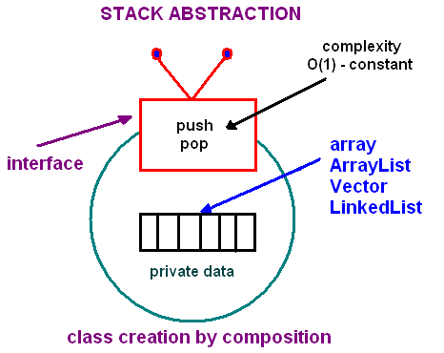
Adapter Classes and Delegation
In software engineering, the adapter pattern (also known as wrapper) allows an interface of an existing class (server or target) to be used by another interface (client.)
Make existing classes work with other classes without modifying their source code.
Publicly inherit the interface of the abstract class and privately inherit the implementation of the legacy component.
Client
Target
The adapter classes solve problems like:
How can a class be reused that does not have an interface that a client requires?
How can classes that have incompatible interfaces work together?
How can an alternative interface be provided for a class?

Slide 40
The Stack ADT
A stack is similar to a restricted list.
The standard library defines the stack as a template class that takes any of the sequential containers (vector, list, or deque).
Implementations use sequential containers:
A contiguous container (such as a vector),
A linked container (such as special-purpose single-linked list.)
Stack has-a container

Slide 41
Vector Stack
#ifndef MY_STACK_H_
#define MY_STACK_H_
#include <vector>
template <typename T>
class Stack
{
private:
std::vector<T> myStack;
public:
/** Construct an empty stack */
Stack() {}
/** Push item on stack */
void push(const T& item) { myStack.push_back(item); }
/** Return top of stack */
T& top() { return myStack.back(); }
/** Pop top of stack */
void pop() { myStack.pop_back(); }
/** Return TRUE if stack is empty */
bool empty() const { return myStack.size() == 0; }
/** Return number of stack entries */
size_t size() const { myStack.size(); }
};
#endif // MY_STACK_H_
Let's use a vector for our stack.
(stack has-a vector)
All sequential containers provide the functions empty, size, back (equivalent to stack::top), push_back (equivalent to stack::push) and pop_back (equivalent to stack::pop), so we could use any of these containers.
A stack is an adapter class because it adapts the functions available in another class to the interface its clients expect by giving different names to essentially the same operations.
The stack class uses the delegation pattern by making the functions in the underlying container class do its work.

Slide 42
Linked List Stack
We can also implement a stack using a linked list of nodes
push() inserts a node at the head of the list.
top_of_stack = new Node(item, top_of_stack);
top_of_stack->next references the old top of stack
top() returns top_of_stack->data.
pop() resets top_of_stack to the value stored in the next field of the list head and then deletes the old top of the stack (pointed to by old_top).
When the stack is empty, top_of_stack == NULL.

Slide 43
Linked List Stack
#ifndef MY_STACK_H_
#define MY_STACK_H_
#include <list>
template <typename T>
class Stack
{
private:
std::list<T> myStack;
public:
/** Construct an empty stack */
Stack() {}
/** Push item on stack */
void push(const T& item) { myStack.push_back(item); }
/** Return top of stack */
T& top() { return myStack.back(); }
/** Pop top of stack */
void pop() { myStack.pop_back(); }
/** Return TRUE if stack is empty */
bool empty() const { return myStack.empty(); }
/** Return number of stack entries */
size_t size() const { myStack.size(); }
};
#endif // MY_STACK_H_
list<Item_Type> for stack<Item_Type>
A stack is an adapter class for linked lists because it adapts the functions available in another class to the interface its clients expect by giving different names to essentially the same operations.

Slide 44
Comparing Stack Implementations
All stack operations using a sequential container (such as a vector, linked list, or deque) are O(1).
By delegating the operations to an underlying sequential container, we avoid having to implement these operations ourselves.
By using the functions push_back, pop_back, and back, we are assured of constant time (O(1)) performance.
Linked list implementation:
Will use exactly the needed storage for the stack (but additional storage needed for the links.)
Constructing a copy of the stacked item (or reference) is probably a wash.
Because all insertions and deletions are at one end, the flexibility provided by a double-linked data structure is under-utilized.
Vector implementation:
To achieve the amortized constant performance for push_back, the vector and deque allocate additional space.
Random access in stack is possible.

Slide 45
Stack Errors
Stack underflow.
Pop(), Top()
Stack overflow.
Push()
Stack error handling.
Try-catch throw correct errors
Testing Equivalence Classes
Test top, pop, push, empty for each:
Empty stack
Stack with one element
Stack with some elements, probably call pop/push twice or more often
Stack full
Push N distinct elements, pop N times and ensure the same elements are retrieved in reverse order

Slide 46
Be Safe

