Slide 1
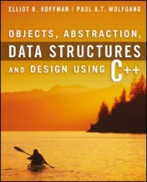
Welcome to
CS 235 Data Structures
Sequential Containers, 4.1-2 (11)

Slide 2
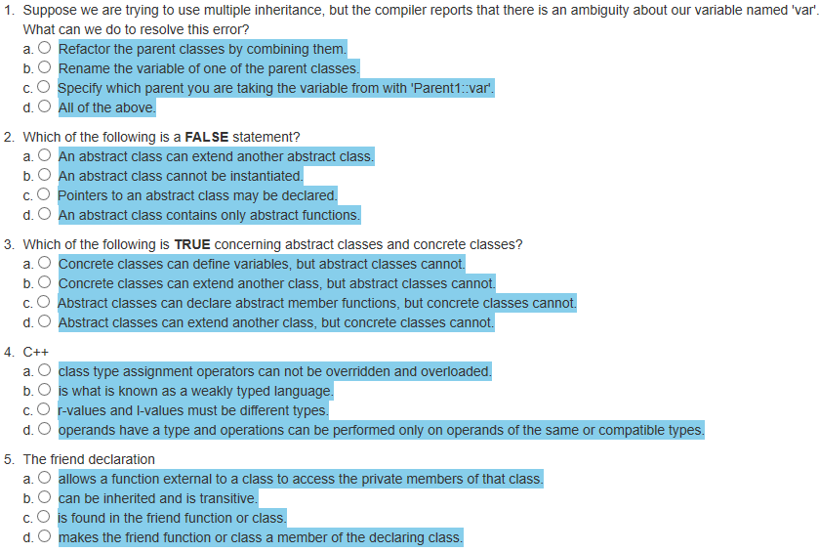
Attendance Quiz #10

Slide 3
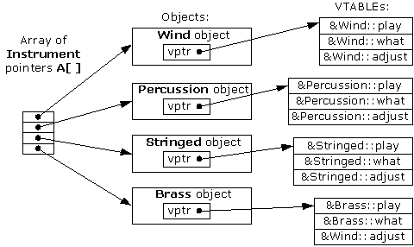
Tip #11: Virtual Functions
Polymorphism refers to being able to associate many meanings to one function name by means of a special mechanism known as virtual functions or late binding.
There are clear advantages to using virtual functions, so, why not make all member functions virtual?
The answer: There is overhead (execution and memory) to making a function virtual.
Virtual functions use more storage and make your program run slower than if functions were not virtual.
That is why the designers of C++ gave the programmer control over which member functions are virtual and which are not.
If you expect to need the advantages of a virtual member function, then by all means, make that member function virtual.
If you do not expect to need the advantages of a virtual function, then your program will run more efficiently if you do not make the member function virtual.
class Instrument
virtual void play() {}
class Wind : public Instrument
virtual void play() {}
class Percussion : public Instrument
virtual void play() {}
...
vector<Instrument*> instruments;
instruments.push_back(new Wind());
instruments.push_back(new Percussion());
for (size_t i; i < instruments.size(); ++i)
instruments[i]->play();

Slide 4
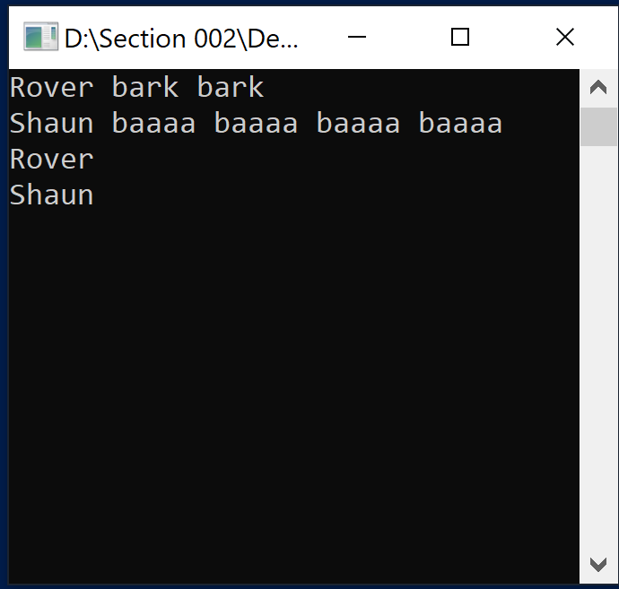
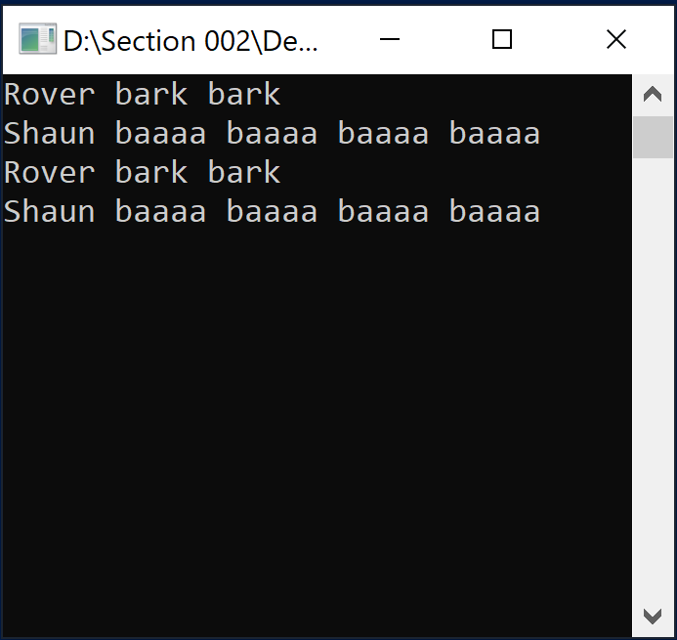
Follow up...
#include <iostream>
#include <sstream>
#include <vector>
using namespace std;
class Animal
{
private:
string name;
public:
Animal(string n) : name(n) {}
~Animal() = default;
string toString() const
{
ostringstream os;
os << name;
return os.str();
}
};
class Dog : public Animal
{
private:
int bark;
public:
Dog(string n, int b) : Animal(n), bark(b) {}
~Dog() = default;
string toString() const
{
ostringstream os;
os << Animal::toString();
for (int i = 0; i < bark; ++i) os << " bark";
return os.str();
}
};
class Sheep : public Animal
{
private:
int baaaa;
public:
Sheep(string n, int b) : Animal(n), baaaa(b) {}
~Sheep() = default;
string toString() const
{
ostringstream os;
os << Animal::toString();
for (int i = 0; i < baaaa; ++i)
os << " baaaa";
return os.str();
}
};
int main()
{
Dog rover("Rover", 2);
Sheep sheep("Shaun", 4);
cout << rover.toString() << endl;
cout << sheep.toString() << endl;
vector<Animal*> animal;
animal.push_back(&rover);
animal.push_back(&sheep);
for (size_t i = 0; i < animal.size(); ++i)
{
cout << animal[i]->toString() << endl;
}
return 0;
}
Here is the "Dog and Pony" code (I mean "Dog and Sheep"...)
There is a problem with the output. Can you figure it out?
virtual string toString() const

Slide 5
Chapter 4
11 - Sequential Containers

Slide 6
Chapter 4 Objectives
To become familiar with the Standard Template Library (STL) and template classes.
To understand how to use a vector class and how to implement it using an array for storage.
To understand the difference between a shallow copy and deep copy.
To introduce linked list and study the differences between single-, double-, and circular linked list data structures.
To introduce structs.
So far, we’ve considered one data structure — the array.
The C++ developers have provided more tools for programmers by providing a rich set of data structures written as C++ template classes.
In this chapter we discuss the STL classes called sequences.

Slide 7
Sequence Classes
A sequence has the property that objects of the same type are stored in a linear manner and can be inserted or removed anywhere in the sequence.
Some sequences are indexed, which means their elements can be accessed in arbitrary order (called random access) using a subscript to select an element.
For other sequences you must start at the beginning and process the elements in order and use Iterators to facilitate sequential access and random access.
The STL sequence containers are:
array - represents a static contiguous array.
vector - represents a dynamic contiguous array.
forward_list - represents a singly-linked list.
list - represents a doubly-linked list.
deque - represents a double-ended queue.

Slide 8
4.1 Template Classes and the Vector
Vector
Specification of the vector Class
Function at and the Subscripting Operator
4.1, pgs. 232-236

Slide 9
Template Classes
A C++ template is literally a template or blueprint for creating a generic class or function of a specified type.
A template is not a class.
Using C++ templates avoids having to write nearly identical classes (int, float, etc.), but results in compiled code that is mostly as if we had written each version separately.
A C++ template uses "Instantiation-style polymorphism".
For example, the template MyClass<T> isn't really a generic class that can be compiled to code.
Only the result of instantiation of the template can be compiled.
As an example, the string class is an instantiation of the basic_string class template with a char type.
Strings are objects that represent sequences of characters.
basic_string supports all the operations of a sequence container.
typedef basic_string<char> string;

Slide 10
C++ Templates
Templates allow functions and classes to be instantiated for generic types.
Templates allow a function or class to work on many different data types without being rewritten for each one.
template <typename T1, typename T2>
class MyPair
{
private:
T1 first;
T2 second;
public:
MyPair(T1 f, T2 s) : first(f), second(s) { }
T1 getFirst() { return first; }
T2 getSecond() { return second; }
};
MyPair<string, int> myDog("Dog", 36);
MyPair<double, double> myFloats(3.0, 2.18);

Slide 11
The Vector
A vector is a template class based on a dynamic array which means you can select its elements in arbitrary order as determined by the subscript value.
In addition, a vector supports the following operations that an array does not:
Increase or decrease its length.
Insert an element at a specified position without writing code to shift the other elements to make room.
Remove an element at a specified position without writing code to shift the other elements to fill in the resulting gap.
Vectors are used most often when a programmer wants to add new elements to the end of a list but still needs the capability to access, in arbitrary order, the elements stored in the list.

Slide 12
Vector Size
The size of a vector automatically increases as new elements are added to it, and the size decreases as elements are removed.
If an insertion is not at the end of the vector, the existing entries in the vector are shifted automatically to make room for the entry being inserted.
Similarly, if an element other than the last one is removed, the other entries are shifted automatically to close up the space that was vacated.
The number of elements a vector currently contains is returned by the member function size.
Each vector object also has a capacity, which is the number of elements it can store.
When a vector’s size is equal to its capacity, the capacity is increased automatically.

Slide 13
A Vector Class Object
template<typename T>
class Vector
{
private:
// Data fields
/** The initial capacity of the array */
static const size_t INITIAL_CAPACITY = 10;
/** The current capacity of the array */
size_t current_capacity;
/** The current num_items of the array */
size_t num_items;
/** The array to contain the data */
T* the_data;
public:
// Member Functions
...
};
We will implement a simplified version of the vector template class.
static means shared by all instances of Vector. const tells the compiler that no one can modify INITIAL_CAPACITY.
The physical size of the dynamic array (type size_t is an unsigned int) .
The number of data items stored is indicated by the data field num_items
The vector data is stored in a dynamic array of type T.

Slide 14
String Vector
vector<string> my_vector;
my_vector.push_back("Bashful");
my_vector.push_back("Awful");
my_vector.push_back("Jumpy");
my_vector.push_back("Happy");
my_vector.insert(2, "Doc");
my_vector.push_back("Dopey");
my_vector.erase(1);
my_vector[2] = "Sneezy";

Slide 15
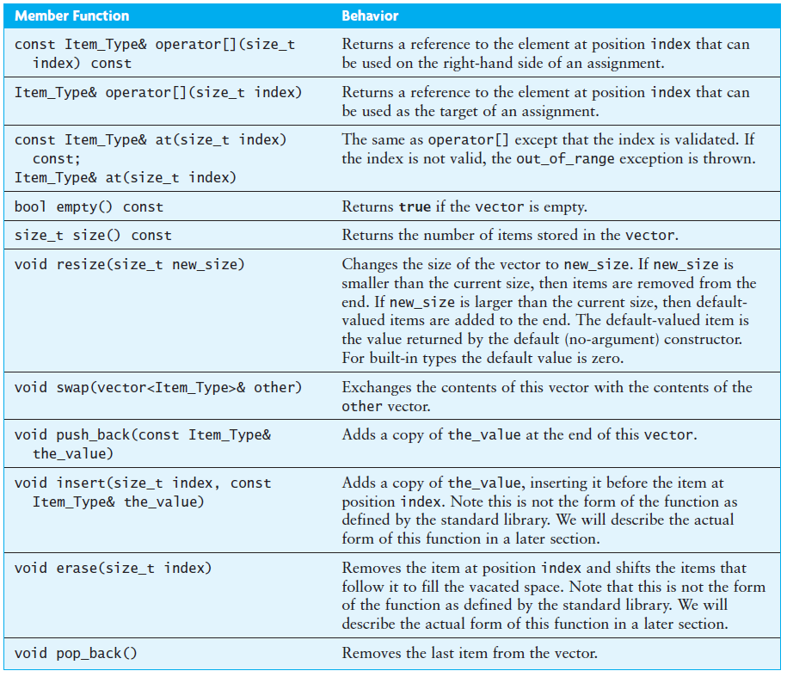
Specification of the vector Class
Because Item_Type is determined when the vector is created, the actual argument and return types for these functions may be different for different instantiations of the vector class.
Two entries for operator[] and member function at().
const values can’t be changed.
Function at validates the index.
The size_t type is an unsigned int; we use it here because all vector indexes must be nonnegative

Slide 16
Function at and Subscript Operator
The non-const operators reference an element of the vector whose value can be changed.
The const subscripting operator (“[ ]”) also returns a reference to element of the vector but the value cannot be changed.
Both of the following statements retrieve and display the value of element 2 of vector<int> v
cout << v[2];
cout << v.at(2);
Both of the following statements add 6 to the value of element 2 of vector v and assign that sum to element 3 of vector v
v[3] = v[2] + 6;
v.at(3) = v.at(2) + 6;
In these statements, the reference to element 2 retrieves a value of vector v that is not changed
In contrast, both references to element 3 change its value.
The function at validates the index (throws an exception on out-of-bounds).

Slide 17
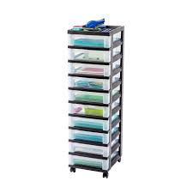
4.2 Applications of Vectors
4.2, pgs. 238-240

Slide 18
Vectors vs. Static Arrays
Vectors can grow, static arrays cannot.
If you use a vector to store enemies in a game, then the vector will grow as the number of enemies increase.
If you use a static array, then it must be large enough to contain the maximum possible number of enemies.
And that memory will be “used up” for the entire duration of the game.
Std::vectors work with STL algorithms which may save some time in coding certain effects.
Vectors pre-allocates space for future elements, so extra space required beyond what's necessary for the elements themselves is allocated.
Vector iterators are invalidated if you add or remove elements to or from the vector.

Slide 19
Traversing STL Vectors w/Iterators
Typically, iterators are used to access elements of a container in linear fashion.
int sum = 0;
vector<int> vec = { 1, 2, 3, 4, 5 };
using Iter = std::vector<int>::const_iterator;
for (Iter iter = vec.begin(); iter != vec.end(); ++iter)
{
sum += *iter;
}
Vector iterators are used with standard algorithms.
#include <numeric>
vector<int> vec = { 1, 2, 3, 4, 5 };
int sum = std::accumulate(vec.begin(), vec.end(), 0)
The advantage of using iterator is that you can apply the same pattern with other containers.

Slide 20
Be Safe

