Slide 1
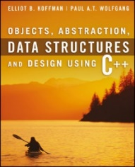
Welcome to
CS 235 Data Structures
Program Correctness, 2.1-3 (07)

Slide 2
Attendance Quiz #6

Slide 3
Tip #07: The Rule of Seven
There is a rule of nature commonly known as the 'Rule of Seven'.
The number of information chunks that short-term memory can comfortably handle.
Grouping situations where control is optimized around the seven mark.
Grouping of leaves on plants,
Number of digits in a phone number,
Seven churches, seven angles, seven seals, seven deadly sins...
A simple application of the rule of seven in programming is
Functions with up to seven chunks of code, each containing seven statements.
Results a reasonable function size of around 49 lines.
The actual grouping count in many situations is actually rather inexact, and an extension to this rule is 'seven, plus or minus two'.
Thus, if the size of a group is steadily increasing, when it gets to ten it can be broken into two independent groups of five, each of which now fits back into the bottom end of the five to nine range.
Applying this rule of seven extension to the reasonable function size example gives a function size range of between 25 and 100 lines.

Slide 4
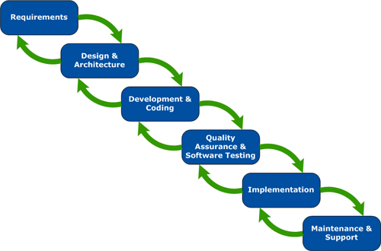
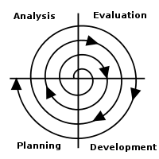
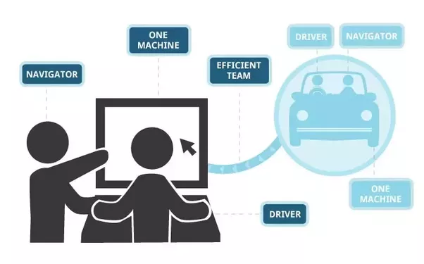
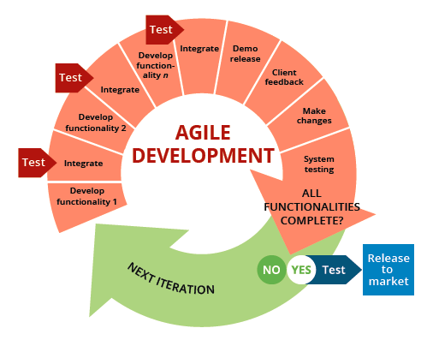
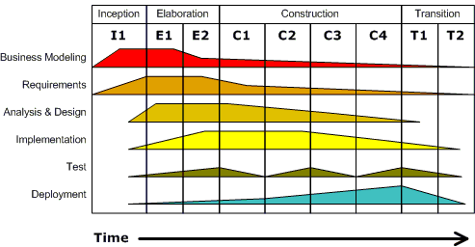
Software Development
Waterfall
Spiral
Extreme
Agile
Unified or Core Flow Model

Slide 5
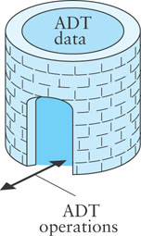
ADTs
An Abstract Data Type (ADT) is a mathematical model for data types.
A C++ class provides one way to implement an ADT.
A user interacts with an ADT thru the class public methods.
An ADT encapsulates data and methods and is a contract between the designer of the class, the implementor of the class, and the programmer who uses the class.
Any programmer who develops or uses an ADT class knows exactly what methods are available in that class and what operations they will perform.
Pre- and post- conditions are part of the contract between a call to a class method and the results of the method call.
A pre-condition is a statement of any assumptions or constraints on the method's input data that are expected to apply before the method is executed.
If a pre-condition is not met, there is no guarantee that the method will do what is expected.
A post-condition is a statement that describes the results after the method completes and returns.
When implementing an ADT, we document the pre-conditions and post-conditions in the documentation comments.

Slide 6
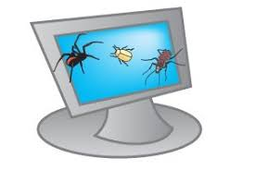
2.1 Program Defects and "Bugs''
Syntax Errors
Run-time Errors
Logic Errors
2.1, pgs. 130-137

Slide 7
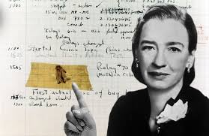
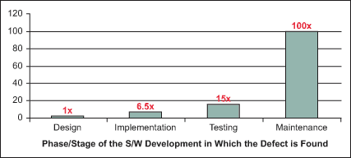
Program Defects and "Bugs"
The term "bug" refers to a software defect.
Debugging is a commonly used term for removing defects.
Easier to eliminate defects by careful design than through testing.
Testing is used to show that a program is correct, but
it is difficult to determine how much testing needs to be done.
testing can never demonstrate the complete absence of defects.
complete testing in some environments (missile control software, nuclear power plant controls) is very difficult.
You may encounter three kinds of defects or errors:
Syntax errors,
Run-time errors or exceptions,
Logic errors.

Slide 8
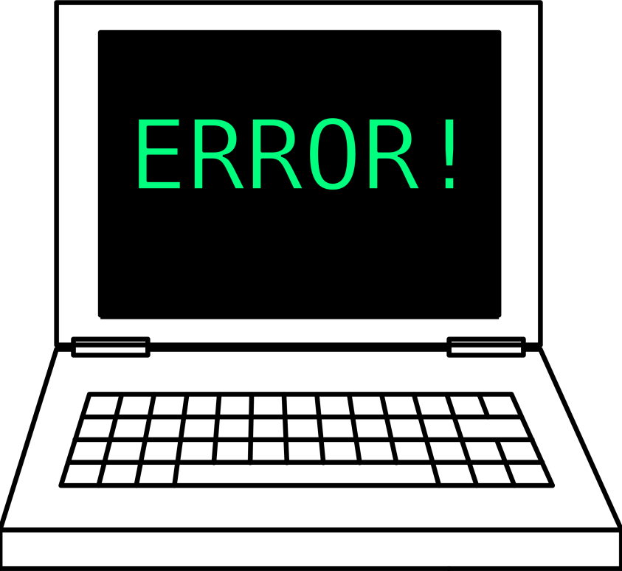
Syntax Errors
Syntax errors are mistakes in using the grammar (syntax) of the C++ language.
The C++ compiler will detect most syntax errors during compilation.
Some common syntax errors:
Omitting or misplacing braces that bracket compound statements.
Invoking a member function that is not defined for the object to which it is applied.
Not declaring a variable before using it.
Providing multiple declarations of a variable.
Not assigning a value to a local variable before referencing it.
Not returning a value from a function whose result type is not void.
Unfortunately, the compiler may not detect syntax errors that are the result of typographical errors, such as using = when you intended to use ==.

Slide 9
Run-time Errors
Run-time errors occur during program execution when the computer or the C++ run-time library detects an operation that it knows to be incorrect.
Most run-time errors cause the operating system or run-time library to issue an error message and halt the program.
Different computers, operating systems, and compilers handle these errors differently.
Some common run-time errors include:

Slide 10
Logic Errors
A logic error occurs when the programmer or analyst
makes a mistake in the design of a class.
makes a mistake in the design of a class function.
has implemented an algorithm incorrectly.
uses an incorrect algorithm.
The C++ code will compile and run, but will not meet the specifications—it will produce incorrect results.
Most logic errors do not cause syntax or run-time errors and, consequently, are difficult to find.
Test cases can help find logic errors.
Test cases allow the programmer to compare actual program output with the expected results.
Software professionals must be diligent in detecting and correcting logic errors.

Slide 11
2.2 Exceptions
Ways to Indicate an Error
The throw Statement
Uncaught Exceptions
Catching and Handling Exceptions with try and catch Blocks
Standard Exceptions
The Exception Class Hierarchy
Catching All Exceptions
2.2, pgs. 138-147

Slide 12
To Error is Human
What to do with an error:
Return a special value.
Use a bool return value to indicate success or failure.
Set a global variable.
Print an error message.
Print an error message and exit the program.
Put an input or output stream in a fail state.
The first three options allow the user of a function to respond to the error.
To err is human…
But to really screw up,
you need a computer!

Slide 13
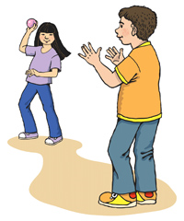
Exceptions
An alternate way to indicate an error, especially if there are several possible errors, is through the use of exceptions.
Exceptions are used to signal that an error has occurred during the execution of a program.
You can insert code in your program that throws an exception when a particular kind of error occurs.
When an exception is thrown, the normal flow of execution is interrupted and control transfers to another part of the program.
An exception handler allows the user to catch or handle the exception.

Slide 14
Exception Handling
The exception object can be of any type.
The standard library includes standard exception classes.
User defined exceptions can be of any data type.
If an exception is thrown and not caught, then the program aborts and an error message is displayed.
To avoid uncaught exceptions, enclose the code segment within a try block followed by catch block(s) that catch and handle thrown exceptions.
Code within a try block is referred to as protected code.
More than one catch block can follow a try block.
Each catch block handles a different kind of exception.
They are checked in the order in which they appear.
Check specific exception before more general exceptions.

Slide 15
try-catch Blocks
What could go wrong?
-35
20xx
What could go wrong?
What could go wrong?
-35
try
{
}
What could go wrong?
-35
20xx
<cr>
age = read_int("Enter your age: ");
catch (std::ios_base::failure& f)
{
cerr << endl << "Invalid number format input";
age = DEFAULT_AGE;
}
A failure object could be thrown if an invalid number is entered.
catch (std::exception& ex)
{
cerr << endl << "Fatal error: " << ex.what();
abort();
}
If all statements in the try block execute without error, the exception handler (the catch block) is skipped.
catch (...)
{
cerr << endl << "Undefined exception in read_int";
abort();
}

Slide 16
When To Use try-catch Blocks
When an error event happens routinely and could be considered part of normal execution, handle without throwing exceptions.
Use try-catch blocks
Around code that can potentially (and unexpectedly) generate an exception.
Prevent and recover from application crashes.
Throw an exception when your program can identify an external problem that prevents execution.
Compared to error reporting via return-codes and if statements, using try / catch / throw is likely to result in code
that has fewer bugs,
is less expensive to develop,
and has faster time-to-market.
Constructors and Destructors
DO: Constructors don't have a return type, so it's not possible to use return codes, therefore throw an exception.
DON'T: Destructors should never throw an exception because of stack unwinding.

Slide 17
2.3 Testing Programs
Structured Walkthroughs
Levels and Types of Testing
Preparations for Testing
Testing Tips for Program Systems
Developing the Test Data
Testing Boundary Conditions
Who Does the Testing?
Stubs
Drivers
Testing a Class
Using a Test Framework
Regression Testing
Integration Testing
2.3, pgs. 148-159

Slide 18
Testing Programs
Even after all syntax and run-time errors are removed and a program executes through to normal completion, there is a possibly that undetected logic errors exist.
The "best" kind of logic error is one that occurs in an area of the program that always runs.
The "worst" kind of logic error is in an obscure part of the code that is executed infrequently.
Testing Techniques:
Structured walkthroughs.
Testing at various levels.
Blackbox / whitebox testing.
Test boundary conditions.
Regression testing.

Slide 19
Regression Testing
Regression testing is re-running functional and non-functional tests to ensure that previously developed and tested software still performs after a change.
Bug fixes
Software enhancements
Configuration changes
Electronic component changes.
As software is updated or changed, or reused on a modified target, emergence of old/new faults is quite common.
A fix gets lost through poor revision control practices.
A fix for a problem will be "fragile" - narrow vs. general case.
A fix in one area inadvertently causes a software bug in another area.
Some feature redesign makes the same mistakes that were made in the original implementation of the feature.
It is considered good coding practice, when a bug is located and fixed, to record a test that exposes the bug and re-run that test regularly after subsequent changes to the program.

Slide 20
Tips for Testing Classes
If the function implements an interface, the interface specification should document the input parameters and the expected results.
Document each function parameter and class attribute carefully, using comments as you write the code.
Leave a trace of execution by displaying the function name as you enter it.
Display the values of all input parameters upon entry to a function. Also display the values of any class attributes that are accessed by this function; check that these values make sense.
Display the values of all function outputs after returning from a function.
By hand computation, verify that these values are correct.

Slide 21
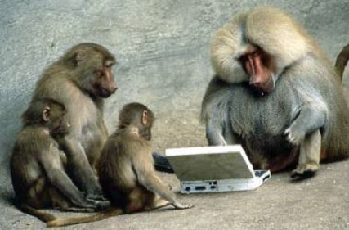
Be Safe

