Slide 1
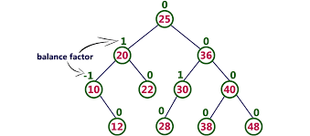
Lab 11 - AVL
Lab 11: AVL Trees

Slide 2
AVL Trees
In 1962 G.M. Adel'son-Vel'skiî and E.M. Landis developed a self-balancing tree, known by their initials: AVL.
The AVL tree algorithm keeps track of the difference in height of each subtree.
An AVL tree is balanced when the heights of all right and left subtrees are equal (or nearly equal.)
As items are added to (or removed from) a tree, the balance of each subtree from the insertion (or removal) point up to the root is updated.
BalanceFactor = height(right subtree) – height(left subtree)
The absolute difference between the left subtree and right subtree is never greater than 1.
If the balance gets out of the range -1 to +1, the subtree is rotated to bring it back into range.

Slide 3
AVL Trees
A node's "heaviness" is derived from its balance factor.
A subtree is right-heavy if the balance factor is greater than zero.
If the balance factor is less than zero then the subtree is left-heavy.
If the balance factor is zero then the subtree is perfectly in balance.
If a node's balance factor gets out of the range -1 to +1, the subtree is rotated according to its balance factor to bring it back into range.
Left-Left (parent balance is -2, left child balance is -1)
Rotate right around parent
Left-Right (parent balance -2, left child balance +1)
Rotate left around child
Rotate right around parent
Right-Right (parent balance +2, right child balance +1)
Rotate left around parent
Right-Left (parent balance +2, right child balance -1)
Rotate right around child
Rotate left around parent

Slide 4
Lab Guidelines
There are multiple correct methods for rebalancing nodes in an AVL tree. (Each method may result in a different AVL tree.)
You should follow the algorithms presented in the course text, starting on page 634.
For example, when a Node is left-imbalanced and its left child is balanced, treating it as a Left-Right case will produce a "balanced" tree, but it would be different from the expected output. You should treat this as a Left-Left case.
When removing a node with two children, replace it with its in-order-predecessor, or "greatest left child."
You should remove nodes from the AVL tree in the same manner used in the BST lab.
Remember to disallow duplicate entries and handle the case where the element to be removed is not in the tree.
You are required to make your AVL a template class.
You may not use any Standard Library data structures.

Slide 5
AVL Commands
COMMAND | DESCRIPTION | OUTPUT
INT | Instantiates AVL object for subsequent commands. | True
STRING | Instantiates AVL object for subsequent commands. | True
add <data> | Add data node to AVL. Return false if duplicate. | True False
remove <data> | Remove node from AVL. Return false if not found. | True False
clear | Delete all nodes from the AVL. | True
print | Print AVL (using insertion operator) in level-order. | Level-order listing of AVL.
size | Output the number of nodes in the AVL. | Number of AVL nodes
find <data> | Find and display node in AVL. Return "Found" or "Not Found". | Found Not Found!

Slide 6
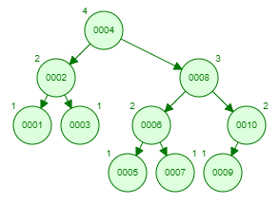
Example
INT true
add 1 true
add 2 true
add 3 true
add 1 false
print:
1: 2
2: 1 3
add 4 true
add 5 true
add 6 true
add 10 true
print:
1: 4
2: 2 6
3: 1 3 5 10
add 8 true
add 7 true
add 9 true
print:
1: 4
2: 2 8
3: 1 3 6 10
4: 5 7 9 _
INT
add 1
add 2
add 3
add 1
print
add 4
add 5
add 6
add 10
print
add 8
add 7
add 9
print

