Slide 1
Lab 08 - BST

Slide 2
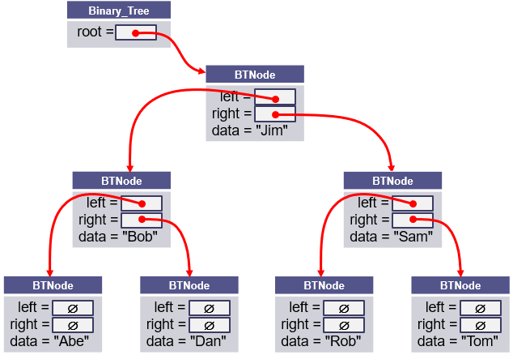
L08 – Binary Search Tree
A binary search tree (BST), which may sometimes be called an ordered or sorted binary tree, is a node-based data structure where each node references a value, a left child, and a right child.
In a Binary Search Tree, the left subtree of a node contains only nodes with values less than the node's value, the right subtree of a node contains only nodes with values greater than the node's value, there are no duplicate nodes, and both left and right subtrees of a node must also be binary search trees.

Slide 3
Traversal
pre_order_traversal(node)
if node is NULL return
visit node
pre_order_traversal(node.left)
return pre_order_traversal(node.right)
Full tree
internal nodes w/2 children
Complete tree
unfilled nodes right on row h
Predecessor
left, right-most node
Successor
right, left-most node
in_order_traversal(node)
if node is NULL return
in_order_traversal(node.left)
visit node
return in_order_traversal(node.right)
8
4
12
post_order_traversal(node)
if node is NULL return
post_order_traversal(node.left)
post_order_traversal(node.right)
visit node
return
2
6
10
14
1
3
5
7
9
11
13
15

Slide 4
Search, Insert, Delete
bool search(node, value)
if node is NULL
return false
if node.value == value
return true
if value < node.value
return search(node.left, value)
if value > node.value
return search(node.right, value)
bool insert(Node*& node, const T& data)
if node is NULL
node = new Node(data)
return true
if data == node->data
return false
if data < node->data
return insert(node->left, data);
if data > node->data
return insert(node->right, data);
bool delete(Node*& node, const T& data)
if node is NULL, return false
if data < node->data, return delete(node->left, data)
if data > node->data, return delete(node->right, data)
if node has no children, parent = NULL, return true
if node has 1 child, parent = node->(left or right), return true
exchange node->data with in_order_predecessor->data
return delete(node->left, data)

Slide 5
BST Commands
COMMAND | DESCRIPTION | OUTPUT
INT | Instantiates a BST object for subsequent commands. | OK, Error
STRING | Instantiates a BST object for subsequent commands. | OK, Error
add <data> | Add data node to BST. Return false if duplicate. | OK, Error
remove <data> | Remove node from BST. Return false if not found. | OK, Error
clear | Delete all nodes from the BST. | OK
print | Print BST (using insertion operator) in level-order. | Level-order list, empty
copy | Make deep copy of BST. | OK
printcopy | Print BST (using insertion operator) in level-order. | Level-order list, empty
size | Output the number of nodes in the BST. | Number of BST nodes
find <data> | Find and display node in BST. | found, not found
tree (Bonus) | Output the contents of the BST using begin() and end() iterators in in-order. | In-order listing of BST.

Slide 6
Level-Order Traversal
/** Output nodes at a given level */
bool outLevel(Node<T>* root, int level, stringstream& out) const
{
if (root == NULL) return false;
if (level == 0)
{
out << " " << root->data;
if ((root->left != NULL) || (root->right != NULL)) return true;
return false;
}
if ((level == 1) && !root->left_ && root->right_) out << " _";
bool left = outLevel(root->left, level - 1, out);
bool right = outLevel(root->right, level - 1, out);
if ((level == 1) && root->left_ && !root->right_) out << " _";
return left || right;
} // end outLevel()
int level = -1;
do
{
out << endl << " " << ++level << ":";
} while (outLevel(root, level, out));
Add 2 True
Add 3 True
Add 4 True
PrintBST
0: 2
1: _ 3
2: _ 4

Slide 7
BST Grading Criteria
Points | Requirement (50 + 10)
15 | BST commands "INT" and "STRING" set the BST template type mode to int and string respectively. BST command "add" adds an int or string element to the BST. (Attempt to add a duplicate node outputs False.) BST command "print" outputs the BST in level order. (If the BST is empty, output "Empty".) (lab08_in_01.txt)
5 | BST commands "size" and "clear" are correctly implemented for types int and string. (lab08_in_02.txt)
10 | Nodes are correctly removed from the BST using the "remove" command. (Attempt to remove a non-existent node outputs False.) (lab08_in_03.txt)
10 | The BST "find" command outputs "Found" if the value is in the BST and "Not Found" if the node is not found. (lab08_in_04.txt)
10 | The BST "copy" command makes a deep copy of the current BST. BST command "printcopy" outputs the deep BST copy in level order. (lab08_in_05.txt)
-10 | Memory leaks, array out-of-bounds, or use of STL container detected.
10 | BONUS: The "tree" command displays the tree in in-order using BST iterators. (If the BST is empty, output "Empty".) (lab07_in_06.txt)
2 | A BST class is derived from the abstract BSTInterface interface class.
2 | All classes have public toString and friend insertion member functions
2 | BONUS: The bonus "tree" command is implemented using an iterator implemented as a BST inner class with ++, *, and != operators. The BST class has public begin() and end() functions that return instantiated iterators.

Slide 8
BST Class
#include "BSTInterface.h"
template<typename T>
class BST : public BSTInterface<T>
{
private:
struct Node
{
T data_;
Node* left_;
Node* right_;
Node(const T& d) : data_(d), left_(NULL), right_(NULL) { }
};
Node* root_;
public:
BST() { this->root_ = NULL; }
~BST() { clearTree(); }
/** Return true if node added to BST, else false */
virtual bool addNode(const T& data) { return insert(this->root_, data); }
/** Return true if node removed from BST, else false */
virtual bool removeNode(const T& data) { return remove(this->root_, data); }
/** Return true if BST cleared of all nodes, else false */
virtual bool clearTree() { return deleteTree(root_); }
/** Return a level order traversal of a BST as a string */
virtual string toString() const { ... }
/** Override insertion operator to insert BST string */
friend std::ostream& operator<< (ostream& os, const BST<T>& bst) { ... }
};
Class BST inherits from the interface template BSTInterface class.
structs are lightweight objects and often used in place of a class if the object's main responsibility is a type of data storage. A node represents a single value, is similar to a primitive type, is mutable, and relatively small, and hence a good candidate for a struct

Slide 9
Iterator (Bonus)
#include "BSTInterface.h"
template<typename T>
class BST : public BSTInterface<T>
{
private:
struct Node { ... };
Node* root_;
public:
BST() { this->root_ = NULL; }
~BST() { clearTree(); }
/** BST iterator */
class Iterator
{
private:
mutable int index_;
Node* root_;
public:
Iterator(int index, Node* root) : index_(index), root_(root) {}
~Iterator() {}
virtual bool operator!=(const Iterator& rhs) const { ... }
virtual Iterator operator++(T) { ... }
virtual T operator*() const { ... }
};
virtual Iterator find(T& value) { ... }
virtual Iterator begin() { ... }
virtual Iterator end() { ... }
};
if (item1 == "Find")
{
out << endl << "Find " << data;
BST<int>::Iterator iter = bst.find(data);
BST<int>::Iterator end_iter = bst.end();
if (!(iter != end_iter)) out << " Not Found";
else out << " Found " << *iter;
}
else if (item1 == "Tree")
{
out << endl << "Tree ";
BST<int>::Iterator iter = bst.begin();
BST<int>::Iterator end_iter = bst.end();
if (iter == end_iter) out << " Empty";
for (; iter != end_iter; iter++)
out << " " << *iter;
}
BST
Iterator
Nested classes can access all members of the parent via a reference/pointer

Slide 10
Iterator
BST<int>
Node* root_;
8
8
8
Iterator
int index_ = 0; Node* root_;
begin()
5
3
3
3
3
9
9
9
9
Iterator
int index_ = 7; Node* root_;
2
2
2
1
4
4
4
4
12
12
12
12
end()
11
11
11
11
BST<int>::Iterator iter = bst.begin();
BST<int>::Iterator end_iter = bst.end();
if (iter == end_iter) out << " Empty";
for (; iter != end_iter; iter++)
out << " " << *iter;
?

Slide 11
Copying Objects
Applications require that a copy of an object be an independent copy, which means being able to modify one of the objects without affecting the other.
Copying of primitive types is straightforward—the values are duplicated and placed in the target locations (shallow).
If the object references a dynamically allocated object, the memory allocated to that object must be freed (deep).
The Gang of Three Rule basically states that if a class defines one (or more) of the following, it should probably explicitly define all three:
Copy constructor – create new object members from corresponding member constructors.
Copy assignment operator – assign corresponding members from existing members.
Destructor – call the destructors of all the object's class-type members.
The default constructors and assignment operators only do shallow copies.
Destructors contain code that is run whenever an object is destroyed.
An explicit deep copy constructor, assignment operator, and destructor must be created when a class contains pointers to dynamically allocated resources.

Slide 12
Copy Constructor / Assignment Operator
To create an independent copy of an object, the
Copy constructor is called when a new object is created from an existing object:
MyClass t1; // default constructor
MyClass t2 = t1; // copy constructor (t2 is new)
Assignment operator is called when an already initialized object is assigned a new value from another existing object.
t2 = t1; // assignment operator (t2 exists)
t2.operator=(t1); // assignment operator (equivalent)
Examples:
BST<int> bst1; // default constructor of bst1
BST<int> bst2(bst1); // copy constructor of bst1
bst2 = bst1; // assignment operator
The copy constructor is invoked automatically:
when an object is passed to a function by value.
when an object is returned from a function.
when an object is initialized with another object of the same class.
when the compiler generates a temporary object.

Slide 13
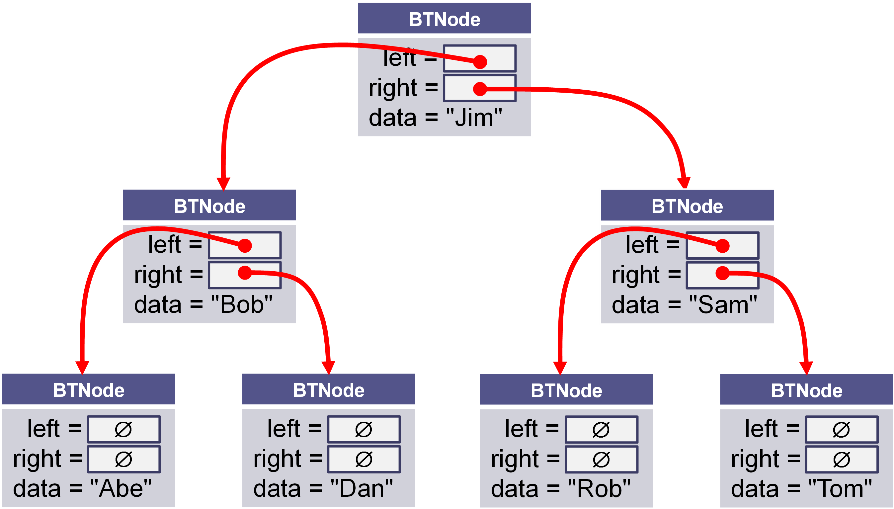
Shallow vs Deep Copy
Copying size and root fields create independent copies of the variables but not independent copies of the BST tree nodes.
Copying a pointer this way is considered a shallow copy.
We need to create an independent copy or a deep copy of the underlying array so that bst1.root and bst2.root point to different trees, making bst2 a deep copy of bst1.
BST<int> bst1
size_ = 7 int* root_ =
BST<int> bst2
size_ = 7 int* root_ =

Slide 14
Copy Constructor
/** Deep copy constructor.
@param bst The BST to be copied
@return This BST with a new copy of the bst's contents
*/
BST<T>(const BST<T>& bst) : root_(NULL), size_(0)
{
// recursively copy nodes from bst to this bst.
copyNode(bst.root_);
}
BST<int> bst1;
BST<int> bst2(bst1);
this
bst
Construct a new BST<T> (*this).
Recursively copy nodes from bst to the new BST.

Slide 15
Assignment Operator
/** Assign the contents of one BST to another.
@param other The BST to be assigned to this BST
@return This BST with a copy of the other BST's contents
*/
BST<T>& operator=(const BST<T>& rhs)
{
// Make a copy of the rhs BST.
BST<T> the_copy(rhs);
// Swap elements of this (not dynamic data)
// with the the_copy.
this->swap(the_copy);
// Return self (the copy will be deleted)
return *this;
}
BST<int> bst1;
BST<int> bst2(bst1);
bst2 = bst1;
this
other
Make a deep copy of rhs (rhs → the_copy)
Exchange *this and the_copy elements only (*this ←→ the_copy)
Return *this and
Delete the_copy (destructor)

Slide 16
The Destructor
The purpose of the destructor is to undo what the constructor does.
The constructor takes a block of uninitialized memory and sets it to a valid state, thus creating an object.
When the destructor is finished, the object is in an invalid state and the memory it occupies can be reused for creating other objects.
If this is not done, the program will have memory leaks.
Each class has a default destructor, which effectively invokes the destructor for each data field.
If the pointer references a dynamically allocated object (such as the BST nodes referenced by pointer root), the memory allocated to that object must be freed!

Slide 17
Be Safe

