Slide 1
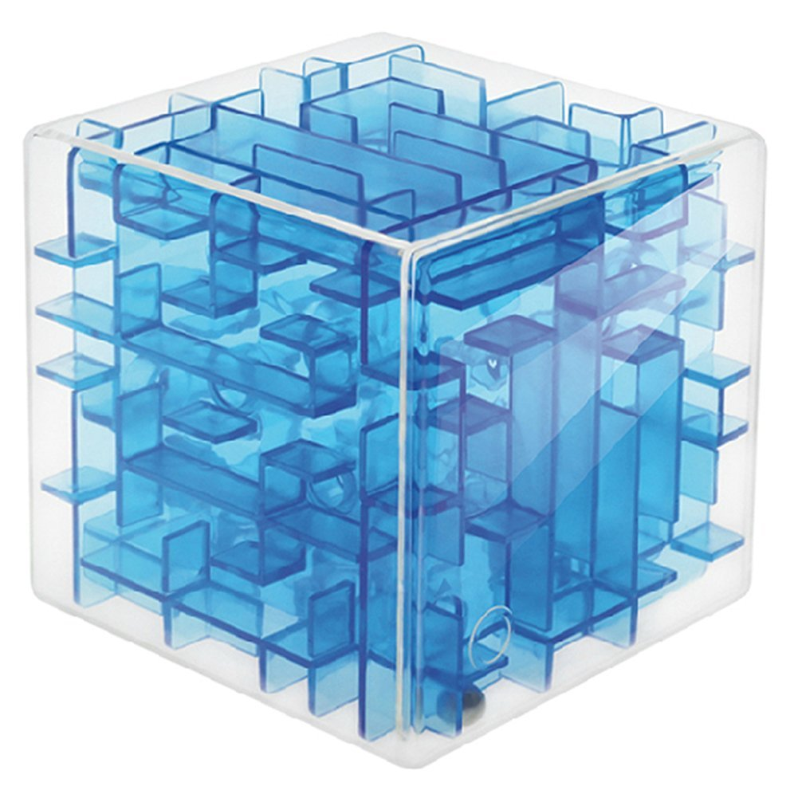
Lab 07 – 3D Maze

Slide 2
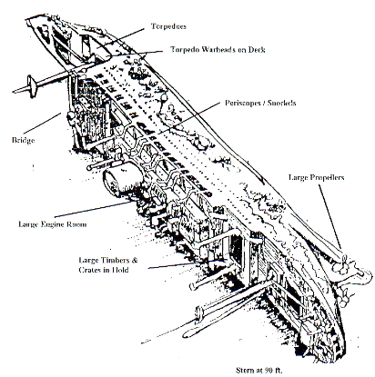
3D Maze
Two SCUBA diving buddies have encountered a large, box-shaped storage facility inside the hull of the Heian Maru, a 512' submarine tender lying on the bottom of Truk Lagoon at 108'.
The storage facility is composed of cells, some of which can be entered and some which cannot. The only exterior walls that are missing are on the front of
storage facility in the upper left corner, and on the rear of the storage facility in the lower right corner. The divers wish to determine a path through the storage facility.
Use backtracking to find a path through the maze or to prove that there is no path."

Slide 3
Finding a Path through a Maze
Problem
Use backtracking to find and display the path through a maze.
From each point in a maze you can move to an unblocked adjacent cell in a left, right, up, down, in, or out direction.
Analysis
The maze will consist of an array of cells.
The entry point is the top left corner (maze[0][0][0]) and the exit point is the bottom right corner (maze[height-1][width-1][layers-1]).
All cells will initially have an OPEN or BLOCKED value.
After exploring the maze, cell values will be one of the following:
Cells not visited will have an OPEN or BLOCKED value.
Cells not on the path that have been visited will have a VISITED value.
Cells on the path through the maze will have either a LEFT, RIGHT, UP, DOWN, IN, or OUT value.
The exit cell (if found) will have an EXIT value.

Slide 4
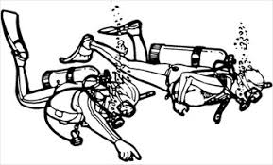
The Maze Layout
The maze size is defined by height × width × layer as specified on the first line of the test file.
Width
Left Right
Width
Left Right
START 0,0,0 | 0,1,0 | 0,2,0 | 0,3,0
1,0,0 | 1,1,0 | 1,2,0 | 1,3,0
2,0,0 | 2,1,0 | 2,2,0 | 2,3,0
3,0,0 | 3,1,0 | 3,2,0 | 3,3,0
0 (START) | 0 (Open) | 0 (Open) | 0 (Open)
0 (Open) | 1 (Blocked) | 1 (Blocked) | 1 (Blocked)
0 (Open) | 1 (Blocked) | 1 (Blocked) | 1 (Blocked)
0 (Open) | 1 (Blocked) | 1 (Blocked) | 1 (Blocked)
Layer
Out IN
Layer
Out IN
0,0,1 | 0,1,1 | 0,2,1 | 0,3,1
1,0,1 | 1,1,1 | 1,2,1 | 1,3,1
2,0,1 | 2,1,1 | 2,2,1 | 2,3,1
3,0,1 | 3,1,1 | 3,2,1 | 3,3,1
0 (Open) | 0 (Open) | 0 (Open) | 1 (Blocked)
1 (Blocked) | 1 (Blocked) | 1 (Blocked) | 1 (Blocked)
1 (Blocked) | 1 (Blocked) | 1 (Blocked) | 1 (Blocked)
0 (Open) | 1 (Blocked) | 1 (Blocked) | 1 (Blocked)
Height
Down Up
0,0,2 | 0,1,2 | 0,2,2 | 0,3,2
1,0,2 | 1,1,2 | 1,2,2 | 1,3,2
2,0,2 | 2,1,2 | 2,2,2 | 2,3,2
3,0,2 | 3,1,2 | 3,2,2 | 3,3,2
Height
Down Up
0 (Open) | 0 (Open) | 1 (Blocked) | 0 (Open)
0 (Open) | 1 (Blocked) | 1 (Blocked) | 0 (Open)
0 (Open) | 1 (Blocked) | 1 (Blocked) | 1 (Blocked)
0 (Open) | 1 (Blocked) | 1 (Blocked) | 1 (Blocked)
0,0,3 | 0,1,3 | 0,2,3 | 0,3,3
1,0,3 | 1,1,3 | 1,2,3 | 1,3,3
2,0,3 | 2,1,3 | 2,2,3 | 2,3,3
3,0,3 | 3,1,3 | 3,2,3 | EXIT 3,3,3
1 (Blocked) | 0 (Open) | 1 (Blocked) | 1 (Blocked)
1 (Blocked) | 0 (Open) | 1 (Blocked) | 1 (Blocked)
1 (Blocked) | 0 (Open) | 1 (Blocked) | 1 (Blocked)
1 (Blocked) | 0 (Open) | 0 (Open) | 0 (Exit)

Slide 5
Maze Values
Resulting maze values tell which way to proceed thru the maze ("L", "R", "U", "D", "I", or "O".)
Width
Left Right
R (Right) | R (Right) | I (In) | 0 (Open)
0 (Open) | 1 (Blocked) | 1 (Blocked) | 1 (Blocked)
0 (Open) | 1 (Blocked) | 1 (Blocked) | 1 (Blocked)
0 (Open) | 1 (Blocked) | 1 (Blocked) | 1 (Blocked)
Layer
Out IN
I (In) | L (Left) | L (Left) | 1 (Blocked)
1 (Blocked) | 1 (Blocked) | 1 (Blocked) | 1 (Blocked)
1 (Blocked) | 1 (Blocked) | 1 (Blocked) | 1 (Blocked)
0 (Open) | 1 (Blocked) | 1 (Blocked) | 1 (Blocked)
Height
Down Up
R (Right) | I (In) | 1 (Blocked) | 0 (Open)
0 (Open) | 1 (Blocked) | 1 (Blocked) | 0 (Open)
0 (Open) | 1 (Blocked) | 1 (Blocked) | 1 (Blocked)
0 (Open) | 1 (Blocked) | 1 (Blocked) | 1 (Blocked)
1 (Blocked) | D (Down) | 1 (Blocked) | 1 (Blocked)
1 (Blocked) | D (Down) | 1 (Blocked) | 1 (Blocked)
1 (Blocked) | D (Down) | 1 (Blocked) | 1 (Blocked)
1 (Blocked) | R (Right) | R (Right) | E (Exit)

Slide 6
Dynamic Arrays
A dynamic array is basically an array of pointers to arrays. A 2-dimensional dynamic array is created/deleted using a loop as follows:
int height = 10;
int width = 10;
int **myArray = new int*[height];
for(int i = 0; i < height; ++i)
{
myArray[i] = new int[width];
}
Constructor
for(int i = 0; i < height; ++i)
{
delete [] myArray[i];
}
delete [] myArray;
Destructor

Slide 7
The 3D Maze Array
The 3D maze array is of data type "int***" - a pointer to a pointer to a pointer to an int.
int**
int*
int
int*** maze_
int maze[3][2][2]

Slide 8
2D Implementation
bool find_maze_path(int height, int width)
{
if ( out of bounds... )
return false; // out of bounds (base case #1)
if ( blocked... )
return false; // blocked (base case #2)
if ( exit... )
{
maze_[height][width] = EXIT; // success! (base case #3)
return true;
}
// NOTE: not the search pattern used for 3d solutions
maze_[height][width] = PATH; // possible path, try all paths
if (find_maze_path( up... ) || // check up
find_maze_path( down... ) || // check down
find_maze_path( left... ) || // check left
find_maze_path( right... ) ) // check right
return true; // one of the paths works
maze_[height][width] = VISITED; // none work, don’t visit again
return false;
}

Slide 9
Requirements
Points | Requirement (45 + 8 Points)
10 | Backtracking used to correctly solve a 4 x 4 x 4 maze (lab07_in_01.txt).
10 | Backtracking used to correctly solve a 5 x 5 x 5 maze (lab07_in_02.txt).
10 | Backtracking used to correctly solve a 5 x 10 x 6 maze (lab07_in_02.txt).
10 | Backtracking used to correctly solve a large maze.
10 | Your Maze program uses backtracking to detect an unsolvable maze (lab07_in_05.txt).
-10 | Memory Leaks, array out-of-bounds, STL containers in any test.
Points | Peer Review
2 | A Maze class contains a dynamically sized 3-dimensional maze array as specified by the first line of the input file.
2 | The Maze class is derived from the abstract MazeInterface interface class. No STL container is used anywhere in your Maze class.
2 | The Maze toString() function returns a formatted string of the maze (as described above.)

