Slide 1
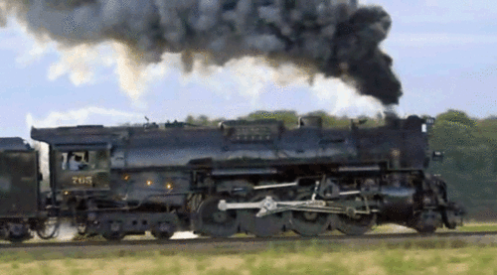
Lab 06 – Railroad

Slide 2
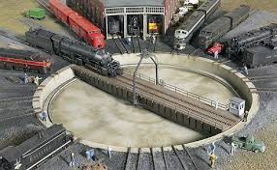
Lab 06 - Railroad
Create a railroad train station that uses a central turntable and roundhouses to store train cars as well as changes the order of cars entering and leaving the station.
Cars may enter the train station if the turntable is empty.
From the turntable cars can be moved to a "stack" roundhouse facility (LIFO) or a "queue" roundhouse facility (FIFO).
Train cars leave the train station by moving from the turntable to a "vector" of outbound cars.
Station 235
What objects (classes)?
Cars
Station
Stack, Queue, Vector
How to describe interactions?
UML
Stack
Queue
Vector
Incoming Cars
Outgoing Cars

Slide 3
Car
Vector<T>
<<interface>>
DequeInterface<T>
-id_:unsigned int
-container__:Deque<T>
+Car()
+Car(const unsigned int&)
+~Car()
+operator==(const Car&):bool
+operator!=(const Car&):bool
+toString() const:string
+Vector()
+~Vector()
+push_back(const T&):void
+pop_back():void
+back():T&
+size():size_t
+at(size_t):T&
+toString() const:string
+static const size_t
DEFAULT_CAPACITY = 4
+DequeInterface()
+~DequeInterface()
+push_front(const T&):void
+push_back(const T&):void
+pop_front():void
+pop_back():void
+front():T&
+back():T&
+size():size_t
+empty() const:bool
+at(size_t):T&
+toString() const:string
Station<T>
-train_:Vector<T>
-stack_:Stack<T>
-queue_:Queue<T>
-turnTableCar_:T
-empty:bool
Queue<T>
-container__:Deque<T>
+Queue()
+~Queue()
+push(const T&):void
+pop():void
+top():T&
+size():size_t
+at(size_t):T&
+toString() const:string
+Station()
+~Station()
+addCar(const T&):string
+removeCar():string
+topCar():string
+sizeTrain():string
+addStack():string
+removeStack():string
+topStack():string
+sizeStack():string
+addQueue():string
+removeQueue():string
+topQueue():string
+sizeQueue():string
+find(T):string
+toString() const:string
Deque<T>
-capacity:size_t
-num_items:size_t
-front_index:size_t
-rear_index:size_t
-the_data:T*
+Deque()
+~Deque()
+push_front(const T&):void
+push_back(const T&):void
+pop_front():void
+pop_back():void
+front():T&
+back():T&
+size():size_t
+empty() const:bool
+at(size_t):T&
+toString() const:string
-reallocate():void
Stack<T>
-container__:Deque<T>
+Stack()
+~Stack()
+push(const T&):void
+pop():void
+top():T&
+size():size_t
+at(size_t):T&
+toString() const:string

Slide 4
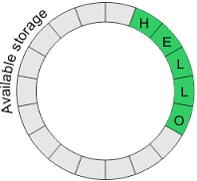
Dequeue has-a Dynamic Circular Buffer
capacity = 16
num_items = 5
the_data
L | O |  |  |  |  |  |  |  |  |  |  |  | H | E | L
rear_index
front_index
/** Return a reference to an item in the deque. */
T& operator[](size_t index)
{
return the_data[(index + front_index) % capacity];
}
front_index
the_data
rear_index

Slide 5
Dynamic Circular Buffer
front
capacity = 16
num_items = 5
the_data
L | O |  |  |  |  |  |  |  |  |  |  |  | H | E | L
the_data
back
back
front
The modulo operator (%) is a remainder operator with truncated division (towards 0).
If either operand is negative (signed), the remainder operator result has the same sign as the dividend (the first operand in the expression).
When using unsigned operands (size_t), incrementing indexes with wraparound is correctly implemented by:
front = (front + 1) % capacity;
However, decrementing indexes (and capacity is not a power of 2), must use the following :
if (front == 0) front = capacity - 1;
else front = (front - 1) % capacity;

Slide 6
Specification of the Deque
Behavior | Member Function
Insert element at back | void push_back(item)
Insert element at front | void push_front(item)
Remove last element | void pop_back();
Remove first element | void pop_front();
Examine last element | item& back();
Examine first element | item& front();
Index | item& at(index);
Size | size_t size();
*Insert element | iterator insert(iterator, item);
*Remove all items | void remove(item);
*Index | item& []
*Iterator start | iterator begin();
*Iterator end | iterator end();
*Not Required for Lab 06 Deque

Slide 7
Specification of the Deque
Behavior | Member Function
Insert element at back | void push_back(item)
Insert element at front | void push_front(item)
Remove last element | void pop_back();
Remove first element | void pop_front();
Examine last element | item& back();
Examine first element | item& front();
Index | item& at(index);
Size | size_t size();
*Not Required for Lab 06 Deque
*Insert element | iterator insert(iterator, item);
*Remove all items | void remove(item);
*Index | item& []
*Iterator start | iterator begin();
*Iterator end | iterator end();

Slide 8
Wrapper Class
A wrapper (adapter) class is a class that encapsulates or contains another class and uses its functionality to define (add to) the class' behavior.
#include "Deque.h"
template <typename T>
class Vector
{
private:
Deque<T> vector_;
public:
void push_back(T data)
{
vector_.push_back(data);
}
void pop_back(void)
{
vector_.pop_back();
}
...
};
#include "Deque.h"
template <typename T>
class Queue
{
private:
Deque<T> queue_;
public:
void push(T data)
{
queue_.push_back(data);
}
void pop(void)
{
queue_.pop_front();
}
...
};
#include "Deque.h"
template <typename T>
class Stack
{
private:
Deque<T> stack_;
public:
void push(T data)
{
stack_.push_back(data);
}
void pop(void)
{
stack_.pop_back();
}
...
};

Slide 9
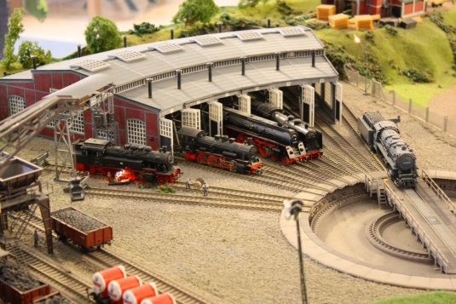
L06 – Railroad Wrapper Classes
Input Commands
Station 235
Station<T>
"Add:station xx"
"Add:stack"
"Add:queue"
"Remove:station"
"Remove:stack"
"Remove:queue"
"Top:station"
"Top:stack"
"Top:queue"
"Size:stack"
"Size:queue"
"Size:train"
"Find xx"
"Queue"
"Stack"
"Train"
string addCar(const T&);
string addStack();
string addQueue();
string removeCar();
string removeStack();
string removeQueue();
string topCar();
string topStack();
string topQueue();
string sizeStack();
string sizeQueue();
string sizeTrain();
string find(T);
string queueToString();
string stackToString();
string vectorToString();
string toString();
Vector<T>, Queue<T>, Stack<T>
void push(const T&);
void pop();
void top();
size_t size();
T& at(size_t);
string toString() const;
<<interface>>
DequeInterface<T>
Deque<T>
void push_front(const T&);
void push_back(const T&);
void pop_front();
void pop_back();
T& front();
T& back();
size_t size();
bool empty() const;
T& at(size_t);
string toString() const;
typedef struct Car car_t;

Slide 10
Station Commands
COMMAND | DESCRIPTION | OUTPUT
Add:station <data> Add:queue <data> Add:stack <data> | Train car enters the station turntable. Train car is removed from the turntable and pushed to the Queue roundhouse. Train car is removed from the turntable and pushed to the Stack roundhouse. | OK Turntable occupied! Turntable empty!
Remove:station Remove:queue Remove:stack | A train car is removed from the turntable and pushed into the train vector. A train car is removed from Queue roundhouse and moved to the station turntable. A train car is removed from Stack roundhouse and moved to the station turntable. | OK Turntable empty! Turntable occupied! Queue empty! Stack empty!
Top:station Top:queue Top:stack | Display the current train car on station turntable, Display the train car at head of Queue roundhouse. Display the train car at head of Stack roundhouse. | <data> Turntable empty! Queue empty! Stack empty!
Size:queue Size:stack Size:train | Output number of train cars in Queue/Stack roundhouses and train vector. | Size of Queue/Stack/Train
Find <data> | Find and display the current location and position of a car in the station data structures (turntable, queue, stack, or vector). | Turntable Queue[<index>] Stack[<index>] Train[<index>] Not Found!
Queue Stack Train | Output the contents of the station structures train vector. | List of train cars leaving the station.

Slide 11
Requirements
Points | Requirement (50 Points)
10 | A train car exiting the station turntable is pushed on a train Vector template class that has-a Deque container and operates as described. (lab06_in_01.txt).
10 | The Stack roundhouse consists of a LIFO template class that has-a Deque container and operates as described above (lab06_in_02.txt).
10 | The Queue roundhouse consists of a FIFO template class that has-a Deque container and operates as described above (lab06_in_03.txt).
10 | All the station containers (Queue, Stack, Vector) resize correctly (lab06_in_04.txt).
10 | The Find command finds a train car in the station data structures (queue or stack) or the train vector. If found, the name of the structure and the index within the structure is displayed (as described above.) (lab06_in_05.txt).
-10 | Memory leaks, g++ compiler warnings, array out-of-bounds, or use of STL container detected.
Points | Peer Review
2 | A Deque template class is implemented using a dynamic circular array and is derived from the abstract DequeInterface interface class.
2 | All station facility containers (stack, queue, vector, deque) are separate classes that are implemented by "wrapping" your Deque template class.
2 | The Station, Vector, Queue, Stack, and Deque template classes are instantiated as Car data types.

Slide 12
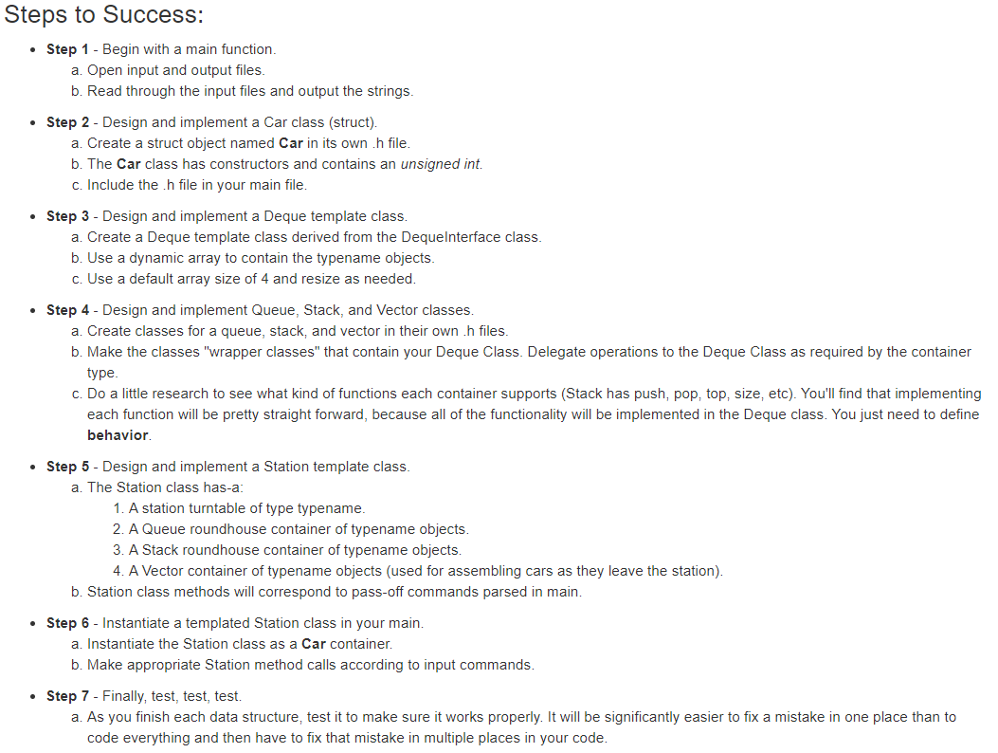

Slide 13
Be Safe

