Slide 1
Lab 05 – Expressions

Slide 2
Requirements
Input is an expression string in infix notation.
Expression: 43 + 2 * 19
Use an ExpressionManager class to hold your infix, postfix, (and prefix) expressions.
Your class should be derived from the abstract interface class ExpressionManagerInterface.
Implement member functions:
virtual int value(void);
virtual string infix(void);
virtual string postfix(void);
virtual string prefix(void);
Output the resulting infix, postfix, (prefix), and integer evaluation value of the expression.
Your calculations should perform integer division and produce integer results.

Slide 3
Example Input / Output
Input
Input
Expression: 43 + 2 * 19
Infix:
Postfix:
Prefix:
Value:
Expression: 2 + 3 - 5
Infix:
Postfix:
Prefix:
Value:
Output
Output
Expression: 43 + 2 * 19
Infix: 43 + 2 * 19
Postfix: 43 2 19 * +
Prefix: + 43 * 2 19
Value: 81
Expression: 2 + 3 - 5
Infix: 2 + 3 - 5
Postfix: 2 3 + 5 -
Prefix: - + 2 3 5
Value: 0

Slide 4
Converting from Infix to Postfix

Slide 5
Converting from Infix to Postfix

Slide 6
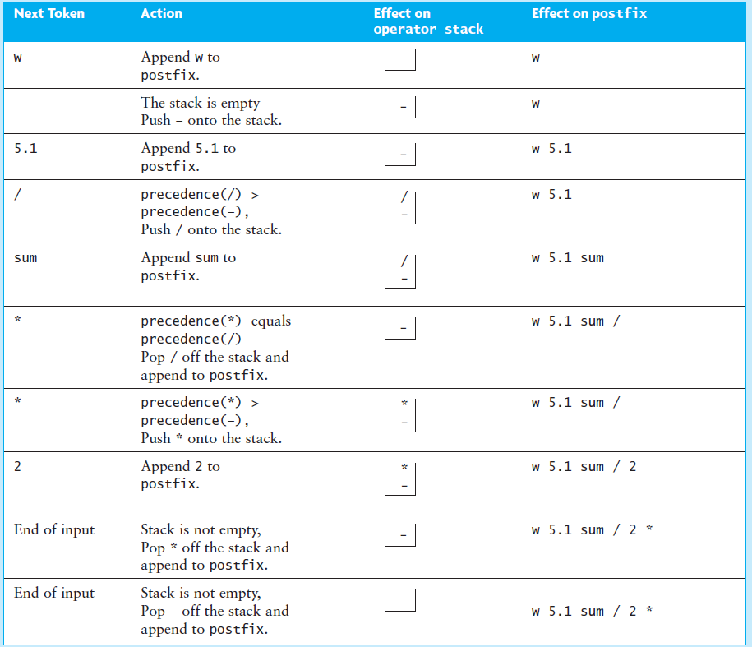
Converting from Infix to Postfix

Slide 7
ExpressionManagerInterface
//YOU MAY NOT MODIFY THIS HEADER INTERFACE
#ifndef EXPRESSION_MANAGER_INTERFACE_H
#define EXPRESSION_MANAGER_INTERFACE_H
#include <string>
using std::string;
class ExpressionManagerInterface
{
public:
ExpressionManagerInterface(void) {};
virtual ~ExpressionManagerInterface(void) {};
/** Return the integer value of the infix expression */
virtual int value(void) = 0;
/** Return the infix items from the expression
Throw an error if the expression
1) is not balanced.
2) the number of operators IS NOT one less than the number of operands.
3) there are adjacent operators. */
virtual string infix(void) = 0;
/** Return a postfix representation of the infix expression */
virtual string postfix(void) = 0;
/** Return a prefix representation of the infix expression */
virtual string prefix(void) = 0;
/** Return the infix vector'd expression items */
virtual string toString() const = 0;
};
#endif // EXPRESSION_MANAGER_INTERFACE_H
ExpressionManagerInterface is an interface.
DO NOT MODIFY!
ExpressionManager
ExpressionManagerInterface

Slide 8
ExpressionManager
class ExpressionManager : public ExpressionManagerInterface
{
private:
string expression_;
std::vector<string> inFix_;
std::vector<string> postFix_;
std::vector<string> preFix_;
const string operators = "([{ -+ */% ";
public:
ExpressionManager() { }
ExpressionManager(string exp) :
expression_(exp), inFix_(NULL), postFix_(NULL), preFix_(NULL) { }
~ExpressionManager() { }
virtual int value(void); /** Return the integer value of the infix expression */
virtual string infix(void); /** Return the infix expression / rejects invalid */
virtual string postfix(void); /** Return a postfix representation */
virtual string prefix(void); /** Return a prefix representation */
virtual string toString() const; /** Return the infix vector'd expression items */
};
#endif // EXPRESSION_MANAGER_H
Inherits from ExpressionManagerInterface

Slide 9
inFix to PreFix
Given two operands a and b and an operator ,
The infix notation implies that  will be placed in between a and b.
When the operator is placed after both operands , it is called postfix notation.
And when the operator is placed before the operands  a b, the expression in prefix notation.
Example: To convert “(A + B) * C” to prefix:
Reverse the infix expression
(A+B)*C becomes C*(B+A).
Note: while reversing each ‘(‘ will become ‘)’ and each ‘)’ becomes ‘(‘.
Obtain the postfix expression (almost) of the modified expression.
Push operator on stack is greater than or equal.
C*(B+A) becomes CBA+*.
Reverse the postfix expression.
CBA+* becomes the prefix expression *+ABC.

