Slide 1
Lab 02 - SNAP

Slide 2
S.N.A.P Lab
Class design is type design - defining effective classes can be challenging.
For the SNAP lab you are to design classes for a school database with has-a and is-a relationships that have natural syntax, intuitive semantics, and efficient memory allocation.
The class objects are populated from parsed input strings.
Use object inheritance, polymorphism, and function and operator overloading where needed.
All member data and internal functions are private.
All classes have a "toString" method with friends for the insertion ("<<") operator.
Use UML diagrams to describe your implementation.

Slide 3
OOP vs. Procedural Programming
Division Of Program: In procedural programming a program is divided into small functions while in OOP it is divided into objects.
Importance: In procedural programming importance is not given to data but to procedures. In OOP importance is given to data rather than functions, because OOP works with real world objects.
Approach: Procedural programming is top down (design functions first.) OOP is bottom up (design objects then interactions.)
Access Specifiers: In procedural programming no access specifiers are used. In OOP different type of specifiers are used for different levels of data protection.
Data Moving: In procedural programming, data can move freely from function to function. In OOP, data can only move via member functions.
Data Access: In procedural programming global data is acceptable and freely accessible. In OOP, public or private access specifiers are used to control data access.
Data Hiding: In procedural programming, no particular method is used for data hiding and therefore it is less secure. A particular method is used for data hiding in OOP so it is more security.
Overloading: Overloading is not possible in procedural programming. Overloading is possible in OOP in the form of function overloading and overloading operator.

Slide 4
Example SNAP Output
Input Strings:
snap(12345,Charlie Brown,Manager,555-1234).
snap(67890,Lucy,Right Field,555-5678).
csg(CS101,12345,A).
csg(CS101,67890,B).
**Error: csgs(CS101,67890,B).
cdh(CS101,M,9AM).
cdh(CS101,W,9AM).
cr(CS101,1170 TMCB).
Vectors:
snap(12345,Charlie Brown,Manager,555-1234)
snap(67890,Lucy,Right Field,555-5678)
csg(CS101,12345,A)
csg(CS101,67890,B)
cdh(CS101,M,9AM)
cdh(CS101,W,9AM)
cr(CS101,1170 TMCB)
Course Grades:
CS101,Charlie Brown,A
CS101,Lucy,B
Student Schedules:
Charlie Brown, 12345, Manager, 555-1234
CS101 MW 9AM, 1170 TMCB
Lucy, 67890, Right Field, 555-5678
CS101 MW 9AM, 1170 TMCB
Student #
Name
Address
Phone #
Course
Student #
Grade
Course
Day
Hour
Course
Room
Input Error
List in csg order
List in snap order
List in csg order

Slide 5
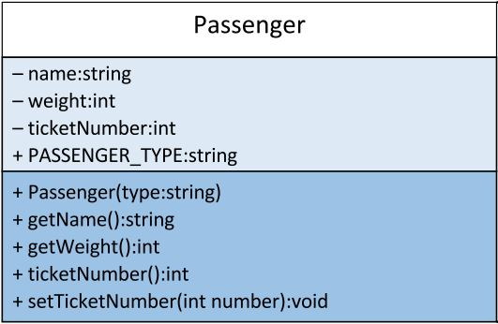
UML
This class is called Passenger.
The data members are all listed by visibility, name, and type.
Visibility: A '-' in front of a data member or function means that the data or function is private. A '+' indicates public visibility and a '#' indicates a protected visibility
Type: You may indicate parameter type and return type before or after the name of the data member/function.
Both of the following are acceptable:
+string getName()
+getName():string
Private
Class Name
Data Members
Class Methods
Public

Slide 6
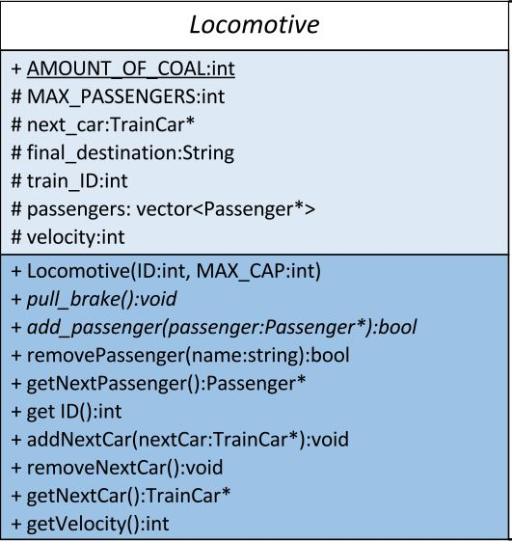
UML: Interfaces / Abstract Functions
There is an important distinction between a concrete class and an abstract class or interface.
An interface has strictly pure virtual functions.
An abstract class has at least one pure virtual function, but other functions may be defined.
Both interfaces and abstract classes have italicized class names. Interfaces are denoted with <<interface>> (not in italics) above the class name.
Virtual functions are italicized.
In this example, because not all of Locomotive's functions are pure virtual, Locomotive is not an interface.

Slide 7
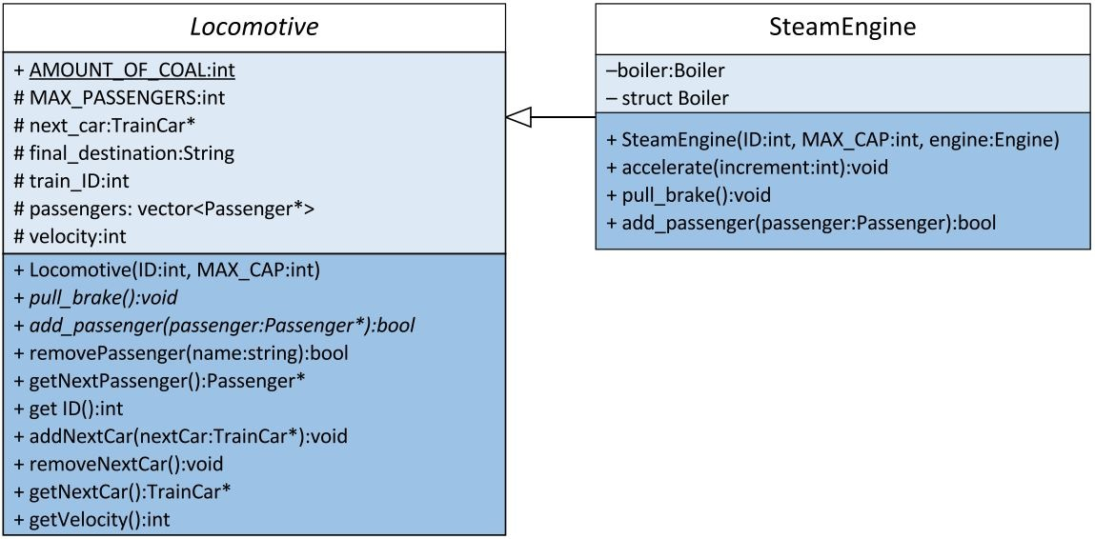
UML Inheritance ("Is-a")
In this example, the class Steam Engine inherits from the abstract class Locomotive. It has access to all of the concrete functions of Locomotive, and also defines the abstract functions of Locomotive.
Note that not all of the concrete functions from Locomotive are included in SteamEngine. This is because they are accessed through inheritance structure. On the other hand, the abstract functions appear in both places. It is a good practice to show a function both where it is declared and where it is defined.
For the interfaces that you will use in this class, it is acceptable to omit the inherited functions from the child class.
Inheritance is indicated with a white triangle arrowhead facing the parent class.

Slide 8
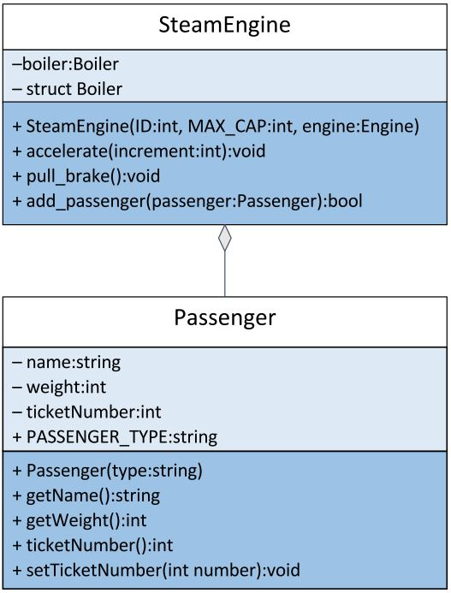
UML Inheritance ("Has-a")
In this example, the class Steam Engine references the class Passenger, placing pointers to Passenger objects inside of its private vector.
This relationship is indicated by using a filled diamond arrow. The arrow faces towards the class that "has" the other thing in it.
Note: For the purposes of our class, we do not distinguish between having an object and having a pointer to an object. Just use the same type of arrow.

Slide 9
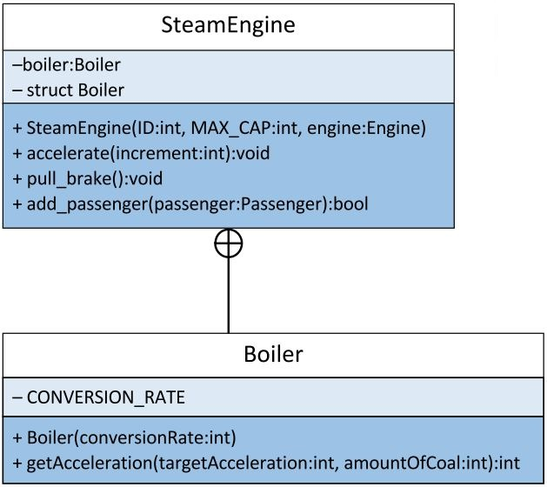
UML Inner Classes
Sometimes, we will define a class within a class, or a struct within a class. When we do this, we include the class/struct declaration inside of the outer class, and then create another box to hold the information for the class/struct.
To show this connection, we use a circle with a cross through it. The circle should be closest to the class that contains the inner class/struct.

Slide 10
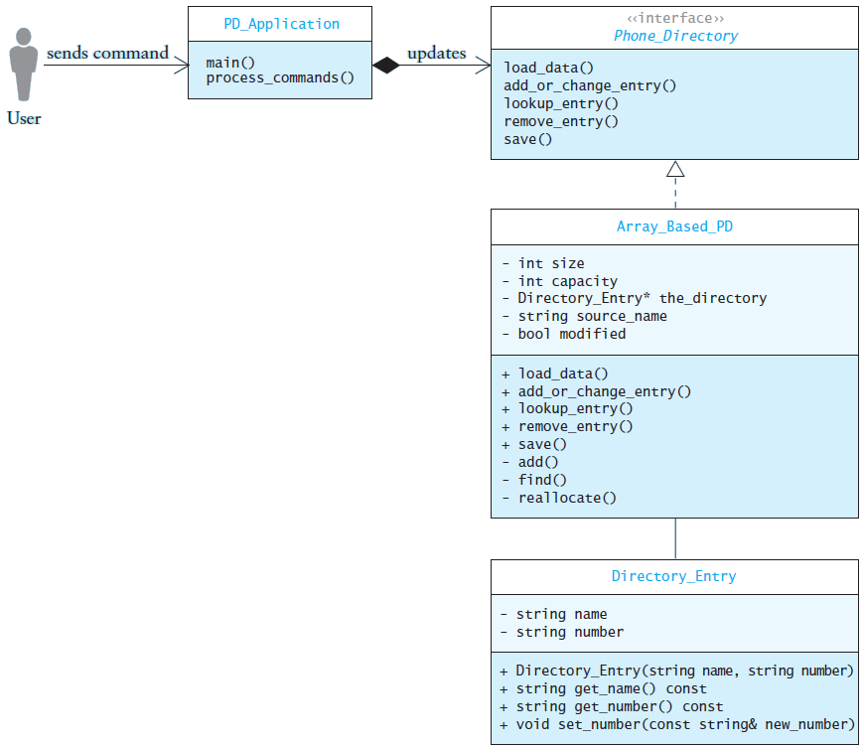
UML

Slide 11
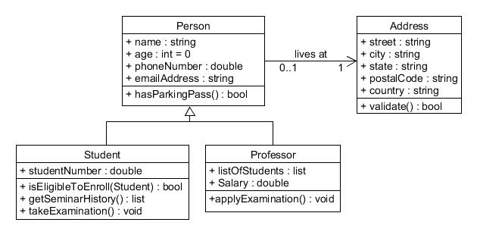
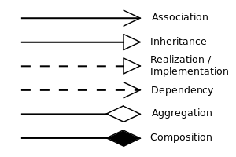
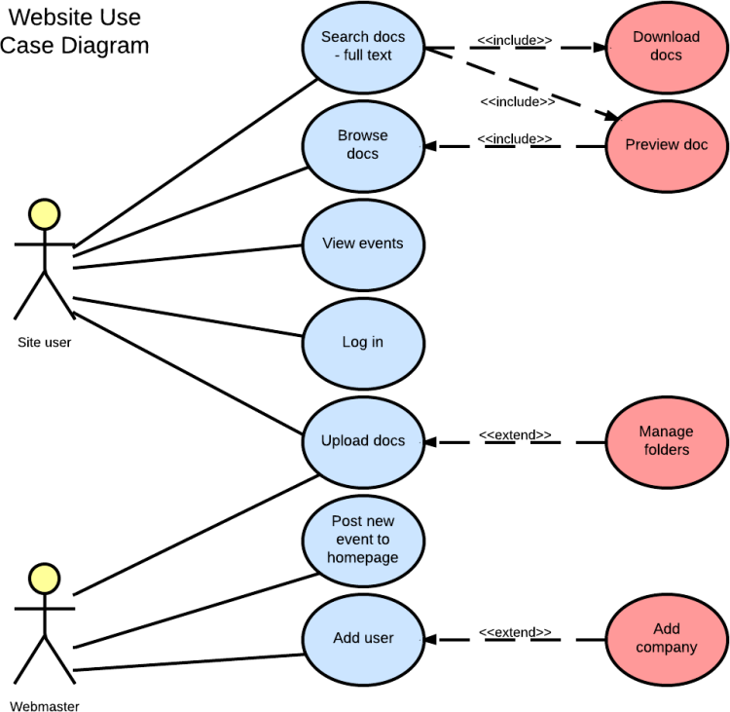
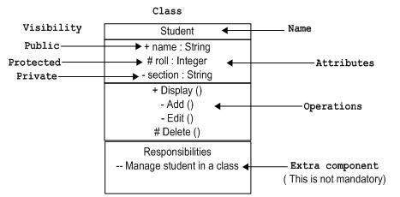
UML Summary

Slide 13
class Animal
{
private:
string name;
public:
Animal(string name) { this->name = name; }
virtual string getName() = 0;
}
Animal
legs:int
class Dog: public Animal
{
private:
int legs;
public:
Dog(string name, int legs)
{ this->name = name; this->legs = legs; }
T getLegs() { return lets; }
virtual string getName() { return name; }
}
int main()
{
Animal* dog = new Dog("Rover", 4);
cout << dog->getName() << " " << dog->getLegs();
return 0;
}

Slide 14
#include <iostream>
#include <string>
using namespace std;
class Animal
{
private:
string name;
public:
Animal() {}
void setName(string name) { this->name = name; }
string getName() { return name; }
};
class Dog : public Animal
{
private:
int legs;
public:
Dog(string name, int legs)
{
setName(name);
this->legs = legs;
}
int getLegs() { return legs; }
};
int main()
{
Dog* dog = new Dog("Rover", 4);
cout << dog->getName() << " " << dog->getLegs();
delete dog;
return 0;
}
Animal
legs:int

Slide 15
UML Summary
is-a

